Slide 1
DETAILED ANALYSIS OF NEW YORK’S STOCK EXCHANGE DATA
BY: JOSHUA ADEJUMOBI
DATA SOURCE: KAGGLE

Slide 2
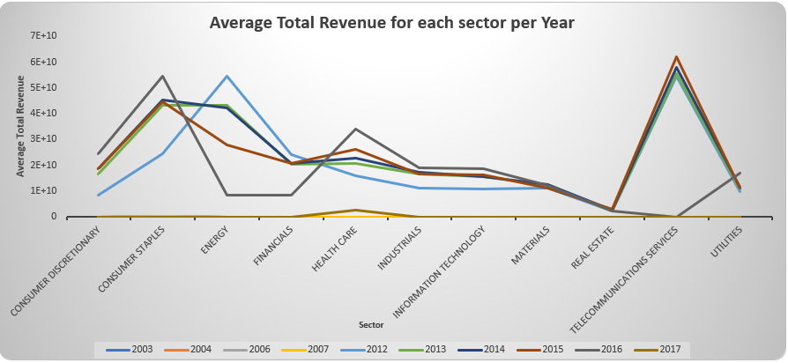
On average, which sector generated the highest total revenue from 2003 to 2017?
On average, telecommunications services generated the highest total revenue from 2012 to 2015, no revenue was recorded for telecommunications services between 2003 and 2007, and also between 2016 to 2017.
From the data, only consumer staples had revenue data from 2003 to 2007 and only health care sector had total revenue data in 2017.
This implies that consumer staples has the highest total revenue 2016, and also between 2003 and 2007 while health care sector has the highest total revenue 2017 and the real estate sector had the smallest revenue between 2012 and 2016.
Telecommunications services sector has a mean of 57537392650, real estate sector has a mean of 2511715663 and consumer staples sector has a mean of 43407926143.
The standard deviation of consumer staples which is 85488778871 is higher than that of telecommunications services which is 60144628766, this implies that the total revenue of sub-industries under the consumer staples sector are more spread out than telecommunications services sector.

Slide 3
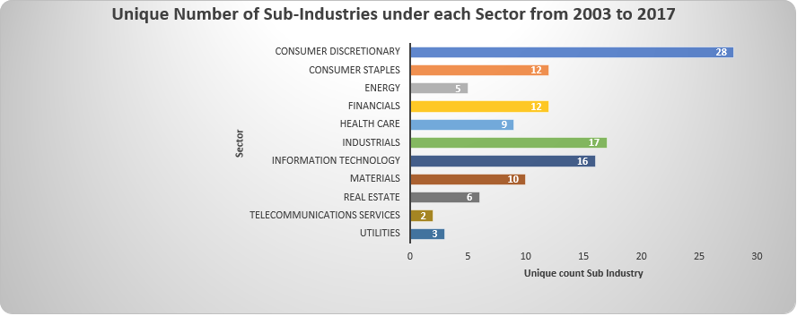
Number of sub-industries under each sector?
Customer discretionary has the highest number of sub-industries under each sector, while telecommunications services has the lowest number of sub-industries.

Slide 4
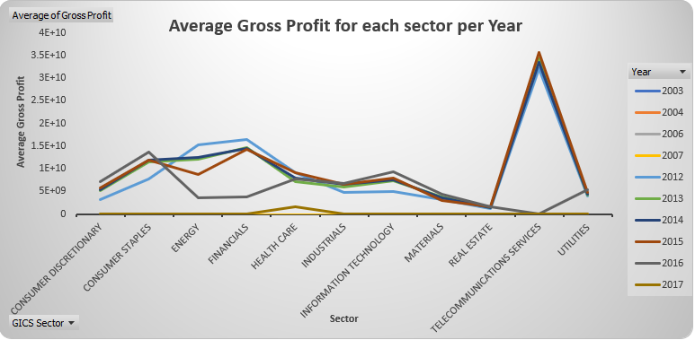
On average, which sector had the highest gross profit from 2003 to 2017?
Just like the total revenue, telecommunications services also have the highest gross profit from 2012 to 2016, consumer staples has the highest gross profit in 2016, and also between 2003 and 2007 while health care sector has the highest gross profit in 2017 and the real estate sector had the smallest gross profit between 2012 and 2016.
The telecommunications services sector has a median value of 10386500000 which implies that 50% of the gross profit from this sector is equal to or higher than 10386500000.
The consumer staples sector has a lower median value of 4594866500, this implies that 50% of the gross profit from the telecommunications services sector is higher than the consumer staples sector because the telecommunications sector have a higher median value than the consumer staples sector.

Slide 5
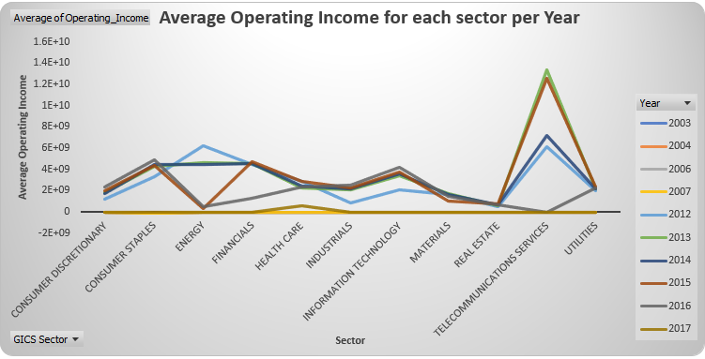
On average, which sector had the highest operating income from 2003 to 2017?
On average, just like total revenue, telecommunications services has the highest operating income from 2012 to 2015, consumer staples has the highest operating income 2016 and also between 2003 and 2007 while health care sector has the highest operating income 2017 and the real estate sector had the smallest operating income between 2012 and 2016.
The telecommunications services sector has a range of 32485000000, which is higher than that of the real estate sector which has a range of 2608248000, this implies that the values for operating income for telecommunications services sector is more spread out than the values for operating income for the real estate sector.

