Slide 1

COMPREHENSIVE BUSINESS ANALYSIS
SQL and Tableau
By
Grace Adekoyejo

Slide 2
INTRODUCTION
This analysis aims to provide a comprehensive understanding of a business project strengths and areas for improvement. It serves as a springboard for strategic decisions that can optimize resource allocation, enhance customer satisfaction, and drive financial growth.
In the subsequent sections, we will delve into the dataset, employing a blend of descriptive, exploratory, and inferential techniques to derive actionable insights. The culmination of these efforts promises to illuminate the project's trajectory and empower stakeholders to make informed, data-driven choices.

Slide 3
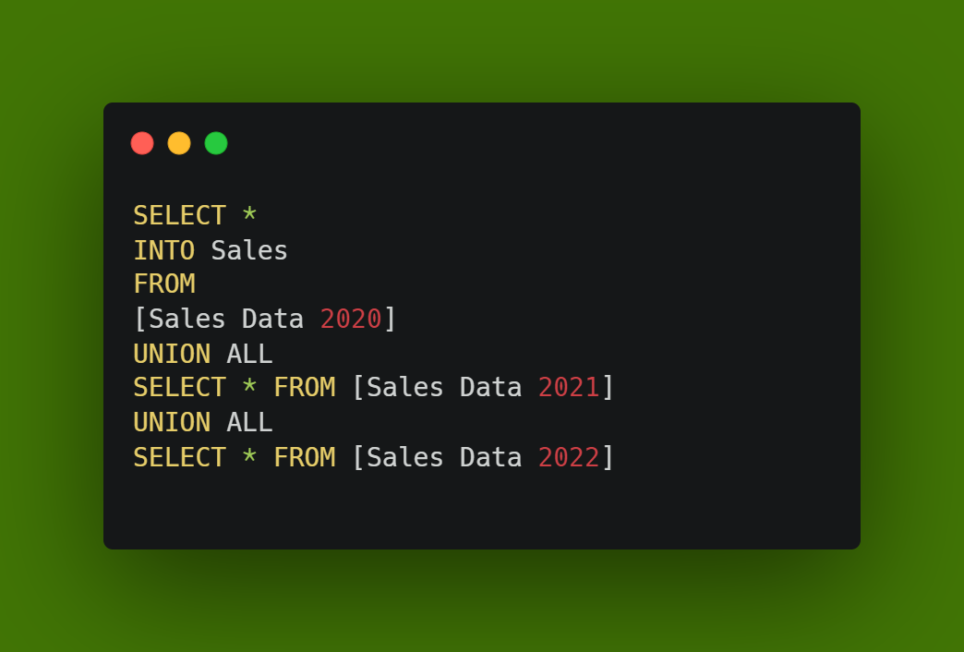
QUESTIONS: COMBINE ALL SALES RECORD
CODE SNIPPET
CHARTS
Notes:
In order to gain a holistic perspective on the project's performance and trends, I have combined sales data from the years 2020, 2021, and 2022 into a single consolidated dataset for comprehensive insights, enhanced accuracy and efficient analysis

Slide 4
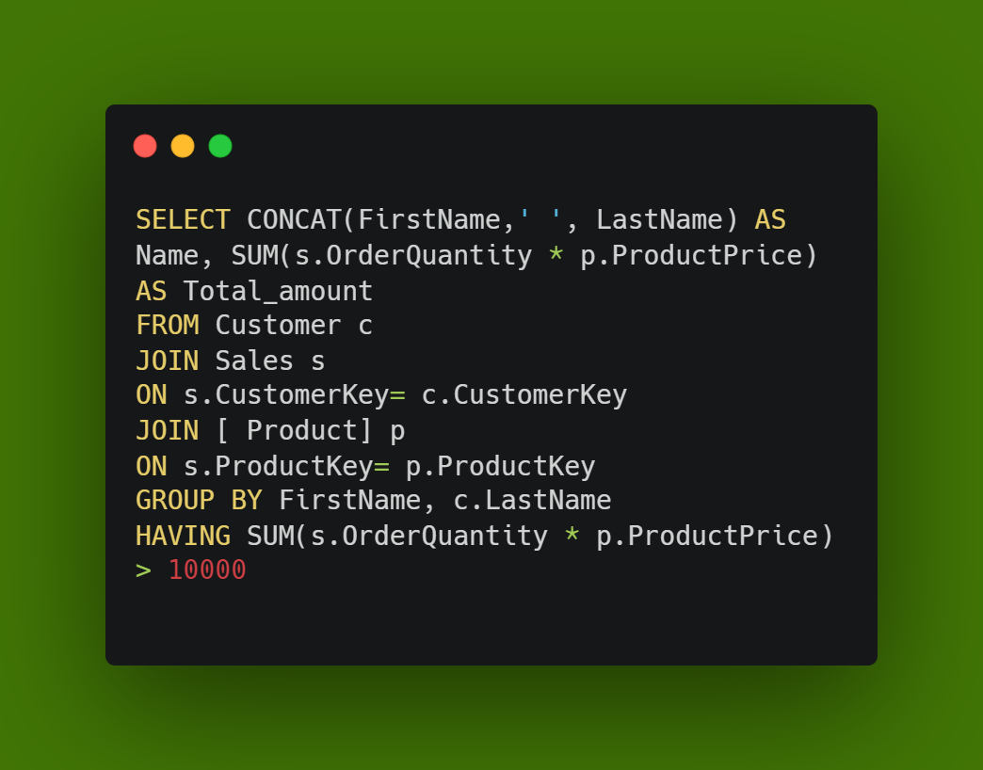
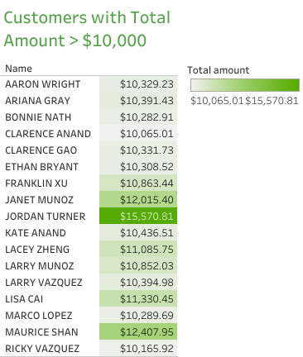
Question 1:Retrieve the customers who have placed orders with a total amount greater than $10000.
CODE SNIPPET
CHARTS
Notes:
The analysis revealed a total of 17 customers who have placed orders with a combined value surpassing $10,000. Identifying these customers give us insight to:
Customer value by recognizing high-value customers which allows for tailored engagement strategies to maintain their loyalty and encourage repeat business.
The customers that play a substantial role in revenue generation, underscoring the importance of nurturing these relationships.
Recommendations: Based on the findings, I propose the following recommendations:
Develop personalized communication and offers for these customers to enhance their experience.
Implement retention strategies to retain and nurture these valuable customers, ensuring a long-lasting partnership.
Leverage their spending behavior to identify upselling and cross-selling opportunities, driving additional revenue.

Slide 5
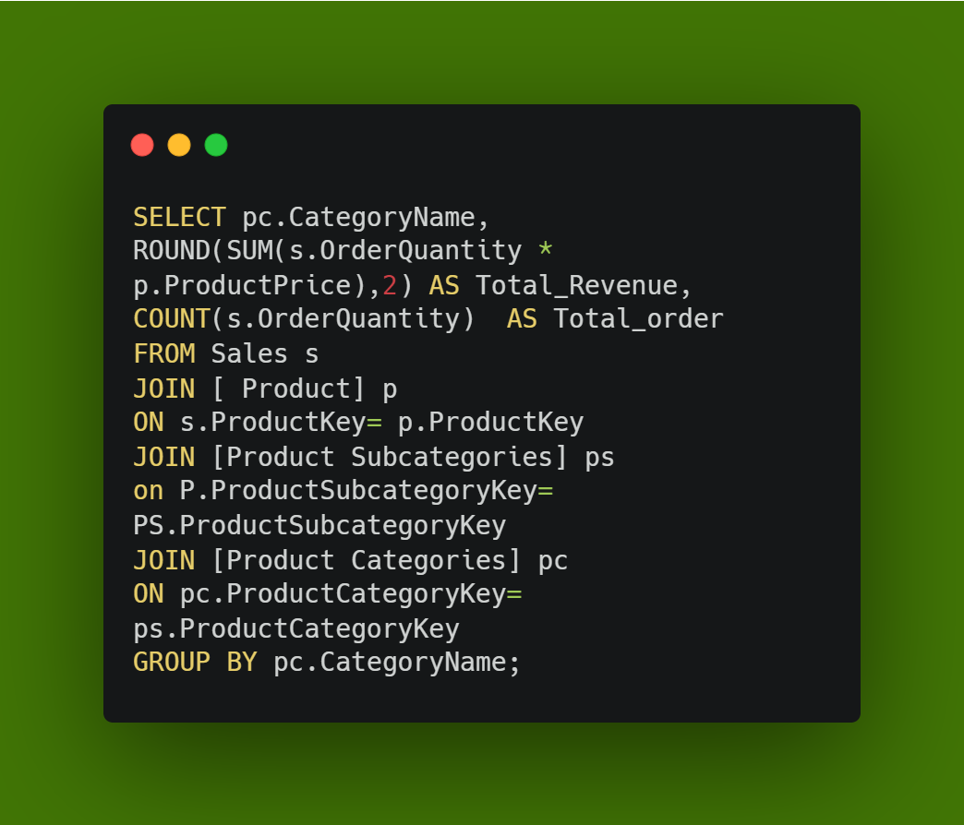
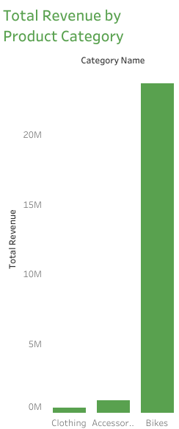
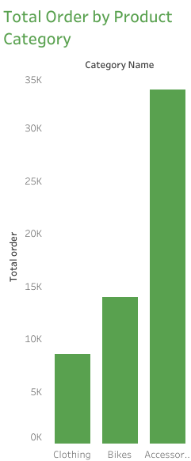
Question2. Retrieve the total revenue and total orders generated by each product category
CODE SNIPPET
CHARTS
Notes:
INSIGHTS
The dataset comprises 3 distinct product categories, each contributing to the project's overall revenue.
‘Bikes’ is seen to generate the most revenue.
The most ordered product is known to be ‘Accessories’
It is concluded that there is no correlation between order and revenue by product
The product ‘Accessories’ with low revenue despite a considerable number of orders indicate opportunities for optimization

Slide 6
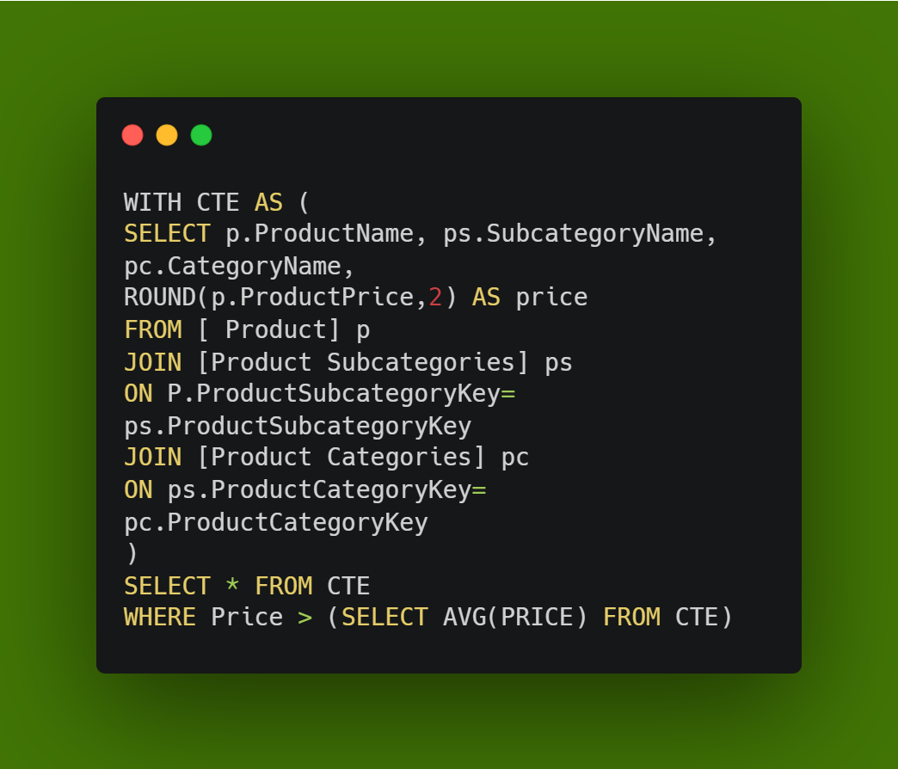
QUESTIONS3: Retrieve the names of products, sub-categories and their categories for
products with a selling price greater than the average selling price of all
products.
CODE SNIPPET
CHARTS
Notes:
The average selling price across all products in the dataset was calculated to be $714.44.
By comparing individual product selling prices to the calculated average, we identified 98 products that boast a selling price greater than the average.
Analyzing the categorization of these products shed light on the balance between quality, features, and pricing within specific categories.
These products can serve as differentiators, highlighting unique value propositions in the market

Slide 7
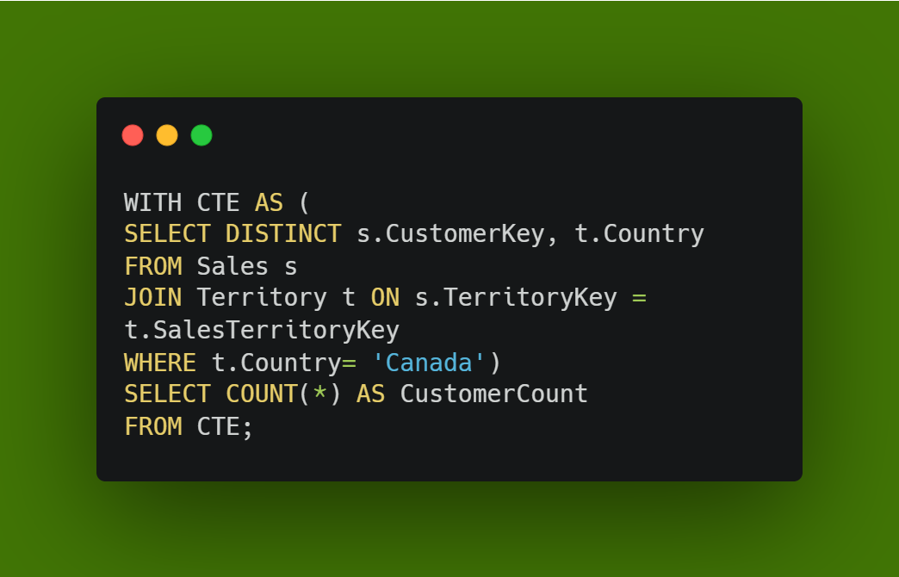
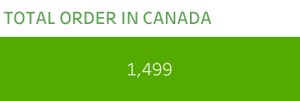
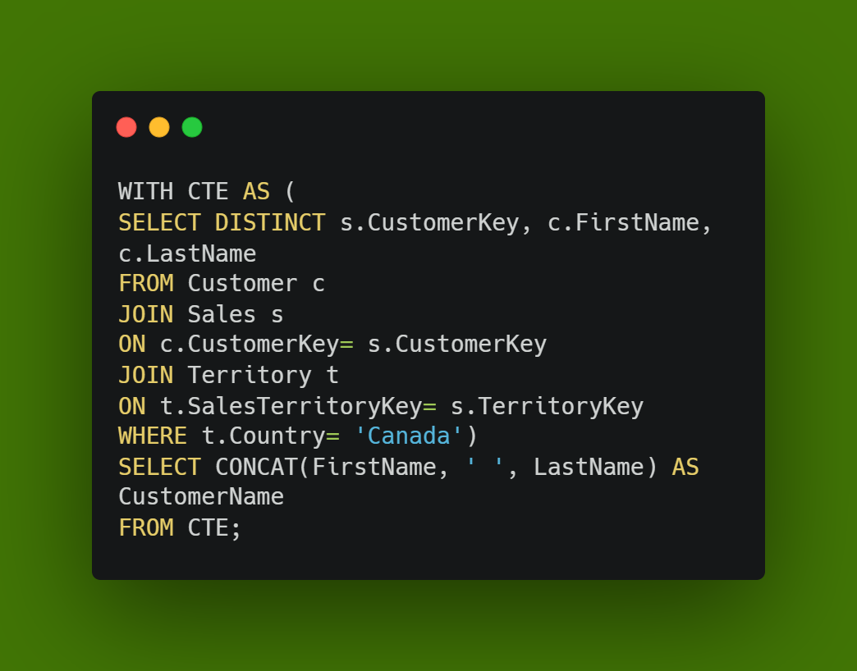
Question4: How many customers have placed orders in “Canada”? List the customer names
CODE SNIPPET
Notes:
A total of 1,499 customers have placed orders within the region of "Canada.“ This signifies the project's reach and traction in this specific region.
The customer names provides insights into specific individuals engaging with the project's offerings in Canada.
This analysis will help to utilize customer feedback and behavior analysis to tailor product offerings and services to the specific needs of the Canadian market

Slide 8
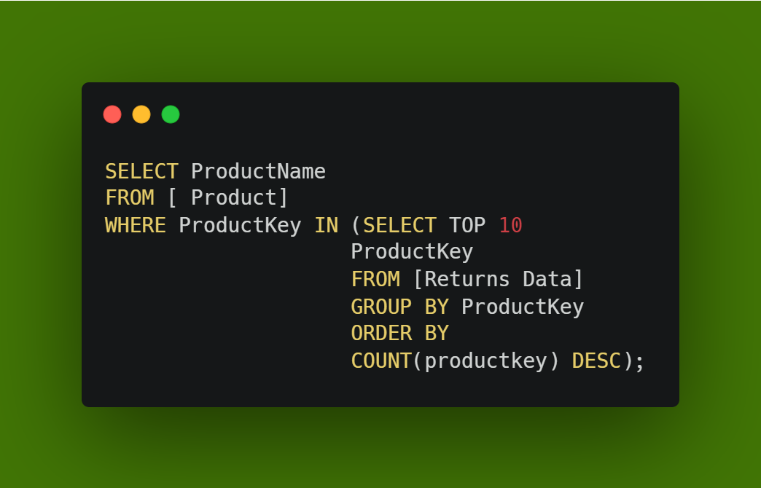
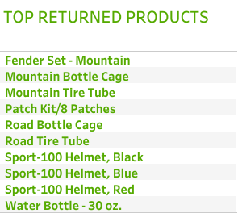
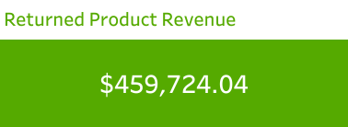
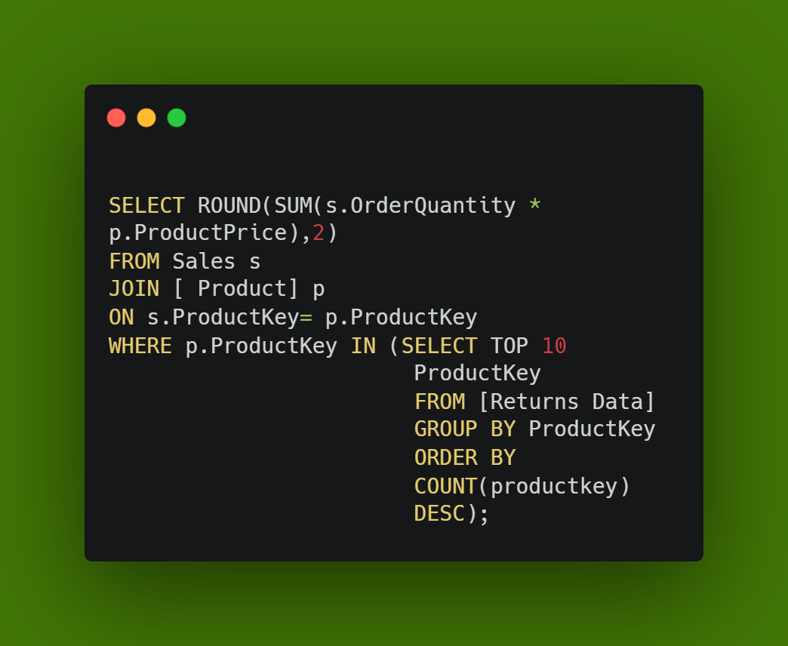
QUESTIONS5: Find the 10 products that have been returned the most. How much money
was generated by these products?
CODE SNIPPET
CHARTS
Notes:
These 10 products indicate potential areas of concern in terms of product quality, customer satisfaction, or other factors.
Recommendations
We need to conduct a detailed investigation into the reasons behind the high returns of these products to address potential issues.
Collaborate with relevant teams to improve the quality, design, or functionality of the products with high return rates.
Proactively communicate with customers who have returned these products to gather feedback and demonstrate commitment to their satisfaction.

Slide 9
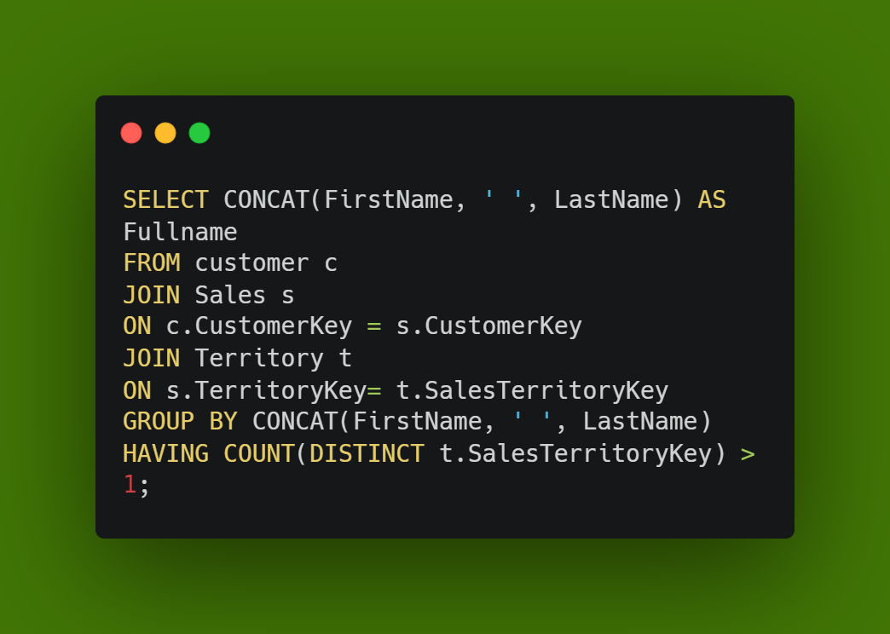
QUESTIONS 6: Get a list of customers who have placed orders in more than one territory
CODE SNIPPET
CHARTS
Notes:
I identified 51 customers who have engaged with the project by placing orders in more than one territory.
Recognizing these customers who engage across different territories highlights the project's appeal beyond specific regions. We can promote products or services between territories and encourage similar behavior in other customers.

Slide 10
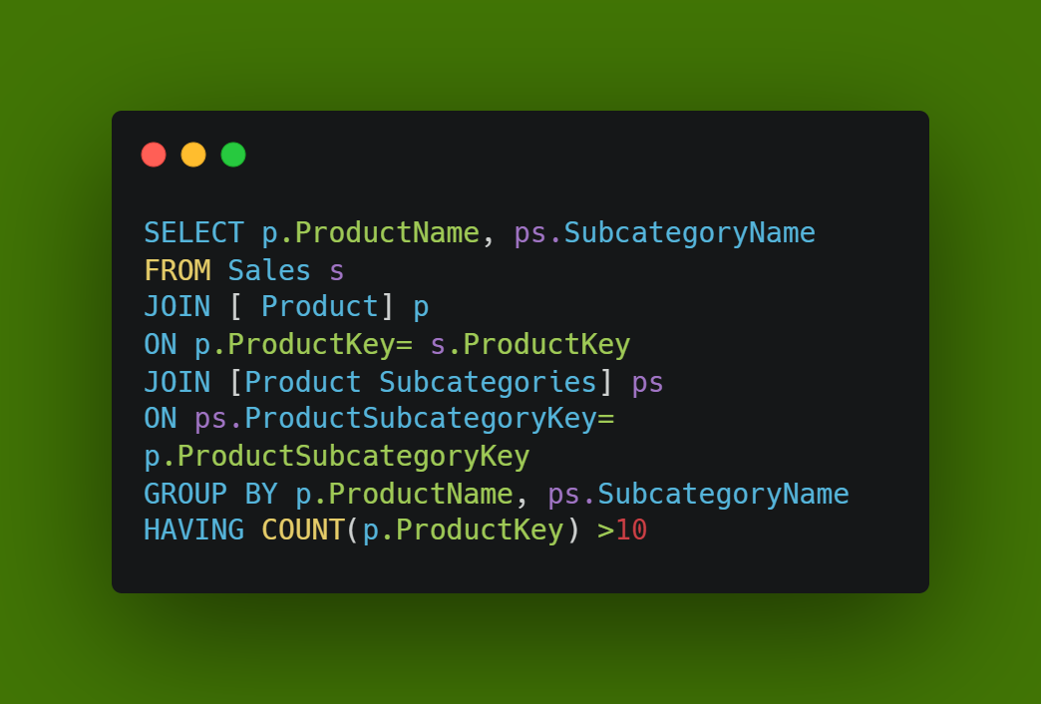
QUESTIONS 7: Retrieve the product names and their corresponding sub-categories for products that have been ordered at least 10 times.
CODE SNIPPET
CHARTS
Notes:
We identified 130 products that have been ordered a minimum of 10 times, indicating their popularity and demand
Recommendations:
Develop promotion and marketing strategies that capitalize on the popularity of these products to drive further sales.
We need to ensure sufficient stock availability for these products with high order frequencies to avoid stock outs.
There is need to engage with customers who have ordered these products to gather feedback and build strong customer relationships.

Slide 11
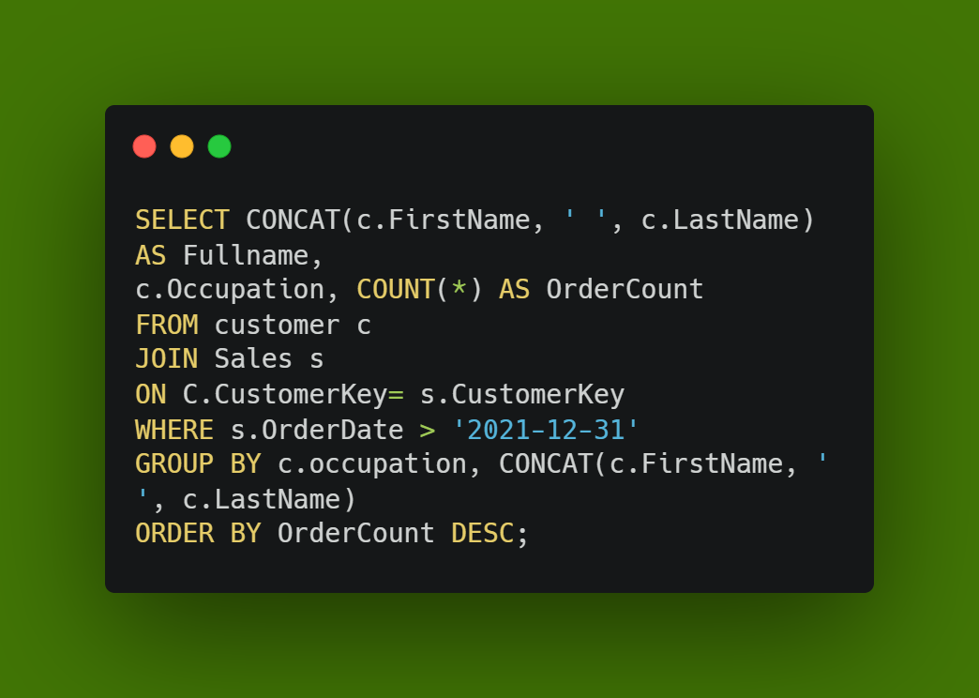
QUESTIONS 8: List the customer names who have placed orders after 2021. What is the
distribution of their occupation?
CODE SNIPPET
CHARTS
Notes:
We identified 10,494 customers who have placed orders after the year 2021, indicating recent engagement with the business.
Analyzing the distribution of their occupations helps in understanding the demographics of customers contributing to post-2021 orders.

Slide 12
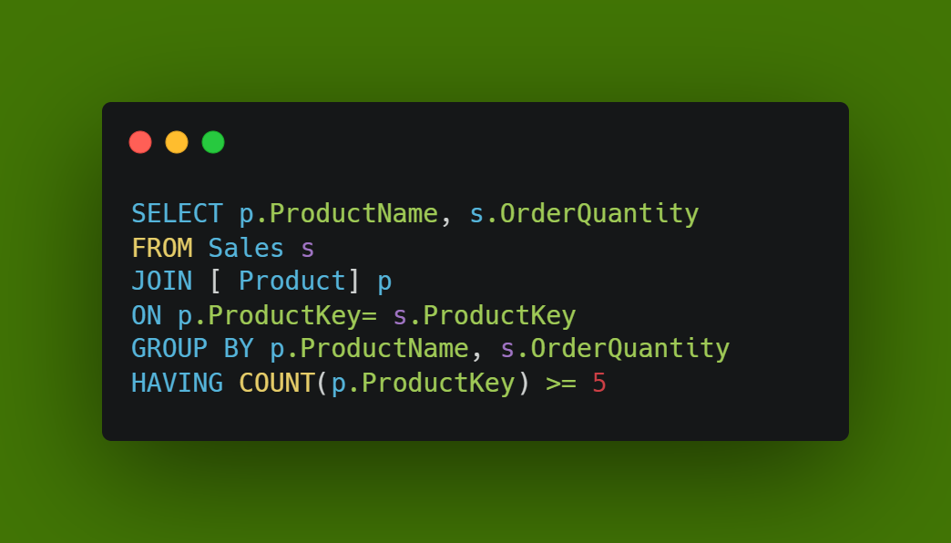
QUESTIONS 9: Get a list of products and their corresponding order quantities for products
that have been ordered at least 5 times.
CODE SNIPPET
CHARTS
Notes:
We identified 170 products that have been ordered a minimum of 5 times, indicative of their popularity and demand.
Insights into the popularity of these products can guide marketing efforts and promotional campaigns.

Slide 13
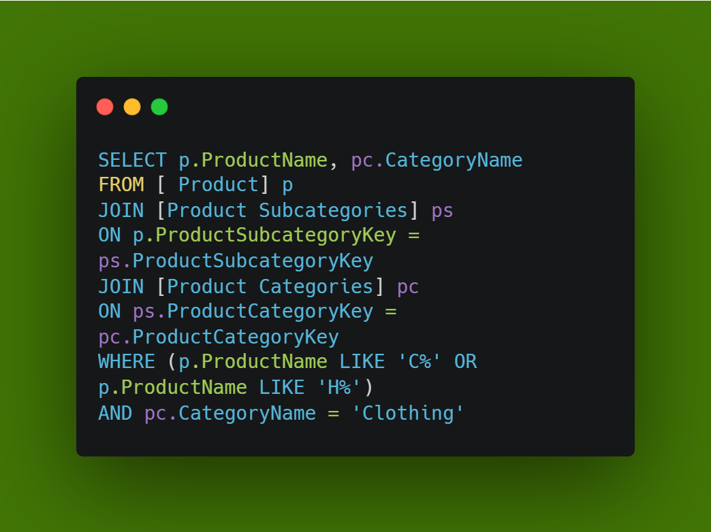
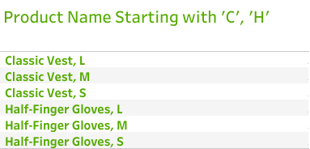
QUESTIONS 10: Retrieve the product names that start with the letter "C" or “H” and are
from the "Clothing" category
CODE SNIPPET
CHARTS
Notes:
We identified 6 products within the "Clothing" category whose names start with the letters "C" or "H," meeting the specified criteria

Slide 14
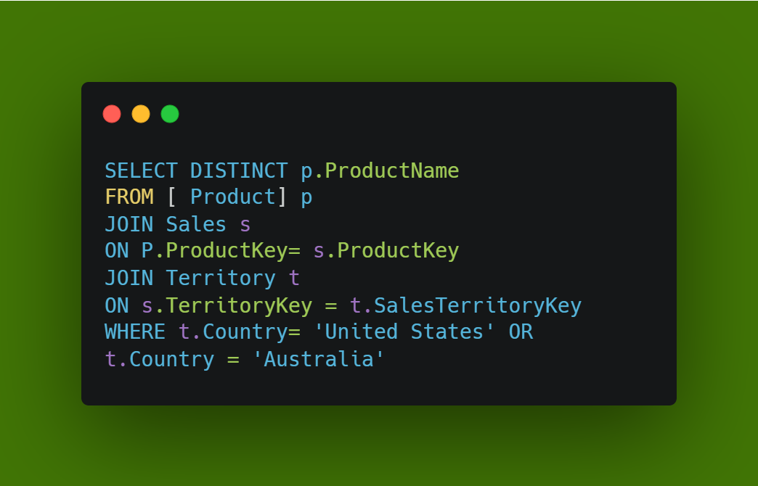
QUESTIONS 11: --Retrieve the product names that have been ordered in the ‘United States’ or "Australia"
CODE SNIPPET
CHARTS
Notes:
We identified 130 products that have been ordered in either the 'United States' or "Australia," indicating their popularity and demand in these regions.
We recommend that we design marketing campaigns that highlight these products to resonate with customers in the 'United States' and "Australia."

Slide 15
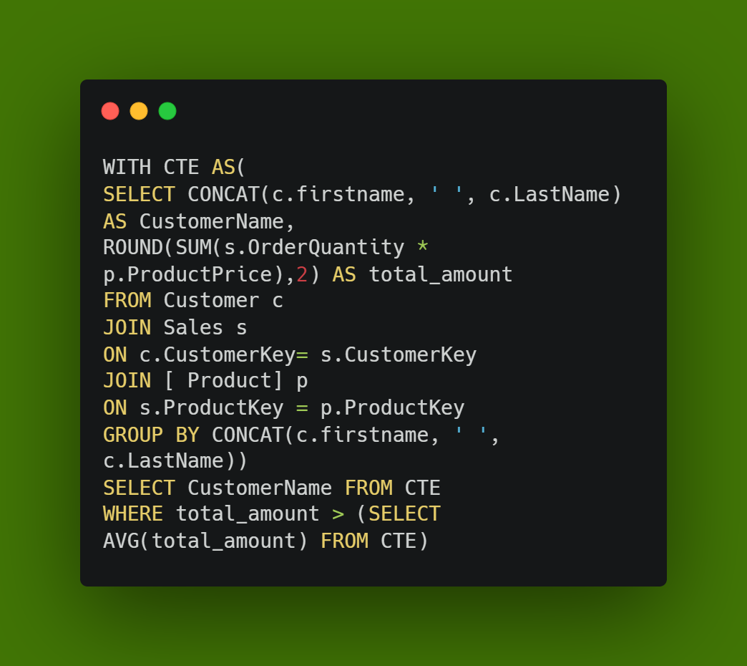
QUESTIONS 12: Find the customer names who have placed orders with a total amount
greater than the average total amount of orders.
CODE SNIPPET
CHARTS
Notes:
We identified 6,626 customers whose total order amounts exceed the calculated average, indicating higher-than-average engagement. This demonstrate loyalty and engagement with the business.

Slide 16
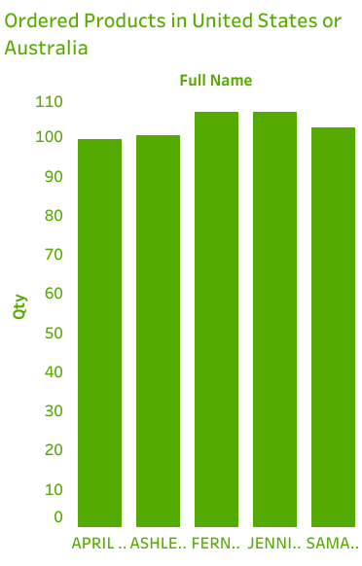
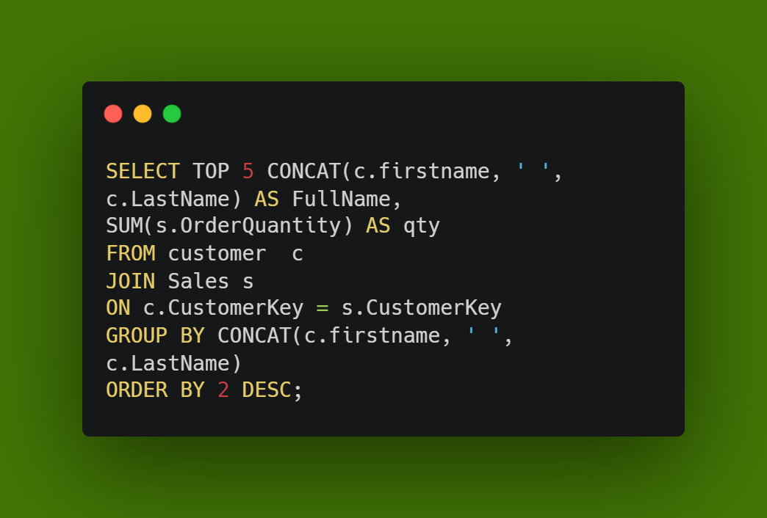
QUESTIONS 13:Retrieve the top 5 customers who have placed the highest number of orders, along with their order counts.
CODE SNIPPET
CHARTS
Notes:
These 5 customers potentially represent valuable contributors to the business revenue and customer base.
Recommendation
Acknowledge and appreciate the loyalty of these top customers to foster continued engagement.
Design personalized offers and incentives to further enhance loyalty and customer lifetime value.

Slide 17
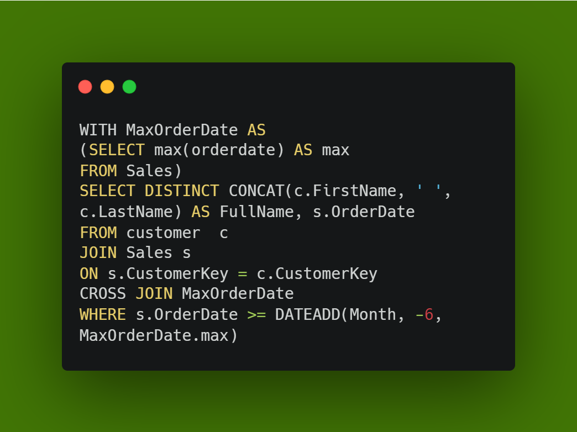
QUESTIONS 14:-List the customers who have placed orders within the last 6 months
consider the last date in the data)
CODE SNIPPET
CHARTS
Notes:
We identified 11,957 customers who have placed orders within the last 6 months, indicating recent engagement with the project.
Recommendation
Develop retention strategies that cater to the preferences and needs of customers who have engaged in the last 6 months. Engaging with recent customers can lead to higher customer retention rates and continued engagement.

Slide 18
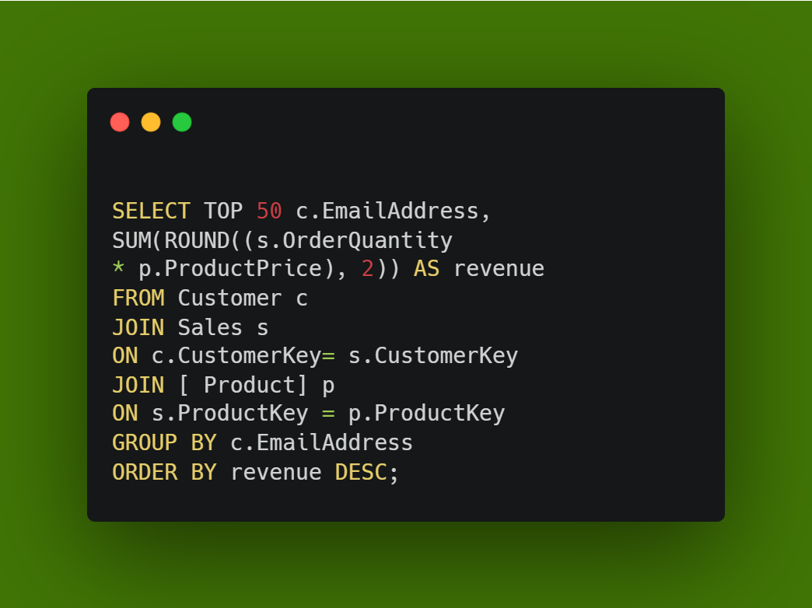
QUESTIONS 15:- --We want to reach out to our best customers in 2022. Can you get emails of Top 50 customers based on revenue?
CODE SNIPPET
CHARTS
Notes:
These customers are prime candidates for personalized outreach efforts to strengthen customer relationships.
Reaching out to these high-revenue customers can foster loyalty and further engagement with the project.
Recommendations
Design personalized communication strategies for each of these top customers to acknowledge their value and offer tailored services.
Consider offering exclusive offers or rewards to these high-revenue customers as a token of appreciation.
Utilize these interactions to collect feedback, suggestions, and insights for continuous improvement.

Slide 19
CONCLUSION
Through comprehensive analysis of customer data, product performance, and market engagement, this report presents a nuanced understanding of our project's dynamics. Insights into customer behaviors, product popularity, and regional preferences guide strategic decision-making. Leveraging this knowledge, we can optimize marketing efforts, enhance customer relationships, and drive growth. By acting on these insights, we position ourselves for sustained success in an ever-evolving landscape.

