Slide 1

PERFORMANCE ANALYSIS
RECOVERY PLAN
Kavak Cinema: Performance Analysis & Recovery Plan
A data-driven strategy to achieve +20% profit growth and operational excellence.
Prepared By: Adel Al-Khaldi | Tools: Excel & Python (Streamlit)

Slide 2
SECTION 01
Executive Summary
The cinema generates $501,887 annually but is operating well below its potential. The ~$100K gap to the 20% target is achievable. Our modelled initiatives project $638,618, exceeding the target by $36,354.
$501,887
$602,264
Baseline Annual Profit
Target Profit (+20%)
Full-year baseline
+$100,377 gap to close

Slide 3
SECTION 02
Profitability Analysis
Despite three F&B revenue streams, ticket sales still account for 51.2% of total profit. Hot Food represents only 9.5% of profit despite having the highest unit margin at $6.00/dish, revealing an untapped revenue opportunity.
Item
Annual Profit
% of Total
Unit Margin
Tickets
$256,890
51.2%
$5.00 / ticket
Popcorn
$121,238
24.2%
$4.25 / unit
Soda
$75,944
15.1%
$2.50 / unit
Hot Food
$47,815
9.5%
$6.00 / dish ← HIGHEST

Slide 4
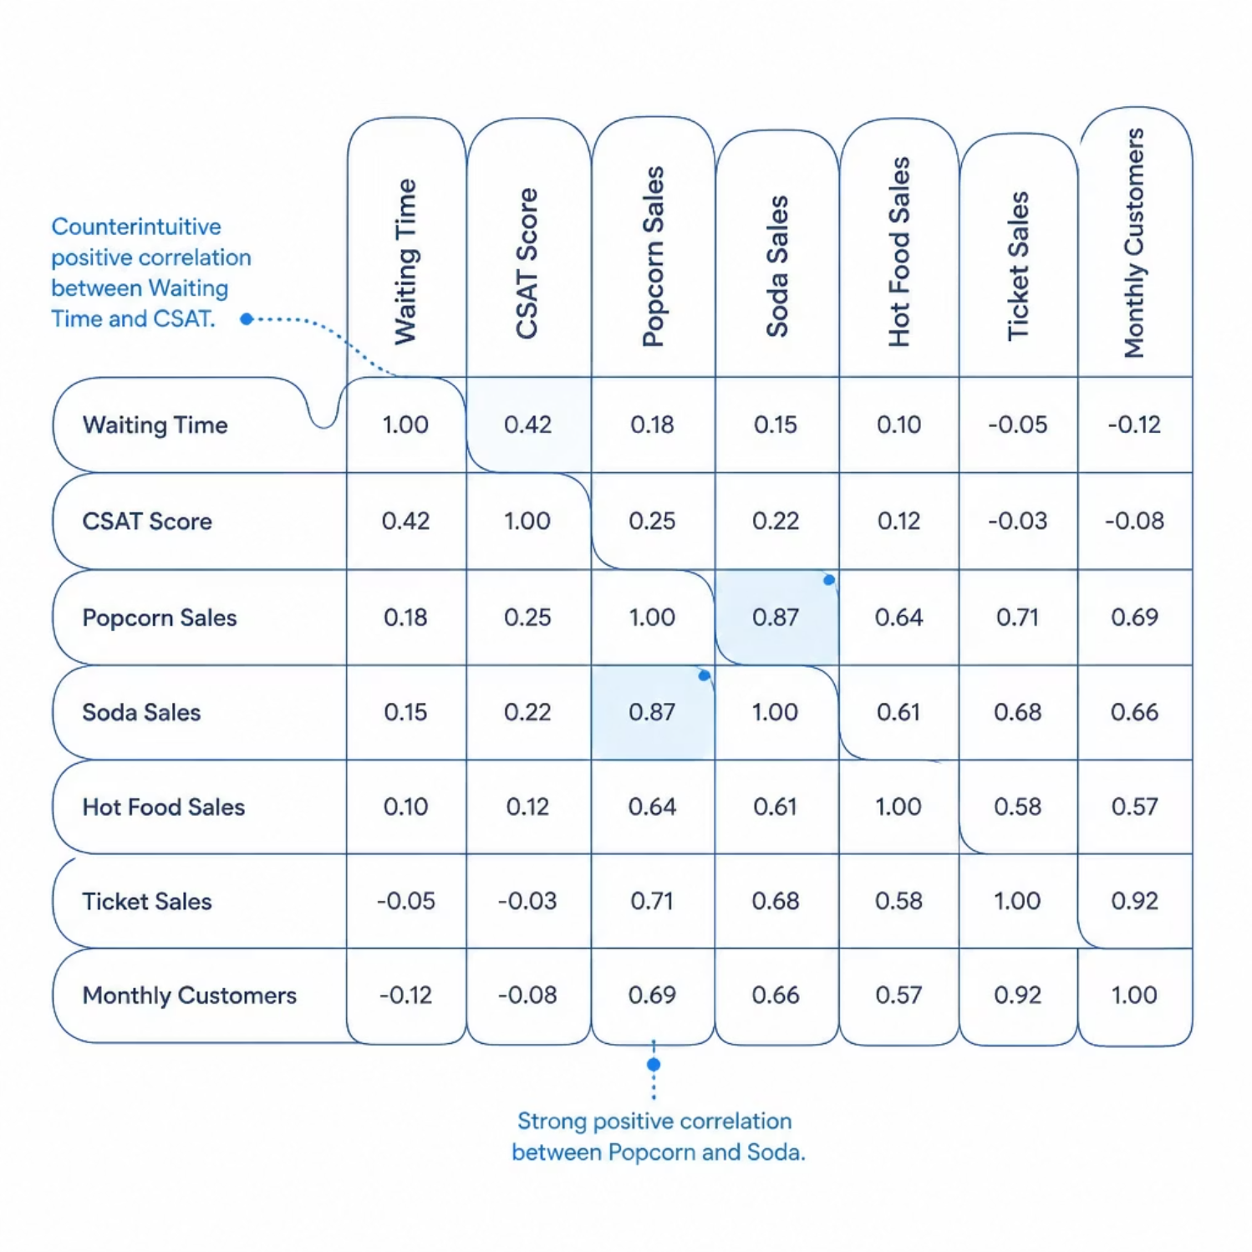

SECTION 02
Correlation Analysis (Kendall's Tau)
A Kendall's Tau correlation matrix was computed across seven primary variables — the best method for identifying correlation among small datasets.
Key Findings:
Waiting Time has a positive correlation with CSAT (counterintuitively), suggesting wait time is NOT the primary CSAT driver despite common assumption. Popcorn and Soda sales are highly positively correlated.

Slide 5




SECTION 03
Diagnosing Underperformance
The root cause of F&B underperformance is not a lack of product selection, but a failure to convert foot traffic into additional purchases. Hot Food has the lowest attach rate at 15.5%.
Low F&B Attach Rates
CSAT Breakdown
Static Staffing vs. Demand
Hot Food attach rate is only 15.5% vs. 55.5% for Popcorn and 59.1% for Soda — a stark gap in conversion.
CSAT averaged 4.3/10 with 7 of 12 months below 5.0. Food Quality is the critical detractor at 2.25/10 CSAT when primary.
15 FTEs fixed year-round causes understaffing during peaks (25-min waits) and overstaffing during troughs (pure redundancy).

Slide 6

SECTION 03
CSAT Detractor Hierarchy
Decomposing by primary detractor category reveals a clear hierarchy of customer complaints across 12 months.
Detractor Category
# Months
Avg CSAT
Impact
Critical Finding: Food Quality registers an average CSAT of 2.25/10 when it is the primary detractor — the strongest direct link to low food revenue.
Food Quality
4 months
2.25 / 10
CRITICAL — direct link to low food revenue
Cinema Hygiene
5 months
4.2 / 10
Moderate — affects repeat visits
Waiting Time
3 months
7.3 / 10
LOW — customers forgiving of queues

Slide 7




SECTION 04
Recovery Plan: Four Targeted Initiatives
All projections assume a static customer base to remain conservative. The combined impact exceeds the $602,264 target.
F&B Combo Promotions
1
75% combo adoption, 12% discount. Bundle: Ticket + Popcorn + Soda. +$462,660
Discount Rates & Packages can be modified**
2
Food Quality Control
Strict QC protocols on hot food. Attach rate rises from 15.5% to 25%. +$77,067
3
Delivery App Integration
List F&B on Talabat/Noon. +25% F&B delivery sales uplift. +$61,249
4
Operational Efficiency
Flexible scheduling/staffing & training instead of static no. of workers. Resulting in 7.5% efficiency gain on profit base. +$37,642

Slide 8



SECTION 05
Negotiation: Retaining the Cinema Session
Proposed Solution: A 6-month trial period with bi-weekly reporting to mall management showing total profit and F&B spend.
Few operational & logistical changes can achieve 20% minimum profit assuming no additional customers and conservative estimates.
Higher Spend Per Head
Evening sessions attract after-work adults with higher disposable income and stronger F&B spend.
Mall Customer Retention
Late screenings keep mall visitors on-site longer to dine, shop, and spend before the movie begins.
Low-Risk Trial Period
A 6-month pilot with regular reporting gives management clear evidence before making a long-term decision.

Slide 9
SECTION 06
KPI Framework & Monitoring Plan
Each KPI maps directly to an identified issue or recovery initiative with a defined monitoring cadence.
KPI
Baseline
Target
Cadence & Method
Monthly Total Profit
$41,824
$50,189
Monthly P&L review — Excel dashboard
CSAT Score
4.3 / 10
≥ 7.0
Weekly survey aggregate, flag if below 6.0
Hot Food Attach Rate
15.5%
≥ 25%
Weekly POS report, split by session time
Combo Adoption Rate
0%
≥ 75%
Daily POS — initiative launch week 1 KPI
Avg Wait Time
13 mins
≤ 10 mins
Daily manager log; escalate at >15 mins
Customers/FTE Ratio
9.51
≥ 11.0
Weekly — adjust flex scheduling if below
Food Quality Complaints
~4 mo/yr
0
Real-time: manager review of every 1–2 star
Delivery App Profits
$0
+25% F&B
Weekly app dashboard (Talabat partner portal)
Tools: Excel for initial data discovery | Python (Streamlit + Plotly) for interactive stakeholder exploration

Slide 10
Thank You
Any Questions?
An Interactive Version of the report can be found at https://kavakcinemadashboard-interview.streamlit.app/

