Slide 1
Emojify – Create your own emoji with Machine Learning
Adel Abdallah..☺

Slide 2
Contents
1) Introduction
2) Dataset
3) Libraries
4) Diagram
5) Final Output

Slide 3

Introduction☻
Our idea is to Take a Photo.
And using the opencv and keras model,
To Convert the Image Into Emoji.

Slide 4

The Dataset
► The data set refers from kaggle website.
● Link : https://www.kaggle.com/msambare/fer2013
► Train Image
● The training archive contains 28,709 images of emotions.
► Test Image
● The test archive contains 7,178 images of emotions.

Slide 5
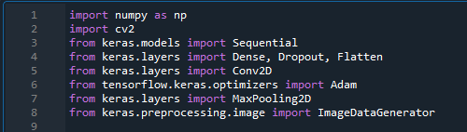
About libraries
1) numpy
2) opencv
3) keras
4) tensorflow
5) tkinter

Slide 6
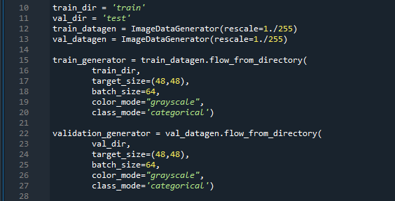
• Initializing the training and validation generators

Slide 7

Diagram
Open-cv Cascade
Will detect the bounding
Boxes in the webcam
Webcam
Capturing
Images
Mapping them with Emojy-Fy
Predicting current emotions of user

Slide 8

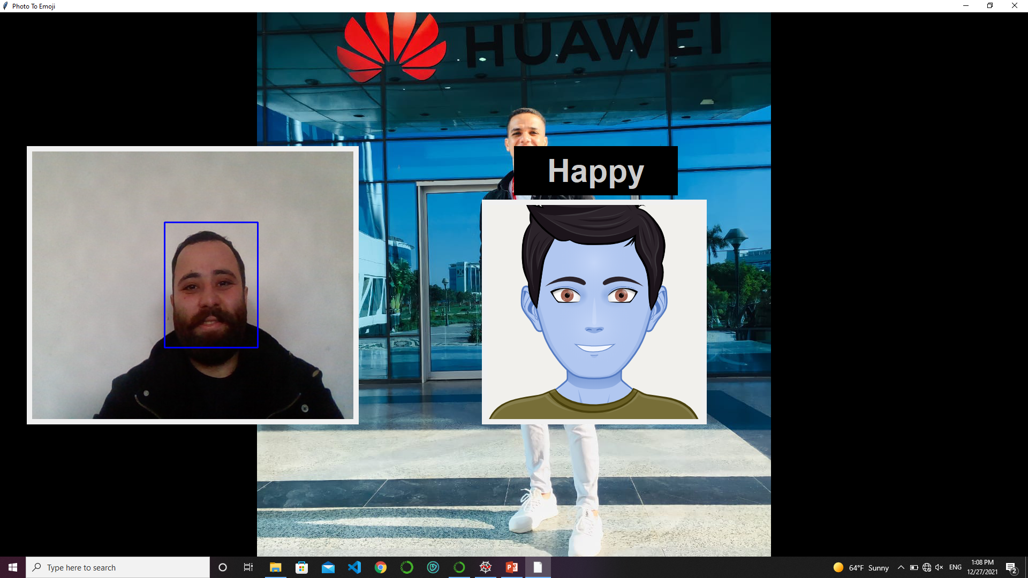
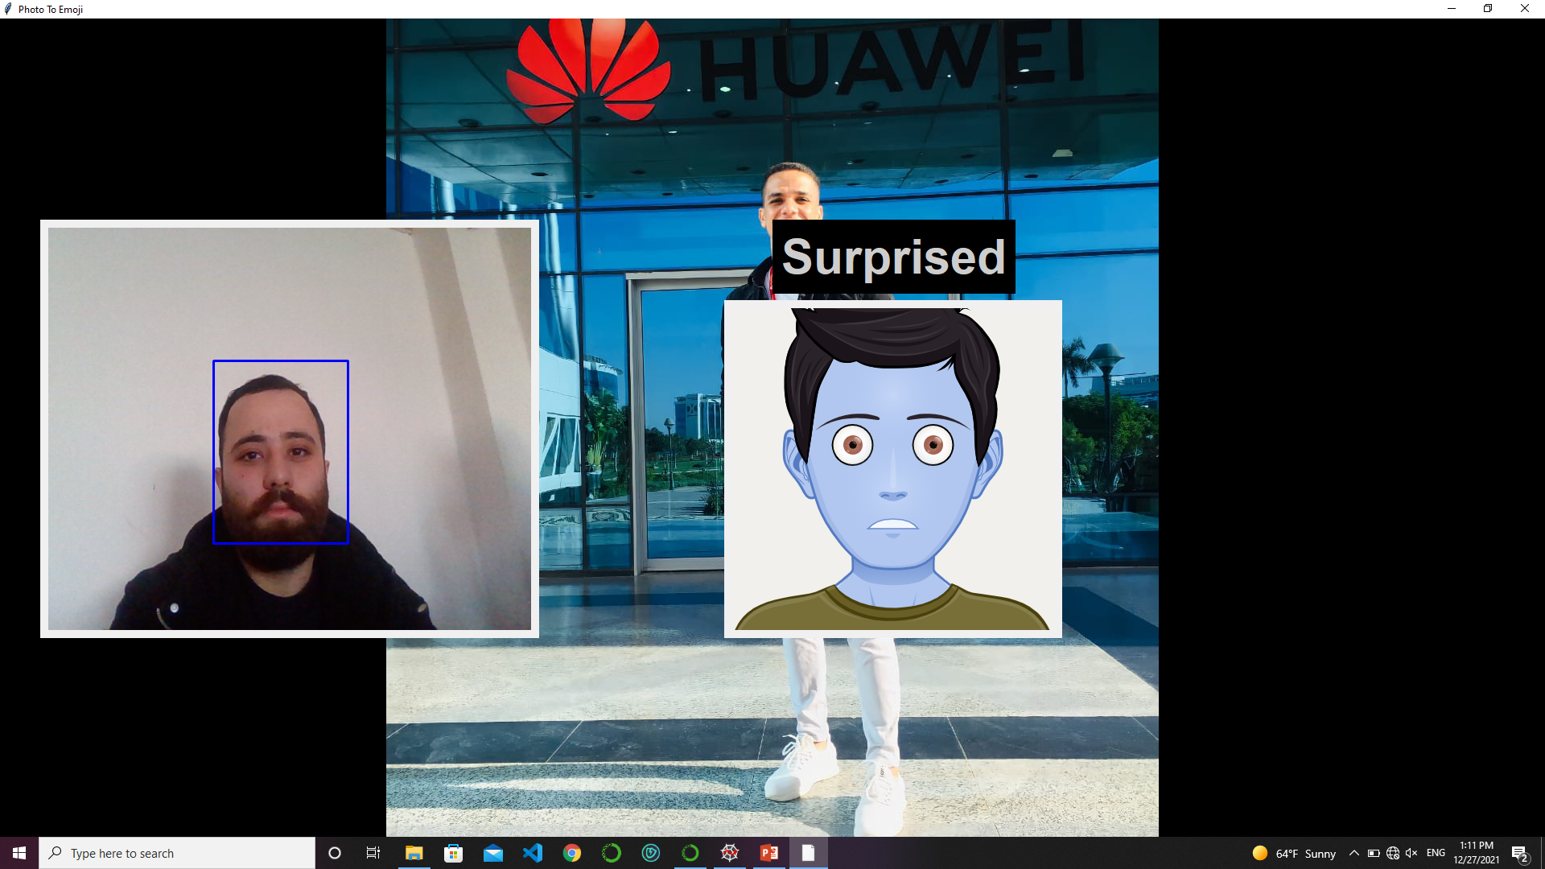
Final output

Slide 9
By/ Adel Abdallah
Emoji Presentation
Thank You..☻

