Slide 1
Event Engine Account and Prework

Slide 2
Logging in to your Account

Slide 3
MODULE 1: Deploy Resources
Log Into AWS Console through Event Engine
Create Key Pair
Deploy VPC Environment
Deploy Storage Gateway Workshop Resources

Slide 4
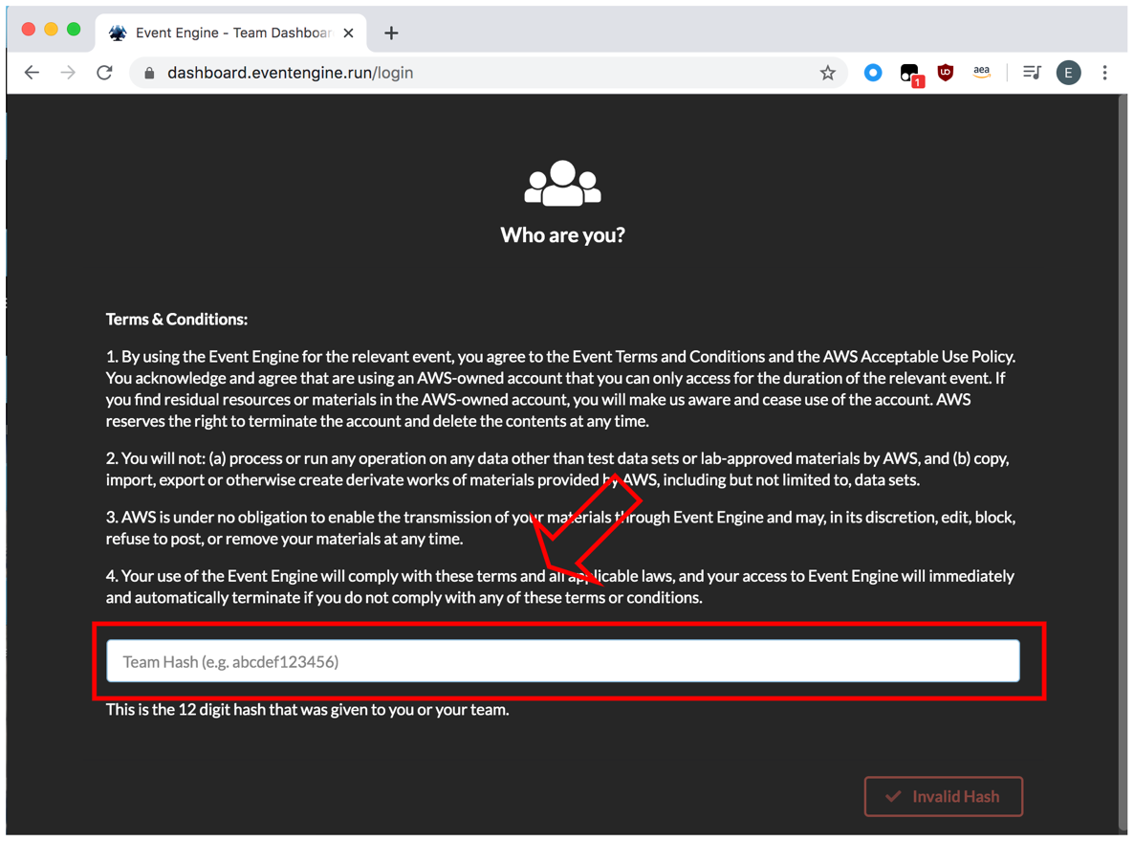
Log Into AWS Console through Event Engine
Go to https://dashboard.eventengine.run/login
Enter in Hash provided by organizers

Slide 5
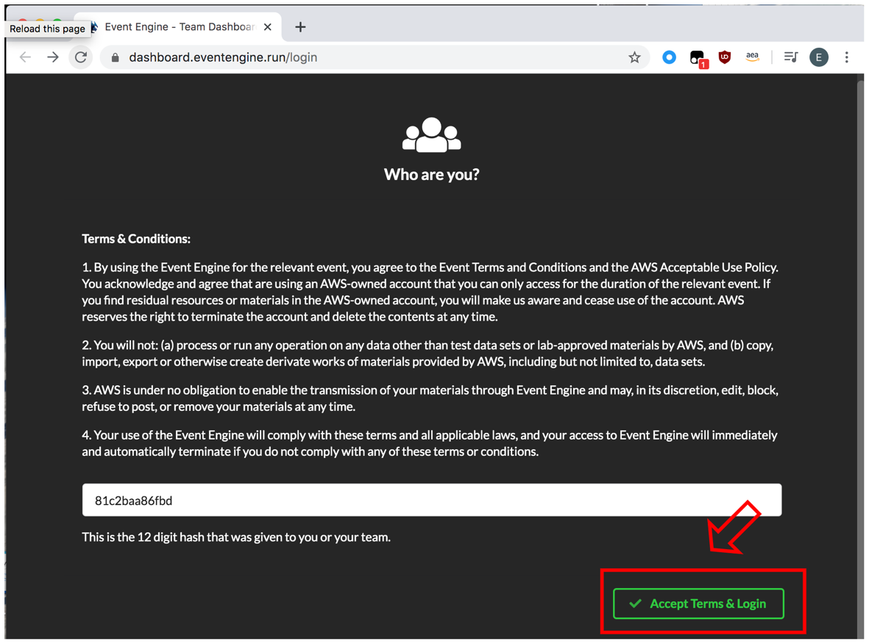
3. Click Accept Terms & Login

Slide 6
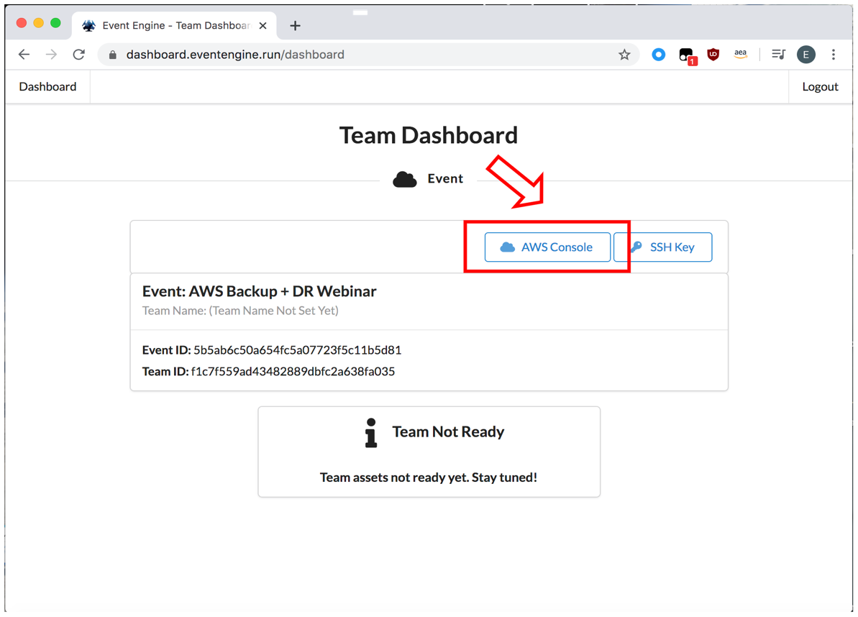
4. Click AWS Console

Slide 7
Storage Gateway Lab Setup

Slide 8
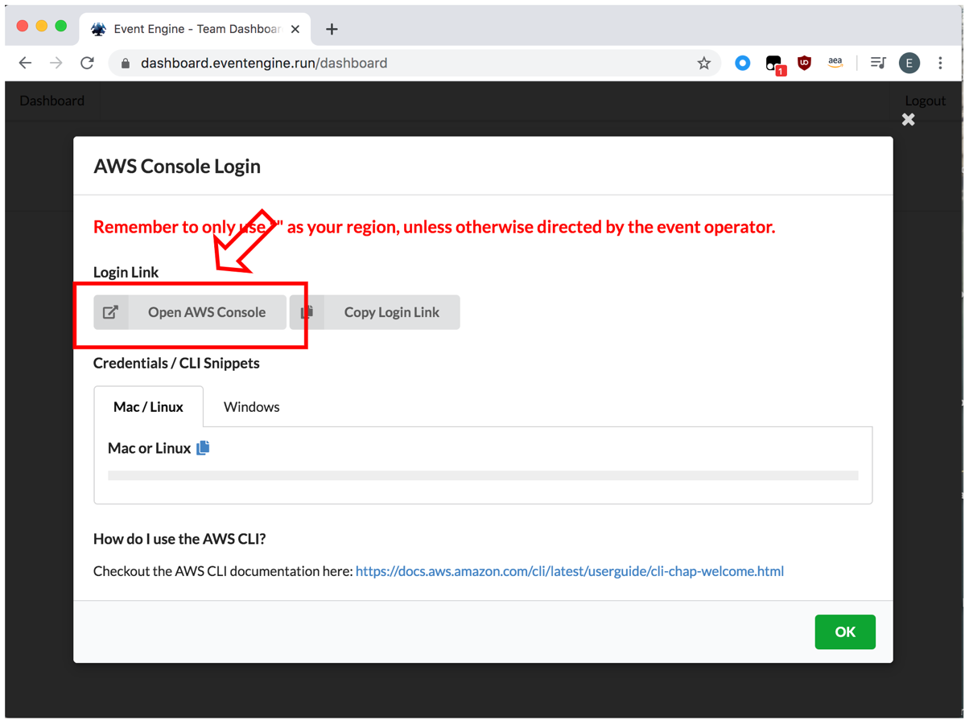
6. Click Open AWS Console

Slide 9
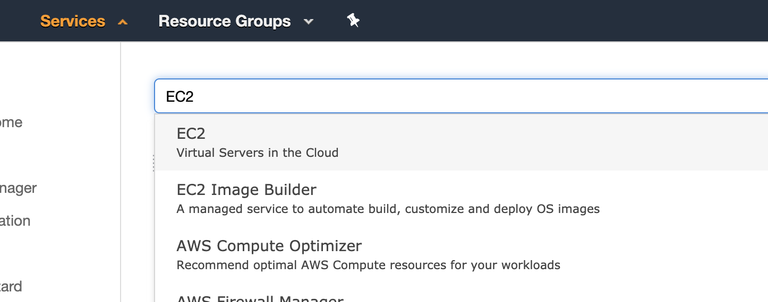
Create Key Pair
On the AWS Console, make sure region is set to us-east-1 (N.Virginia)
Click Services and type & select EC2

Slide 10
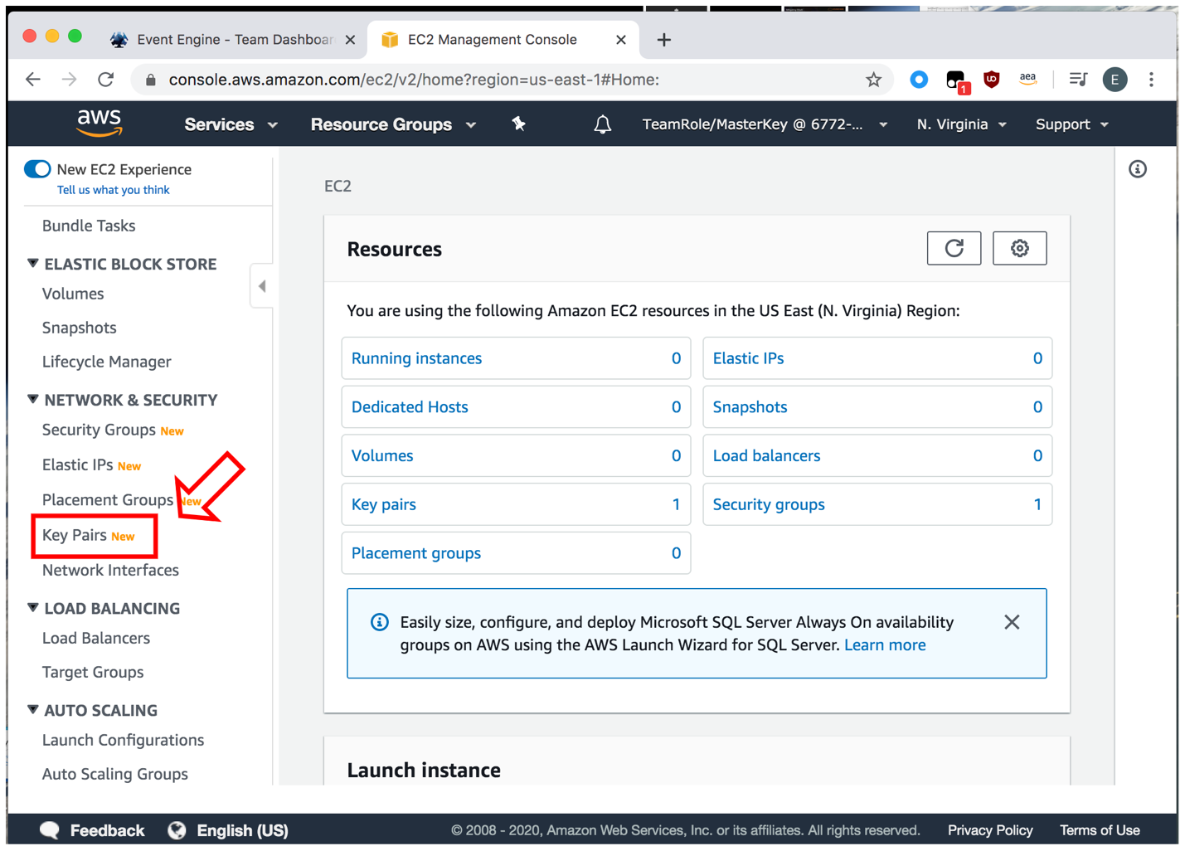
3. Navigate to Network & Security, and select Key Pairs from the menu
Click Create key pair
Enter the Key pair name of : stg316 key Select PEM file format
Select Create
* .pem file will automatically be downloaded to “downloads” folder (or a location you specified)

Slide 11
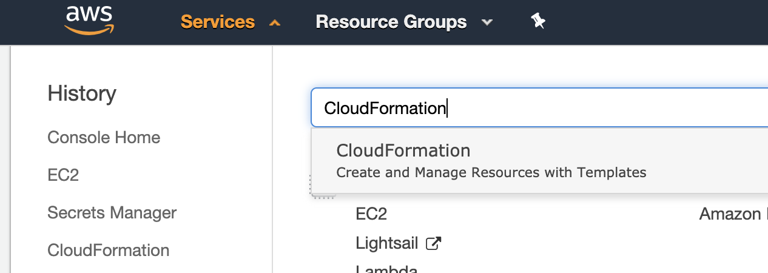
Deploy VPC Environment
On the AWS Console, click Services and type & select CloudFormation
2. Make sure N. Virginia region is selected

Slide 12
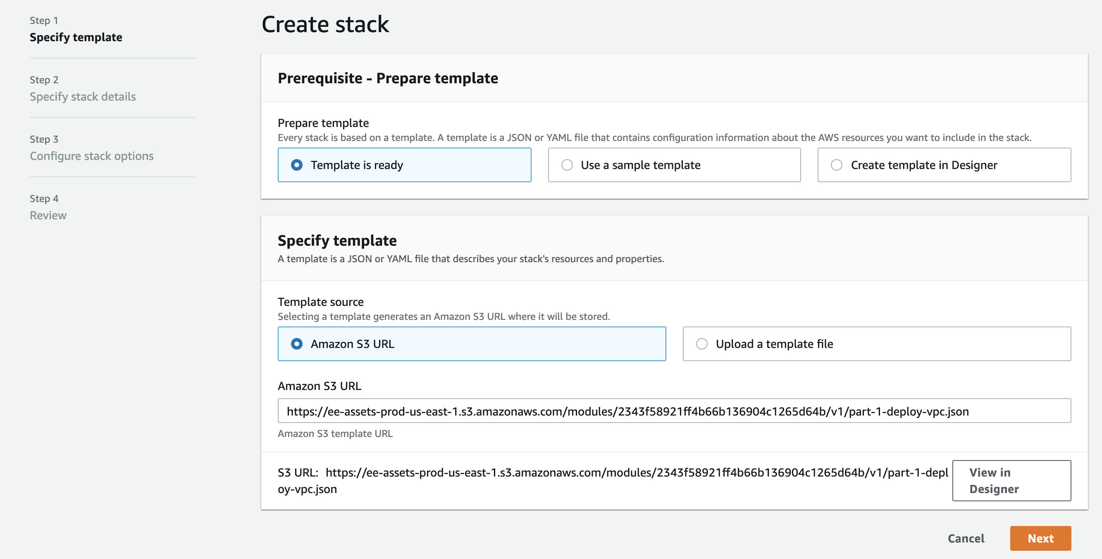
3. Click Create stack
4. Under Amazon S3 URL copy and paste this URL:
https://ee-assets-prod-us-east-1.s3.amazonaws.com/modules/2343f58921ff4b66b136904c1265d64b/v1/part-1-deploy-vpc.json
5. Click Next

Slide 13
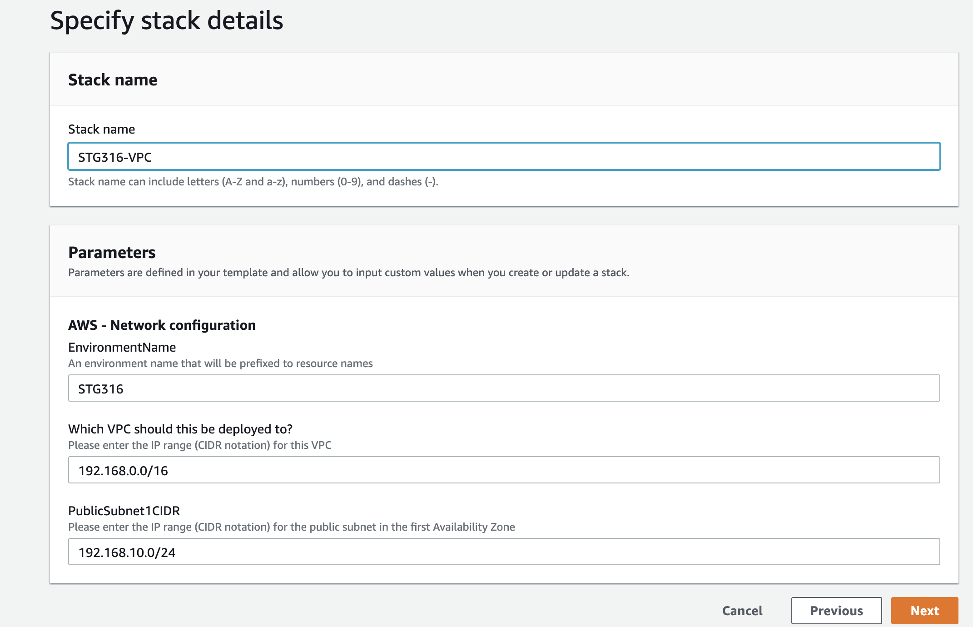
6. Enter the Stack name of STG316-VPC, then click Next
7. On the next page scroll to the bottom and click on Next to continue, then click on Create stack

Slide 14
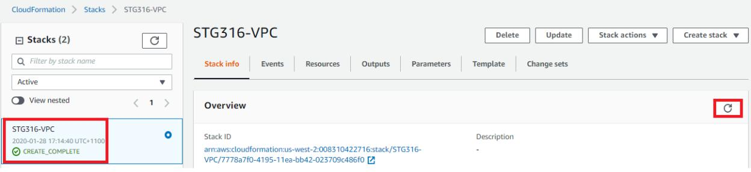
8. Click on the Stack info tab and click on the refresh icon as highlighted in RED until the status value changes to CREATE_COMPLETE (this may take 1-2 minutes) as shown below

Slide 15
Deploy Storage Gateway Workshop Resources
On the AWS Console, click Services and type & select CloudFormation
2. Make sure N. Virginia region is selected

Slide 16
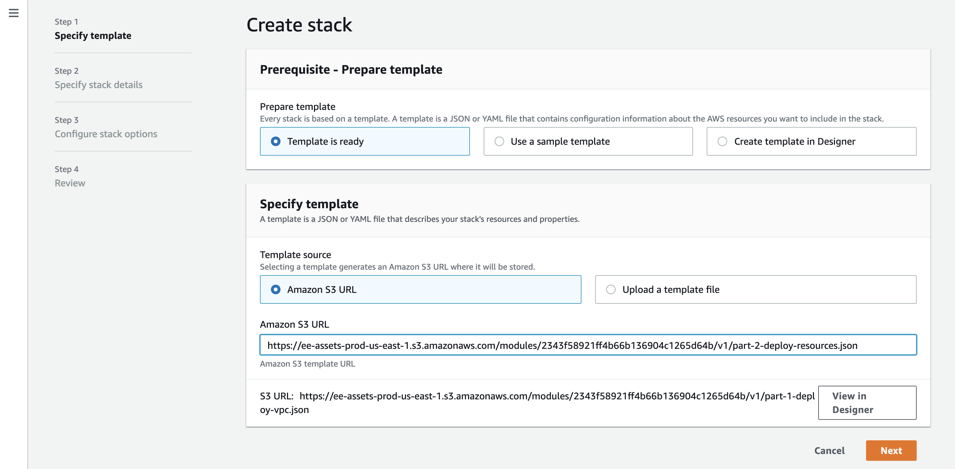
3. Click Create stack
4. Under Amazon S3 URL copy and paste this URL:
https://ee-assets-prod-us-east-1.s3.amazonaws.com/modules/2343f58921ff4b66b136904c1265d64b/v1/part-2-deploy-resources.json
5. Click Next

Slide 17
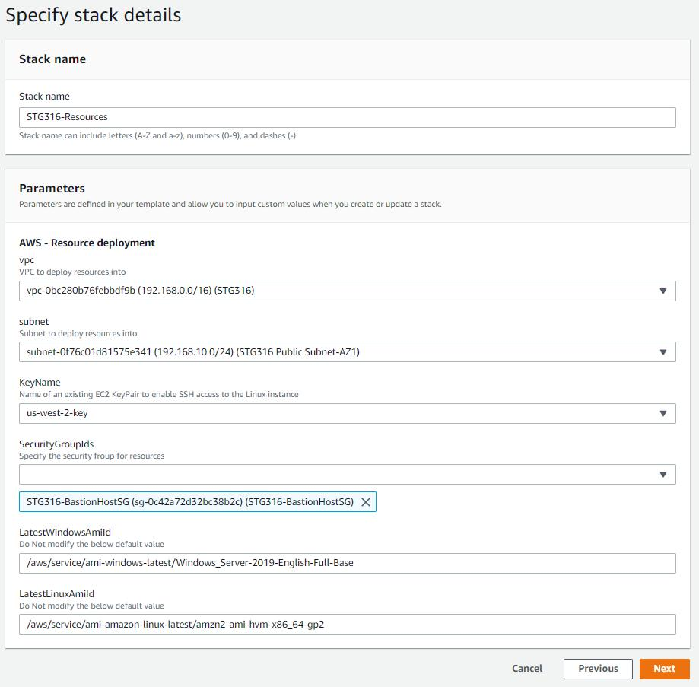
6. Enter the Stack name of STG316-Resources, make sure the following options are selected:
VPC – contains STG316
Subnet – contains STG316 Public
Subnet-AZ1
KeyName – key pair name you
created in the previous step
SecurityGroupIds - STG316-BastionHostSG
7. Click Next

Slide 18
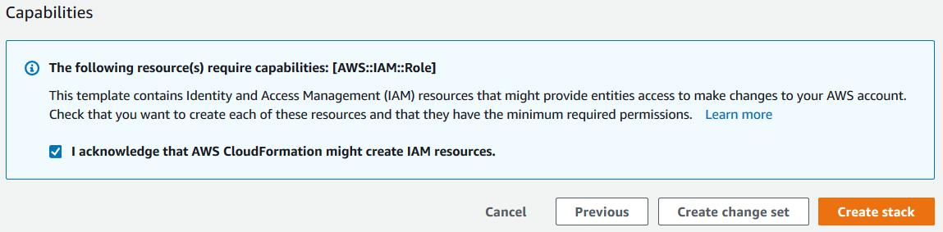
8. Scroll to the bottom of the next screen and click on Next
9. Scroll to the bottom of the next screen, check the CloudFormation acknowledgement box and click on Create stack

Slide 19
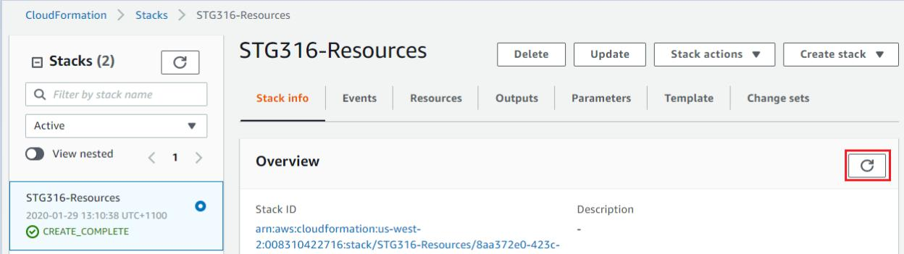
10. Click on the Stack info tab and click on the refresh icon as highlighted in RED until the status value changes to CREATE_COMPLETE (this may take 1-2 minutes) as shown below

Slide 20
CloudEndure Lab Setup

Slide 21
Download the CloudFormation Templates
Go to https://bit.ly/backup-dr-cfn. Download and unzip “backup-dr-workshop-master.zip”. There’s two CloudFormation templates that we will be deploying for the CloudEndure lab under the cloudendure folder:
cloudendure/source_infra_stack.yaml
cloudendure/dr_infra_stack.yaml

Slide 22
Create Key Pair
2. On the AWS Console, make sure region is set to us-east-1 (N.Virginia)
3. Click Services and type & select EC2

Slide 23
4. Navigate to Network & Security, and select Key Pairs from the menu
Click Create key pair
Enter the Key pair name of : cloudendure-workshop Select PEM file format
Select Create
* .pem file will automatically be downloaded to “downloads” folder (or a location you specified)

Slide 24
Deploy VPC Environment (for the Source Infra)
On the AWS Console, click Services and type & select CloudFormation
2. Make sure N. Virginia region is selected

Slide 25
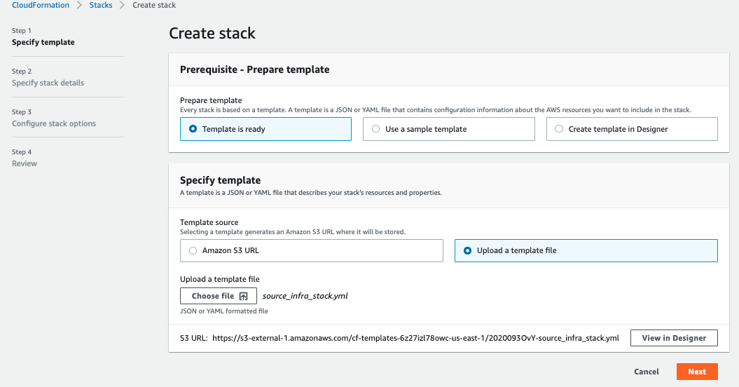
3. Click Create stack and then click Upload a template file.
4. Select the downloaded CloudFormation template source_infra_stack.yaml you downloaded in Step 1.
5. Click Next

Slide 26
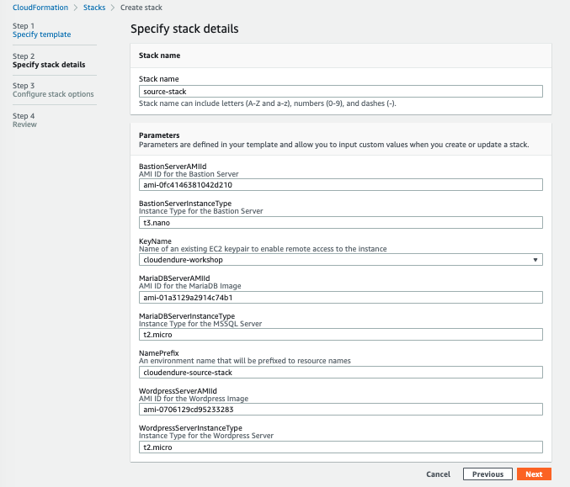
6. Enter the Stack name as source-stack, then click Next and set the KeyName into cloudendure-workshop that you have created in Step 4. Leave other fields as default.
7. On the next page scroll to the bottom and click on Next to continue, then click on Create stack

Slide 27
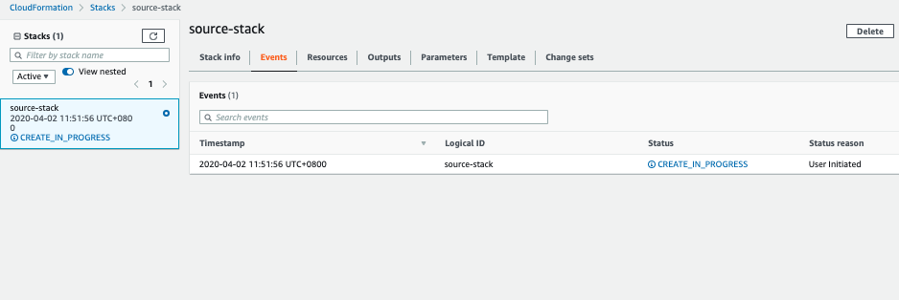
8. Click on the Stack info tab and click on the refresh icon as highlighted in RED until the status value changes to CREATE_COMPLETE (this may take 1-2 minutes) as shown below

Slide 28
Deploy VPC Environment (for the DR Infra)
On the AWS Console, click Services and type & select CloudFormation
2. Make sure N. Virginia region is selected

Slide 29
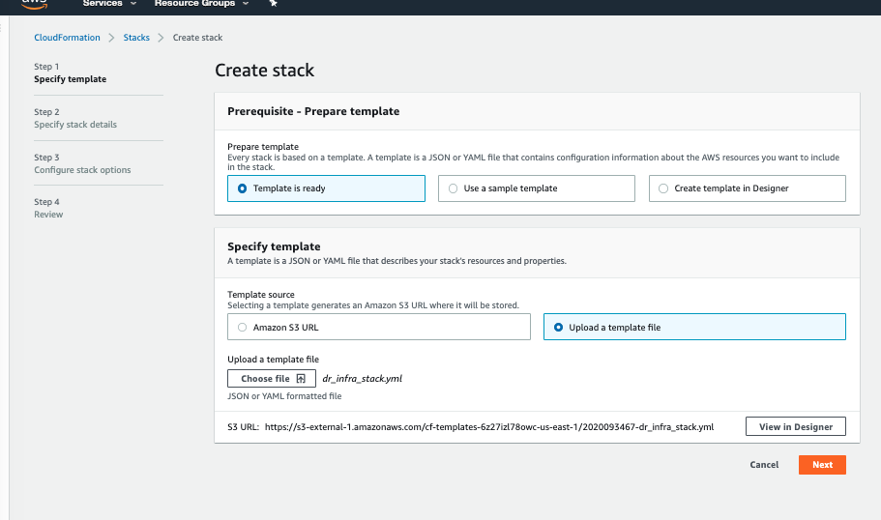
3. Click Create stack and then click Upload a template file.
4. Select the downloaded CloudFormation template dr_infra_stack.yaml you downloaded in Step 1.
5. Click Next

Slide 30
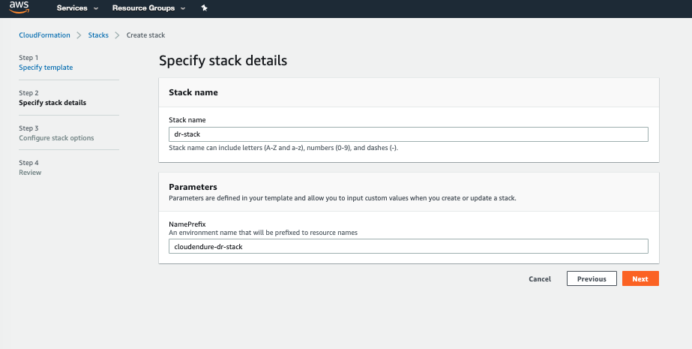
6. Enter the Stack name as dr-stack, then click Next and set the KeyName into cloudendure-workshop that you have created in Step 4. Leave other fields as default.
7. On the next page scroll to the bottom and click on Next to continue, then click on Create stack

Slide 31
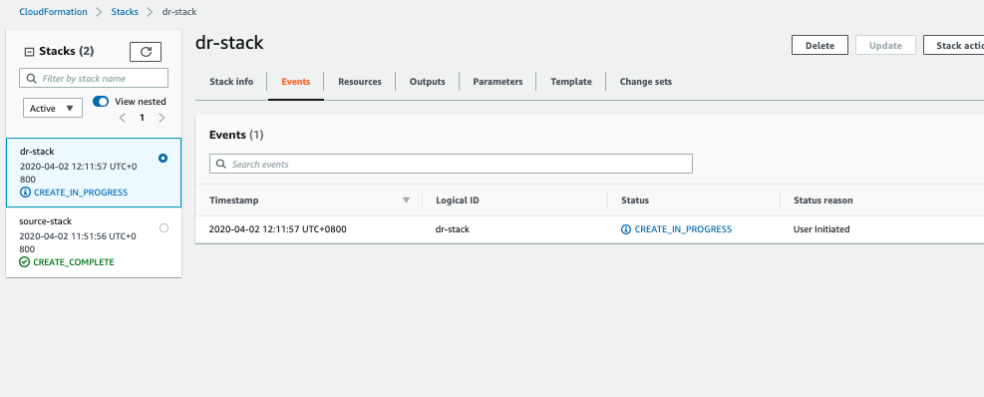
8. Click on the Stack info tab and click on the refresh icon as highlighted in RED until the status value changes to CREATE_COMPLETE (this may take 1-2 minutes) as shown below

