Slide 1
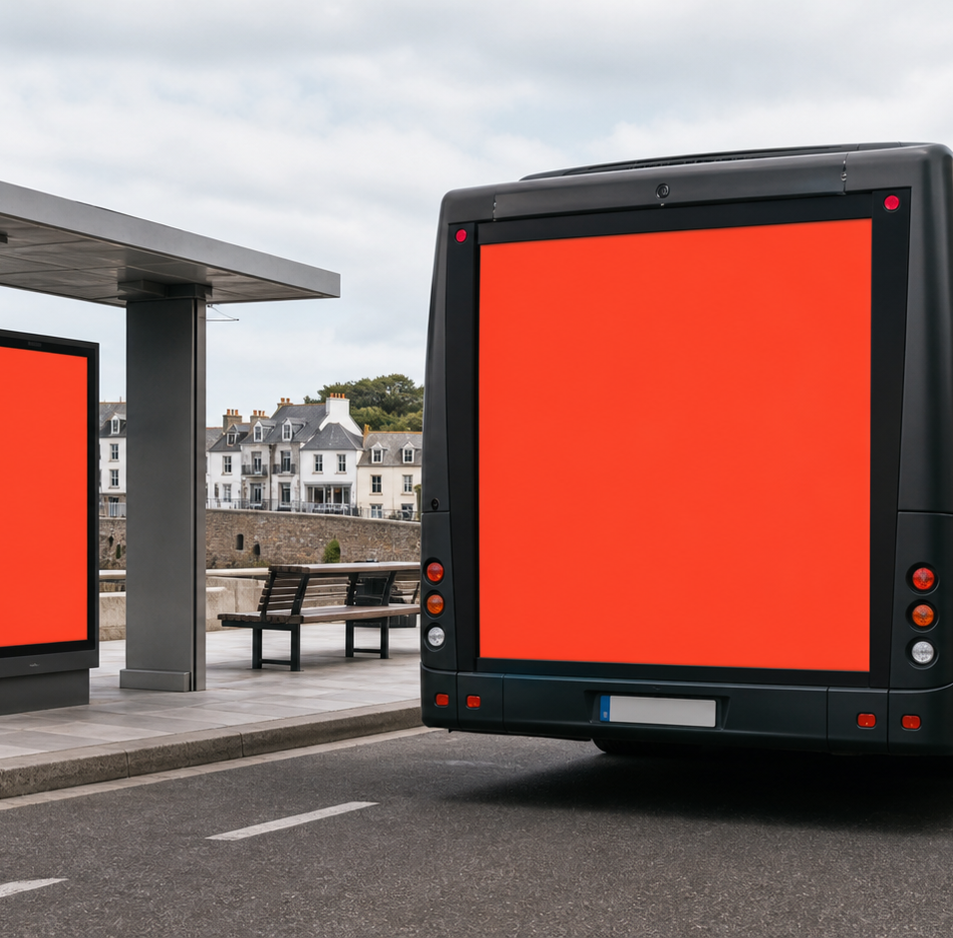

BRAND SYSTEM
Built to be
seen in public.
Logo, visual system, interface templates and presentation layouts for Island Media Co.
Notes:
[Sources]
- OpenAI image generation through Codex, bus and transport-hub image, generated 30 August 2026.
- Original Island Media Co identity created for this request.
[/Sources]

Slide 2

THE PUBLIC FRAME
The identity is built around the media space
Two opposing corners hold a simple I. The result reads as an ad surface, a screen, a crop and an island identity without relying on a literal billboard icon.
Space
The frame can hold any format, from a bus rear to a portrait screen.
Signal
Coral marks the action or point that needs attention.
Service
The central I keeps the operator and client experience connected.
PUBLIC FRAME
ISLAND MEDIA CO. / BRAND SYSTEM
02
Notes:
[Sources]
- Original Island Media Co logo concept and rationale created for this request.
[/Sources]

Slide 3

LOGO SYSTEM
The mark stays clear at every scale
PRIMARY
REVERSE
Full logo
Compact mark
Use for navigation and proposals. Minimum 160 px on screen or 35 mm in print.
Use where the wordmark is already present. Minimum 24 px on screen or 8 mm in print.
COMPACT MARK
ISLAND MEDIA CO. / BRAND SYSTEM
03
Notes:
[Sources]
- Original Island Media Co logo files created for this request.
[/Sources]

Slide 4
LOGO USE
Give the logo space and keep it simple
CLEAR SPACE
DO
Use approved artwork
Choose the light, reverse or monochrome version that gives the strongest contrast.
Hold it on a clean field
Use Carbon, Warm White or a quiet part of an image.
DO NOT
Keep at least the MEDIA CO. cap height around the full lockup.
Stretch, rotate, outline, add a shadow, use a gradient or replace the central I.
ISLAND MEDIA CO. / BRAND SYSTEM
04
Notes:
[Sources]
- Original Island Media Co logo usage rules created for this request.
[/Sources]

Slide 5
COLOUR SYSTEM
Carbon leads. Coral makes the moment visible.
Carbon
Signal Coral
Warm White
Atlantic
Concrete
#101820
#FF5A3D
#F6F4EF
#17324D
#AAB3BA
Use Coral for action and emphasis, not for long text blocks. Carbon on Coral passes WCAG AA for normal text at 5.78:1. White on Coral is for large display type only.
ISLAND MEDIA CO. / BRAND SYSTEM
05
Notes:
[Sources]
- Colour contrast ratios calculated from the original palette using the WCAG relative luminance formula.
[/Sources]

Slide 6
TYPOGRAPHY
One typeface keeps every surface direct and legible
Aa
Display
56 / 60
Out there, clearly managed.
Heading 1
40 / 44
Out there, clearly managed.
Heading 2
32 / 36
Out there, clearly managed.
AVENIR NEXT
A practical geometric sans that stays clear in a large campaign headline and on a fitter’s phone.
Body
16 / 24
Out there, clearly managed.
Label
13 / 16
Out there, clearly managed.
Fallback: Avenir, Helvetica Neue, Arial
ISLAND MEDIA CO. / BRAND SYSTEM
06
Notes:
[Sources]
- Avenir Next is a system font in the production environment. No font file is redistributed.
[/Sources]

Slide 7

LAYOUT LANGUAGE
Use the frame to hold attention, not decorate everything
Keep one dominant composition. Let the corner device identify the media surface, then leave the rest of the layout quiet.
8 px rhythm
Build spacing in simple multiples of 8.
Straight media, soft UI
Keep campaign frames square. Use 10 to 12 px radii for controls and surfaces.
ISLAND MEDIA CO. / BRAND SYSTEM
07
Notes:
[Sources]
- OpenAI image generation through Codex, charging-station image, generated 30 August 2026.
- Original layout rules created for this request.
[/Sources]

Slide 8
INTERFACE FOUNDATION
The product system stays bold, calm and accessible
Use Coral for the main next step. Keep status colours separate so attention, success and risk are never confused with the brand accent.
Primary action
Check availability
Neutral surface
8 px spacing · 10 px controls · 12 px surfaces · 20 px feature panels
Clear hierarchy, one border, no decorative shadow stack.
Operational status
Success
Warning
Risk
Information
ISLAND MEDIA CO. / BRAND SYSTEM
08
Notes:
[Sources]
- Original interface tokens and accessibility rules created for this request.
[/Sources]

Slide 9
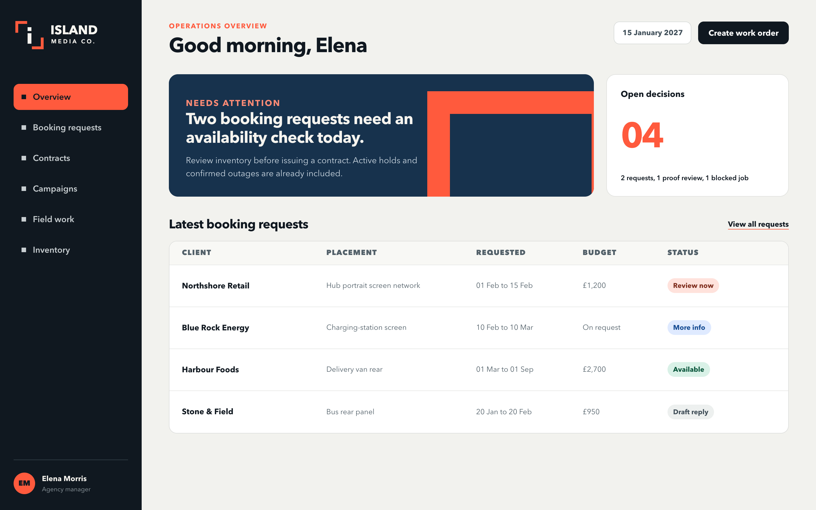
DESKTOP MANAGEMENT
Management gets fast hierarchy and clear decisions
The dashboard leads with work that needs a decision. Coral flags attention without turning the whole interface into an alert state.
Lead with attention
Open requests and blocked work appear before passive totals.
Keep states explicit
Every chip uses a label, not colour alone.
ISLAND MEDIA CO. / BRAND SYSTEM
09
Notes:
[Sources]
- Original management interface template rendered from HTML and CSS created for this request.
- Fictional product context comes from the supplied Frameworks candidate pack.
[/Sources]

Slide 10
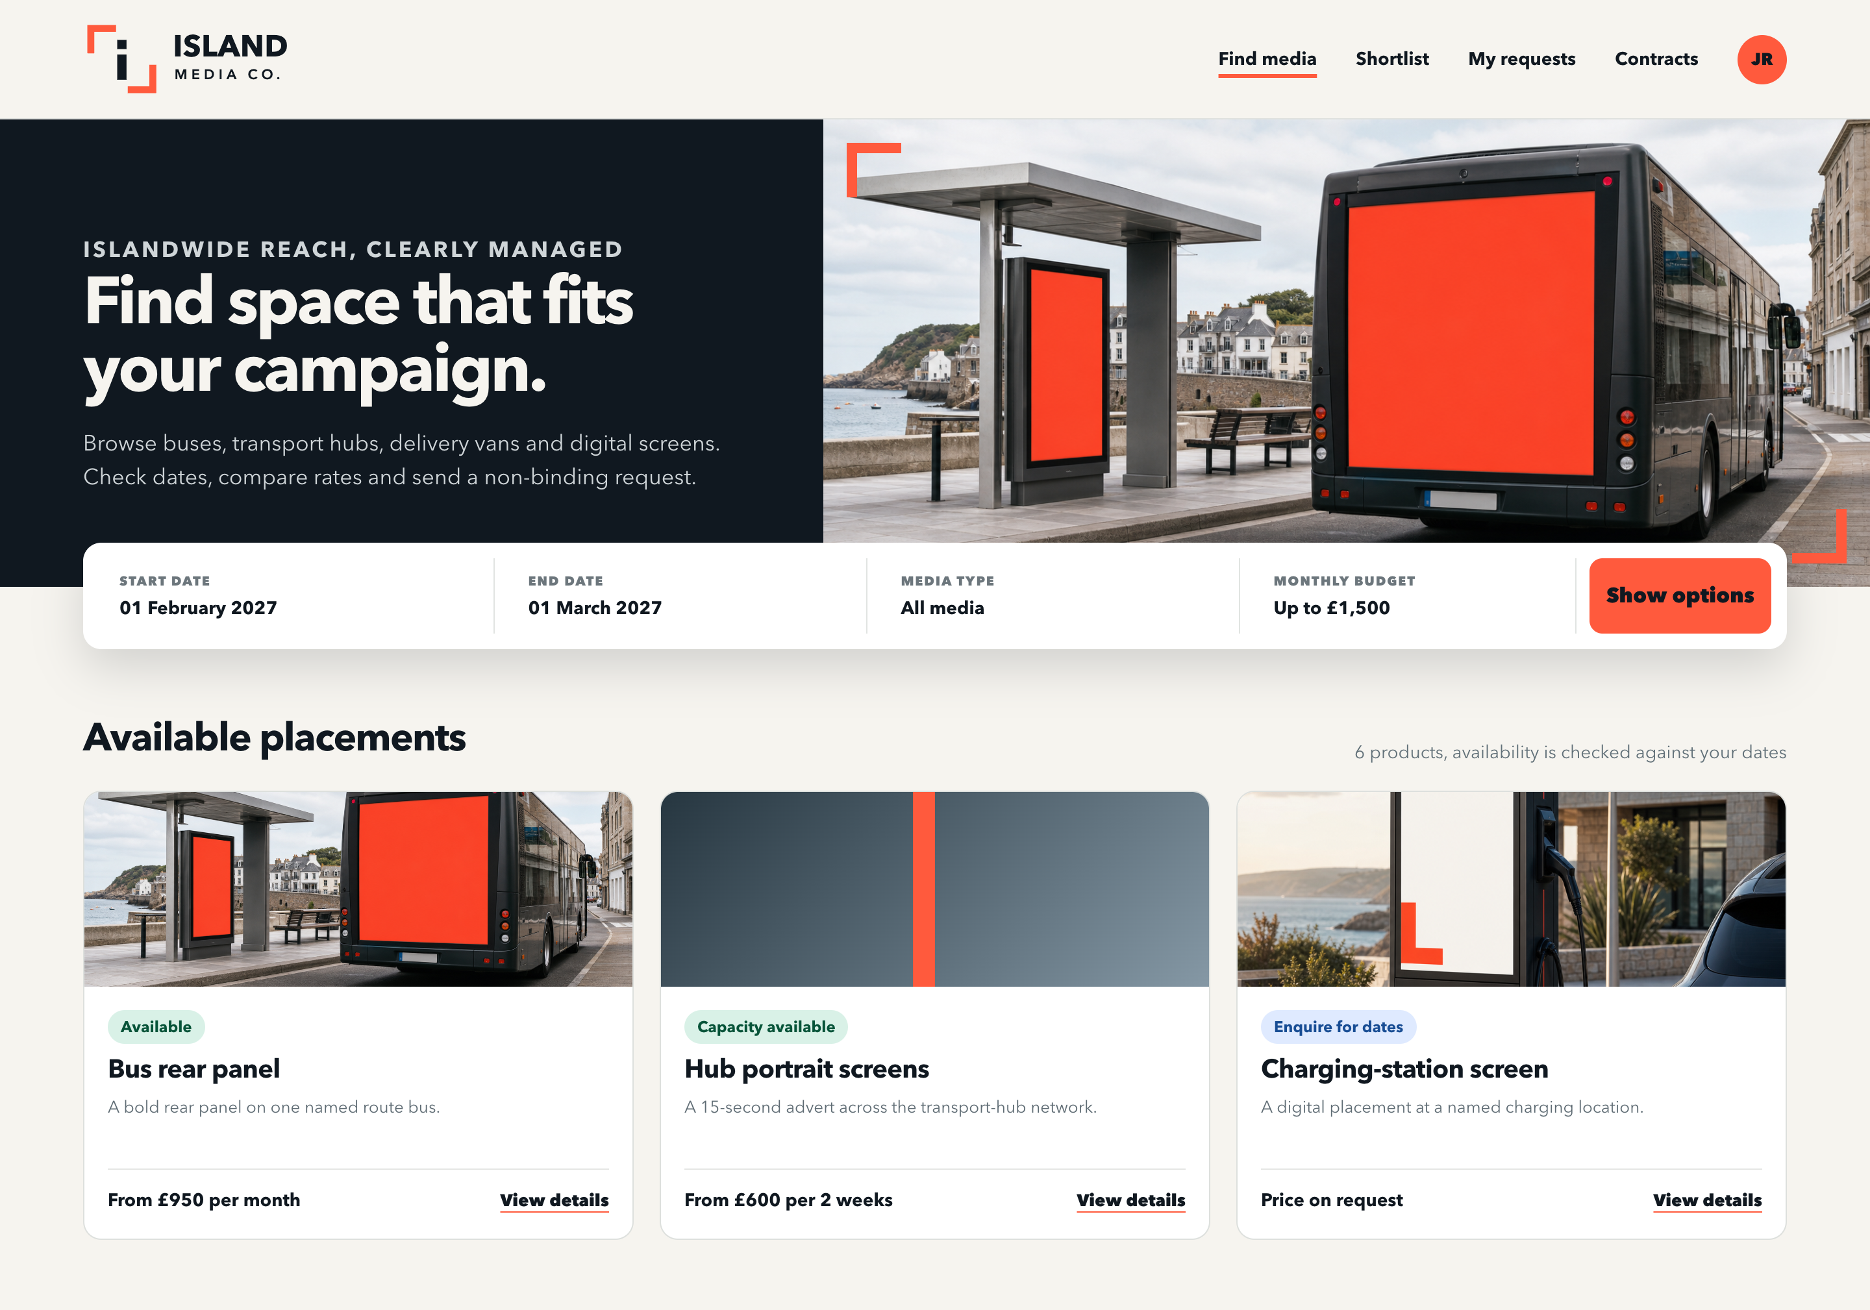
CLIENT PORTAL
Clients see media as simple, useful choices
Strong campaign language up front, plain filters in the middle and honest availability on every product.
ISLAND MEDIA CO. / BRAND SYSTEM
10
Notes:
[Sources]
- Original client portal template rendered from HTML and CSS created for this request.
- The portal template includes OOH images generated with OpenAI image generation through Codex on 30 August 2026.
- Fictional product names and rates come from the supplied Frameworks candidate pack.
[/Sources]

Slide 11
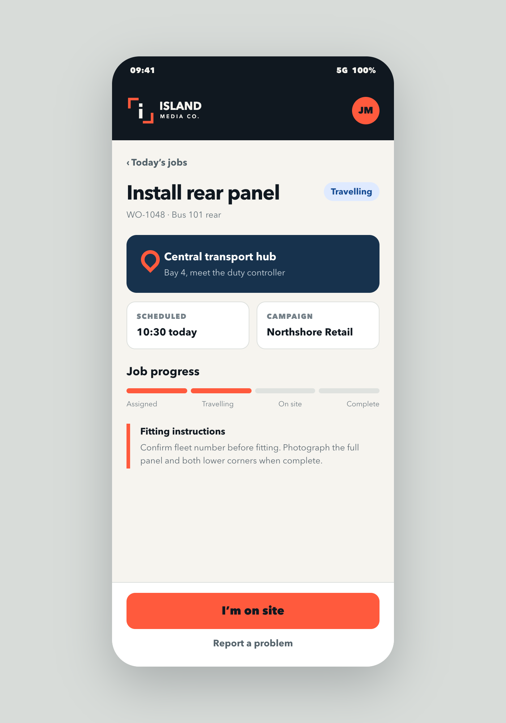
FITTER MOBILE
One clear next action survives a busy job
Location, time and instructions sit above the progress action. The screen stays usable in one hand and does not hide failure or blocked states.
44 px minimum controls
Large targets support field use.
Action before decoration
The primary button states the next real job step.
ISLAND MEDIA CO. / BRAND SYSTEM
11
Notes:
[Sources]
- Original fitter mobile interface template rendered from HTML and CSS created for this request.
- Fictional job and product context comes from the supplied Frameworks candidate pack.
[/Sources]

Slide 12

EDITABLE PRESENTATION TEMPLATES
The same system, ready for campaign proposals and reviews.
Duplicate the next four slides in PowerPoint and replace the sample copy or image area.
ISLAND MEDIA CO. / TEMPLATE SECTION
12
Notes:
[Sources]
- Original PowerPoint layout system created for this request.
[/Sources]

Slide 13
CAMPAIGN PROPOSAL
Campaign title goes here
Client name · Month YYYY
ISLAND MEDIA CO. / DUPLICATE THIS COVER
13
Notes:
[Sources]
- Original editable cover layout created for this request.
[/Sources]

Slide 14
CONTENT TEMPLATE
One clear point per slide
Write one short sentence that explains the point and why it matters.
01
Evidence
Add one fact, example or decision that supports the point.
02
Meaning
Explain the practical consequence in plain English.
03
Action
End with the next decision, owner or deadline.
ISLAND MEDIA CO. / DUPLICATE THIS CONTENT SLIDE
14
Notes:
[Sources]
- Original editable content layout created for this request.
[/Sources]

Slide 15
IMAGE TEMPLATE
Let the placement do the work
Use one strong image and only the copy needed to explain why it matters.
REPLACE WITH ONE STRONG IMAGE
Add one clear next step
ISLAND MEDIA CO. / IMAGE TEMPLATE
15
Notes:
[Sources]
- Original editable image layout created for this request.
[/Sources]

Slide 16
DECISION CLOSE
What needs deciding next?
State the decision, owner and due date in one sentence.
Decision · Owner · Date
ISLAND MEDIA CO. / DUPLICATE THIS CLOSE
16
Notes:
[Sources]
- Original editable decision-close layout created for this request.
[/Sources]

