Slide 1
React
And Friends

Slide 2
React JS
What about my Data?!?!11!One!1
To Do Example
Network Example
React Native

Slide 3
What is React?
And why is it all up in my grill?!

Slide 4
Flux <~ Redux
Gigawatts of fun ;)

Slide 5
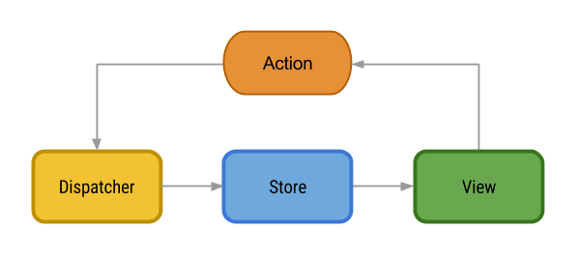

Slide 6
To Do List
Action Packed Shopping

Slide 7
On Networks
And promises unbroken (unless there’s an error)

Slide 8
Learn Once, Write Everywhere
Native UI + JS Logic == 😍

