Slide 1

Database Management Systems (CS 564)
Fall 2017
Lecture 20

Slide 2
Relational Operators: Building Blocks of Relational Query Answering
Finally, how rather than what

Slide 3
DBMS Architecture
Web Forms
Application Front Ends
SQL Interface
SQL Commands
Query Evaluation Engine
Plan Executor
Parser
Operator Evaluator
Optimizer
Transaction Manager
File and Access Methods
Recovery Manager
DBMS
Concurrency Control
Buffer Manager
Storage Manager
Lock Manager
Disk Space Manager
Index Files
Database
System Catalog
Data Files

Slide 4
Query Execution
SQL Query
Query Parser
Parsed Query
Query Optimizer
Plan Generator
Plan Cost Estimator
Evaluation Plan
Query Plan Evaluator
Operator Evaluators

Slide 5
Logical vs Physical Operators
Logical operators
What they do
e.g., selection, project, join, union, grouping
Physical operators
How they do it
e.g., nested loop join, sort-merge join, hash join, index join

Slide 6
Example
𝜏_{buyer}
External Merge-sort
Quicksort for Internal, B=20
𝜋_{buyer}
SELECT DISTINCT P.buyer
FROM Purchase P,
Person Q
WHERE P.buyer=Q.name
AND Q.city=‘Madison’
ORDER BY P.buyer
Hash-based Projection
⨝_{buyer=name}
Nested Loop Join
𝜎_{city = ‘Madison’}
Purchase
Table Scan
Index Scan
Assume that Person has a hash index on city
Person
Purchase
Person

Slide 7
Relational Operations
A query plan
Logical tree
Implementation choice at every node
Scheduling of operations
Will see implementations for the following relational operations
Select
Project
Join
Aggregation
Set operators

Slide 8
Selection
Example: 𝜎_{city=‘Madison’}(Purchase)
Access path: a specific way of retrieving tuples from a relation
File scan access path
Scan the entire file of R, match selection predicate for each tuple
Cost = O(N) where N is the number of R’s pages
Indexed access path
Use an index matching the selection predicate (e.g. city=‘Madison’)
Cost varies depending on the index

Slide 9
Selection: Example
User(UID, Name, Age)
SELECT UID, Name
FROM User
WHERE Age BETWEEN 20 AND 30
Access path | S = 1 | S = 10
Unsorted file scan | 10000 | 10000
1M records
Each page holds
100 records, or
500 (key, rid) pairs
S% of records satisfy the selection criteria
Sorted file scan | ~14+100 | ~14+1000
Unclustered B+tree on Age | 3+10000 | 3+100000
Clustered B+tree on Age | 3+100 | 3+1000

Slide 10
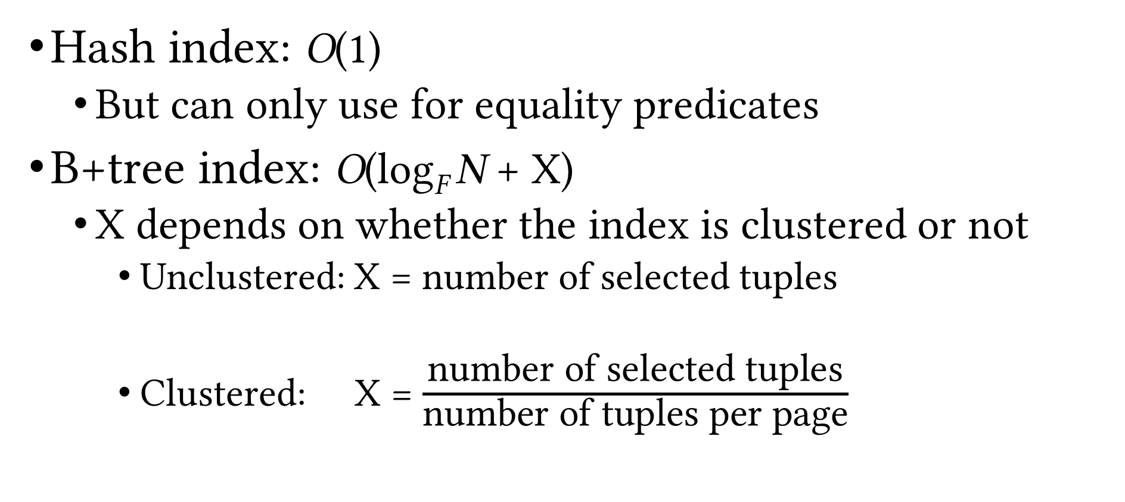
Index Scan Cost
Hash index: O(1)
But can only use for equality predicates
B+tree index: O(log_{F} N + X)
X depends on whether the index is clustered or not
Unclustered: X = number of selected tuples
Clustered: X = $\frac{\text{number} \text{of} \text{selected} \text{tuples}}{\text{number} \text{of} \text{tuples} \text{per} \text{page}}$

Slide 11
Matching Index
An index matches a predicate when it can be used to evaluate the predicate in a query
Example
User(UID, Name, Age)
Access path | Age = 22 | Age >= 24
Hash index on Age | ✓ | ⨯
Clustered B+tree on Age | ✓ | ✓
⨯
Unclustered B+tree on Age
⨯
✓
✓
First sort rids based on pid

Slide 12
Matching Index (Cont.)
Example
User(UID, Name, Age, ParentID)
Access path | Age = 22 | Age >= 24
Hash index on (Age, Name) | ⨯ | ⨯
Clustered B+tree on Age | ✓ | ✓
Prefix-match property of B+tree indexes
Clustered B+tree on (Age, Name) | ✓ | ✓
Clustered B+tree on (Age, Name, ParentID) | ✓ | ✓
Clustered B+tree on (Name, Age) | ⨯ | ⨯

Slide 13
General Selection Condition
A combination of predicates
e.g. R.a>10, R.c=23, R.a>10 ∧ R.c=23, R.a>10 ∨ R.c=23
Convert to conjunctive normal form (CNF)
General form: p₁ ∧ p₂ … ∧ p_{n} where each p_{i} is called a conjunct
Example: (R.a>10 ∧ R.c=23) ∨ R.b<=12
Convert to (R.a>10 ∨ R.b<=12) ∧ (R.c=23 ∨ R.b<=12)
An index can be used to evaluate a selection operation only if it matches some predicate in the selection condition
Notice the difference with cow book

Slide 14
Conjunction of Simple Predicates
Selection condition p₁ ∧ p₂ … ∧ p_{n} where each p_{i} is a simple predicate (i.e. of the form “att op val”)
e.g. a=7 ∧ b<5 ∧ c=4
When can we use an index to evaluate a selection?
Hash index on search key K
If all p_{i}s are equality predicates (e.g. Age=23) and the set of attributes in K is a subset of attributes appearing in p₁, p₂, …,p_{n}
B+tree index on search key K
If a prefix subset of K is a subset of attributes appearing in p₁, p₂, …,p_{n}
Primary conjunct: conjuncts in the selection conditions that an index matches

Slide 15
Conjunction of Simple Predicates (Cont.)
Example
R(a, b, c, d)
Index | a=10 ∧ b=24 | d=10 ∧ c<=19 ∧ a>24
HashInx(a, b) | ✓ | ⨯
HashInx(d) | ⨯ | ✓
B+tree(a, b) | ✓ | ✓
B+tree(b, a) | ✓ | ⨯
B+tree(b, c) | ✓ | ⨯
B+tree(b, c, d) | ✓ | ⨯
B+tree(c, d, a) | ⨯ | ✓

Slide 16
Disjunction of Simple Predicates
What if you have disjunctions?
Example
Relation R(a, b, c, d)
Selection condition: a=7 ∨ b<5 ∨ c=4
Hash index on a and B+tree index on (b, c)
Use both indexes to obtain partial results, then union them to generate the final result set
Hash index on a and B+tree index on b
Don’t use any indexes; scan the whole R
Can use indexes only when we have appropriate indexes for every simple predicate in the disjunction

Slide 17
General Selection Condition (Cont.)
More examples
Hash index on a and hash index on b
Selection condition: a=7 ∨ b>5
Need a scan
Hash index on a and B+tree on b
Selection condition: a=7 ∨ b>5
Scan or use both indexes (fetch rids and take the union)
Hash index on a and B+tree on b
Selection condition: (a=7 ∨ c>5) ∧ b>5
Scan or use B+tree
Hash index on (a, c) and B+tree on b
Selection condition: a=7 ∧ b>5 ∧ c=15
Use both indexes (fetch rids and take the intersection)

Slide 18
Matching Index (Cont.)
A selection condition can match more than one index
Example
Relation R(a, b, c, d)
Hash index on a and B+tree index on (b, c)
Selection condition: a=7 ∧ b=5 ∧ c=4
Which index should we use?
Use either index
Use both indexes, then intersect the rid sets, and then fetch the tuples

Slide 19
Matching Index (Cont.)
A predicate can match more than one index/access path
Example
Relation R(a, b, c)
Hash index on a and B+tree index on (a, c)
Selection condition: a=7 ∧ b=5
Which index should we use?
Decide based on selectivity of the access paths

Slide 20
Selectivity
Fraction of pages (data and index pages) that need to be retrieved if we use this access pattern to retrieve all the desired tuples
Want to choose the most selective path
Estimating the selectivity of an access path is a hard problem

Slide 21
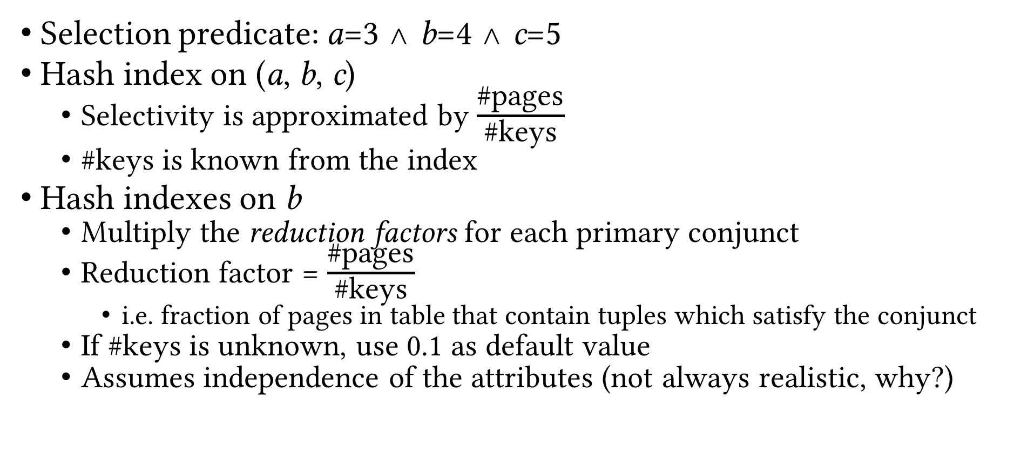
Estimating Selectivity: Example
Selection predicate: a=3 ∧ b=4 ∧ c=5
Hash index on (a, b, c)
Selectivity is approximated by $\frac{\text{\#}\text{pages}}{\text{\#}\text{keys}}$
#keys is known from the index
Hash indexes on b
Multiply the reduction factors for each primary conjunct
Reduction factor = $\frac{\text{\#}\text{pages}}{\text{\#}\text{keys}}$
i.e. fraction of pages in table that contain tuples which satisfy the conjunct
If #keys is unknown, use 0.1 as default value
Assumes independence of the attributes (not always realistic, why?)

Slide 22
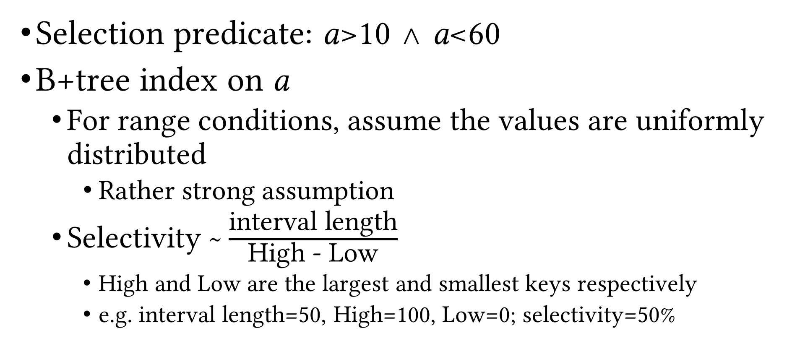
Estimating Selectivity: Example (Cont.)
Selection predicate: a>10 ∧ a<60
B+tree index on a
For range conditions, assume the values are uniformly distributed
Rather strong assumption
Selectivity ~ $\frac{\text{interval} \text{length}}{\text{High}\text{ - }\text{Low}}$
High and Low are the largest and smallest keys respectively
e.g. interval length=50, High=100, Low=0; selectivity=50%

Slide 23
Recap
Logical vs physical operations
Different ways of implementing each operation
Selection operation
Access paths
Scan
Utilize matching index
Decide among access paths
Use selectivity

Slide 24
Projection
Simple case: SELECT R.a, R.d
Scan the file and for each tuple output R.a, R.d
Hard case: SELECT DISTINCT R.a, R.d
Project out the attributes
Eliminate duplicate tuples (the difficult part!)
Two solutions
Sorting-based
Hashing-based

Slide 25
Sorting-based Deduplication
Sort R on (a, b)
During the first pass, eliminate everything but a and b from each tuple
Call the collection of resulting runs T
During the later passes, eliminate duplicates when encountered
Cost = N_{R}+N_{T}+EMrgCost(N_{T})
N_{R} = number of pages of relation R
N_{T} = number of pages storing the results of the first pass, i.e. containing a and b only
EMrgCost(N_{T}) = cost of merging (second and later passes of external merge-sort) N_{T} pages
What params would this depend on?

Slide 26
Sorting-based Deduplication: Example
P₁₋₃
P₄₋₆
P₇₋₉
P₁₀₋₁₂
P₁₃₋₁₅
P₁₆₋₁₈
P₁₉
Input file
Pass 0
3,4
2,6
4,9
7,8
5,6
1,3
2
1-page runs
Pass 1
2,3
4,7
1,3
4,6
8,9
5,6
2
2-page runs
Pass 2
2,3
4,6
1,2
4-page runs
7,8
3,5
9
6
Pass 3
1,2
3,4
5,6
8-page runs
7,8
9

Slide 27
Hashing-based Deduplication
Create a hash table on R(a, b)
If the hash table fits entirely in memory, done!
Cost = N_{R}
Else, use a 2-phase algorithm
Partitioning: project out attributes and split the input into B-1 partitions using a hash function h₁
Deduplication: read each partition into memory and use an in-memory hash table (with a different hash function h₂) to remove duplicates

Slide 28
Hashing-based Deduplication (Cont.)
(Partitions of)
T
R
Hash table for partition i
Output
Partition buffers
1
2
h₂
INPUT
h₁
. . .
. . .
. . .
. . .
. . .
Output
buffer
B-1
Input buffer
for partition i
B buffer pages
B buffer pages
Partitioning
Deduplication

Slide 29
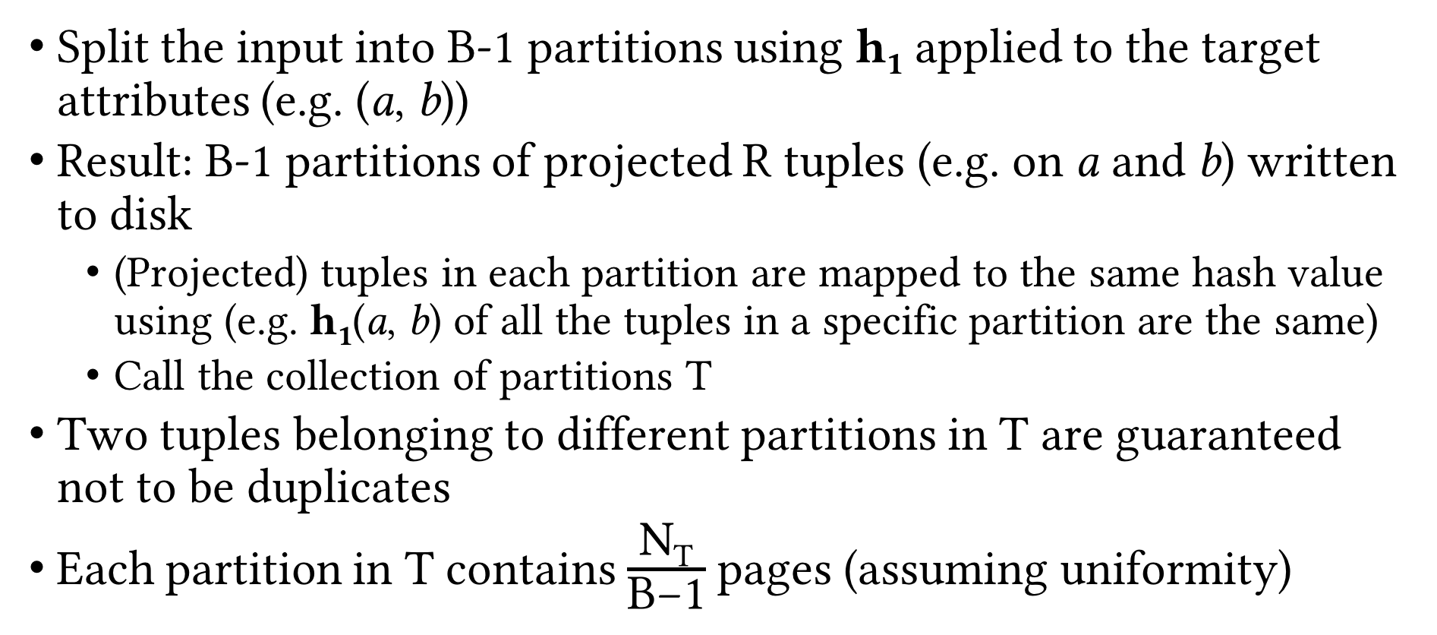
Partitioning Phase
Split the input into B-1 partitions using h₁ applied to the target attributes (e.g. (a, b))
Result: B-1 partitions of projected R tuples (e.g. on a and b) written to disk
(Projected) tuples in each partition are mapped to the same hash value using (e.g. h₁(a, b) of all the tuples in a specific partition are the same)
Call the collection of partitions T
Two tuples belonging to different partitions in T are guaranteed not to be duplicates
Each partition in T contains $\frac{\text{N}\text{T}}{\text{B}\text{−1}}$ pages (assuming uniformity)

Slide 30
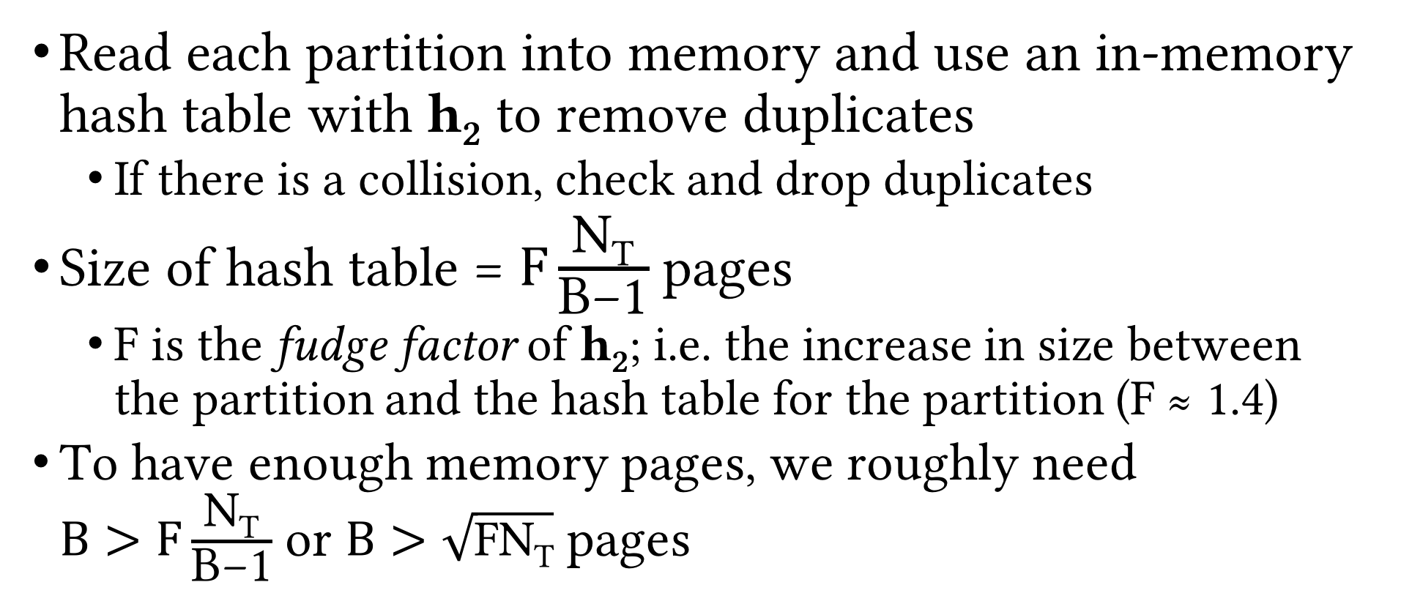
Deduplication Phase
Read each partition into memory and use an in-memory hash table with h₂ to remove duplicates
If there is a collision, check and drop duplicates
Size of hash table = $F\frac{\text{N}\text{T}}{\text{B}\text{−1}}$ pages
F is the fudge factor of h₂; i.e. the increase in size between the partition and the hash table for the partition (F ≈ 1.4)
To have enough memory pages, we roughly need $B>F\frac{\text{N}\text{T}}{\text{B}\text{−1}}$ or $B>\sqrt{\text{FN}\text{T}}$ pages

Slide 31
Sort- vs. Hashing-based Deduplication
Usually, I/O cost is the same = N_{R} + 2N_{T} (why?)
In practice, sorting-based is popular for projection
Gives sorted result (preferred)
Handles skewed data better

Slide 32
Using Indexes for Projection
Index with projection list as subset of index key (index-only scan)
Use only key values as the T for sorting/hashing
Tree-based index with projection list as prefix of index key
Leaf pages are already sorted on projection list
Just scan them in order, project out and deduplicate on-the-fly

Slide 33
Recap
Selection operation
Access paths
Scan vs utilize matching index
Use selectivity to decide among access paths
Projection operation
Sorting-based
Variations on external merge-sort
Hash-based
2-phase algorithm

Slide 34
Join Operation
We consider equi-join
Most common, important and well-studied join op
Example: Course ⨝_{Course.CID=Section.CID} Section
Various algorithms
Nested loop join
Block nested loop join
Index nested loop join
Block index nested loop join
Sort-merge join
Hash join

Slide 35
Join Processing
Next Up
Questions?

