Slide 1

Database Management Systems (CS 564)
Fall 2017
Lecture 8

Slide 2
Relational Algebra: Foundations of Operating on Relational Data
“Art is fire plus algebra.”
- J. L. Borges

Slide 3
Building a Data-Driven Application
Requirement Analysis
Conceptual Database Design
Logical Database Design
Schema Refinement
Physical Database Design
Application Development

Slide 4


Building a Data-Driven Application
Requirement Analysis
Conceptual Database Design
Logical Database Design
Query using SQL
Schema Refinement
Database
Create DB using SQL
Physical Database Design
Application Development

Slide 5
Recap: Schema Refinement
Redundancy causes various kinds of anomalies
To refine schemas:
Detect anomalies
Find FDs , apply Armstrong’s axioms, find anomalies
Remove anomalies
Decompose the anomalous schemas
Desired decomposition properties
Redundancy reducing, lossless join, dependency preserving
Normal forms
3NF, BCNF, 4NF, …

Slide 6


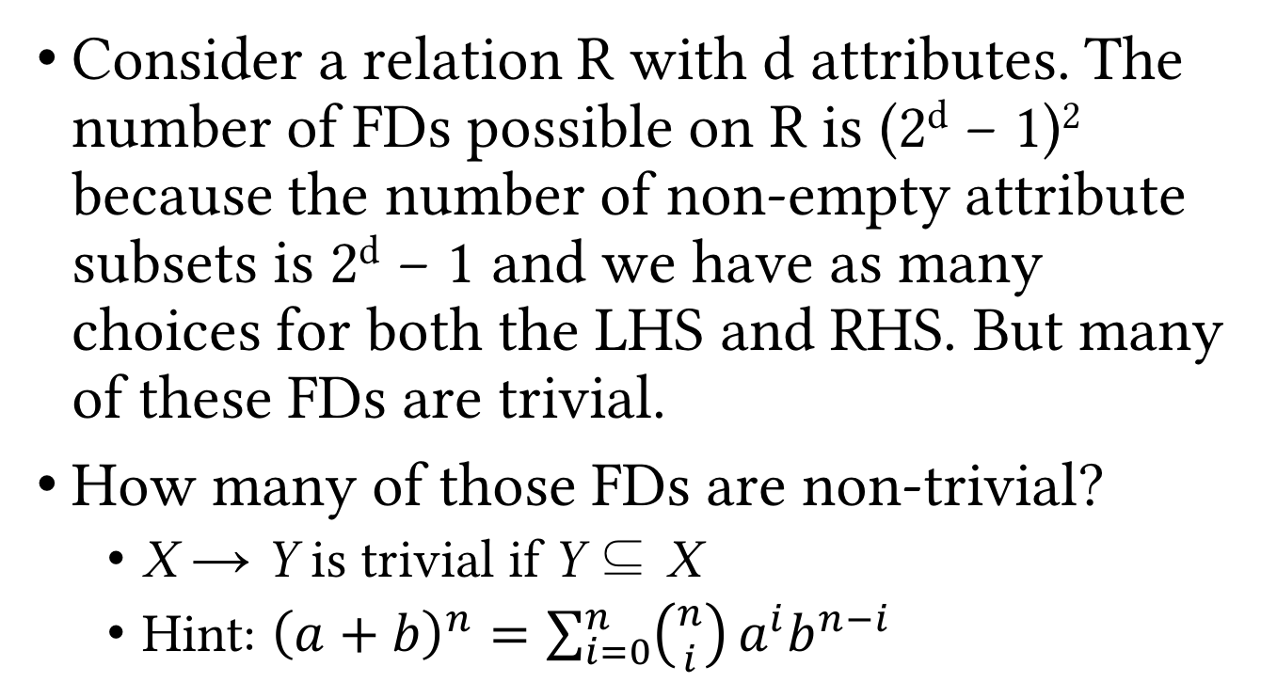
Review Exercise
Consider a relation R with d attributes. The number of FDs possible on R is (2^{d} − 1)² because the number of non-empty attribute subsets is 2^{d} − 1 and we have as many choices for both the LHS and RHS. But many of these FDs are trivial.
How many of those FDs are non-trivial?
X → Y is trivial if Y ⊆ X
Hint: ${\left(a+b\right)}^{n}=\sum_{i=0}^{n}{\left({n \atop i}\right)}a^{i}b^{n−i}$

Slide 7
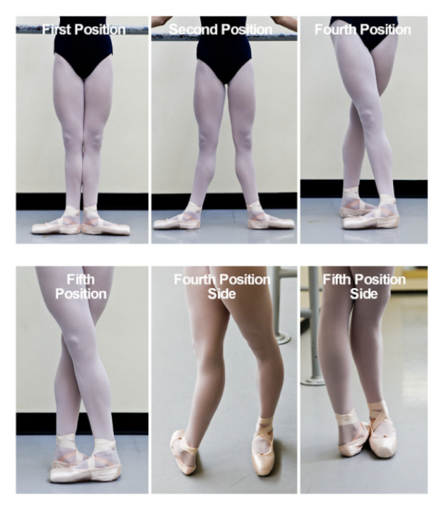
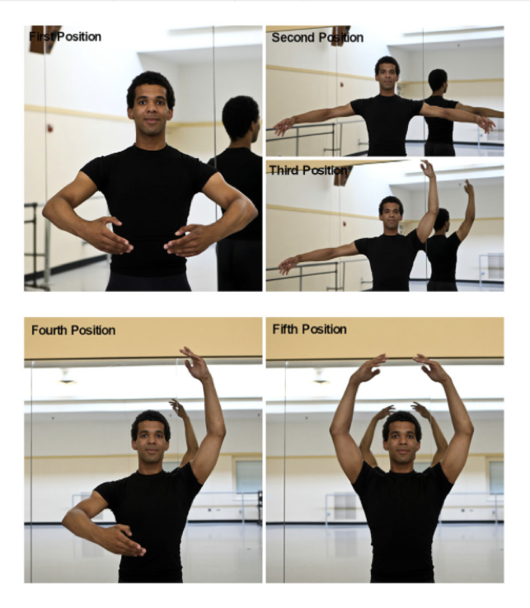

Slide 8
Query Processing Pipeline
SQL Query
Relational Algebra (RA) Plan
Optimized RA Plan
Execution
Declarative query
(from user)
Translate to relational algebra expression
Find
logically equivalent
-but more efficient- RA expression
Execute each operation of the optimized plan
A rough analogy:
Java Program
Bytecode
Hotspot Detection & Optimization
Execution

Slide 9
Query Processing Pipeline
SQL Query
Relational Algebra (RA) Plan
Optimized RA Plan
Execution
Declarative query
(from user)
Translate to relational algebra expression
Find
logically equivalent
-but more efficient- RA expression
Execute each operation of the optimized plan
Relational algebra gives us a precise and optimizable framework to execute declarative (SQL) queries.

Slide 10
Example
SELECT Student.Name
FROM Student, Department
WHERE Major = DID AND
Age > 22;
𝜋_{Student.Name}
𝜎_{Age > 22}
⨝_{Major = DID}
Student
Department

Slide 11
Example
SELECT Student.Name
FROM Student, Department
WHERE Major = DID AND
Age > 22;
𝜋_{Student.Name}
⨝_{Major = DID}
𝜎_{Age > 22}
Department
Student

Slide 12
Formal Relational Query Languages
Help fetching exactly the data we want
Easy to specify matching conditions
Easy to compose and construct complex queries
Declarative, i.e. specify what you want, not how to obtain it
Rich formal frameworks to enable composition/inference of operations on data
Two main formal relational query language
Relational algebra
Relational calculus

Slide 13
Relational Algebra (RA)
Most widely used formalization for manipulating structured data
Main components of an (abstract) algebra
Operands
e.g. integers
Operations
e.g. addition and multiplication
Properties of operations
e.g. associativity and commutativity
Special elements
e.g. identity elements for addition (0) and multiplication (1)
Go read about groups, rings and fields, among most beautiful mathematical constructs!

Slide 14
RA Operands: Relations
Input and output of RA operations are relations (instances)
i.e. sets of tuples
Example
SecID | CID | Semester | Year | Instructor
30098 | MATH240 | Fall | 2017 | Euclid
40026 | CS367 | Fall | 2016 | Dijkstra
1005 | CS367 | Spring | 2004 | Gauss
30451 | CS764 | Fall | 2017 | Patel
20006 | CS564 | Spring | 2001 | Codd
∪
Section1
Section2
SecID | CID | Semester | Year | Instructor
30451 | CS764 | Fall | 2017 | Patel
20006 | CS564 | Spring | 2001 | Codd
40026 | CS367 | Fall | 2016 | Dijkstra
SecID | CID | Semester | Year | Instructor
30098 | MATH240 | Fall | 2017 | Euclid
40026 | CS367 | Fall | 2016 | Dijkstra
1005 | CS367 | Spring | 2004 | Gauss

Slide 15
Relational Operations
A collection of actions to manipulate relations
e.g. ∪ in the previous example
A query is a composition of relations using relational operations
Two main categories
Basic operations
Derived and auxiliary operations

Slide 16
Schema vs. Instance, Revisited
A query (in relational algebra or calculus) is applied to a database instance
The result (output) is also a database instance
Schema of the input is fixed for a query
Schema of the output is determined by the query specifics
Same query can be applied to different instances that have the same schema

Slide 17
Basic Relational Operations
Selection (𝜎)
Projection (𝜋)
Cartesian product (×)
Set operations
Union (∪)
Difference (- or ∖)

Slide 18
Selection
Return all rows that satisfy a condition
Notation: 𝜎_{C}(R)
C: condition that output rows should satisfy
=, <, >, ≥, ≤, ∧, ∨, ¬, …
R: input relation
Output schema: same as input schema (i.e. R’s schema)

Slide 19
Selection (Cont.)
Example: 𝜎_{Age > 22}(Student)
SID | Name | Class | Major
8 | Brown | 24 | CS
23 | Boll | 23 | BIOL
Operator
vs
Operation
𝜎_{Age > 22}
Student
SID | Name | Class | Major
17 | Smith | 22 | MATH
8 | Brown | 24 | CS
5 | Moreno | 21 | PHYS
23 | Boll | 23 | BIOL
7 | Bakhtiari | 21 | CS

Slide 20
Projection
Return specific attributes of all rows
Notation: 𝜋_{A1, …, An}(R)
Input schema: R(B1, …, Bm)
A1, …, An: list of attributes to project onto, s.t. {A1, …, An} ⊆{B1, …, Bm}
Output schema: S(A1, …, An)

Slide 21
Projection (Cont.)
Example: 𝜋_{Name, Major}(Student)
Name | Major
Smith | MATH
Brown | CS
Moreno | PHYS
Boll | BIOL
𝜋_{Name, Major}
Set semantics; i.e. eliminates duplicates
Student
SID | Name | Class | Major
17 | Smith | 22 | MATH
8 | Brown | 24 | CS
5 | Moreno | 21 | PHYS
23 | Boll | 23 | BIOL
7 | Brown | 21 | CS

Slide 22
Cartesian Product
Return the concatenation of every tuple in R₁ with every tuple in R₂
Notation: R₁×R₂
Input schemas: R₁(A1,…,An), R₂(B1,…,Bm)
Condition: {A1,…,An}∩{B1,…,Bm}=∅
Output schema: S(A1,…,An,B1,…,Bm)

Slide 23
Cartesian Product (Cont.)
Example: Student×Department
SID | Name | Class | Major | DID | DName | Address
17 | Smith | 22 | MATH | CS | Computer Sciences | ADD1
8 | Brown | 24 | CS | MATH | Mathematics | ADD2
17 | Smith | 22 | MATH | PHYS | Physics | ADD3
8 | Brown | 24 | CS | CS | Computer Sciences | ADD1
17 | Smith | 22 | MATH | MATH | Mathematics | ADD2
8 | Brown | 24 | CS | PHYS | Physics | ADD3
×
Student
Department
SID | Name | Class | Major
17 | Smith | 22 | MATH
8 | Brown | 24 | CS
DID | DName | Address
CS | Computer Sciences | ADD1
MATH | Mathematics | ADD2
PHYS | Physics | ADD3

Slide 24
Union
Return the union of all the tuples in R₁ and R₂
Notation: R₁∪R₂
Input schemas: R₁ and R₂ have the same schema, with attributes A1,…,An
i.e. union-compatible
Output schema: the same as the input relations

Slide 25
Union (Cont.)
Example
SecID | CID | Semester | Year | Instructor
30098 | MATH240 | Fall | 2017 | Euclid
40026 | CS367 | Fall | 2016 | Dijkstra
1005 | CS367 | Spring | 2004 | Gauss
30451 | CS764 | Fall | 2017 | Patel
20006 | CS564 | Spring | 2001 | Codd
∪
Section1
Section2
SecID | CID | Semester | Year | Instructor
30451 | CS764 | Fall | 2017 | Patel
20006 | CS564 | Spring | 2001 | Codd
40026 | CS367 | Fall | 2016 | Dijkstra
SecID | CID | Semester | Year | Instructor
30098 | MATH240 | Fall | 2017 | Euclid
40026 | CS367 | Fall | 2016 | Dijkstra
1005 | CS367 | Spring | 2004 | Gauss

Slide 26
Difference
Return the the tuples in R₁ that are not in R₂
Notation: R₁-R₂ (or R₁∖R₂)
Input schemas: R₁ and R₂ are union-compatible
Output schema: the same as the input relations

Slide 27
Difference (Cont.)
Example
SecID | CID | Semester | Year | Instructor
30451 | CS764 | Fall | 2017 | Patel
20006 | CS564 | Spring | 2001 | Codd
-
Section1
Section2
SecID | CID | Semester | Year | Instructor
30451 | CS764 | Fall | 2017 | Patel
20006 | CS564 | Spring | 2001 | Codd
40026 | CS367 | Fall | 2016 | Dijkstra
SecID | CID | Semester | Year | Instructor
30098 | MATH240 | Fall | 2017 | Euclid
40026 | CS367 | Fall | 2016 | Dijkstra
1005 | CS367 | Spring | 2004 | Gauss

Slide 28
Example Queries
SELECT *
FROM User
WHERE Age >= 20
AND Age < 30;
𝜎_{Age ≥ 20 ∧ Age < 30}(User)
𝜎_{Age ≥ 20 ∧ Age < 30}
User

Slide 29
Example Queries (Cont.)
SELECT Name
FROM User
WHERE Age >= 20
AND Age < 30;
𝜋_{Name}(𝜎_{Age ≥ 20 ∧ Age < 30}(User))
𝜋_{Name}
𝜎_{Age ≥ 20 ∧ Age < 30}
User

Slide 30
Example Queries (Cont.)
Student
Department
SID | SName | Class | Major
17 | Smith | 21 | MATH
8 | Brown | 24 | CS
5 | Moreno | 21 | PHYS
DID | DeptName | Address
CS | Computer Sciences | ADD1
MATH | Mathematics | ADD2
PHYS | Physics | ADD3
SELECT DeptName
FROM Student, Department
WHERE Major = DID AND
Class = 21;
𝜋_{DeptName}
𝜎_{Major = DID ∧ Class = 21}
Q: Is this an efficient way of answering this query in practice?
×
Student
Department
𝜋_{DeptName}(𝜎 _{Major = DID ∧ Class = 21}(Student×Department))

Slide 31
Recap: Basic Relational Operations
Selection (𝜎)
Projection (𝜋)
Cartesian product (×)
Set operations
Union (∪)
Difference (- or ∖)

Slide 32
Derived and Auxiliary Relational Operations
Renaming (𝜌)
Join (⨝)
Set operations
Intersection (∩)
Division (/)

Slide 33
Renaming
Return the same relation instance with the attributes renamed
Notation: 𝜌_{B1,…,Bn}(R)
Input schema: R(A1,…,An)
Output schema: S(B1,…,Bn)
Another notation: 𝜌_{{Ai➝Bi}}(R)

Slide 34
Renaming (Cont.)
Example: 𝜌_{StID, StName, StClass, StMaj}(Student)
StID | StName | StClass | StMaj
17 | Smith | 22 | MATH
8 | Brown | 24 | CS
23 | Boll | 23 | BIOL
7 | Bakhtiari | 21 | CS
𝜌_{StID, StName, StClass, StMaj}
Student
SID | Name | Class | Major
17 | Smith | 22 | MATH
8 | Brown | 24 | CS
23 | Boll | 23 | BIOL
7 | Bakhtiari | 21 | CS

Slide 35
Intersection
Return the intersection of tuples in R₁ and R₂
Notation: R₁∩R₂
Input schemas: R₁ and R₂ are union-compatible
Output schema: the same as the input relations
Intersection is derived
R₁∩R₂ = R₁-(R₁-R₂)

Slide 36
Intersection (Cont.)
Example
SecID | CID | Semester | Year | Instructor
1005 | CS367 | Spring | 2004 | Gauss
40026 | CS367 | Fall | 2016 | Dijkstra
∩
Section1
Section2
SecID | CID | Semester | Year | Instructor
1005 | CS367 | Spring | 2004 | Gauss
20006 | CS564 | Spring | 2001 | Codd
40026 | CS367 | Fall | 2016 | Dijkstra
SecID | CID | Semester | Year | Instructor
30098 | MATH240 | Fall | 2017 | Euclid
40026 | CS367 | Fall | 2016 | Dijkstra
1005 | CS367 | Spring | 2004 | Gauss

Slide 37
Side Note: Operations on Bags
Union: {a,b,b,c} ∪ {a,b,b,b,e,f,f} = {a,a,b,b,b,b,b,c,e,f,f}
Add the number of occurrences
Difference: {a,b,b,b,c,c} – {b,c,c,c,d} = {a,b,b,d}
Subtract the number of occurrences
Intersection: {a,b,b,b,c,c} ∩ {b,b,c,c,c,c,d} = {b,b,c,c}
Minimum of the two numbers of occurrences
Selection: preserve the number of occurrences
Projection: preserve the number of occurrences (no duplicate elimination)
Cartesian product, join: no duplicate elimination

Slide 38
Join
One of the most important and well-studied operations in relational databases
Comes in various flavors
Theta join
Natural join
Equi-join
Semi-join
Inner join
Outer join
Anti-join
…

Slide 39
Theta Join
Return all the combinations of R₁ and R₂ tuples which satisfy the join condition 𝜃
Notation: R₁⨝_{𝜃}R₂
Equivalent expression: 𝜎_{𝜃}(R₁×R₂)
Input schemas: R₁(A1,…,An) and R₂(B1,…,Bm)
Condition 𝜃: a Boolean condition on A1,…,An,B1,…,Bm
Output schema: S(A1,…,An,B1,…,Bm)

Slide 40
Theta Join (Cont.)
Example: Student ⨝_{Major=DID ∧ Class=21} Department
SID | SName | Class | Major | DID | DeptName | Address
17 | Smith | 21 | MATH | MATH | Mathematics | ADD2
5 | Moreno | 21 | PHYS | PHYS | Physics | ADD3
⨝_{Major=DID ∧ Class=21}
Student
Department
SID | SName | Class | Major
17 | Smith | 21 | MATH
8 | Brown | 24 | CS
5 | Moreno | 21 | PHYS
DID | DeptName | Address
CS | Computer Sciences | ADD1
MATH | Mathematics | ADD2
PHYS | Physics | ADD3

Slide 41
Natural Join
Return all the combinations of tuples of R₁ and R₂ which agree on the join attributes
Notation: R₁⨝R₂
Input schemas: R₁(A1,…,An) and R₂(B1,…,Bm)
Join attributes: {A1,…,An}∩{B1,…,Bm}
Output schema: S(C1,…,Cp) s.t. {C1,…,Cp}={A1,…,An}∪{B1,…,Bm}

Slide 42
Natural Join (Cont.)
Example: Student ⨝ Department = πSID,SName,Class,DID,DeptName,Address(𝜎_{DID=DID2}(Student×𝜌_{DID2,DeptName,Address}(Department)))
SID | SName | Class | DID | DeptName | Address
17 | Smith | 21 | MATH | Mathematics | ADD2
8 | Brown | 24 | CS | Computer Sciences | ADD1
5 | Moreno | 21 | PHYS | Physics | ADD3
⨝
Student
Department
SID | SName | Class | DID
17 | Smith | 21 | MATH
8 | Brown | 24 | CS
5 | Moreno | 21 | PHYS
DID | DeptName | Address
CS | Computer Sciences | ADD1
MATH | Mathematics | ADD2
PHYS | Physics | ADD3

Slide 43
Equi-join
Return all the combinations of tuples of R₁ and R₂ which satisfy the equality condition C=D
Equi-join is a special case of theta join
Natural join is a special case of equi-join
Notation: R₁⨝_{C=D}R₂
Equivalent expression: 𝜎_{C=D}(R₁×R₂)
Input schemas: R₁(A1,…,An) and R₂(B1,…,Bm)
C⊆{A1,…,An} and D⊆{B1,…,Bm}
Output schema: S(A1,…,An,B1,…,Bm)

Slide 44
Equi-join (Cont.)
Example: Student ⨝_{Major=DID} Department
SID | SName | Class | Major | DID | DeptName | Address
17 | Smith | 21 | MATH | MATH | Mathematics | ADD2
8 | Brown | 24 | CS | CS | Computer Sciences | ADD1
5 | Moreno | 21 | PHYS | PHYS | Physics | ADD3
⨝_{Major=DID}
Student
Department
SID | SName | Class | Major
17 | Smith | 21 | MATH
8 | Brown | 24 | CS
5 | Moreno | 21 | PHYS
DID | DeptName | Address
CS | Computer Sciences | ADD1
MATH | Mathematics | ADD2
PHYS | Physics | ADD3

Slide 45
Semi-join
Return all tuples of R₁ which satisfy the natural join condition
Notation: R₁⋉R₂
Equivalent expression: π_{A1,…,An}(R₁⨝R₂)
Input schemas: R₁(A1,…,An) and R₂(B1,…,Bm)
Join attributes: {A1,…,An}∩{B1,…,Bm}
Output schema: S(A1,…,An)

Slide 46
Semi-join (Cont.)
Example: Student ⋉ GradeReport
SID | SName | Class | Major
17 | Smith | 21 | MATH
8 | Brown | 24 | CS
⋉
Student
GradeReport
SID | SName | Class | Major
17 | Smith | 21 | MATH
8 | Brown | 24 | CS
5 | Moreno | 21 | PHYS
SID | CID | Grade
8 | CS367 | A
17 | CS564 | NULL

Slide 47
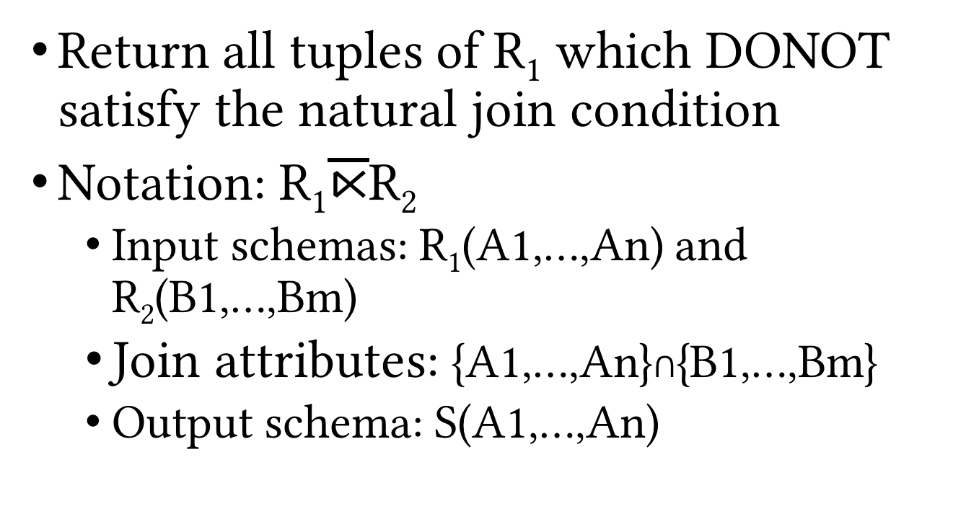
Anti-join
Return all tuples of R₁ which DONOT satisfy the natural join condition
Notation: R₁$\overline{⋉}$R₂
Input schemas: R₁(A1,…,An) and R₂(B1,…,Bm)
Join attributes: {A1,…,An}∩{B1,…,Bm}
Output schema: S(A1,…,An)

Slide 48


Anti-join (Cont.)
Example: S $\overline{⋉}$ G
SID | SName | Class | Major
5 | Moreno | 21 | PHYS
Q: Can you rewrite anti-join using other RA operations?
$$\overline{⋉}$$
S
G
SID | SName | Class | Major
17 | Smith | 21 | MATH
8 | Brown | 24 | CS
5 | Moreno | 21 | PHYS
SID | CID | Grade
8 | CS367 | A
17 | CS564 | AB

