Slide 1

Database Management Systems (CS 564)
Fall 2017
Lecture 22

Slide 2
Relational Operators: Building Blocks of Relational Query Answering
Finally, how rather than what

Slide 3
Recap
Selection
Access paths (scan, utilize matching index)
Decide among access paths (use selectivity)
Projection
Deduplication (sorting- vs hashing-based)
Join
NLJ, BNLJ, PNLJ, INLJ, BINLJ

Slide 4
Nested Loop Join
Let R and S be the relations we want to join
Brain-dead solution: use nested for loops over the tuples of R and S
What’s wrong with this solution?
for each tuple t_{R} in R
for each tuple t_{S} in S
if tuple t_{R} and t_{S} match on the join attribute then
Concat t_{R} and t_{S} and output

Slide 5
Nested Loop Join: Example
SID | SName | Class | Major | DID | DeptName | Address
17 | Smith | 21 | MATH | MATH | Mathematics | ADD2
8 | Brown | 24 | CS | CS | Computer Sciences | ADD1
5 | Moreno | 21 | PHYS | PHYS | Physics | ADD3
⨝_{Major=DID}
R
S
SID | SName | Class | Major
17 | Smith | 21 | MATH
8 | Brown | 24 | CS
5 | Moreno | 21 | PHYS
DID | DeptName | Address
CS | Computer Sciences | ADD1
MATH | Mathematics | ADD2
PHYS | Physics | ADD3

Slide 6
Page Nested Loop Join (PNLJ)
Use nested for loops over the pages of R and S
R is called the outer relation and S is called the inner relation
Outer relation should be the smaller relation
i.e. N_{R} ≤ N_{S}
Q: How many buffer pages PNLJ need?
A: Three. Why?
for each page p_{R} in R
for each page p_{S} in S
Check every pair of tuples in p_{R} and p_{S},
and if they match, concat them and output
Q: What is the cost of PNLJ?
A: N_{R} + N_{R} * N_{S}

Slide 7
PNLJ: Example
R ⨝_{Major=DID} S
S
Smith | MATH
Brown | CS
Moreno | ECON
Jefferies | CS
Suganthan | CS
Konda | CS
Xi | PHYS
Ramirez | CS
Javier | CS
Zhang | MATH
Lotfi | ECON
CS | Computer Sciences | Brown | CS
CS | Computer Sciences | Jefferies | CS
CS | Computer Sciences
MATH | Mathematics
PHYS | Physics
BIOL | Biology
Smith | MATH
Brown | CS
Moreno | ECON
Jefferies | CS
R
CS | Computer Sciences
MATH | Mathematics
PHYS | Physics
BIOL | Biology
ECON | Economics
INFOSCI | Information Sciences
CS | Computer Sciences | Brown | CS
CS | Computer Sciences | Jefferies | CS

Slide 8
PNLJ: Example (Cont.)
R ⨝_{Major=DID} S
S
Smith | MATH
Brown | CS
Moreno | ECON
Jefferies | CS
Suganthan | CS
Konda | CS
Xi | PHYS
Ramirez | CS
Javier | CS
Zhang | MATH
Lotfi | ECON
CS | Computer Sciences | Brown | CS
CS | Computer Sciences | Jefferies | CS
CS | Computer Sciences
MATH | Mathematics
PHYS | Physics
BIOL | Biology
Smith | MATH
Brown | CS
Moreno | ECON
Jefferies | CS
R
CS | Computer Sciences
MATH | Mathematics
PHYS | Physics
BIOL | Biology
ECON | Economics
INFOSCI | Information Sciences
MATH | Mathematics | Smith | MATH

Slide 9
PNLJ: Example (Cont.)
R ⨝_{Major=DID} S
S
Smith | MATH
Brown | CS
Moreno | ECON
Jefferies | CS
Suganthan | CS
Konda | CS
Xi | PHYS
Ramirez | CS
Javier | CS
Zhang | MATH
Lotfi | ECON
CS | Computer Sciences | Brown | CS
CS | Computer Sciences | Jefferies | CS
CS | Computer Sciences
MATH | Mathematics
PHYS | Physics
BIOL | Biology
Suganthan | CS
Konda | CS
Xi | PHYS
Ramirez | CS
R
CS | Computer Sciences
MATH | Mathematics
PHYS | Physics
BIOL | Biology
ECON | Economics
INFOSCI | Information Sciences
MATH | Mathematics | Smith | MATH

Slide 10
PNLJ: Example (Cont.)
R ⨝_{Major=DID} S
S
Smith | MATH
Brown | CS
Moreno | ECON
Jefferies | CS
Suganthan | CS
Konda | CS
Xi | PHYS
Ramirez | CS
Javier | CS
Zhang | MATH
Lotfi | ECON
CS | Computer Sciences | Brown | CS
CS | Computer Sciences | Jefferies | CS
CS | Computer Sciences
MATH | Mathematics
PHYS | Physics
BIOL | Biology
MATH | Mathematics | Smith | MATH
CS | Computer Sciences | Suganthan | CS
Suganthan | CS
Konda | CS
Xi | PHYS
Ramirez | CS
…
R
CS | Computer Sciences
MATH | Mathematics
PHYS | Physics
BIOL | Biology
ECON | Economics
INFOSCI | Information Sciences
MATH | Mathematics | Smith | MATH
CS | Computer Sciences | Suganthan | CS

Slide 11
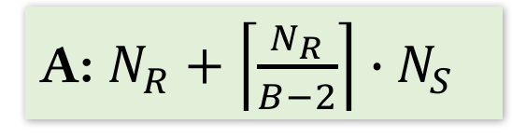
Block Nested Loop Join (BNLJ)
Better utilize memory buffers
for each block p_{R,1 , …,} p_{R,B-2} of B-2 pages of R
for each page p_{S} in S
Check every pair of tuples in p_{R,j} and p_{S},
and if they match, concat them and output
Q: What is the cost of BNLJ?
A: $N_{R}+\left\lceil \frac{N_{R}}{B−2}\right\rceil ∙N_{S}$

Slide 12
BNLJ: Example
R ⨝_{Major=DID} S
B = 4
S
Smith | MATH
Brown | CS
Moreno | ECON
Jefferies | CS
Suganthan | CS
Konda | CS
Xi | PHYS
Ramirez | CS
Javier | CS
Zhang | MATH
Lotfi | ECON
CS | Computer Sciences
MATH | Mathematics
PHYS | Physics
BIOL | Biology
ECON | Economics
INFOSCI | Information Sciences
Smith | MATH
Brown | CS
Moreno | ECON
Jefferies | CS
R
CS | Computer Sciences
MATH | Mathematics
PHYS | Physics
BIOL | Biology
ECON | Economics
INFOSCI | Information Sciences

Slide 13
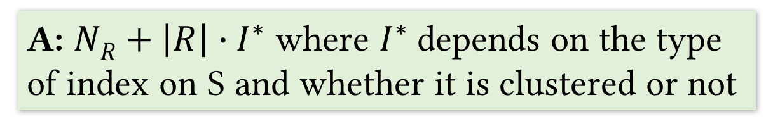
Index Nested Loop Join (INLJ)
Utilize existing indexes
Suppose S has an index on the join attribute(s)
for each page p_{R} of R
for each tuple t_{R} in p_{R}
Probe the index on S to find any tuples matching t_{R}
and if found, concat them and output
Q: What is the cost of INLJ?
A: $NR+\left|R\right|∙I^{∗}$ where $I^{∗}$depends on the type of index on S and whether it is clustered or not

Slide 14

Block Index Nested Loop Join (BINLJ)
Improve performance using available buffer pages
for each block p_{R,1 , …,} p_{R,B-2} of B-2 pages of R
Sort the tuples in the current block (in memory)
for each tuple t_{R} in the current sorted block
Probe the index on S to find any tuples matching t_{R}
and if found, concat them and output
Q: Why soring each block?
A: Reusing index and data pages in buffer
Q: What is the cost of BINLJ?
A: $NR+\left|R\right|∙I^{∗}$ where $I^{∗}$depends on the type of index on S and whether it is clustered or not

Slide 15
BINLJ: Example
R ⨝_{Major=DID} S
S
Smith | MATH
Brown | CS
Moreno | ECON
Jefferies | CS
Suganthan | CS
Konda | CS
Xi | PHYS
Ramirez | CS
Javier | CS
Zhang | MATH
Lotfi | ECON
CS | Computer Sciences
MATH | Mathematics
PHYS | Physics
BIOL | Biology
ECON | Economics
INFOSCI | Information Sciences
Brown | CS
Jefferies | CS
Suganthan | CS
Konda | CS
I_{S}
R
CS | Computer Sciences
MATH | Mathematics
PHYS | Physics
BIOL | Biology
ECON | Economics
INFOSCI | Information Sciences

Slide 16
Sort-merge Join (SMJ)
Join is like deduplication in that they both need to check equality
So we can sort R and S on join attribute(s) and then merge them to find matching tuples
Instead of dropping them as in deduplication, concat them and output
Sort R and S on join attribute(s)
Merge the sorted R and S on join attribute(s), check for matching (i.e. duplicate) tuples
If matching pair found, concat them and output
Q: What is the cost of SMJ?
A: EMS(R) + EMS(S) + N_{R} + N_{S} where EMS is the cost of external merge-sort

Slide 17
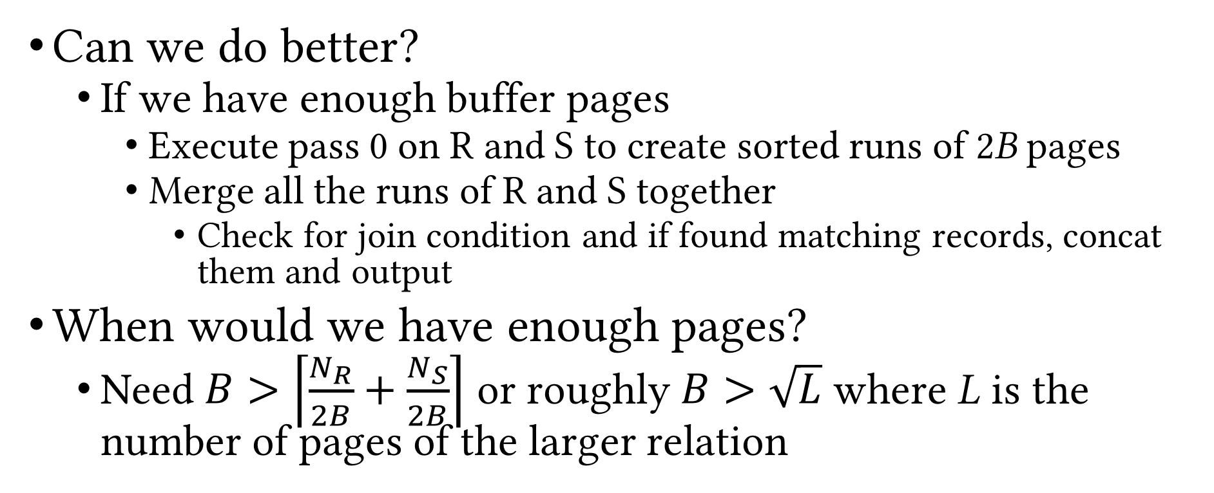
SMJ (Cont.)
Can we do better?
If we have enough buffer pages
Execute pass 0 on R and S to create sorted runs of 2B pages
Merge all the runs of R and S together
Check for join condition and if found matching records, concat them and output
When would we have enough pages?
Need $B>\left\lceil \frac{N_{R}}{2B}+\frac{N_{S}}{2B}\right\rceil$ or roughly $B>\sqrt{L}$ where L is the number of pages of the larger relation
Q: What is the cost of improved SMJ?
A: 3(N_{R} + N_{S})
Q: What is the worst-case cost of improved SMJ?
A: 2(N_{R} + N_{S}) + N_{R} * N_{S} (why?)

Slide 18
SMJ: Example
R
B = 8
R
EMS
Pass0
16 pages
15 pages
. . .
16 pages
5 pages
Output
S
S
EMS Pass0
11 pages
16 pages
. . .
12 pages
Merging

Slide 19
Hash Join (HJ)
Use hash-based deduplication to join tables
Partition R and S on join attribute(s) using hash function h₁
// Assume wlog that N_{R} ≤ N_{S}
for each partition R_{k} of R
Build an in-memory hash table on R_{k}
Probe the hash table with records in S_{k} and
check for matching tuples
If found, concat them and output

Slide 20
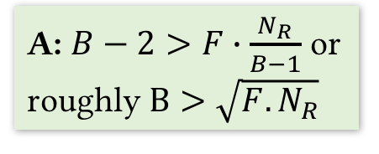
HJ (Cont.)
R
Partition buffers
Partitions of R
1
Q: What is the cost of HJ?
A: 3(N_{R} + N_{S})
INPUT
2
h₂
h₁
Output
. . .
. . .
. . .
Hash table for
R_{i}
B-1
h₂
S
Partitions of S
. . .
. . .
1
Output
buffer
2
Input buffer
for S_{i}
INPUT
h₁
. . .
. . .
. . .
Join (B buffer pages)
B-1
Q: What is memory requirement of HJ?
A: $B−2>F∙\frac{N_{R}}{B−1}$ or roughly $B>\sqrt{F.N_{R}}$
Partitioning (B buffer pages)

Slide 21
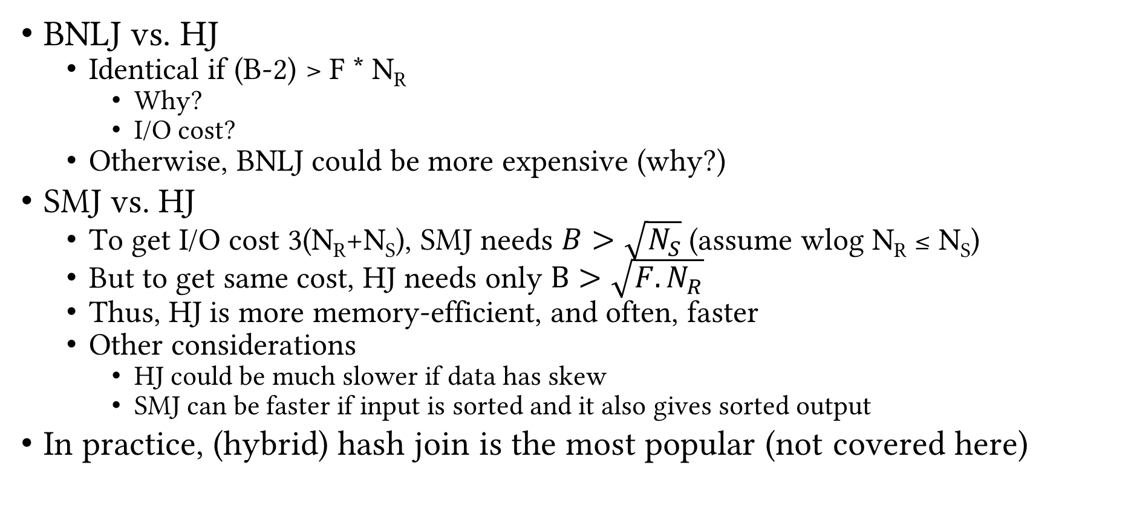
Comparison of Hash Algorithms
BNLJ vs. HJ
Identical if (B-2) > F * N_{R}
Why?
I/O cost?
Otherwise, BNLJ could be more expensive (why?)
SMJ vs. HJ
To get I/O cost 3(N_{R}+N_{S}), SMJ needs $B>\sqrt{N_{S}}$ (assume wlog N_{R} ≤ N_{S})
But to get same cost, HJ needs only $B>\sqrt{F.N_{R}}$
Thus, HJ is more memory-efficient, and often, faster
Other considerations
HJ could be much slower if data has skew
SMJ can be faster if input is sorted and it also gives sorted output
In practice, (hybrid) hash join is the most popular (not covered here)

Slide 22
General Join Conditions
Multiple equalities
e.g. R.a = S.b ∧ R.c = S.d
HJ works fine: hash R on (a, c) and S on (b, d)
SMJ works fine: sort S on (a, c) and S on (b, d)
INLJ: use (build, if needed) a matching index on S
Inequalities
e.g. R.a > S.b
HJ and SMJ not applicable
INLJ: use (build, if needed) a B+tree index on S
BNLJ might often be among the best choices
Inequality checks might lead to large outputs

Slide 23
System Support
 | (P/B/I/BI)NLJ | SMJ | HJ
PostgreSQL | ✓ | ✓ | ✓
Oracle Database | ✓ | ✓ | ✓
Microsoft SQL Server | ✓ | ✓ | ✓
MySQL | ✓ | ⨯ | ⨯
SQLite | ✓ | ⨯ | ⨯
* Courtesy of Kedi Cui

Slide 24
Recap
Logical vs physical operations
Different ways of implementing each operation
Selection
Access paths (scan, utilize matching index)
Decide among access paths (use selectivity)
Projection
Deduplication (sorting- vs hashing-based)
Join
NLJ, BNLJ, PNLJ
INLJ, BINLJ
SMJ
HJ

Slide 25
Set Operations
Cross product (R × S)
Logically, an equi-join with no join condition
Use BNLJ
Intersection (R ∩ S)
Logically, an equi-join with join condition being a conjunction of all attributes
Same tradeoffs
Union (R ∪ S)
Similar to intersection, but need to deduplicate matching tuple pairs and output only once
Set difference (R − S)
Similar to duplicate elimination

Slide 26
Implementing Union and Set Difference
Sorting-based
Use SMJ (with all attributes as join attributes)
R ∪ S: deduplicate matching tuples during merge
R − S: exclude matching tuples during merge
Hashing-based
Use HJ (with all attributes as join attributes)
Build hash table on S_{i}
R ∪ S: probe hash table with R_{i}, if matching pair found, discard tuple, else insert R_{i} tuple into hash table
Hash table holds the output
R − S: probe hash table with R_{i}, if matching pair found, discard tuple, else output the R_{i} tuple

Slide 27
Aggregates
𝛾_{X,Agg(Y)}(R)
Easy case: X is empty
Simply aggregate values of Y
Not-so-easy case: X is not empty
Need to “collect” groups of tuples that match on X, then apply Agg(Y)
Three algorithms, using
Sorting
Hashing
Index

Slide 28
Evaluation of Aggregates: Easy Case
Keep running partial aggregate information and update incrementally, one tuple at a time
SUM and COUNT: partial sum or count
MAX and MIN: maximum or minimum value observed so far
AVG: partial sum AND count; at the end, calculate average as sum/count

Slide 29
Sorting-based Evaluation of Aggregates
Sort R on X
Read R into memory in sorted order
For every distinct value x_{i} of X
Compute the aggregate on the on the group of tuples with X=x_{i}
Output x_{i} and the aggregate value
Improvement: partial aggregation during the sort phase
Cost = sort(R)

Slide 30
Hashing-based Evaluation of Aggregates
Build hash table using X
Each bucket contains the X values and running partial aggregate information
For each tuple r in each page in R
If r(X) is present in hash table, update running info
Else, insert new X value into hash table and initialize running info
Hash table holds the final output in the end

Slide 31
Index-based Evaluation of Aggregates
Given B+tree index such that X ∪ Y is a subset of index key
Use leaf level of index instead of R for sorting-/hash-based aggregate evaluation
Given B+tree index such that X is a prefix subset of index key
Leaf level already sorted
Can fetch data records in order
If leaf pages contain the records, just one scan of leaf level is enough

Slide 32
Recap
Selection
Access paths (scan, utilize matching index)
Decide among access paths (use selectivity)
Projection
Deduplication (sorting- vs hashing-based)
Join
NLJ, BNLJ, PNLJ, INLJ, BINLJ, SMJ, HJ
Union and set difference
Sorting- and hashing-based
Aggregates
Sorting-, hashing- and index-based

Slide 33
Query Optimization
Next Up
Questions?

