Slide 1

Database Management Systems (CS 564)
Fall 2017
Lecture 26

Slide 2
Transaction Management
How to serve the masses

Slide 3
Detailed DBMS Architecture
Web Forms
Application Front Ends
SQL Interface
SQL Commands
Query Evaluation Engine
Plan Executor
Parser
Operator Evaluator
Optimizer
Transaction Manager
File and Access Methods
Recovery Manager
DBMS
Concurrency Control
Buffer Manager
Storage Manager
Lock Manager
Disk Space Manager
Index Files
Database
System Catalog
Data Files

Slide 4
Motivation
A SQL query is too fine-grained
In most real-world applications, a logical unit of work could be coarser
May need multiple DDL + DML queries together
May involve reading and/or writing (update/delete/insert)
May need to check for integrity constraints
Example
Transfer money between accounts
Purchase a group of products
Register for a class (either waitlist or allocated)

Slide 5
Transaction
A sequence of operations on the database that captures one “logical unit of work” for an application
Reflects a single real-world state transition
Not specific to the relational data model
In the real world, a transaction either happens completely or not at all
All or nothing

Slide 6
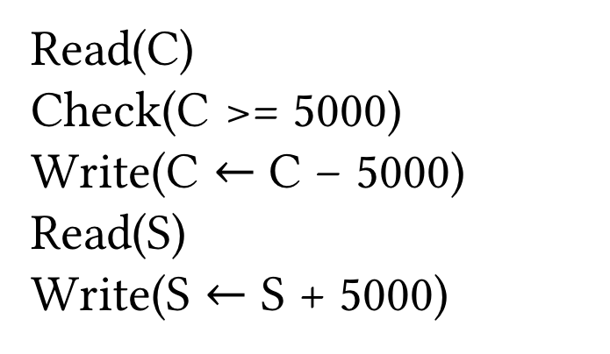
Example
Transfer $5000 from Leila’s checking (C) to her savings (S) account
A logical unit of work in a bank’s DBMS
A sequence of operations on the database
Read(C)
Check(C >= 5000)
Write(C $←$ C – 5000)
Read(S)
Write(S $←$ S + 5000)
A transaction

Slide 7
Transaction Management
Inconsistencies can occur when
Operations of multiple transactions interleave
DBMS crashes
User aborts a transaction
Why not run only one query on the system at any time?
Low utilization
Miss opportunities CPU/IO overlap and multi-core parallelism
Long running queries starve other queries
Provide the users with an illusion of a single-user system

Slide 8
Transactions in SQLite
Example
BEGIN TRANSACTION;
UPDATE accounts SET balance = balance – 5000 WHERE account_no = 100;
UPDATE accounts SET balance = balance + 5000 WHERE account_no = 200;
COMMIT;
BEGIN TRANSACTION;
UPDATE accounts SET balance = balance – 2000 WHERE account_no = 100;
COMMIT;
BEGIN TRANSACTION;
UPDATE accounts SET balance = balance – 5000 WHERE account_no = 109;
ROLLBACK;
BEGIN TRANSACTION;
UPDATE accounts SET balance = balance – 5000 WHERE account_no = 100;
UPDATE accounts SET balance = balance + 5000 WHERE account_no = 200;
COMMIT;

Slide 9

Transaction Management Model
BEGIN
R (C)
W (C)
R (S)
W (S)
COMMIT
Operations
Read (R)
Write (W)
Granularity
Item
Tuple
Relation, …
Special operations
Begin
Commit
Abort (rollback)
All SQL queries are translated into a sequence of read and write operations
Read (C)
Assert (C >= 5000)
Write (C $←$ C – 5000)
Read (S)
Write (S $←$ S + 5000)
C 8000
C 3000
C 8000
C 3000
S 2000
S 7000
S 2000
S 7000
RAM
Disk

Slide 10

Transaction Management Model (Cont.)
BEGIN
R (C)
W (C)
Abort
Read (C)
Write (C ← C – 5000)
Assert (C >= 0)
Read (S)
Write (S $←$ S + 5000)
C 4000
C -1000
C 4000
C -1000
S 2000
Need to “erase” all the traces of the transaction
RAM
Disk

Slide 11
Transaction Management (Cont.)
A transaction must satisfy the all-or-nothing property
Logical unit of work is indivisible, i.e. either all operations get done or none of them get done
Database state must remain consistent
Application’s invariants define what is consistent
e.g. balance of each account should be a positive number
A transaction is assumed to get the database from one consistent state to another
Might be temporarily inconsistent in the middle, but no external viewer sees these inconsistent states

Slide 12
ACID Properties
A transaction manager should ensure 4 key properties
Atomicity
A transaction should be indivisible (all or nothing)
Consistency
Database should not become inconsistent in the end
Isolation
A transaction should not worry about or interact with other concurrent transactions on the DBMS
Durability
All changes of a “committed” transaction must persist
Logging and Recovery
App semantics and Schedules
Concurrency Control
Logging and Recovery

Slide 13
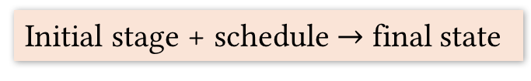
Transaction Schedules
T1
T2
Tell us how to interleave concurrent transactions
Benefits of interleaving
Lets us exploits disk/CPU and multi-core parallelism
Helps avoid starvation of shorter transactions
Initial stage + schedule $→$ final state
A schedule
Begin
 | Begin
R_{T1}(A)
W_{T1} (A)
 | R_{T2}(A)
 | W_{T2} (A)
R_{T1} (B)
W_{T1} (B)
Commit
 | R_{T2}(B)
 | W_{T2} (B)
 | Commit
T1
T2
Begin
R_{T1}(A)
W_{T1} (A)
R_{T1} (B)
W_{T1} (B)
Commit
Begin
R_{T2}(A)
W_{T2} (A)
R_{T2}(B)
W_{T2} (B)
Commit
Time
A schedule should preserve the temporal order of ops in each transaction

Slide 14
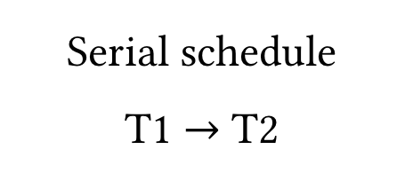
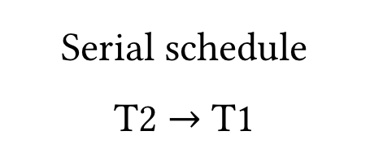
Transaction Schedules (Cont.)
T1
T2
Complete schedule
Each transaction ends with either a commit or an abort
Serial schedule
No interleaving of ops from different transactions
Begin
 | Begin
R_{T1}(A)
W_{T1} (A)
 | R_{T2}(A)
 | W_{T2} (A)
R_{T1} (B)
W_{T1} (B)
Commit
 | R_{T2}(B)
 | W_{T2} (B)
 | Commit
Begin
R_{T1}(A)
W_{T1} (A)
R_{T1} (B)
W_{T1} (B)
Commit
 | Begin
 | R_{T2}(A)
 | W_{T2} (A)
 | R_{T2}(B)
 | W_{T2} (B)
 | Commit
 | Begin
 | R_{T2}(A)
 | W_{T2} (A)
 | R_{T2}(B)
 | W_{T2} (B)
 | Commit
Begin
R_{T1}(A)
W_{T1} (A)
R_{T1} (B)
W_{T1} (B)
Commit
A sensible, consistent and isolated schedule
Abort
Any serial schedule is considered acceptable, even if they end up with different database states
Serial schedule
T1 $→$ T2
Serial schedule
T2 $→$ T1

Slide 15
Transaction Schedules (Cont.)
T1
T2
Begin
 | Begin
R_{T1}(A)
 | R_{T2}(A)
 | W_{T2} (A)
W_{T1} (A)
R_{T1} (B)
W_{T1} (B)
Commit
 | R_{T2}(B)
 | W_{T2} (B)
 | Commit
Q: What is wrong with this schedule?
A: Update of A by T2 is lost
“Bad” schedules like this could lead to inconsistent states
Q: What is an acceptable schedule?

Slide 16
Serializability
Equivalence of schedules
Two schedules are equivalent iff for any starting state of the database, the effect of them are the same; i.e. they lead the database to the same end state
Serializable schedule
A schedule that is equivalent to some complete serial schedule
Do NOT confuse serial and serializable!

Slide 17
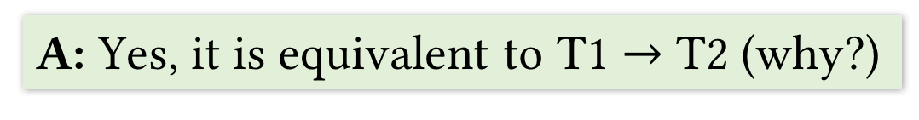
Serializability: Example
T1
T2
Begin
 | Begin
R_{T1}(A)
W_{T1} (A)
 | R_{T2}(A)
 | W_{T2} (A)
R_{T1} (B)
W_{T1} (B)
Commit
 | R_{T2}(B)
 | W_{T2} (B)
 | Commit
Q: Is this schedule serializable?
A: Yes, it is equivalent to T1 $→$ T2 (why?)

Slide 18
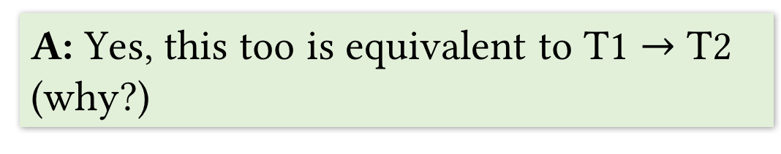
Serializability: Example (Cont.)
T1
T2
Begin
 | Begin
R_{T1}(A)
W_{T1} (A)
 | R_{T2}(A)
R_{T1} (B)
W_{T1} (B)
 | W_{T2} (A)
 | R_{T2}(B)
 | W_{T2} (B)
Commit
 | Commit
Q: Is this schedule serializable?
A: Yes, this too is equivalent to T1 $→$ T2 (why?)

Slide 19
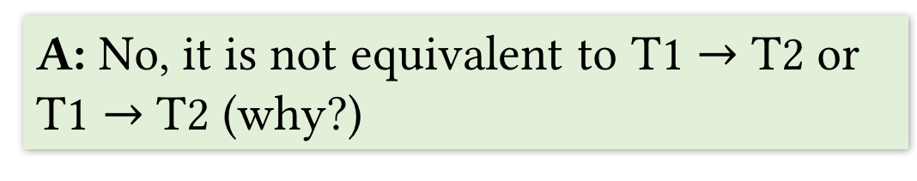
Serializability: Example (Cont.)
T1
T2
Begin
 | Begin
R_{T1}(A)
 | R_{T2}(A)
 | W_{T2} (A)
W_{T1} (A)
R_{T1} (B)
W_{T1} (B)
Commit
 | R_{T2}(B)
 | W_{T2} (B)
 | Commit
A conflict
Q: Is this schedule serializable?
A: No, it is not equivalent to T1 $→$ T2 or T1 $→$ T2 (why?)

Slide 20
Types of Conflicts among Transactions
Write-write (WW) conflict
Write-read (WR) conflict
Read-write (RW) conflict

Slide 21
Write-write (WW) Conflict
T1
T2
T1 overwrites T2’s update without reading the new A
Overwriting uncommitted data
Also happens with blind writes
Writing without ever reading
Begin
 | Begin
R_{T1}(A)
 | R_{T2}(A)
 | W_{T2} (A)
W_{T1} (A)
R_{T1} (B)
W_{T1} (B)
Commit
 | R_{T2}(B)
 | W_{T2} (B)
 | Commit

Slide 22
Write-read (WR) Conflict
T1
T2
T2 uses A and B values based on incomplete commit
A is already written by T1, but B is not
Also called inconsistent read
Begin
 | Begin
R_{T1}(A)
W_{T1} (A)
 | R_{T2}(A)
 | W_{T2} (A)
 | R_{T2}(B)
 | W_{T2} (B=A*B)
 | Commit
R_{T1} (B)
W_{T1} (B)
Commit

Slide 23
Write-read (WR) Conflict (Cont.)
T2 uses a value of A written by T1 which is eventually rolled back
Also called dirty read
T1
T2
Begin
 | Begin
R_{T1}(A)
W_{T1} (A)
 | R_{T2}(A)
 | W_{T2} (B=2*A)
 | Commit
Abort

Slide 24
Read-write (RW) Conflict
T1
T2
T1 reads A “consecutively”, but sees two different values
Also called unrepeatable read
Begin
 | Begin
R_{T1}(A)
W_{T1} (C=2*A)
 | R_{T2}(A)
 | W_{T2} (A)
 | R_{T2}(B)
 | W_{T2} (B)
 | Commit
R_{T1} (A)
W_{T1} (D=3*A)
Commit

Slide 25
Dealing with Aborts
Serializability: only worry about committed transactions and pretend as if aborted transactions did not even happen
To make the above “illusion” possible, two new issues to deal with if aborted transactions present
How to undo the effects of an aborted transaction?
All changes made by it should be undone
Use logging and recovery (later)
What if some other transactions got affected by it?
Must undo all affected transactions as well

Slide 26
Cascading Aborts
T1
T2
Abort of T1 leads to an abort of T2 (why?)
DBMS replaces T2’s commit with an abort
Begin
 | Begin
R_{T1}(A)
W_{T1} (A)
 | R_{T2}(A)
 | W_{T2} (A)
Abort
 | Commit
Abort

Slide 27
Cascading Aborts (Cont.)
T2 is committed, hence cannot be rolled back
Called unrecoverable schedule
Recoverable schedule: all transactions commit (if at all) only after all other transactions that supply dirty data commit/abort
T1
T2
Begin
 | Begin
R_{T1}(A)
W_{T1} (A)
 | R_{T2}(A)
 | W_{T2} (A)
 | Commit
Abort

Slide 28
Avoiding Cascading Aborts
Avoid-cascading-aborts (ACA) schedule
No transaction is allowed to read dirty data, i.e. all transactions read changes of committed transactions only
Guarantees that cascading aborts will not arise
Also guaranteed to be a recoverable schedule
A similar issue arises if a transaction overwrites dirty data
Handled using concurrency control

Slide 29
Concurrency Control
Various mechanisms used by DBMSs to ensure serializability and recoverability
Most common mechanism is locking
Lock: small bookkeeping object associated with a data item (tuple, attribute, table, etc.)
Managed by lock manager

Slide 30
Locks
Simplified view: each lock is a triplet (txnid, rid, mode)
txnid: the ID of the transaction holding the lock
rid: the ID of the record on which the lock is acquired
mode: how the transaction wants to access the record
Shared (S) or exclusive (X)
--
S
X
--
√
√
√
S
√
√
X
√
Compatibility Matrix
Acquired when requesting an item from buffer manager
Use a wait queue for each lock
Keeps track of transactions not able to acquire the lock

Slide 31
Locking Protocols
Determines when locks should be acquired/released by transactions
Lock acquire/release done automatically by DBMS
Strict 2-phase locking (strict 2PL)
Request S (resp. X) lock before R (resp. W) on item
Release all locks only when transaction finishes
Ensures serializability and recoverability
Lock point
Growing phase
# Locks
Time

Slide 32
Locking Protocols (Cont.)
(Non-strict) 2PL:
Relax 2: if any lock released, cannot acquire new locks
Ensures serializability, but not recoverability
Lock point
Growing phase
Shrinking
phase
# Locks
Time

Slide 33
Locking Protocols: Example
T1
T2
Q: Is this schedule serializable?
Q: Is this schedule recoverable?
Begin
 | Begin
R_{T1}(A)
W_{T1} (A)
 | R_{T2}(A)
 | W_{T2} (A)
 | R_{T2}(B)
 | W_{T2} (B)
 | Commit
R_{T1} (B)
W_{T1} (B)
Commit
 | R_{T2}(A)
 | …
Suppose we use strict 2PL
X(A)
Wait!
DBMS makes T1 acquire X lock on A
T2 forced to wait before R(A)
--
S
X
Q: When will T1 release X lock on A?
√
√
√
--
Q: Is this new schedule serializable?
UX(A)
S
√
√
X
√
T2 resumed
Q: What if we use (non-strict) 2PL?

Slide 34
Deadlocks
Arise when two transactions wait on each other
Wait and do nothing forever
Example
T1
T2
Begin
 | Begin
R_{T1}(A)
 | R_{T2}(B)
 | W_{T2} (A)
 | Commit
W_{T1} (B)
Commit
S(A)
S(B)
A
X(A)
T1
T2
Wait!
X(B)
Wait!
B

Slide 35
Deadlocks (Cont.)
Two ways of dealing with deadlocks
Deadlock prevention
Avoid schedules that could cause deadlocks
Deadlock detection and breaking
A naive solution: timeout and abort transactions
More sophisticated solutions exist

Slide 36
Granularity of Locks
What is the precise “data item” a transaction needs to lock?
Tuple? Attribute? Whole table? Index?
Affects both efficiency (throughput) and correctness
Thrashing: too many transactions asking X lock on same data item
Hurts throughput (number transactions finished per sec)
Some ways to avoid thrashing
Lock smallest granularity needed for transaction
Reduce the time a transaction holds a lock
UPDATE Students SET Grade = “A” WHERE StID=123;
Locking whole table might be an overkill

Slide 37
Granularity of Locks (Cont.)
DBMSs allow for predicate locks too
Bizarre correctness issues can arise on interleaving granularity+mode combos
Example
T1: X lock on predicate; read table, update only tuples matching predicate
T2 comes in to insert new tuple, but it satisfies predicate
T1 reads again: sees previously unseen tuple
Phantom problem

Slide 38
Concurrency Control in SQL
DBMSs give users control over the locking overhead incurred by their transactions
Desired concurrent behavior required from DBMS
Three mechanisms
Diagnostic size: number of error messages
Access mode
Isolation level

Slide 39
Concurrency Control in SQL (Cont.)
Define transactions
Begin is usually implicit
Can still use BEGIN TRANSACTION
COMMIT
ROLLBACK (Abort)
SAVEPOINT
Save intermediate work of long-running transactions
Access modes
READ WRITE (default)
READ ONLY
No one can change the data

Slide 40
Concurrency Control in SQL (Cont.)
Isolation level
The extent to which a given transaction is exposed to the actions of other transactions executing concurrently
Trade-off: concurrency vs. exposure
Desired concurrent behavior required from DBMS
Determines precise locking protocol
Four main levels
READ UNCOMMITTED
READ COMMITTED
REPEATABLE READ
SERIALIZABLE

Slide 41
Concurrency Control in SQL (Cont.)
READ UNCOMMITTED
Long X locks only, no S locks
Vulnerable to inconsistency
WR and RW might arise
READ COMMITTED
Long X locks, short S locks
WR conflicts do not arise, RW might
REPEATABLE READ
Long X and S locks on real objects
Neither WR nor RW arise, but phantom problem might
SERIALIZABLE
Long X and S locks on phantoms too
No conflicts, no phantom
Default in most RDBMSs
Long lock: keep until commit
Short lock: release immediately

Slide 42
Concurrency Control in SQL: Example
MySQL
SET TRANSACTION ISOLATION LEVEL SERIALIZABLE;
SET SESSION TRANSACTION ISOLATION LEVEL REPEATABLE READ;
SET TRANSACTION READ ONLY;

Slide 43
Recovery
Helps persist committed transactions’ changes and undo effects of aborted transactions
Ensures atomicity and durability
Log: a file in which any changes to DBMS are recorded
Precise entry depends on kind of change
Write-ahead logging (WAL) protocol
Ensure change is written to log first before actual data
Upon commit, force all log records to disk first
During recovery, log tells what to undo and/or redo
Two mechanisms crucial to enable WAL
Stealing Frames
Forcing Pages

Slide 44
Recovery (Cont.)
Stealing frames
Allow stealing buffer frames from uncommitted transactions
Helps improve throughout, but challenge for atomicity
Forcing pages
Every page write is sent to disk immediately
Hurts response time, but nice for durability
Ideal: steal + no force
To steal frame, write summary to log
Helps undo
To avoid forcing, write summary to log
Helps redo

Slide 45
Recap
Transactions
Bundling operations on data
Transaction management
Executing multiple transactions concurrently
ACID properties
Conflicts and aborts
Concurrency control
Ensuring serializability and recoverability
Locks and granularity of locks
(Strict) 2PL
Deadlocks
Isolation levels
Recovery
Logs and WAL
Stealing frames and forcing pages

Slide 46
The World of Data Management!
Next Up
Questions?

