Slide 1

Database Management Systems (CS 564)
Fall 2017
Lecture 25

Slide 2
Query Optimization
Disaster-prevention mode!

Slide 3
Announcements
Project Stage 5 is up!
Please start early; you’ll need time to debug, add extra features, write report, etc.
Course evaluations are out
Please give your feedback and suggestions

Slide 4
Recap
Logical vs physical query plans
Relational query optimization: given a logical query plan, find a PQP that is not clearly awful!
Query optimizer components
Plan generator/enumerator: generate a subset of all possible PQP
Plan cost estimator: estimate the cost of each PQP and pick the fastest one to execute

Slide 5
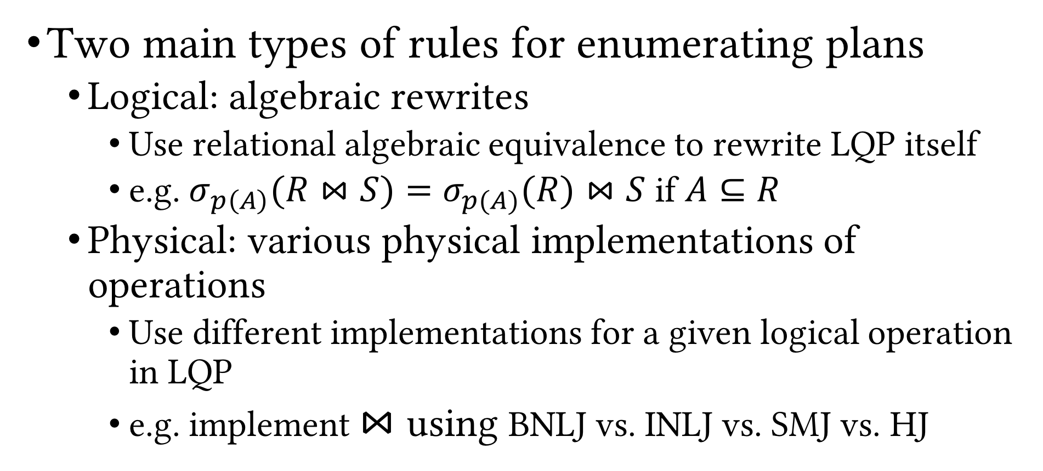
Recap (Cont.)
Two main types of rules for enumerating plans
Logical: algebraic rewrites
Use relational algebraic equivalence to rewrite LQP itself
e.g. $σ_{p\left(A\right)}(R⋈S)=σ_{p(A)}(R)⋈S$ if $A⊆R$
Physical: various physical implementations of operations
Use different implementations for a given logical operation in LQP
e.g. implement $⋈$ using BNLJ vs. INLJ vs. SMJ vs. HJ

Slide 6
Recap (Cont.)
Join orderings
Bushy, left-deep or right-deep
Materialization vs. pipelining
Benefits of pipelining
Display the outputs to the user incrementally
Parallelize execution on multi-core CPUs
⨝
⨝
⨝
⨝
⨝
U
R
⨝
⨝
⨝
T
S
⨝
R
T
U
S
R
S
T
U

Slide 7
Blocking Operations
External Merge-sort
Quicksort for Internal, B=20
External Merge-sort
Quicksort for Internal, B=20
Hash join results can be pipelined to projection
Hash-based Projection
Hash-based Projection
Sorting results have to be materialized and cannot be pipelined
Hash Join
Sort-merge Join
Table Scan
B+tree Scan (Index Leaf Nodes)
Table Scan
Table Scan
Purchase
Person
Purchase
Person

Slide 8
Iterator Interface
Enables us to abstract away individual physical operation implementation details
Makes pipelining easier
Each physical operation should support three functions
Open(): initialize the operation’s “state”, get arguments, allocate input and output buffers
GetNext(): ask the operation to “deliver” next output tuple; pass it on; if blocking, wait
Close(): clear operation’s state, free up space

Slide 9
Plan Cost Estimation
Do not know the exact cost of PQPs (why?)
For each PQP considered by the plan generator, the plan cost estimator computes estimated cost of the PQP
Weighted sum of plan operations’ I/O costs and CPU costs
Distributed RDBMSs also include network cost
Challenge: Given a PQP, compute overall cost
Pipelining vs. blocking ops; cannot simply add costs
Hard to estimate cardinality of intermediate relations
Remember we ignored OUTPUT cost!?

Slide 10


Plan Cost Estimation (Cont.)
Estimating the cost of a query plan involves
Estimating the cost of each operation in the plan, which depends on
Input cardinalities
Algorithm cost (known)
Estimating the cardinalities of intermediate results
Need statistics about input relations
Tracked in system catalog

Slide 11
System Catalog
Set of pre-defined relations for metadata about DB (schema)
For each relation
Relation name,
File name and structure (heap file, clustered B+tree, etc.)
Attribute names and types
Integrity constraints
Indexes
For each index
Index name, structure (B+tree, hash, etc.), search key
For each view
View name
View definition

Slide 12
System Catalog: Example
SQLite
select * from sqlite_master;
type name tbl_name rootpage sql
---------- ---------- ---------- ---------- ----------------------------------------------------table User User 2 CREATE TABLE User ( UID CHAR(20), Name CHAR(50), ...
index sqlite_aut User 3 table Event Event 4 CREATE TABLE Event ( EID CHAR(20), Name CHAR(50),...
index sqlite_aut Event 5 table Participat Participat 6 CREATE TABLE ParticipateIn ( EID CHAR(20), UID CH...
index sqlite_aut Participat 7

Slide 13
System Catalog: Example (Cont.)
PostgreSQL*
Catalog Table Name | Purpose
pg_aggregate | aggregate functions
pg_am | index access methods
pg_amop | access method operators
pg_amproc | access method support procedures
pg_attrdef | column default values
pg_attribute | table columns ("attributes")
pg_authid | authorization identifiers (roles)
pg_auth_members | authorization identifier membership relationships
pg_cast | casts (data type conversions)
pg_class | tables, indexes, sequences, views ("relations")
pg_constraint | check constraints, unique constraints, primary key constraints, foreign key constraints
pg_collation | collations (locale information)
pg_conversion | encoding conversion information
pg_database | databases within this database cluster
pg_db_role_setting | per-role and per-database settings
pg_default_acl | default privileges for object types
pg_depend | dependencies between database objects
pg_description | descriptions or comments on database objects
pg_enum | enum label and value definitions
pg_extension | installed extensions
pg_foreign_data_wrapper | foreign-data wrapper definitions
pg_foreign_server | foreign server definitions
pg_foreign_table | additional foreign table information
pg_index | additional index information
Catalog Table Name | Purpose
pg_inherits | table inheritance hierarchy
pg_language | languages for writing functions
pg_largeobject | data pages for large objects
pg_largeobject_metadata | metadata for large objects
pg_namespace | schemas
pg_opclass | access method operator classes
pg_operator | operators
pg_opfamily | access method operator families
pg_pltemplate | template data for procedural languages
pg_proc | functions and procedures
pg_rewrite | query rewrite rules
pg_seclabel | security labels on database objects
pg_shdepend | dependencies on shared objects
pg_shdescription | comments on shared objects
pg_statistic | planner statistics
pg_tablespace | tablespaces within this database cluster
pg_trigger | triggers
pg_ts_config | text search configurations
pg_ts_config_map | text search configurations' token mappings
pg_ts_dict | text search dictionaries
pg_ts_parser | text search parsers
pg_ts_template | text search templates
pg_type | data types
pg_user_mapping | mappings of users to foreign servers
* https://www.postgresql.org/docs/9.1/static/catalogs-overview.html

Slide 14
Statistics in System Catalog
RDBMS periodically collects stats about the data
Can be slightly out-of-date
For each table R
Cardinality, i.e., number of tuples, NTuples(R)
Size, i.e., number of pages, NPages(R), or just N_{R}
For each Index X
Cardinality, i.e., number of distinct keys IKeys(X)
Size, i.e., number of pages IPages(X) (for a B+ tree, this is the number of leaf pages only)
Height (for tree indexes) IHeight(X)
Min and max key values in index ILow(X), IHigh(X); i.e. key ranges
More advanced query optimizers
Histograms
Wavelets

Slide 15
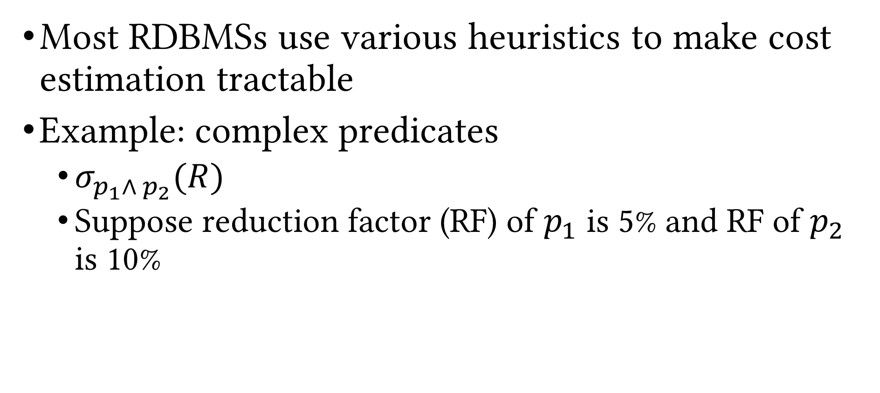
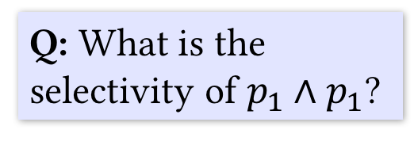
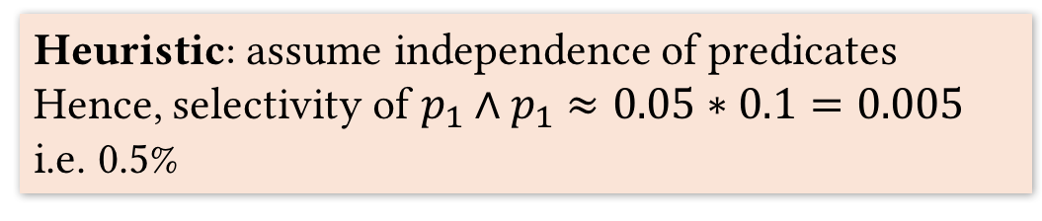
Plan Cost Estimation (Cont.)
Most RDBMSs use various heuristics to make cost estimation tractable
Example: complex predicates
$σ_{p_{1}∧ p_{2}}(R)$
Suppose reduction factor (RF) of $p_{1}$ is 5% and RF of $p_{2}$ is 10%
Q: What is the selectivity of $p_{1}∧p_{1}$?
Heuristic: assume independence of predicates
Hence, selectivity of $p_{1}∧p_{1}$ $≈0.05∗0.1=0.005$
i.e. 0.5%
A: Not enough info!

Slide 16

Example: System R Query Optimizer
System R
First RDBMS to implement SQL
Developed at IBM in the 70’s
Many ideas from System R persist to the day as fundamental building blocks of data management systems
Didn’t have a logo!
What they created in its loving memory

Slide 17
Example: System R Query Optimizer
Unit of optimization: query block
Example
SELECT S.name
FROM Student S
WHERE S.age IN
(SELECT MAX (S2.age)
FROM Student S2
GROUP BY S2.class)
Outer block
Nested block

Slide 18
Example: System R Query Optimizer
Optimize one block at a time
Treat nested blocks as calls to a subroutine
Execute the nested block once per outer tuple
Today, more complex optimization
For each block, consider the following plans
All available access paths, for each relation in FROM clause
All join permutations of left-deep join trees

Slide 19
System R Optimizer: Plan Enumeration
Two main cases
Single-relation plans
Multiple-relation plans
Single-relation plan (no joins)
Access paths
File scan
Index scan(s)

Slide 20
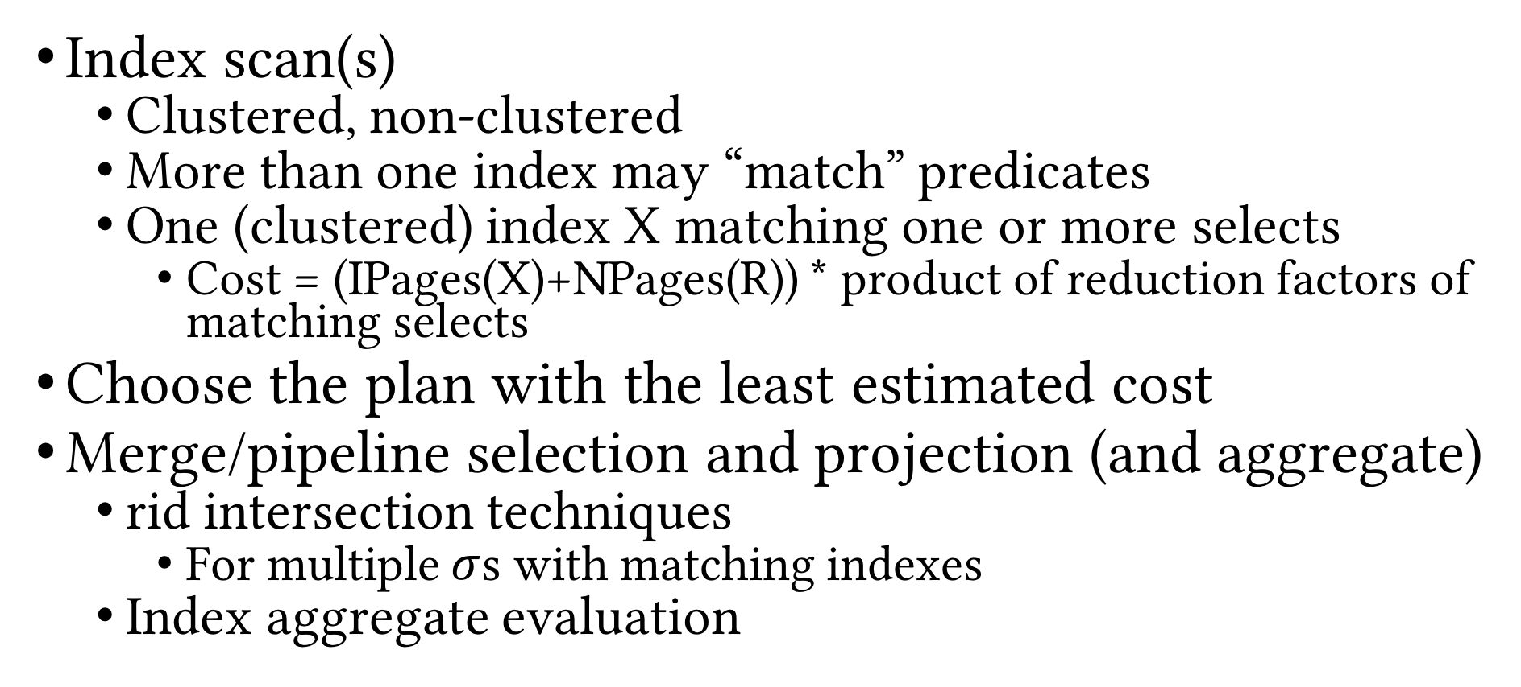
System R Optimizer: Single-relation Plans
Index scan(s)
Clustered, non-clustered
More than one index may “match” predicates
One (clustered) index X matching one or more selects
Cost = (IPages(X)+NPages(R)) * product of reduction factors of matching selects
Choose the plan with the least estimated cost
Merge/pipeline selection and projection (and aggregate)
rid intersection techniques
For multiple $σ$s with matching indexes
Index aggregate evaluation

Slide 21
System R Optimizer: Example
Employee(SSN, Name, Address, Salary, DeptID)
1,000 data pages
10K tuples
100 pages in B+tree
#depts: 10
Salary range: 10K–200K
SELECT Name
FROM Employee
WHERE DeptID = 8 AND
Salary > 40000
File scan: 1,000 pages
B+tree index on DeptID
#tuples retrieved: (1/10) * 10,000
Clustered index: (1/10) * (100+1,000) pages
Unclustered index: (1/10) * (100+10,000) pages
B+tree index on Salary
Clustered index: (200-40)/(200-10) * (100+1,000) pages
Unclustered index: …
What if we have histograms?

Slide 22
System R Optimizer: Multiple-relation Plans
Need to deal with joins
Consider left-deep plans only
Left-deep plans can potentially be fully pipelined
Intermediate results not written to temporary files
Not all left-deep plans can be fully pipelined (e.g. SMJ)
Decide
Join order
Method used for each join

Slide 23
Enumeration of Left-deep Plans
Using N passes (for N relations joined)
Pass 1: find best 1-relation plan for each relation
Pass 2: find best way to join result of each 1-relation plan (as outer) to another relation (all 2-relation plans)
…
Pass N: find best way to join result of a (N-1)-relation plan (as outer) to the N^{th} relation (all N-relation plans)
For each subset of relations, retain only
Cheapest plan overall
Cheapest plan for each interesting order of the tuples

Slide 24
Enumeration of Left-deep Plans: Example
Employee(SSN, eName, Address, Salary, DeptID)
Department(DeptID, dName, Floor, Manager)
SELECT eName
FROM Employee JOIN Department
WHERE dName = `Toy’
Employee: B+tree on SSN and DeptID
Department: B+tree on DeptID and dName
Pass 1
Employee (E)
P1_{E}: Scan E, P2_{E}: Indexed scan on E.DeptID
Department (D)
P1_{D}: Scan D, P2_{D}: Indexed scan on D.DeptID, P3_{D}: Indexed scan on D.dName

Slide 25
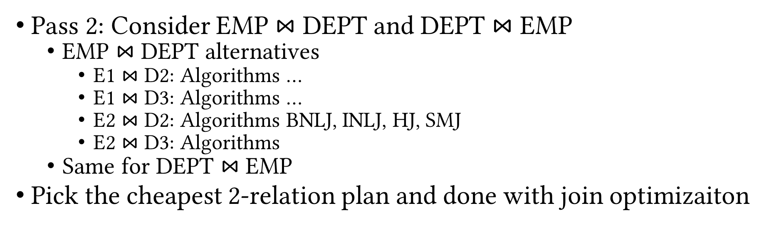
Enumeration of Left-deep Plans: Example (Cont.)
Employee(SSN, eName, Address, Salary, DeptID)
Department(DeptID, dName, Floor, Manager)
SELECT eName
FROM Employee JOIN Department
WHERE dName = `Toy’
Employee: B+tree on SSN and DeptID
Department: B+tree on DeptID and dName
Pass 2: Consider EMP $⋈$ DEPT and DEPT $⋈$ EMP
EMP $⋈$ DEPT alternatives
E1 $⋈$ D2: Algorithms …
E1 $⋈$ D3: Algorithms …
E2 $⋈$ D2: Algorithms BNLJ, INLJ, HJ, SMJ
E2 $⋈$ D3: Algorithms
Same for DEPT $⋈$ EMP
Pick the cheapest 2-relation plan and done with join optimizaiton

Slide 26
System R Optimizer (Cont.)
ORDER BY, GROUP BY handled as a final step
Only “join” relations if there is a connecting join condition, i.e. avoid Cartesian products if possible
Still exponential in number of tables to join
In reality, use dynamic programming

Slide 27
Recap
Plan generator and cost estimator work in tandem
Rules determine what PQPs are enumerated
Logical: algebraic rewrites of LQP
Physical: operation implementations and ordering alternatives
Cost models and heuristics help approximating the costs of the PQPs
Active research area
Parametric query optimization, multi-objective query optimization, multiple query optimization, online query optimization, dynamic re-optimization, etc.

Slide 28
Detailed DBMS Architecture
Web Forms
Application Front Ends
SQL Interface
SQL Commands
Query Evaluation Engine
Plan Executor
Parser
Operator Evaluator
Optimizer
Transaction Manager
File and Access Methods
Recovery Manager
DBMS
Concurrency Control
Buffer Manager
Storage Manager
Lock Manager
Disk Space Manager
Index Files
Database
System Catalog
Data Files

Slide 29
Transaction Management
Next Up
Questions?

