Slide 1

Database Management Systems (CS 564)
Fall 2017
Lecture 20

Slide 2
Relational Operators: Building Blocks of Relational Query Answering
Finally, how rather than what

Slide 3
DBMS Architecture
Web Forms
Application Front Ends
SQL Interface
SQL Commands
Query Evaluation Engine
Plan Executor
Parser
Operator Evaluator
Optimizer
Transaction Manager
File and Access Methods
Recovery Manager
DBMS
Concurrency Control
Buffer Manager
Storage Manager
Lock Manager
Disk Space Manager
Index Files
Database
System Catalog
Data Files

Slide 4
Query Execution
SQL Query
Query Parser
Parsed Query
Query Optimizer
Plan Generator
Plan Cost Estimator
Evaluation Plan
Query Plan Evaluator
Operator Evaluators

Slide 5
Logical vs Physical Operators
Logical operators
What they do
e.g., selection, project, join, union, grouping
Physical operators
How they do it
e.g., nested loop join, sort-merge join, hash join, index join

Slide 6
Example
𝜏_{buyer}
External Merge-sort
Quicksort for Internal, B=20
𝜋_{buyer}
SELECT DISTINCT P.buyer
FROM Purchase P,
Person Q
WHERE P.buyer=Q.name
AND Q.city=‘Madison’
ORDER BY P.buyer
Hash-based Projection
⨝_{buyer=name}
Nested Loop Join
𝜎_{city = ‘Madison’}
Purchase
Table Scan
Index Scan
Assume that Person has a hash index on city
Person
Purchase
Person

Slide 7
Relational Operations
A query plan
Logical tree
Implementation choice at every node
Scheduling of operations
Will see implementations for the following relational operations
Select
Project
Join
Aggregation
Set operators

Slide 8
Selection
Example: 𝜎_{city=‘Madison’}(Purchase)
Access path: a specific way of retrieving tuples from a relation
File scan access path
Scan the entire file of R, match selection predicate for each tuple
Cost = O(N) where N is the number of R’s pages
Indexed access path
Use an index matching the selection predicate (e.g. city=‘Madison’)
Cost varies depending on the index

Slide 9
Selection: Example
User(UID, Name, Age)
SELECT UID, Name
FROM User
WHERE Age BETWEEN 20 AND 30
Access path | S = 1 | S = 10
Unsorted file scan | 10000 | 10000
1M records
Each page holds
100 records, or
500 (key, rid) pairs
S% of records satisfy the selection criteria
Sorted file scan | ~14+100 | ~14+1000
Unclustered B+tree on Age | 3+10000 | 3+100000
Clustered B+tree on Age | 3+100 | 3+1000

Slide 10
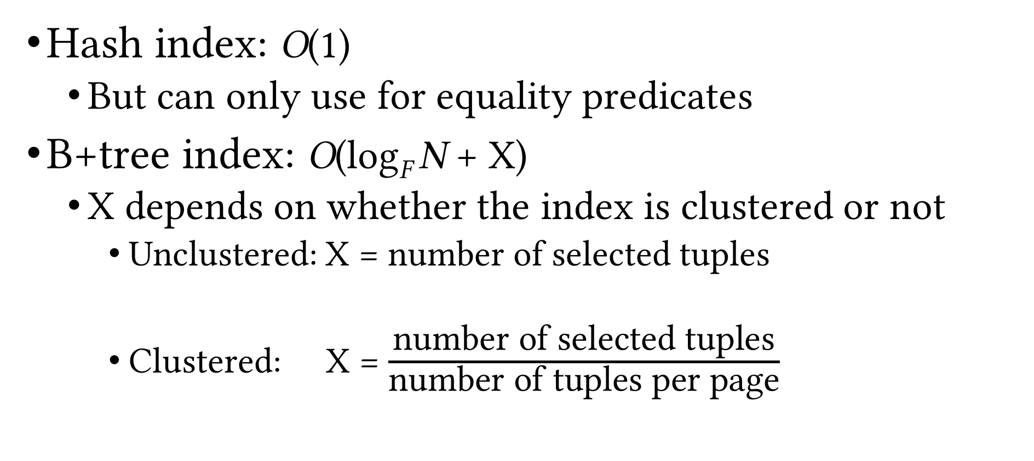
Index Scan Cost
Hash index: O(1)
But can only use for equality predicates
B+tree index: O(log_{F} N + X)
X depends on whether the index is clustered or not
Unclustered: X = number of selected tuples
Clustered: X = $\frac{\text{number} \text{of} \text{selected} \text{tuples}}{\text{number} \text{of} \text{tuples} \text{per} \text{page}}$

Slide 11
Matching Index
An index matches a predicate when it can be used to evaluate the predicate in a query
Example
User(UID, Name, Age)
Access path | Age = 22 | Age >= 24
Hash index on Age | ✓ | ⨯
Clustered B+tree on Age | ✓ | ✓
⨯
Unclustered B+tree on Age
⨯
✓
✓
First sort rids based on pid

Slide 12
Matching Index (Cont.)
Example
User(UID, Name, Age, ParentID)
Access path | Age = 22 | Age >= 24
Hash index on (Age, Name) | ⨯ | ⨯
Clustered B+tree on Age | ✓ | ✓
Prefix-match property of B+tree indexes
Clustered B+tree on (Age, Name) | ✓ | ✓
Clustered B+tree on (Age, Name, ParentID) | ✓ | ✓
Clustered B+tree on (Name, Age) | ⨯ | ⨯

Slide 13
General Selection Condition
A combination of predicates
e.g. R.a>10, R.c=23, R.a>10 ∧ R.c=23, R.a>10 ∨ R.c=23
Convert to conjunctive normal form (CNF)
General form: p₁ ∧ p₂ … ∧ p_{n} where each p_{i} is called a conjunct
Example: (R.a>10 ∧ R.c=23) ∨ R.b<=12
Convert to (R.a>10 ∨ R.b<=12) ∧ (R.c=23 ∨ R.b<=12)
An index can be used to evaluate a selection operation only if it matches some predicate in the selection condition
Notice the difference with cow book

Slide 14
Conjunction of Simple Predicates
Selection condition p₁ ∧ p₂ … ∧ p_{n} where each p_{i} is a simple predicate (i.e. of the form “att op val”)
e.g. a=7 ∧ b<5 ∧ c=4
When can we use an index to evaluate a selection?
Hash index on search key K
If all p_{i}s are equality predicates (e.g. Age=23) and the set of attributes in K is a subset of attributes appearing in p₁, p₂, …,p_{n}
B+tree index on search key K
If a prefix subset of K is a subset of attributes appearing in p₁, p₂, …,p_{n}
Primary conjunct: conjuncts in the selection conditions that an index matches

Slide 15
Conjunction of Simple Predicates (Cont.)
Example
R(a, b, c, d)
Index | a=10 ∧ b=24 | d=10 ∧ c<=19 ∧ a>24
HashInx(a, b) | ✓ | ⨯
HashInx(d) | ⨯ | ✓
B+tree(a, b) | ✓ | ✓
B+tree(b, a) | ✓ | ⨯
B+tree(b, c) | ✓ | ⨯
B+tree(b, c, d) | ✓ | ⨯
B+tree(c, d, a) | ⨯ | ✓

Slide 16
Disjunction of Simple Predicates
What if you have disjunctions?
Example
Relation R(a, b, c, d)
Selection condition: a=7 ∨ b<5 ∨ c=4
Hash index on a and B+tree index on (b, c)
Use both indexes to obtain partial results, then union them to generate the final result set
Hash index on a and B+tree index on b
Don’t use any indexes; scan the whole R
Can use indexes only when we have appropriate indexes for every simple predicate in the disjunction

Slide 17
General Selection Condition (Cont.)
More examples
Hash index on a and hash index on b
Selection condition: a=7 ∨ b>5
Need a scan
Hash index on a and B+tree on b
Selection condition: a=7 ∨ b>5
Scan or use both indexes (fetch rids and take the union)
Hash index on a and B+tree on b
Selection condition: (a=7 ∨ c>5) ∧ b>5
Scan or use B+tree
Hash index on (a, c) and B+tree on b
Selection condition: a=7 ∧ b>5 ∧ c=15
Use both indexes (fetch rids and take the intersection)

Slide 18
Matching Index (Cont.)
A selection condition can match more than one index
Example
Relation R(a, b, c, d)
Hash index on a and B+tree index on (b, c)
Selection condition: a=7 ∧ b=5 ∧ c=4
Which index should we use?
Use either index
Use both indexes, then intersect the rid sets, and then fetch the tuples

Slide 19
Matching Index (Cont.)
A predicate can match more than one index/access path
Example
Relation R(a, b, c)
Hash index on a and B+tree index on (a, c)
Selection condition: a=7 ∧ b=5
Which index should we use?
Decide based on selectivity of the access paths

Slide 20
Selectivity
Fraction of pages (data and index pages) that need to be retrieved if we use this access path to retrieve all the desired tuples
Want to choose the most selective path
Estimating the selectivity of an access path is a hard problem

Slide 21
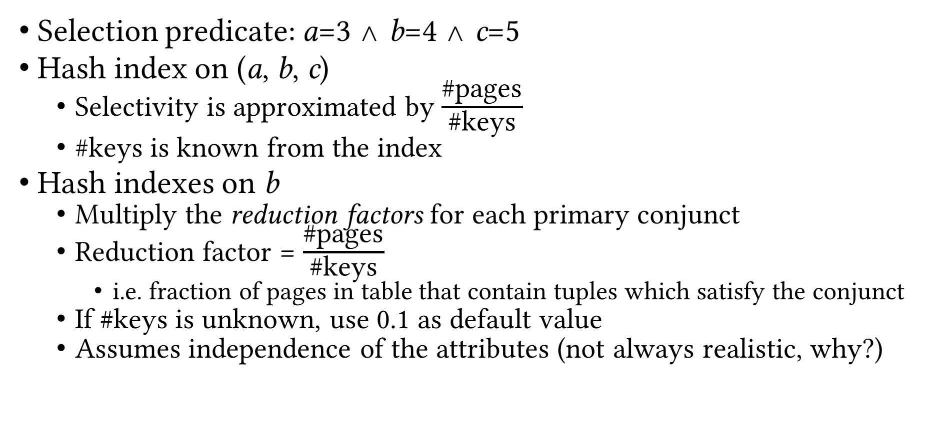
Estimating Selectivity: Example
Selection predicate: a=3 ∧ b=4 ∧ c=5
Hash index on (a, b, c)
Selectivity is approximated by $\frac{\text{\#}\text{pages}}{\text{\#}\text{keys}}$
#keys is known from the index
Hash indexes on b
Multiply the reduction factors for each primary conjunct
Reduction factor = $\frac{\text{\#}\text{pages}}{\text{\#}\text{keys}}$
i.e. fraction of pages in table that contain tuples which satisfy the conjunct
If #keys is unknown, use 0.1 as default value
Assumes independence of the attributes (not always realistic, why?)

Slide 22
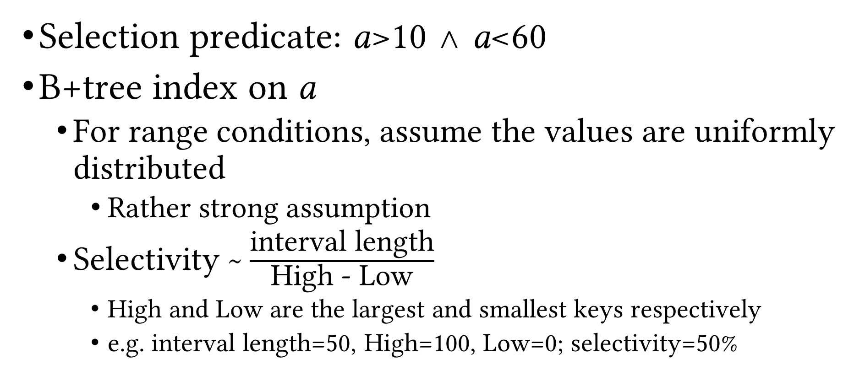
Estimating Selectivity: Example (Cont.)
Selection predicate: a>10 ∧ a<60
B+tree index on a
For range conditions, assume the values are uniformly distributed
Rather strong assumption
Selectivity ~ $\frac{\text{interval} \text{length}}{\text{High}\text{ − }\text{Low}}$
High and Low are the largest and smallest keys respectively
e.g. interval length=50, High=100, Low=0; selectivity=50%

Slide 23
Recap
Logical vs physical operations
Different ways of implementing each operation
Selection operation
Access paths
Scan
Utilize matching index
Decide among access paths
Use selectivity

