Slide 1

Database Management Systems (CS 564)
Fall 2017
Lecture 21

Slide 2
Relational Operators: Building Blocks of Relational Query Answering
Finally, how rather than what

Slide 3
Recap
Logical vs physical operations
Different ways of implementing each operation
Selection operation
Access paths
Scan
Utilize matching index
Decide among access paths
Use selectivity

Slide 4
Query Execution
SQL Query
Query Parser
Parsed Query
Query Optimizer
Plan Generator
Plan Cost Estimator
Evaluation Plan
Query Plan Evaluator
Operator Evaluators

Slide 5
Example
𝜏_{buyer}
External Merge-sort
Quicksort for Internal, B=20
𝜋_{buyer}
SELECT DISTINCT P.buyer
FROM Purchase P,
Person Q
WHERE P.buyer=Q.name
AND Q.city=‘Madison’
ORDER BY P.buyer
Hash-based Projection
⨝_{buyer=name}
Nested Loop Join
𝜎_{city = ‘Madison’}
Purchase
Table Scan
Index Scan
Assume that Person has a hash index on city
Person
Purchase
Person

Slide 6
Matching Index (Cont.)
A predicate can match more than one index/access path
Example
Relation R(a, b, c)
Hash index on a and B+tree index on (a, c)
Selection condition: a=7 ∧ b=5
Which index should we use?
Decide based on selectivity of the access paths

Slide 7
Selectivity
Fraction of pages (data and index pages) that need to be retrieved if we use this access path to retrieve all the desired tuples
Want to choose the most selective path
Estimating the selectivity of an access path is a hard problem

Slide 8
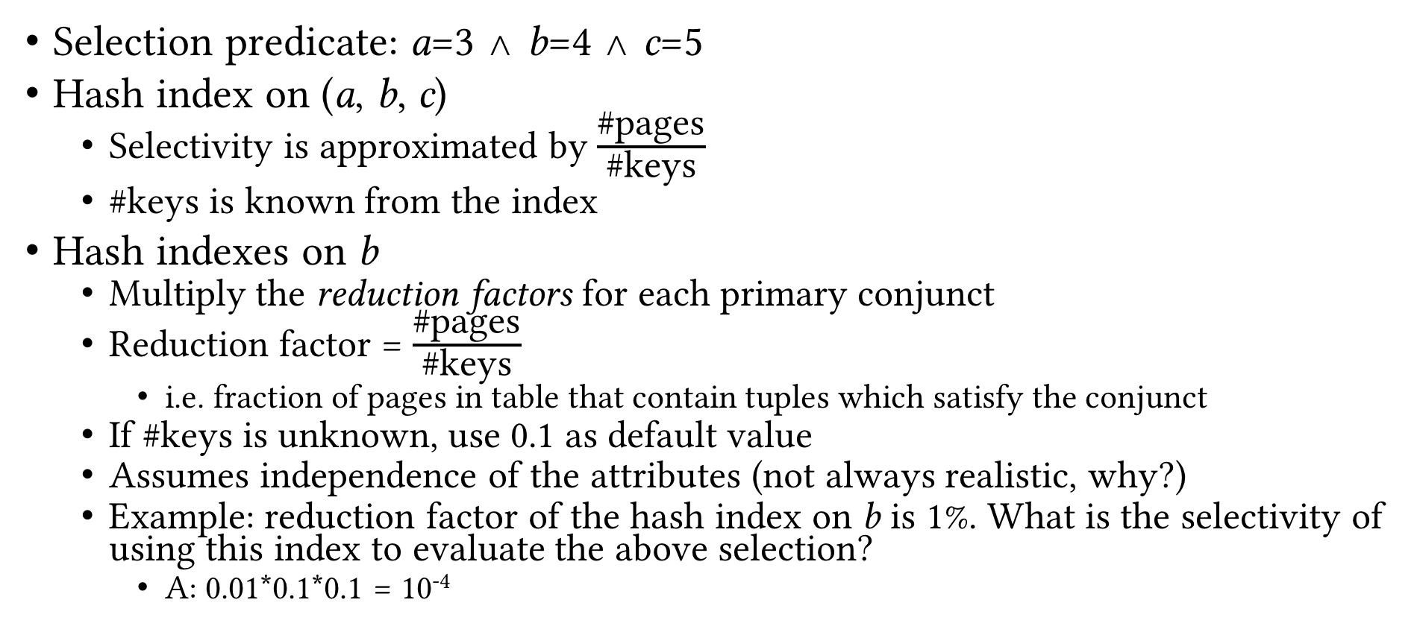
Estimating Selectivity: Example
Selection predicate: a=3 ∧ b=4 ∧ c=5
Hash index on (a, b, c)
Selectivity is approximated by $\frac{\text{\#}\text{pages}}{\text{\#}\text{keys}}$
#keys is known from the index
Hash indexes on b
Multiply the reduction factors for each primary conjunct
Reduction factor = $\frac{\text{\#}\text{pages}}{\text{\#}\text{keys}}$
i.e. fraction of pages in table that contain tuples which satisfy the conjunct
If #keys is unknown, use 0.1 as default value
Assumes independence of the attributes (not always realistic, why?)
Example: reduction factor of the hash index on b is 1%. What is the selectivity of using this index to evaluate the above selection?
A: 0.01*0.1*0.1 = 10⁻⁴

Slide 9
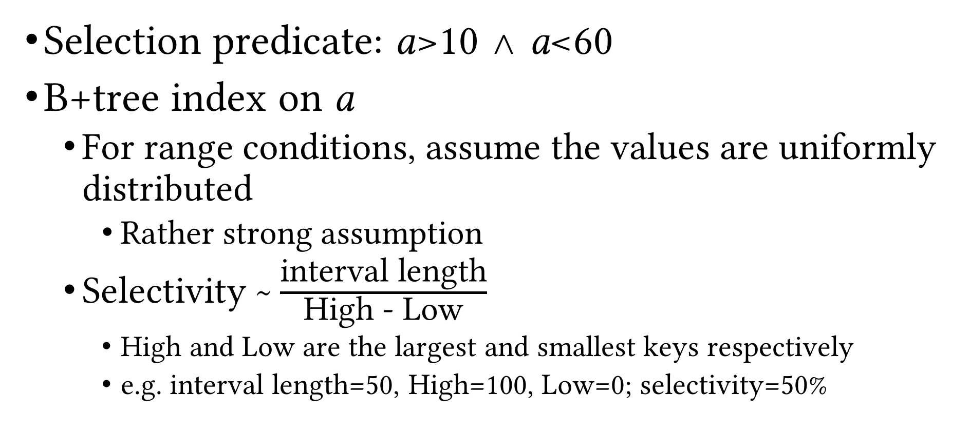
Estimating Selectivity: Example (Cont.)
Selection predicate: a>10 ∧ a<60
B+tree index on a
For range conditions, assume the values are uniformly distributed
Rather strong assumption
Selectivity ~ $\frac{\text{interval} \text{length}}{\text{High}\text{ − }\text{Low}}$
High and Low are the largest and smallest keys respectively
e.g. interval length=50, High=100, Low=0; selectivity=50%

Slide 10
Projection
Simple case: SELECT R.a, R.d
Scan the file and for each tuple output R.a, R.d
Hard case: SELECT DISTINCT R.a, R.d
Project out the attributes
Eliminate duplicate tuples (the difficult part!)
Two solutions
Sorting-based
Hashing-based

Slide 11
Sorting-based Deduplication
Sort R on (a, b)
During the first pass, eliminate everything but a and b from each tuple
Call the collection of resulting runs T
During the later passes, eliminate duplicates when encountered
Cost = N_{R}+N_{T}+EMrgCost(N_{T})
N_{R} = number of pages of relation R
N_{T} = number of pages storing the results of the first pass, i.e. containing a and b only
EMrgCost(N_{T}) = cost of merging (second and later passes of external merge-sort) N_{T} pages
What params would this depend on?
Notes:
N_{T}, B, b, double-buffering

Slide 12
Sorting-based Deduplication: Example
P₁₋₃
P₄₋₆
P₇₋₉
P₁₀₋₁₂
P₁₃₋₁₅
P₁₆₋₁₈
P₁₉
Input file
Pass 0
3,4
2,6
4,9
7,8
5,6
1,3
2
Pass 1
2,3
4,7
1,3
4,6
8,9
5,6
2
Pass 2
2,3
4,6
1,2
7,8
3,5
9
6
Pass 3
1,2
3,4
5,6
7,8
9

Slide 13
Hashing-based Deduplication
Create a hash table on R(a, b)
If the hash table fits entirely in memory, done!
Cost = N_{R}
Else, use a 2-phase algorithm
Partitioning: project out attributes and split the input into B-1 partitions using a hash function h₁
Deduplication: read each partition into memory and use an in-memory hash table (with a different hash function h₂) to remove duplicates

Slide 14
Hashing-based Deduplication (Cont.)
(Partitions of)
T
R
Hash table for partition i
Output
Partition buffers
1
2
h₂
INPUT
h₁
. . .
. . .
. . .
. . .
. . .
Output
buffer
B-1
Input buffer
for partition i
B buffer pages
B buffer pages
Partitioning
Deduplication

Slide 15
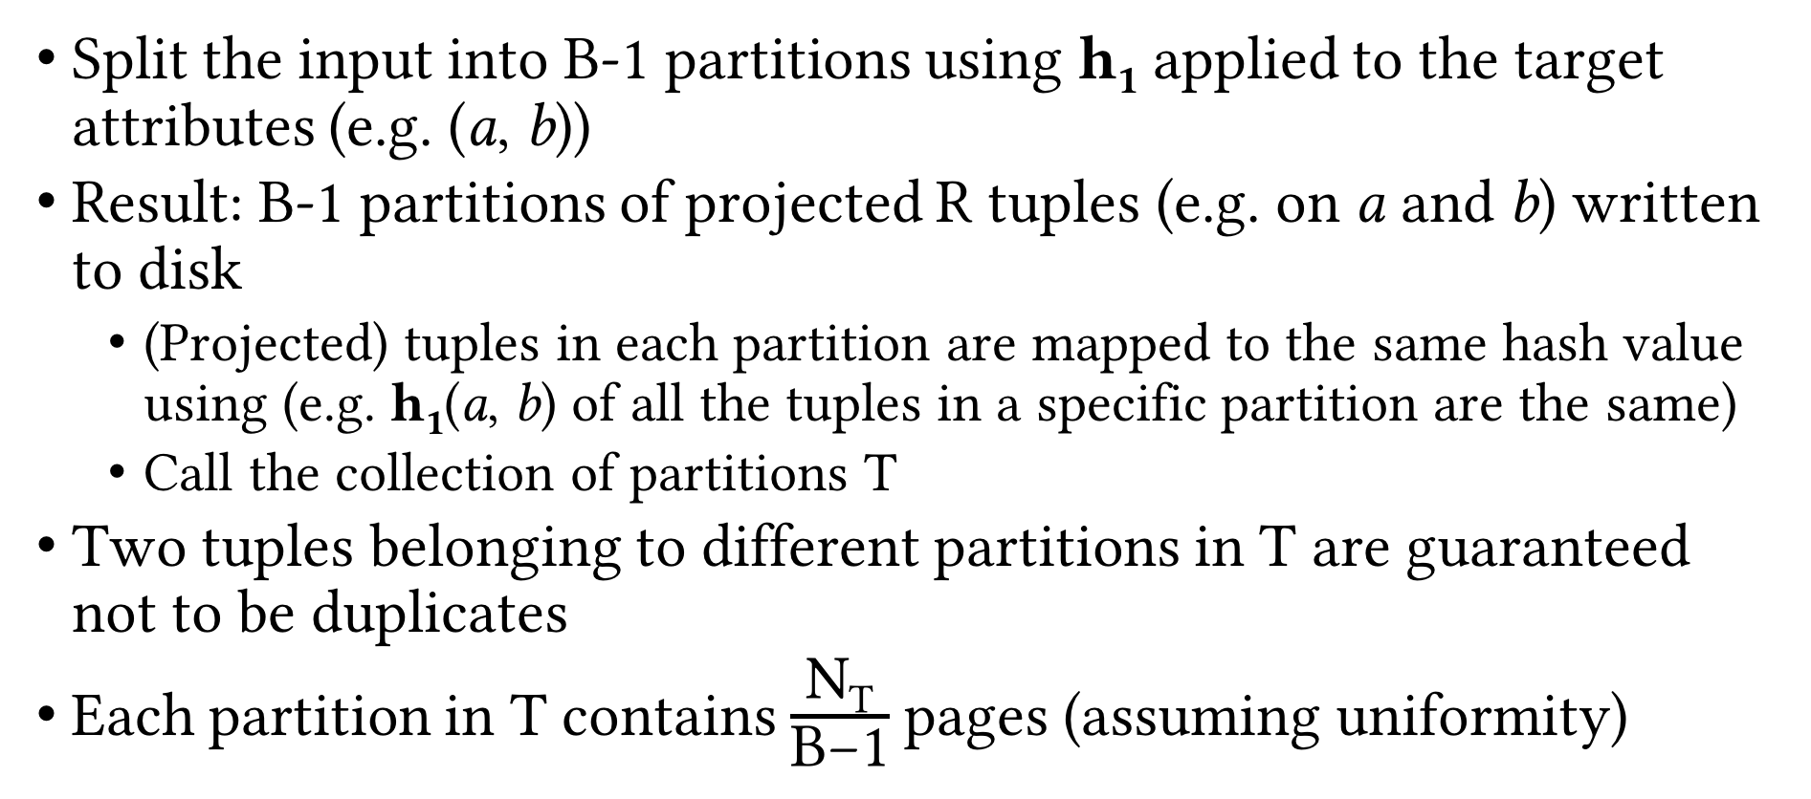
Partitioning Phase
Split the input into B-1 partitions using h₁ applied to the target attributes (e.g. (a, b))
Result: B-1 partitions of projected R tuples (e.g. on a and b) written to disk
(Projected) tuples in each partition are mapped to the same hash value using (e.g. h₁(a, b) of all the tuples in a specific partition are the same)
Call the collection of partitions T
Two tuples belonging to different partitions in T are guaranteed not to be duplicates
Each partition in T contains $\frac{\text{N}\text{T}}{\text{B}\text{−1}}$ pages (assuming uniformity)

Slide 16
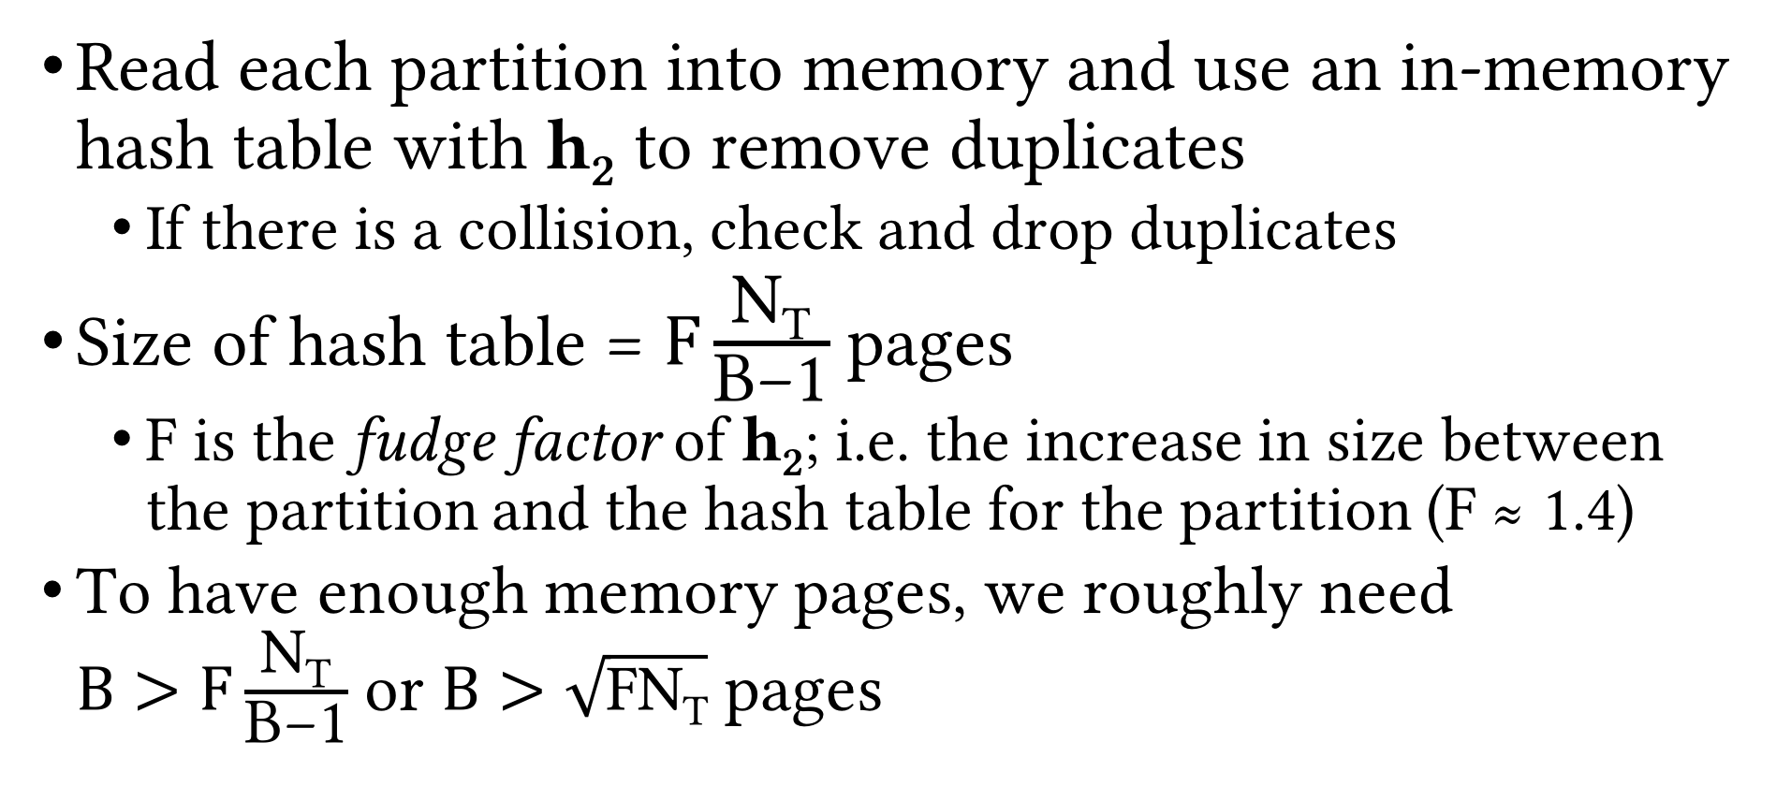
Deduplication Phase
Read each partition into memory and use an in-memory hash table with h₂ to remove duplicates
If there is a collision, check and drop duplicates
Size of hash table = $F\frac{\text{N}\text{T}}{\text{B}\text{−1}}$ pages
F is the fudge factor of h₂; i.e. the increase in size between the partition and the hash table for the partition (F ≈ 1.4)
To have enough memory pages, we roughly need $B>F\frac{\text{N}\text{T}}{\text{B}\text{−1}}$ or $B>\sqrt{\text{FN}\text{T}}$ pages

Slide 17
Sort- vs. Hashing-based Deduplication
Usually, I/O cost is the same = N_{R} + 2N_{T} (why?)
In practice, sorting-based is popular for projection
Gives sorted result (preferred)
Handles skewed data better

Slide 18
Using Indexes for Projection
Index with projection list as subset of index key (index-only scan)
Use only key values as the T for sorting/hashing
Tree-based index with projection list as prefix of index key
Leaf pages are already sorted on projection list
Just scan them in order, project out and deduplicate on-the-fly

Slide 19
Recap
Selection operation
Access paths
Scan vs utilize matching index
Use selectivity to decide among access paths
Projection operation
Sorting-based
Variations on external merge-sort
Hash-based
2-phase algorithm

Slide 20
Join Operation
We consider equi-join
Most common, important and well-studied join op
Example: Course ⨝_{Course.CID=Section.CID} Section
Various algorithms
Nested loop join
Block nested loop join
Index nested loop join
Block index nested loop join
Sort-merge join
Hash join

Slide 21
Nested Loop Join
Let R and S be the relations we want to join
Brain-dead solution: use nested for loops over the tuples of R and S
What’s wrong with this solution?
for each tuple t_{R} in R
for each tuple t_{S} in S
if tuple t_{R} and t_{S} match on the join attribute then
Concat t_{R} and t_{S} and output

Slide 22
Nested Loop Join: Example
SID | SName | Class | Major | DID | DeptName | Address
17 | Smith | 21 | MATH | MATH | Mathematics | ADD2
8 | Brown | 24 | CS | CS | Computer Sciences | ADD1
5 | Moreno | 21 | PHYS | PHYS | Physics | ADD3
⨝_{Major=DID}
R
S
SID | SName | Class | Major
17 | Smith | 21 | MATH
8 | Brown | 24 | CS
5 | Moreno | 21 | PHYS
DID | DeptName | Address
CS | Computer Sciences | ADD1
MATH | Mathematics | ADD2
PHYS | Physics | ADD3

Slide 23
Page Nested Loop Join (PNLJ)
Use nested for loops over the pages of R and S
R is called the outer relation and S is called the inner relation
Outer relation should be the smaller relation
i.e. N_{R} ≤ N_{S}
Q: How many buffer pages PNLJ need?
A: Three. Why?
for each page p_{R} in R
for each page p_{S} in S
Check every pair of tuples in p_{R} and p_{S},
and if they match, concat them and output
Q: What is the cost of PNLJ?
A: N_{R} + N_{R} * N_{S}

Slide 24
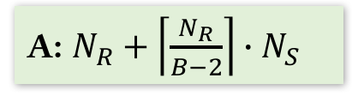
Block Nested Loop Join (BNLJ)
Better utilize memory buffers
In-memory all-pairs comparison could be quite slow (high CPU cost)
Solution: build a hash table on R pages in memory to reduce number of comparisons
Q: What is the cost of BNLJ?
for each block p_{R,1 , …,} p_{R,B-2} of B-2 pages of R
for each page p_{S} in S
Check every pair of tuples in p_{R,j} and p_{S},
and if they match, concat them and output
A: $N_{R}+\left\lceil \frac{N_{R}}{B−2}\right\rceil ∙N_{S}$
Q: What should be the key for this hash table?
A: The join attribute(s)
Q: How would the above cost change?
A: It doesn’t! Then why are we doing this?
Q: What if R fits in memory?

Slide 25
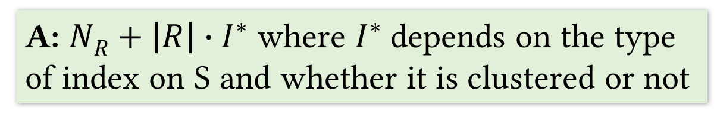
Index Nested Loop Join (INLJ)
Utilize existing indexes
Suppose S has an index on the join attribute(s)
for each page p_{R} of R
for each tuple t_{R} in p_{R}
Probe the index on S to find any tuples matching t_{R}
and if found, concat them and output
Q: What is the cost of INLJ?
A: $NR+\left|R\right|∙I^{∗}$ where $I^{∗}$depends on the type of index on S and whether it is clustered or not

Slide 26

Block Index Nested Loop Join (BINLJ)
Improve performance using available buffer pages
for each block p_{R,1 , …,} p_{R,B-2} of B-2 pages of R
Sort the tuples in the current block (in memory)
for each tuple t_{R} in the current sorted block
Probe the index on S to find any tuples matching t_{R}
and if found, concat them and output
Q: Why soring each block?
A: Reusing index and data pages in buffer
Q: What is the cost of BINLJ?
A: $NR+\left|R\right|∙I^{∗}$ where $I^{∗}$depends on the type of index on S and whether it is clustered or not

Slide 27
Sort-merge Join (SMJ)
Join is like deduplication in that they both need to check equality
So we can sort R and S on join attribute(s) and then merge them to find matching tuples
Instead of dropping them as in deduplication, concat them and output
Sort R and S on join attribute(s)
Merge the sorted R and S on join attribute(s), check for matching (i.e. duplicate) tuples
If matching pair found, concat them and output
Q: What is the cost of SMJ?
A: EMS(R) + EMS(S) + N_{R} + N_{S} where EMS is the cost of external merge-sort
Q: Can we do better?
A: If we have enough buffer pages, we can execute pass 0 on R and S and then merge all the runs together

Slide 28
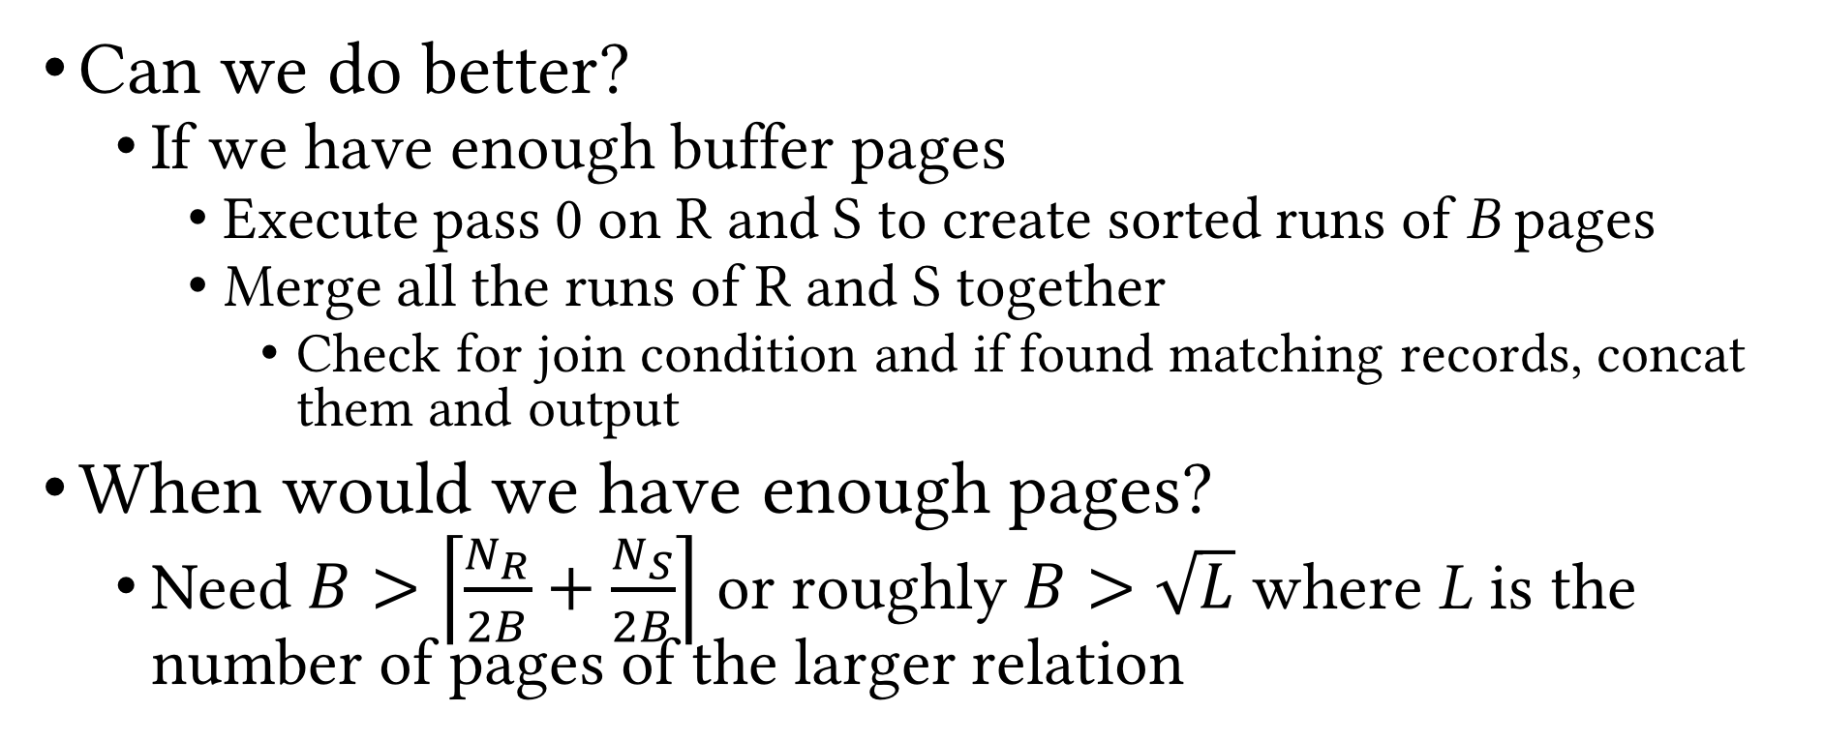
SMJ (Cont.)
Can we do better?
If we have enough buffer pages
Execute pass 0 on R and S to create sorted runs of B pages
Merge all the runs of R and S together
Check for join condition and if found matching records, concat them and output
When would we have enough pages?
Need $B>\left\lceil \frac{N_{R}}{2B}+\frac{N_{S}}{2B}\right\rceil$ or roughly $B>\sqrt{L}$ where L is the number of pages of the larger relation
Q: What is the cost of improved SMJ?
A: 3(N_{R} + N_{S})

Slide 29
Hash Join (HJ)
Use hash-based deduplication to join tables
Partition R and S on join attribute(s) using hash function h₁
// Assume wlog that N_{R} ≤ N_{S}
for each partition R_{k} of R
Build an in-memory hash table on R_{k}
Probe the hash table with records in S_{k} and
check for matching tuples
If found, concat them and output

Slide 30
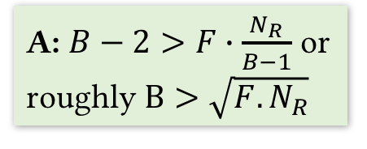
HJ (Cont.)
R
Partition buffers
Partitions of R
1
Q: What is the cost of HJ?
A: 3(N_{R} + N_{S})
INPUT
2
h₂
h₁
Output
. . .
. . .
. . .
Hash table for
R_{i}
B-1
h₂
S
Partitions of S
. . .
. . .
1
Output
buffer
2
Input buffer
for S_{i}
INPUT
h₁
. . .
. . .
. . .
Join (B buffer pages)
B-1
Q: What is memory requirement of HJ?
A: $B−2>F∙\frac{N_{R}}{B−1}$ or roughly $B>\sqrt{F.N_{R}}$
Partitioning (B buffer pages)

Slide 31
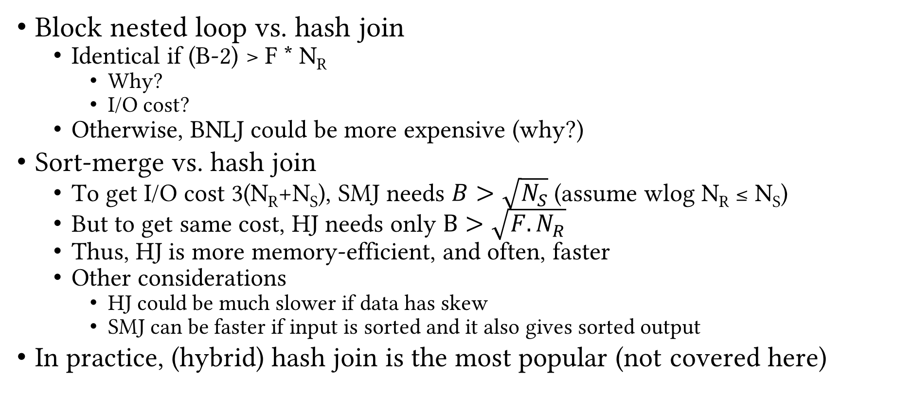
Comparison of Hash Algorithms
Block nested loop vs. hash join
Identical if (B-2) > F * N_{R}
Why?
I/O cost?
Otherwise, BNLJ could be more expensive (why?)
Sort-merge vs. hash join
To get I/O cost 3(N_{R}+N_{S}), SMJ needs $B>\sqrt{N_{S}}$ (assume wlog N_{R} ≤ N_{S})
But to get same cost, HJ needs only $B>\sqrt{F.N_{R}}$
Thus, HJ is more memory-efficient, and often, faster
Other considerations
HJ could be much slower if data has skew
SMJ can be faster if input is sorted and it also gives sorted output
In practice, (hybrid) hash join is the most popular (not covered here)

Slide 32
General Join Conditions
Multiple equalities
e.g. R.a = S.b ∧ R.c = S.d
HJ works fine: hash on (a, c)
SMJ works fine: sort on (a, c)
INLJ: use (build, if needed) a matching index on R
Inequalities
e.g. R.a > S.b
HJ and SMJ not applicable
INLJ: use (build, if needed) a B+tree index on R
BLNJ might often be among the best choices
Inequality checks might lead to large outputs

Slide 33
System Support
 | (P/B/I/BI)NLJ | SMJ | HJ
PostgreSQL | ✓ | ✓ | ✓
Oracle Database | ✓ | ✓ | ✓
Microsoft SQL Server | ✓ | ✓ | ✓
MySQL | ✓ | ⨯ | ⨯
SQLite | ✓ | ⨯ | ⨯
* Courtesy of Kedi Cui

Slide 34
Recap
Logical vs physical operations
Different ways of implementing each operation
Selection
Access paths (scan, utilize matching index)
Decide among access paths (use selectivity)
Projection
Deduplication (sorting- vs hashing-based)
Join
NLJ, BNLJ, PNLJ
INLJ, BINLJ
SMJ
HJ

Slide 35
Set Operations
Cross product (R × S)
Use BNLJ
Intersection (R ∩ S)
Logically, an equi-join with join condition being a conjunction of all attributes
Same tradeoffs
Union (R ∪ S) and difference (R − S)
Similar to intersection, but need to deduplicate matching tuple pairs and output only once

Slide 36
Implementing Union and Set Difference
Sorting-based
Use SMJ (with all attributes as join attributes)
R ∪ S: deduplicate matching tuples during merge
R − S: exclude matching tuples during merge
Hashing-based
Use HJ (with all attributes as join attributes)
Build hash table on S_{i}
R ∪ S: probe hash table with R_{i}, if matching pair found, discard tuple, else insert R_{i} tuple into hash table
Hash table holds the output
R − S: probe hash table with R_{i}, if matching pair found, discard tuple, else output the R_{i} tuple

Slide 37
Aggregates
𝛾_{X,Agg(Y)}(R)
Easy case: X is empty
Simply aggregate values of Y
Not-so-easy case: X is not empty
Need to “collect” groups of tuples that match on X, then apply Agg(Y)
Three algorithms, using
Sorting
Hashing
Index

Slide 38
Evaluation of Aggregates: Easy Case
Keep running partial aggregate information and update incrementally, one tuple at a time
SUM and COUNT: partial sum or count
MAX and MIN: maximum or minimum value observed so far
AVG: partial sum AND count; at the end, calculate average as sum/count

Slide 39
Sorting-based Evaluation of Aggregates
Sort R on X
Read R into memory in sorted order
For every distinct value x_{i} of X
Compute the aggregate on the on the group of tuples with X=x_{i}
Output x_{i} and the aggregate value
Improvement: partial aggregation during the sort phase
Cost = sort(R)

Slide 40
Hashing-based Evaluation of Aggregates
Build hash table using X
Each bucket contains the X values and running partial aggregate information
For each tuple in each page r in R
If r(X) is present in hash table, update running info
Else, insert new X value into hash table and initialize running info
Hash table holds the final output in the end

Slide 41
Index-based Evaluation of Aggregates
Given B+tree index such that X ∪ Y is a subset of index key
Use leaf level of index instead of R for sorting-/hash-based aggregate evaluation
Given B+tree index such that X is a prefix subset of index key
Leaf level already sorted
Can fetch data records in order
If leaf pages contain the records, just one scan of leaf level is enough

Slide 42
Recap
Selection
Access paths (scan, utilize matching index)
Decide among access paths (use selectivity)
Projection
Deduplication (sorting- vs hashing-based)
Join
NLJ, BNLJ, PNLJ, INLJ, BINLJ, SMJ, HJ
Union and set difference
Sorting- and hashing-based
Aggregates
Sorting-, hashing- and index-based

Slide 43
Query Optimization
Next Up
Questions?

