Slide 1

Database Management Systems (CS 564)
Fall 2017
Lecture 15

Slide 2
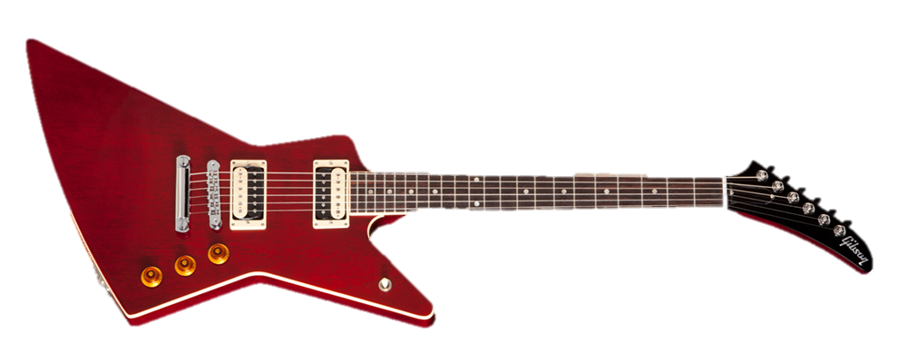
Data Storage and Buffer Management
Where it hits the metal

Slide 3
Recap: Buffer Manager
Requests to buffer manager:
Request a page (pin)
Release a page when it is no longer needed (unpin)
Notify the buffer manager when a page is modified (set dirty bit)
Buffer replacement policies
Least recently used (LRU)
Clock
Most recently used (MRU)
FIFO
Random, …
Sequential flooding
Page request
RAM
Buffer Pool
Page
data
Disk page
Free frame
Disk

Slide 4
Recap: Tables on Disk
Data is stored in tables
Each table is stored in a file on disk
Each file consists of multiple pages
Each page consists of multiple records (i.e. tuples)
Each records consists of multiple (attribute, value) pairs
Data is allocated/deallocated in increments of pages
Logically-close pages should be nearby in the disk

Slide 5


Files of (Pages of) Records
I/O is performed in page units
However, higher level data management operations require accessing and manipulating records and files of records
File = collection of pages Page = collection of records
File operations
Insert/delete/modify a record
Read a particular record (specified using a record ID)
Scan all records (possibly with some condition(s) on the records to be retrieved)
Records are organized in files using various formats, i.e. file organizations
Each file organizations makes certain operations efficient but other operations expensive

Slide 6
Unordered (Heap) File
Simplest file organization
Each page contains records in no particular order
As the file grows and shrinks, pages are allocated and de-allocated
To support record level operations, we must keep track of:
Pages in a file (using page ID (pid))
Free space on pages
Records on a page (using record ID (rid))
Operations: create/destroy file, insert/delete record, fetch a record with a specified rid, scan all records

Slide 7
Heap File Implemented as a List
(heap file name, header page id) are stored “somewhere”
Each (data) page has two pointers + data
Each pointer stores a pid
Pages in the free space list have “some” free space
Data
Page
Data
Page
…
Data
Page
…
Full pages
Header
Page
Data
Page
Data
Page
…
Data
Page
Pages with
free space
…

Slide 8
(Grossly Simplified) Example
R
a | b | c
a₁ | b₁ | c₁
a₂ | b₂ | c₂
a₃ | b₃ | c₃
a₄ | b₄ | c₄
a₅ | b₅ | c₅
a₁ | b₁ | c₁
a₂ | b₂ | c₂
a₃ | b₃ | c₃
a₄ | b₄ | c₄
Full pages
a₅ | b₅ | c₅
Pages with
free space
DELETE FROM R WHERE a = a_{1;}
R
a₃ | b₃ | c₃
a₄ | b₄ | c₄
Full pages
a | b | c
a₂ | b₂ | c₂
a₃ | b₃ | c₃
a₄ | b₄ | c₄
a₅ | b₅ | c₅
a₅ | b₅ | c₅
a₂ | b₂ | c₂
Pages with
free space

Slide 9
Heap File Implemented Using a Page Directory
Each entry for a page also keeps track of
whether the page full or not, or
number of free bytes on the page
Can locate pages for new tuples faster
Directory is a collection of pages; linked list implementation is just one alternative
Data
Page 1
Header
Page
Data
Page 2
Data
Page N
…
Directory
Q: What happens with fixed- vs. variable-length records in terms of full and non-full pages?
Q: How would you find a record with a specific rid?

Slide 10
Page Organizations
A page as a collection of records/tuples
Queries deal with tuples
Hence, the slotted page format
A page is a collection of slots
Each slot may contain a record
rid = <pid, slot number>
Many slotted page organizations
Need to support search, insert and delete records on a page
Page organizations for various record organizations
Fixed-length records
Variable-length records
Other ways of generating rids?

Slide 11
Organization of Pages of Fixed-length Record
Packed organization
N records are always stored in the first N slots
Problem: moving records (for free space management) changes the record ID
Might not be acceptable
Slot 1
 |  |  |  | N
Slot 2
Slot 3
Free space
Number of records

Slide 12


Organization of Pages of Fixed-length Record (Cont.)
Unpacked organization
Use a bitmap to locate records in the page
Slot 1
 |  |  |  |  |  |  |  |  |  |  |  |  | … | 0 | 1 | 0 | 1 |  | M
Slot 2
Slot 3
Free space
3
2
1
Bitmap
Number of slots

Slide 13
Organization of Pages of Variable-length Record
Directory grows backwards
rid does not change if you move a record on the same page (slot number is determined by position in slot directory)
Good for fixed-length records too
Deletion: offset is set to -1
Insertion
Use any available slots
if no space is available, reorganize (move records around)
 |  |  |  |  |  |  | 120, 40 | -1, 0 | 560, 90 | -1, 0 | 0, 50 | 70, 50 | 6 |  | Book-keeping
Free
space
pointer
5
4
3
2
1
0
Slot directory
Number of slots
Slot entry: offset, record length

Slide 14
Record Organization (Format)
Recap
File organization
Heap file
As doubly-linked list
Using page directory
Page organization
For fixed-length records
Packed
Unpacked
For variable-length records
Let’s see fixed- and variable-length record formats now.

Slide 15
Fixed-length Records
All records are of the same length, number of fields and field types
These information are stored in system catalog
The address of each field can be computed from the information in the catalog
F₁
F₂
F₃
F₄
L₁ | L₂ | L₃ | L₄
Base address (B)
Address = B + L₁ + L₂

Slide 16
Variable-length Records, Option 1
Store fields consecutively
Use delimiters to denote the end of each field
Need to scan the whole record to locate a field
F₁
F₂
F₃
F₄
4 |  | $ |  | $ |  | $ |  | $
Field count
Field delimiter (special symbol)

Slide 17
Variable-length Records, Option 2
Store fields consecutively
Use an array of integer offsets in the beginning
Efficient storage of NULLs, small directory overhead, direct access to the i^{th} field
Issues with growing records (change in attribute value, add/drop attributes)
F₁
F₂
F₃
F₄

Slide 18
Motivating Example: Looking Up One Attribute
What can potentially go wrong if we use any of the previous record formats?
CREATE TABLE T (a INTEGER, b INTEGER, c VARCHAR(255), …);
SELECT a
FROM T
WHERE a > 10;

Slide 19
Column Stores
Store columns vertically
Each column of a relation is stored in a different file
Can be compressed as well
Contrast with a row store that stores all the attributes of a tuple/record contiguously
File 1
File 1
File 2
File 3
1234 | 45 | Here goes a very long sentence 1
4657 | 2 | Here goes a very long sentence 2
3578 | 45 | Here goes a very long sentence 3
1234
4657
3578
45
2
45
Here goes a very long sentence 1
Here goes a very long sentence 2
Here goes a very long sentence 3
Row store
Column store

Slide 20
Recap
Architecture of a typical DBMS
Memory hierarchy
CPU cache, main memory, SSD, disk, tape
Secondary storage (disk and SSD)
Buffer manager
Buffer replacement policies: LRU, clock, MRU, FIFO, random, …
File organization
Heap file (as doubly-linked list or directory)
Page organization
For fixed-length (packed and unpacked) and variable-length records
Record organization
Fixed-length and variable-length (two variations) records
Row-store vs. column-store

Slide 21
Indexing
Next Up
Questions?

