Slide 1

Database Management Systems (CS 564)
Fall 2017
Lecture 11

Slide 2

Data Storage and Buffer Management
Where it hits the metal

Slide 3
Building a Data-Driven Application
Requirement Analysis
Conceptual Database Design
Logical Database Design
Schema Refinement
Physical Database Design
Application Development

Slide 4
Building a Data-Driven Application, Augmented
Requirement Analysis
Conceptual Database Design
Logical Database Design
DBMS
Create a Database in a DBMS
Schema Refinement
Physical Database Design
Query the Data through DBMS
Application Development

Slide 5
Simplified DBMS Architecture
SQL Queries
Query Evaluation Engine
Data Access
Storage Manager
I/O Access
Disk
SSD

Slide 6


Detailed DBMS Architecture
Web Forms
Application Front Ends
SQL Interface
SQL Commands
Query Evaluation Engine
Plan Executor
Parser
Operator Evaluator
Optimizer
Transaction Manager
File and Access Methods
Recovery Manager
DBMS
Concurrency Control
Buffer Manager
Storage Manager
Lock Manager
Disk Space Manager
Index Files
Database
System Catalog
Data Files

Slide 7
Storage Manager
Access Methods
Heap Files
Hash Index
Concurrency Control Manager
Recovery Manager
Storage Manager
Sorted Files
B+tree Index
Buffer Manager
I/O Manager
I/O Access
Disk
SSD

Slide 8
Memory Hierarchy
Volatile
Persistent
1-10
CPU
Cache
Main Memory
Price
10²-10³
Access Speed
Access Cycles
Capacity
Flash Storage
10⁵-10⁶
Magnetic Hard Disk Drive (HDD)
10⁷-10⁸
Tape

Slide 9
Memory Hierarchy (Cont.)
Primary storage: main memory (RAM) for currently-used data
Secondary storage: disk for the main database
Increasingly replaced by flash storage
Tertiary storage: tape for archiving older versions of the data
Increasingly replaced by disk

Slide 10
Disk
Secondary storage device of choice
Data is stored and retrieved in units called disk blocks or pages
Unlike RAM, time to retrieve a disk page varies depending upon its location on disk
Therefore, relative placement of pages on disk has major impact on DBMS performance!

Slide 11
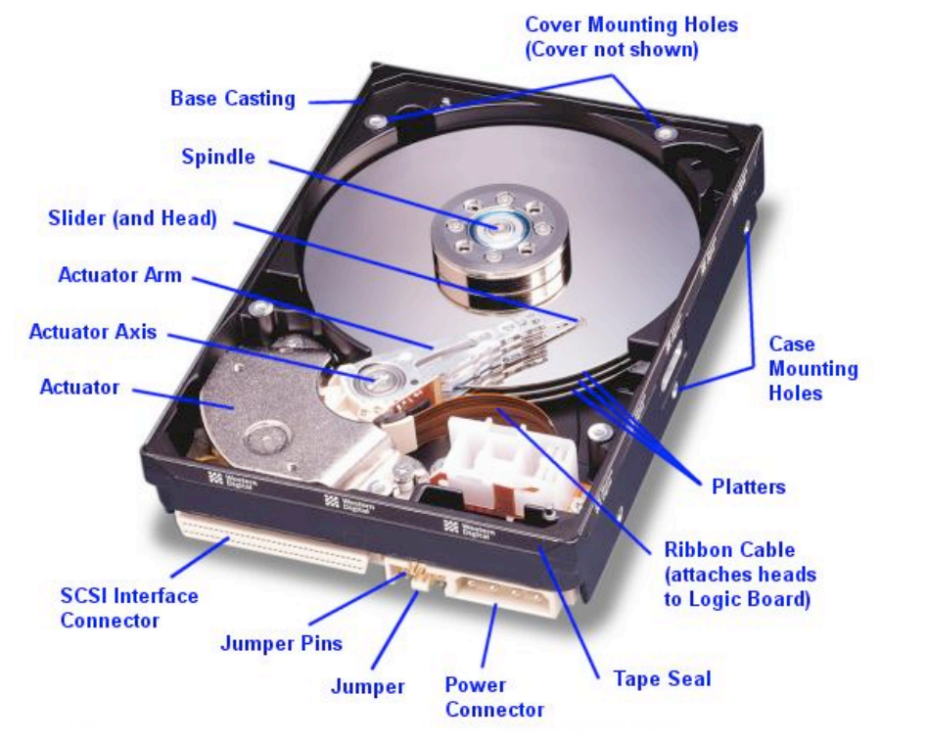
Disk Anatomy

Slide 12
Disk Anatomy (Cont.)
Platter: circular hard surface on which data is stored by inducing magnetic changes
Spindle: axis responsible for rotating the platters
Disk head: mechanism to read or write data
Arm assembly: moves to position a head on a desired track of the platter
RPM (Rotations Per Minute)
7200 RPM – 15000 RPM
Spindle
Disk head
Tracks
Sector
Arm movement
Platters
Arm assembly

Slide 13
Disk Anatomy (Cont.)
Spindle
Data is encoded in concentric circles of sectors called tracks
Sector size is fixed, a characteristic of the disk
Block (page) size: multiple of sector size
At any time, exactly one head can read/write
Disk head
Tracks
Sector
Arm movement
Platters
Arm assembly

Slide 14
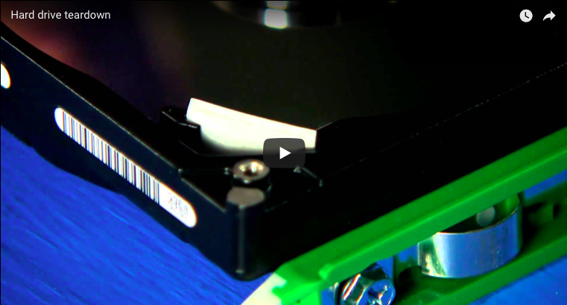

Slide 15
Accessing the Disk
Disk Access Time
Dominated by seek time and rotational delay
=
Seek Time
Time to move the arm to position disk head on the right track
Typical seek time: ~ 9 ms,
~ 4 ms for high-end disks
+
RPM | Average delay (ms)
5,400 | 5.56
7,200 | 4.17
10,000 | 3.00
15,000 | 2.00
Time to wait for sector to rotate under the disk head
Typical delay: 0–10 ms
Maximum delay = 1 full rotation
Average delay ~ half rotation
Rotational Delay
+
Data Transfer Time
Time to move the data to/from the disk surface
Typical rates: ~100 MB/s

Slide 16
Example of HDD Specs
I/O rates
Random access workload (~0.3 MB/s)
Sequential workload (~210 MB/s)
 | Seagate HDD
Capacity | 3 TB
RPM | 7,200
Average Seek Time | 9 ms
Max Transfer Rate | 210 MB/s
# Platters | 3

Slide 17
Accessing the Disk (Cont.)
Key to low disk access time: reduce seek time and/or rotational delay
Through optimizing the sequential arrangement of blocks
“Next” block concept: for each block, load
blocks on the same track, followed by
blocks on the same cylinder, followed by
blocks on adjacent cylinders
For a sequential read, pre-fetching several pages at a time is a big win
Since you don’t need to seek and rotate per page
Reminder:
disk fragmentation
Nice overview of disk architecture and history at http://www.storagereview.com/guide/index.html

Slide 18
Managing Disk Space
Database IO layer works with the disk device in one of the two ways
OS exports a “raw” device interface, which essentially looks like one big file that is a large byte array
OR, the DBMS grabs a big file/directory space in the OS and then uses the OS file as a container for the database
Either way, disk is organized as files, pages and records

Slide 19
Tables on Disk: A Birds Eye View
Data is stored in tables
Each table is stored in a file on disk
Each file consists of multiple pages
Each page consists of multiple records (i.e. tuples)
Each records consists of multiple fields
Data is allocated/deallocated in increments of pages
Logically-close pages should be nearby in the disk

Slide 20
Solid-state Drive (SSD)
Another secondary storage technology
Uses flash memory
No moving parts (i.e. no rotate or seek motors)
Eliminates seek time and rotational delay
Low power consumption and lightweight
Data transfer rate: 300-600 MB/s
Fast sequential and random access

Slide 21
SSDs (Cont.)
Limitation (vanishing)
Small storage capacity (~0.1-0.5x of HDD)
Expensive (~7-20x of HDD)
Writes are much more expensive (~10x) than reads
Limited lifetime
1-10k writes per page
6 year average failure rate

Slide 22
Recap
Architecture of a typical DBMS
Memory hierarchy
CPU cache, main memory, SSD, disk, tape
Disk
Anatomy
Accessing the disk
Seek time, rotational delay, data transfer time
SSD

Slide 23
Buffer Manager
Data must be in RAM for DBMS to operate on it
However, can’t keep all pages DBMS needs in RAM
Buffer manager is in charge of bringing pages from disk to memory as needed by DBMS
Keeps a pool of slots (i.e. frames) to load pages into, i.e. buffer pool
Page request
RAM
Buffer Pool
Page
data
Disk page
Free frame
Disk

Slide 24
Buffer Manager (Cont.)
Requests to buffer manager:
Request a page
Release a page when it is no longer needed
Notify the buffer manager when a page is modified
Information saved for each frame:
Pin count: number of users of the page
Pin a page: indicate that the page is in use (⇒ pin count > 0)
Unpin a page: release the page, and also indicate whether the page is dirtied (⇒ pin count = 0)
Dirty bit: indicates whether the page has been modified and the changes need to be propagated to the disk

Slide 25
Serving a Page
When a page a requested, if:
the page is in the buffer pool, then
return a handle to the frame in the buffer pool
increment the pin count
the page is not in the buffer pool, then
choose a frame for replacement (i.e. with pin count = 0)
if the frame is dirty, write it to disk
read requested page into the chosen frame
pin the page and return a handle to it
Can you tell the number of users currently using some page in the buffer pool?

Slide 26
Buffer Replacement Policy
How to choose a frame for replacement
Least recently used (LRU)
Clock
Most recently used (MRU)
FIFO
Random, …
Replacement policy has a big impact on number of I/Os required to answer various queries
Depends on the access pattern(s) of queries accessing the data

Slide 27
Least Recently Used (LRU) Replacement Policy
Keep a queue of pointers to frames available to be replaced (i.e. pin count = 0)
Add available frame pointers to the tail of the queue
Pick the next available frame to be replaced from the head of the queue
Example
Buffer pool size = 3
No. database pages on disk = 5 (A, B, C, D, E)
Determine the states of page replacement queue and the buffer pool when the following sequence of requests are submitted to the buffer manager:
Request A, modify A, request B, request B, release A, request C, release B, request D, modify D, release B, request A, request E

Slide 28
Clock Replacement Policy
Variant of LRU with lower memory overhead
N frames are ordered as a cycle
A current variable takes on values 1 to N, pointing to the next frame to be considered for replacement
A referenced bit for each page which turns on (is set to 1) when the page pin count becomes 0
Procedure: when need to load a new frame, consider the page pointed to by current
If pin count > 0, increment current (mod N)
If referenced = 1, set it to 0 and increment current (mod N)
Less likely to replace a recently referenced page
If referenced = 0 and pin count = 0, choose the current page for replacement
Repeat the previous example with clock

Slide 29
Sequential Flooding
Nasty situation caused by LRU policy when repeated sequential accesses happen
No. buffer frames < no. pages in file
Each page request causes an I/O!
MRU works much better in these situations
Why?

Slide 30
DBMS vs. OS File System
Q: why not let the OS handle disk space and buffer management?
A: DBMS is better at predicting reference patterns
Buffer management in DBMS requires ability to
“pin” a page in buffer pool
force a page to disk (for recovery and concurrency)
adjust the replacement policy
pre-fetch pages based on predictable access patterns
DBMS can better control the overlap of I/O with computation
Also can leverage multiple disks more effectively

Slide 31
Recap: Tables on Disk
Data is stored in tables
Each table is stored in a file on disk
Each file consists of multiple pages
Each page consists of multiple records (i.e. tuples)
Each records consists of multiple (attribute, value) pairs
Data is allocated/deallocated in increments of pages
Logically-close pages should be nearby in the disk

Slide 32


Files of (Pages of) Records
I/O is performed in page units
However, higher level data management operations require accessing and manipulating records and files of records
File = collection of pages Page = collection of records
File operations
Insert/delete/modify a record
Read a particular record (specified using a record ID)
Scan all records (possibly on some condition(s) on the records to be retrieved)
Records are organized in files using various formats, i.e. file organizations
Each file organizations supports some operations more efficiently

Slide 33
Unordered (Heap) File
Simplest file organization
Each page contains records in no particular order
As the file grows and shrinks, pages are allocated and de-allocated
To support record level operations, we must keep track of:
Pages in a file (using page ID (pid))
Free space on pages
Records on a page (using record ID (rid))
Operations: create/destroy file, insert/delete record, fetch a record with a specified rid, scan all records

Slide 34
Heap File Implemented as a List
(heap file name, header page id) are stored somewhere
Each (data) page has two pointers + data
Each pointer stores a pid
Pages in the free space list have “some” free space
Data
Page
Data
Page
Data
Page
Q: What happens with fixed- vs. variable-length records in terms of full and non-full pages?
Full pages
Header
Page
Data
Page
Data
Page
Data
Page
Pages with
free space
Q: How would you find a record with a specific rid?

Slide 35
Heap File Implemented Using a Page Directory
Each entry for a page keeps track of
whether the page full or not, or
number of free bytes on the page
Can locate pages for new tuples faster
Directory is a collection of pages; linked list implementation is just one alternative
Data
Page 1
Header
Page
Data
Page 2
Data
Page N
…
Directory
Q: What happens with fixed- vs. variable-length records in terms of full and non-full pages?
Q: How would you find a record with a specific rid?

Slide 36
Page Organizations
A page as a collection of records/tuples
Queries deal with tuples
Hence, the slotted page format
A page is a collection of slots
Each slot contains a record
rid = <pid, slot number>
Many slotted page organizations
Need to support search, insert and delete records on a page
Page organizations for various record organizations
Fixed-length records
Variable-length records
Other ways of generating rids?

Slide 37
Organization of Pages of Fixed-length Record
Packed organization
N records are always stored in the first N slots
Problem: moving records (for free space management) changes the record ID
Might not be acceptable
Slot 1
 |  |  |  | N
Slot 2
Slot 3
Free space
Number of records

Slide 38
Organization of Pages of Fixed-length Record (Cont.)
Unpacked organization
Use a bitmap to locate records in the page
Slot 1
 |  |  |  |  |  |  |  |  |  |  |  |  | … | 0 | 1 | 0 | 1 |  | M
Slot 2
Slot 3
Free space
3
2
1
Bitmap
Number of slots

Slide 39
Organization of Pages of Variable-length Record
Directory grows backwards
rid does not change if you move a record on the same page (slot number is determined by position in slot directory)
Good for fixed-length records too
Deletion: offset is set to -1
Insertion
Use any available slots
if no space is available, reorganize (move records around)
 |  |  |  |  |  |  | 120, 40 | -1, 0 | 560, 90 | -1, 0 | 0, 50 | 70, 50 | 6 |  | Book-keeping
Free
space
pointer
5
4
3
2
1
0
Slot directory
Number of slots
Slot entry: offset, record length

Slide 40
Record Organization (Format)
Recap
File organization
Heap file
As doubly-linked list
Using page directory
Page organization
For fixed-length records
Packed
Unpacked
For variable-length records
Let’s see fixed- and variable-length record formats now.

Slide 41
Fixed-length Records
All records are of the same length, number of fields and field types
These information are stored in system catalog
The address of each field can be computed from the information in the catalog
F₁
F₂
F₃
F₄
L₁ | L₂ | L₃ | L₄
Base address (B)
Address = B + L₁ + L₂

Slide 42
Variable-length Records, Option 1
Store fields consecutively
Use delimiters to denote the end of each field
Need to scan the whole record to locate a field
F₁
F₂
F₃
F₄
4 |  | $ |  | $ |  | $ |  | $
Field count
Field delimiter (special symbol)

Slide 43
Variable-length Records, Option 2
Store fields consecutively
Use an array of integer offsets in the beginning
Efficient storage of NULLs, small directory overhead, direct access to the i^{th} field
Issues with growing records (change in attribute value, add/drop attributes)
F₁
F₂
F₃
F₄

Slide 44
Motivating Example: Looking Up One Attribute
What can potentially go wrong if we use any of the previous record formats?
T(a: INTEGER, b: INTEGER, c: VARCHAR(255), …)
SELECT a
FROM T
WHERE a > 10;

Slide 45
Column Stores
Store columns vertically
Each column of a relation is stored in a different file
Can be compressed as well
Contrast with a row store that stores all the attributes of a tuple/record contiguously
File 1
File 1
File 2
File 3
1234 | 45 | Here goes a very long sentence 1
4657 | 2 | Here goes a very long sentence 2
3578 | 45 | Here goes a very long sentence 3
1234
4657
3578
45
2
45
Here goes a very long sentence 1
Here goes a very long sentence 2
Here goes a very long sentence 3
Row store
Column store

Slide 46
Data Storage and Buffer Management
Next Up
Questions?

