Slide 1

Database Management Systems (CS 564)
Fall 2017
Lecture 11

Slide 2

Data Storage and Buffer Management
Where it hits the metal

Slide 3
Building a Data-Driven Application
Requirement Analysis
Conceptual Database Design
Logical Database Design
Schema Refinement
Physical Database Design
Application Development

Slide 4
Building a Data-Driven Application, Augmented
Requirement Analysis
Conceptual Database Design
Logical Database Design
DBMS
Create a Database in a DBMS
Schema Refinement
Physical Database Design
Query the Data through DBMS
Application Development

Slide 5
Simplified DBMS Architecture
SQL Queries
Query Evaluation Engine
Data Access
Storage Manager
I/O Access
Disk
SSD

Slide 6


Detailed DBMS Architecture
Web Forms
Application Front Ends
SQL Interface
SQL Commands
Query Evaluation Engine
Plan Executor
Parser
Operator Evaluator
Optimizer
Transaction Manager
File and Access Methods
Recovery Manager
DBMS
Concurrency Control
Buffer Manager
Storage Manager
Lock Manager
Disk Space Manager
Index Files
Database
System Catalog
Data Files

Slide 7
Storage Manager
Access Methods
Heap Files
Hash Index
Concurrency Control Manager
Recovery Manager
Storage Manager
Sorted Files
B+tree Index
Buffer Manager
I/O Manager
I/O Access
Disk
SSD

Slide 8
Memory Hierarchy
Volatile
Persistent
1-10
CPU
Cache
Main Memory
Price
10²-10³
Access Speed
Access Cycles
Capacity
Flash Storage
10⁵-10⁶
Magnetic Hard Disk Drive (HDD)
10⁷-10⁸
Tape

Slide 9
Memory Hierarchy (Cont.)
Primary storage: main memory (RAM) for currently-used data
Secondary storage: disk for the main database
Increasingly replaced by flash storage
Tertiary storage: tape for archiving older versions of the data
Increasingly replaced by disk

Slide 10
Disk
Secondary storage device of choice
Data is stored and retrieved in units called disk blocks or pages
Unlike RAM, time to retrieve a disk page varies depending upon its location on disk
Therefore, relative placement of pages on disk has major impact on DBMS performance!

Slide 11
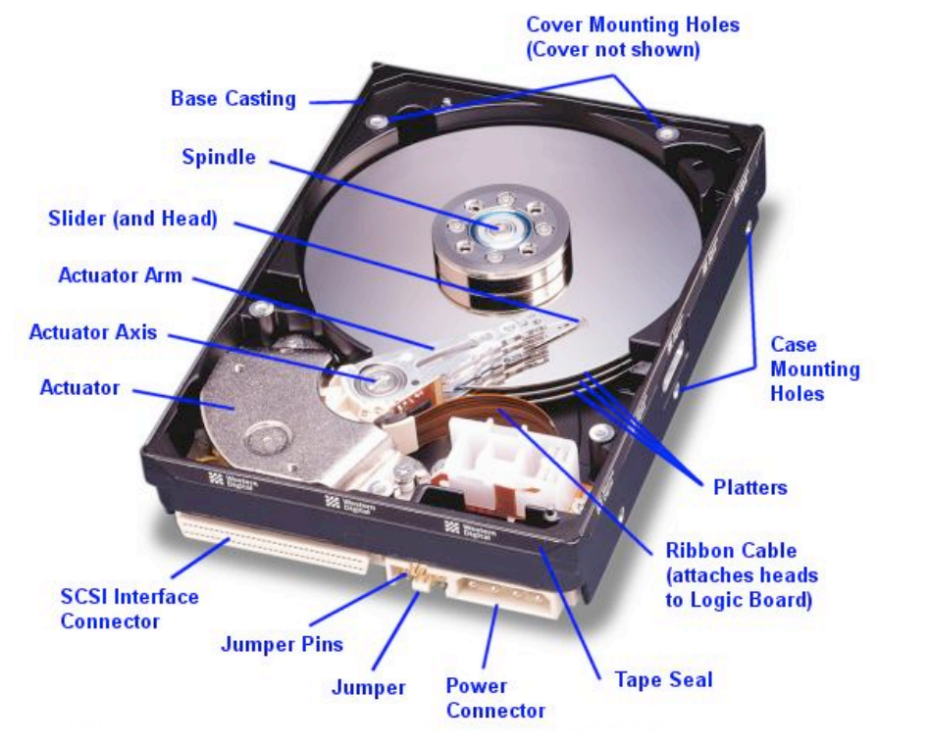
Disk Anatomy

Slide 12
Disk Anatomy (Cont.)
Platter: circular hard surface on which data is stored by inducing magnetic changes
Spindle: axis responsible for rotating the platters
Disk head: mechanism to read or write data
Arm assembly: moves to position a head on a desired track of the platter
RPM (Rotations Per Minute)
7200 RPM – 15000 RPM
Spindle
Disk head
Tracks
Sector
Arm movement
Platters
Arm assembly

Slide 13
Disk Anatomy (Cont.)
Spindle
Data is encoded in concentric circles of sectors called tracks
Sector size is fixed, a characteristic of the disk
Block (page) size: multiple of sector size
At any time, exactly one head can read/write
Disk head
Tracks
Sector
Arm movement
Platters
Arm assembly

Slide 14
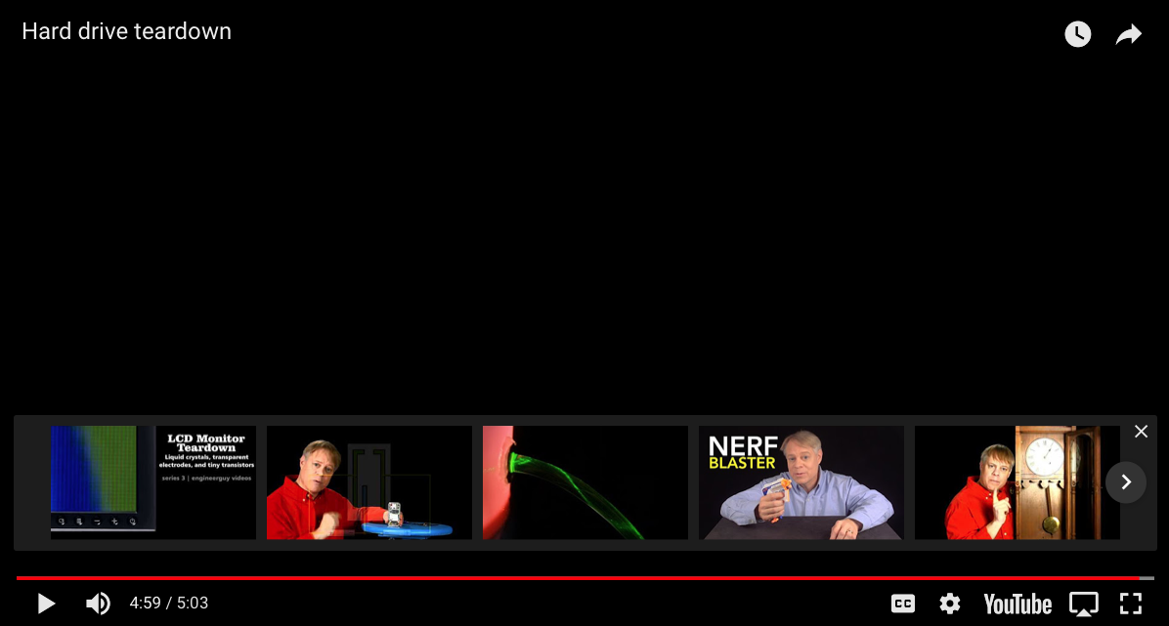

Slide 15
Accessing the Disk
Disk Access Time
Dominated by seek time and rotational delay
=
Seek Time
Time to move the arm to position disk head on the right track
Typical seek time: ~ 9 ms,
~ 4 ms for high-end disks
+
RPM | Average delay (ms)
5,400 | 5.56
7,200 | 4.17
10,000 | 3.00
15,000 | 2.00
Time to wait for sector to rotate under the disk head
Typical delay: 0–10 ms
Maximum delay = 1 full rotation
Average delay ~ half rotation
Rotational Delay
+
Data Transfer Time
Time to move the data to/from the disk surface
Typical rates: ~100 MB/s

Slide 16
Example of HDD Specs
I/O rates
Random access workload (~0.3 MB/s)
Sequential workload (~210 MB/s)
 | Seagate HDD
Capacity | 3 TB
RPM | 7,200
Average Seek Time | 9 ms
Max Transfer Rate | 210 MB/s
# Platters | 3

Slide 17
Accessing the Disk (Cont.)
Key to low disk access time: reduce seek time and/or rotational delay
Through optimizing the sequential arrangement of blocks
“Next” block concept: for each block, load
blocks on the same track, followed by
blocks on the same cylinder, followed by
blocks on adjacent cylinders
For a sequential read, pre-fetching several pages at a time is a big win
Since you don’t need to seek and rotate per page
Reminder:
disk fragmentation
Nice overview of disk architecture and history at http://www.storagereview.com/guide/index.html

Slide 18
Managing Disk Space
Database IO layer works with the disk device in one of the two ways
OS exports a “raw” device interface, which essentially looks like one big file that is a large byte array
OR, the DBMS grabs a big file/directory space in the OS and then uses the OS file as a container for the database
Either way, disk is organized as files, pages and records

Slide 19
Tables on Disk: A Birds Eye View
Data is stored in tables
Each table is stored in a file on disk
Each file consists of multiple pages
Each page consists of multiple records (i.e. tuples)
Each records consists of multiple fields
Data is allocated/deallocated in increments of pages
Logically-close pages should be nearby in the disk

Slide 20
Solid-state Drive (SSD)
Another secondary storage technology
Uses flash memory
No moving parts (i.e. no rotate or seek motors)
Eliminates seek time and rotational delay
Low power consumption and lightweight
Data transfer rate: 300-600 MB/s
Fast sequential and random access

Slide 21
SSDs (Cont.)
Limitation (vanishing)
Small storage capacity (~0.1-0.5x of HDD)
Expensive (~7-20x of HDD)
Writes are much more expensive (~10x) than reads
Limited lifetime
1-10k writes per page
6 year average failure rate

Slide 22
Recap
Architecture of a typical DBMS
Memory hierarchy
CPU cache, main memory, SSD, disk, tape
Disk
Anatomy
Accessing the disk
Seek time, rotational delay, data transfer time
SSD

