Slide 1

Database Management Systems (CS 564)
Fall 2017
Lecture 8

Slide 2
Relational Algebra: Foundations of Operating on Relational Data
“Art is fire plus algebra.”
- J. L. Borges

Slide 3
Building a Data-Driven Application
Requirement Analysis
Conceptual Database Design
Logical Database Design
Schema Refinement
Physical Database Design
Application Development

Slide 4


Building a Data-Driven Application
Requirement Analysis
Conceptual Database Design
Logical Database Design
Query using SQL
Schema Refinement
Database
Create DB using SQL
Physical Database Design
Application Development

Slide 5
Recap: Schema Refinement
Redundancy causes various kinds of anomalies
To refine schemas:
Detect anomalies
Find FDs , apply Armstrong’s axioms, find anomalies
Remove anomalies
Decompose the anomalous schemas
Desired decomposition properties
Redundancy reducing, lossless join, dependency preserving
Normal forms
3NF, BCNF, 4NF, …

Slide 6


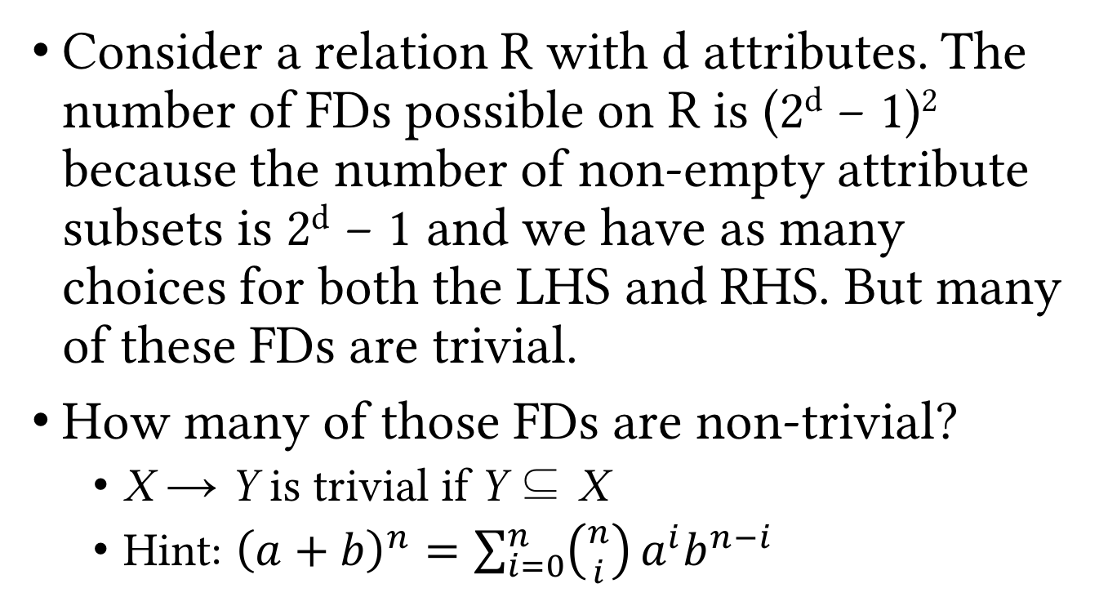
Review Exercise
Consider a relation R with d attributes. The number of FDs possible on R is (2^{d} − 1)² because the number of non-empty attribute subsets is 2^{d} − 1 and we have as many choices for both the LHS and RHS. But many of these FDs are trivial.
How many of those FDs are non-trivial?
X → Y is trivial if Y ⊆ X
Hint: ${\left(a+b\right)}^{n}=\sum_{i=0}^{n}{\left({n \atop i}\right)}a^{i}b^{n−i}$

Slide 7
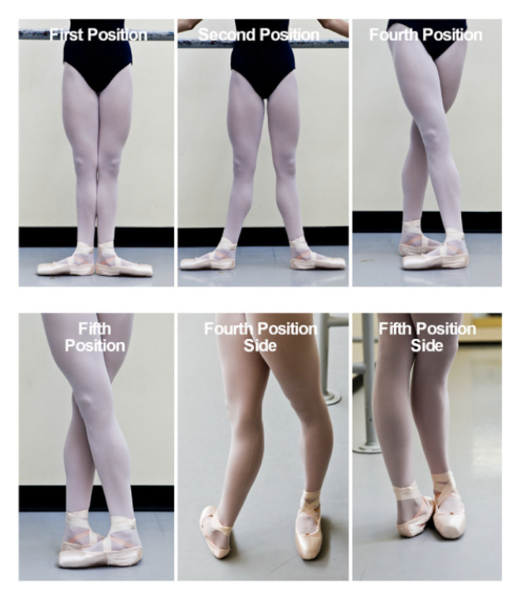
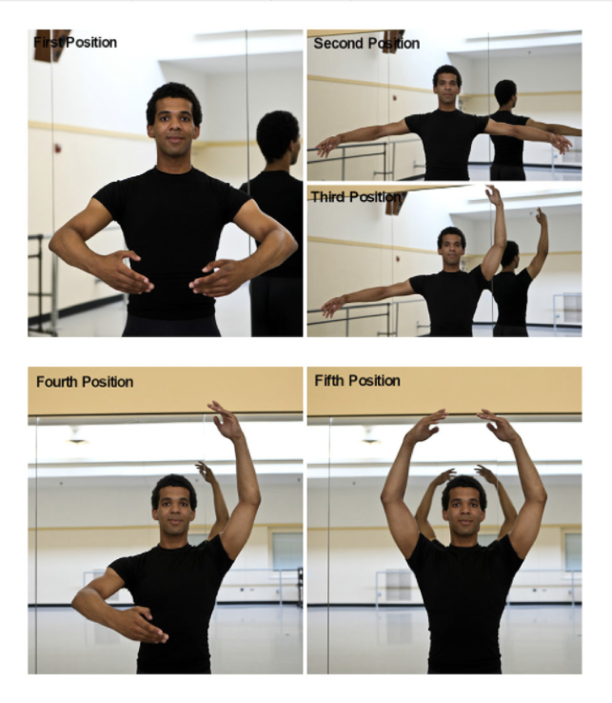

Slide 8
Query Processing Pipeline
SQL Query
Relational Algebra (RA) Plan
Optimized RA Plan
Execution
Declarative query
(from user)
Translate to relational algebra expression
Find
logically equivalent
-but more efficient- RA expression
Execute each operation of the optimized plan
A rough analogy:
Java Program
Bytecode
Hotspot Detection & Optimization
Execution

Slide 9
Query Processing Pipeline
SQL Query
Relational Algebra (RA) Plan
Optimized RA Plan
Execution
Declarative query
(from user)
Translate to relational algebra expression
Find
logically equivalent
-but more efficient- RA expression
Execute each operation of the optimized plan
Relational algebra gives us a precise and optimizable framework to execute declarative (SQL) queries.

Slide 10
Example
SELECT Student.Name
FROM Student, Department
WHERE Major = DID AND
Age > 22;
𝜋_{Student.Name}
𝜎_{Age > 22}
⨝_{Major = DID}
Student
Department

Slide 11
Example
SELECT Student.Name
FROM Student, Department
WHERE Major = DID AND
Age > 22;
𝜋_{Student.Name}
⨝_{Major = DID}
𝜎_{Age > 22}
Department
Student

Slide 12
Formal Relational Query Languages
Help fetching exactly the data we want
Easy to specify matching conditions
Easy to compose and construct complex queries
Declarative, i.e. specify what you want, not how to obtain it
Rich formal frameworks to enable composition/inference of operations on data
Two main formal relational query language
Relational algebra
Relational calculus

Slide 13
Relational Algebra (RA)
Most widely used formalization for manipulating structured data
Main components of an (abstract) algebra
Operands
e.g. integers
Operations
e.g. addition and multiplication
Properties of operations
e.g. associativity and commutativity
Special elements
e.g. identity elements for addition (0) and multiplication (1)
Go read about groups, rings and fields, among most beautiful mathematical constructs!

Slide 14
RA Operands: Relations
Input and output of RA operations are relations (instances)
i.e. sets of tuples
Example
SecID | CID | Semester | Year | Instructor
30098 | MATH240 | Fall | 2017 | Euclid
40026 | CS367 | Fall | 2016 | Dijkstra
1005 | CS367 | Spring | 2004 | Gauss
30451 | CS764 | Fall | 2017 | Patel
20006 | CS564 | Spring | 2001 | Codd
∪
Section1
Section2
SecID | CID | Semester | Year | Instructor
30451 | CS764 | Fall | 2017 | Patel
20006 | CS564 | Spring | 2001 | Codd
40026 | CS367 | Fall | 2016 | Dijkstra
SecID | CID | Semester | Year | Instructor
30098 | MATH240 | Fall | 2017 | Euclid
40026 | CS367 | Fall | 2016 | Dijkstra
1005 | CS367 | Spring | 2004 | Gauss

Slide 15
Relational Operations
A collection of actions to manipulate relations
e.g. ∪ in the previous example
A query is a composition of relations using relational operations
Two main categories
Basic operations
Derived and auxiliary operations

Slide 16
Schema vs. Instance, Revisited
A query (in relational algebra or calculus) is applied to a database instance
The result (output) is also a database instance
Schema of the input is fixed for a query
Schema of the output is determined by the query specifics
Same query can be applied to different instances that have the same schema

Slide 17
Basic Relational Operations
Selection (𝜎)
Projection (𝜋)
Cartesian product (×)
Set operations
Union (∪)
Difference (- or ∖)

Slide 18
Selection
Return all rows that satisfy a condition
Notation: 𝜎_{C}(R)
C: condition that output rows should satisfy
=, <, >, ≥, ≤, ∧, ∨, ¬, …
R: input relation
Output schema: same as input schema (i.e. R’s schema)

Slide 19
Selection (Cont.)
Example: 𝜎_{Age > 22}(Student)
SID | Name | Class | Major
8 | Brown | 24 | CS
23 | Boll | 23 | BIOL
Operator
vs
Operation
𝜎_{Age > 22}
Student
SID | Name | Class | Major
17 | Smith | 22 | MATH
8 | Brown | 24 | CS
5 | Moreno | 21 | PHYS
23 | Boll | 23 | BIOL
7 | Bakhtiari | 21 | CS

Slide 20
Projection
Return specific attributes of all rows
Notation: 𝜋_{A1, …, An}(R)
Input schema: R(B1, …, Bm)
A1, …, An: list of attributes to project onto, s.t. {A1, …, An} ⊆{B1, …, Bm}
Output schema: S(A1, …, An)

Slide 21
Projection (Cont.)
Example: 𝜋_{Name, Major}(Student)
Name | Major
Smith | MATH
Brown | CS
Moreno | PHYS
Boll | BIOL
𝜋_{Name, Major}
Set semantics; i.e. eliminates duplicates
Student
SID | Name | Class | Major
17 | Smith | 22 | MATH
8 | Brown | 24 | CS
5 | Moreno | 21 | PHYS
23 | Boll | 23 | BIOL
7 | Brown | 21 | CS

Slide 22
Cartesian Product
Return the concatenation of every tuple in R₁ with every tuple in R₂
Notation: R₁×R₂
Input schemas: R₁(A1,…,An), R₂(B1,…,Bm)
Condition: {A1,…,An}∩{B1,…,Bm}=∅
Output schema: S(A1,…,An,B1,…,Bm)

Slide 23
Cartesian Product (Cont.)
Example: Student×Department
SID | Name | Class | Major | DID | DName | Address
17 | Smith | 22 | MATH | CS | Computer Sciences | ADD1
8 | Brown | 24 | CS | MATH | Mathematics | ADD2
17 | Smith | 22 | MATH | PHYS | Physics | ADD3
8 | Brown | 24 | CS | CS | Computer Sciences | ADD1
17 | Smith | 22 | MATH | MATH | Mathematics | ADD2
8 | Brown | 24 | CS | PHYS | Physics | ADD3
×
Student
Department
SID | Name | Class | Major
17 | Smith | 22 | MATH
8 | Brown | 24 | CS
DID | DName | Address
CS | Computer Sciences | ADD1
MATH | Mathematics | ADD2
PHYS | Physics | ADD3

Slide 24
Union
Return the union of all the tuples in R₁ and R₂
Notation: R₁∪R₂
Input schemas: R₁ and R₂ have the same schema, with attributes A1,…,An
i.e. union-compatible
Output schema: the same as the input relations

Slide 25
Union (Cont.)
Example
SecID | CID | Semester | Year | Instructor
30098 | MATH240 | Fall | 2017 | Euclid
40026 | CS367 | Fall | 2016 | Dijkstra
1005 | CS367 | Spring | 2004 | Gauss
30451 | CS764 | Fall | 2017 | Patel
20006 | CS564 | Spring | 2001 | Codd
∪
Section1
Section2
SecID | CID | Semester | Year | Instructor
30451 | CS764 | Fall | 2017 | Patel
20006 | CS564 | Spring | 2001 | Codd
40026 | CS367 | Fall | 2016 | Dijkstra
SecID | CID | Semester | Year | Instructor
30098 | MATH240 | Fall | 2017 | Euclid
40026 | CS367 | Fall | 2016 | Dijkstra
1005 | CS367 | Spring | 2004 | Gauss

Slide 26
Difference
Return the the tuples in R₁ that are not in R₂
Notation: R₁-R₂ (or R₁∖R₂)
Input schemas: R₁ and R₂ are union-compatible
Output schema: the same as the input relations

Slide 27
Difference (Cont.)
Example
SecID | CID | Semester | Year | Instructor
40026 | CS367 | Fall | 2016 | Dijkstra
-
Section1
Section2
SecID | CID | Semester | Year | Instructor
30451 | CS764 | Fall | 2017 | Patel
20006 | CS564 | Spring | 2001 | Codd
40026 | CS367 | Fall | 2016 | Dijkstra
SecID | CID | Semester | Year | Instructor
30098 | MATH240 | Fall | 2017 | Euclid
40026 | CS367 | Fall | 2016 | Dijkstra
1005 | CS367 | Spring | 2004 | Gauss

Slide 28
Example Queries
SELECT *
FROM User
WHERE Age >= 20
AND Age < 30;
𝜎_{Age ≥ 22 ∧ Age < 30}(User)
𝜎_{Age ≥ 22 ∧ Age < 30}
User

Slide 29
Example Queries (Cont.)
SELECT Name
FROM User
WHERE Age >= 20
AND Age < 30;
𝜋_{Name}(𝜎_{Age ≥ 22 ∧ Age < 30}(User))
𝜋_{Name}
𝜎_{Age ≥ 22 ∧ Age < 30}
User

Slide 30
Example Queries (Cont.)
Student
Department
SID | SName | Class | Major
17 | Smith | 21 | MATH
8 | Brown | 24 | CS
5 | Moreno | 21 | PHYS
DID | DeptName | Address
CS | Computer Sciences | ADD1
MATH | Mathematics | ADD2
PHYS | Physics | ADD3
SELECT DeptName
FROM Student, Department
WHERE Major = DID AND
Class = 21;
𝜋_{DeptName}
𝜎_{Major = DID ∧ Class = 21}
Q: Is this an efficient way of answering this query in practice?
×
Student
Department
𝜋_{DeptName}(𝜎 _{Major = DID ∧ Class = 21}(Student×Department))

Slide 31
Recap: Basic Relational Operations
Selection (𝜎)
Projection (𝜋)
Cartesian product (×)
Set operations
Union (∪)
Difference (- or ∖)

Slide 32
Derived and Auxiliary Relational Operations
Renaming (𝜌)
Join (⨝)
Set operations
Intersection (∩)
Division (/)

Slide 33
Renaming
Return the same relation instance with the attributes renamed
Notation: 𝜌_{B1,…,Bn}(R)
Input schema: R(A1,…,An)
Output schema: S(B1,…,Bn)
Another notation: 𝜌_{{Ai➝Bi}}(R)

Slide 34
Renaming (Cont.)
Example: 𝜌_{StID, StName, StClass, StMaj}(Student)
StID | StName | StClass | StMaj
17 | Smith | 22 | MATH
8 | Brown | 24 | CS
23 | Boll | 23 | BIOL
7 | Bakhtiari | 21 | CS
𝜌_{StID, StName, StClass, StMaj}
Student
SID | Name | Class | Major
17 | Smith | 22 | MATH
8 | Brown | 24 | CS
23 | Boll | 23 | BIOL
7 | Bakhtiari | 21 | CS

Slide 35
Intersection
Return the intersection of tuples in R₁ and R₂
Notation: R₁∩R₂
Input schemas: R₁ and R₂ are union-compatible
Output schema: the same as the input relations
Intersection is derived
R₁∩R₂ = R₁-(R₁-R₂)

Slide 36
Intersection (Cont.)
Example
SecID | CID | Semester | Year | Instructor
1005 | CS367 | Spring | 2004 | Gauss
20006 | CS564 | Spring | 2001 | Codd
∩
Section1
Section2
SecID | CID | Semester | Year | Instructor
1005 | CS367 | Spring | 2004 | Gauss
20006 | CS564 | Spring | 2001 | Codd
40026 | CS367 | Fall | 2016 | Dijkstra
SecID | CID | Semester | Year | Instructor
30098 | MATH240 | Fall | 2017 | Euclid
40026 | CS367 | Fall | 2016 | Dijkstra
1005 | CS367 | Spring | 2004 | Gauss

Slide 37
Side Note: Operations on Bags
Union: {a,b,b,c} ∪ {a,b,b,b,e,f,f} = {a,a,b,b,b,b,b,c,e,f,f}
Add the number of occurrences
Difference: {a,b,b,b,c,c} – {b,c,c,c,d} = {a,b,b,d}
Subtract the number of occurrences
Intersection: {a,b,b,b,c,c} ∩ {b,b,c,c,c,c,d} = {b,b,c,c}
Minimum of the two numbers of occurrences
Selection: preserve the number of occurrences
Projection: preserve the number of occurrences (no duplicate elimination)
Cartesian product, join: no duplicate elimination

Slide 38
Join
One of the most important and well-studied operations in relational databases
Comes in various flavors
Theta join
Natural join
Equi-join
Semi-join
Inner join
Outer join
Anti-join
…

Slide 39
Theta Join
Return all the combinations of R₁ and R₂ tuples which satisfy the join condition 𝜃
Notation: R₁⨝_{𝜃}R₂
Equivalent expression: 𝜎_{𝜃}(R₁×R₂)
Input schemas: R₁(A1,…,An) and R₂(B1,…,Bm)
Condition 𝜃: a Boolean condition on A1,…,An,B1,…,Bm
Output schema: S(A1,…,An,B1,…,Bm)

Slide 40
Theta Join (Cont.)
Example: Student ⨝_{Major=DID ∧ Class=21} Department
SID | SName | Class | Major | DID | DeptName | Address
17 | Smith | 21 | MATH | MATH | Mathematics | ADD2
5 | Moreno | 21 | PHYS | PHYS | Physics | ADD3
⨝_{Major=DID∧Class=21}
Student
Department
SID | SName | Class | Major
17 | Smith | 21 | MATH
8 | Brown | 24 | CS
5 | Moreno | 21 | PHYS
DID | DeptName | Address
CS | Computer Sciences | ADD1
MATH | Mathematics | ADD2
PHYS | Physics | ADD3

Slide 41
Natural Join
Return all the combinations of tuples of R₁ and R₂ which agree on the join attributes
Notation: R₁⨝R₂
Input schemas: R₁(A1,…,An) and R₂(B1,…,Bm)
Join attributes: {A1,…,An}∩{B1,…,Bm}
Output schema: S(C1,…,Cp) s.t. {C1,…,Cp}={A1,…,An}∪{B1,…,Bm}

Slide 42
Natural Join (Cont.)
Example: Student ⨝ Department = πSID,SName,Class,DID,DeptName,Address(𝜎_{DID=DID2}(Student×𝜌_{DID2,DeptName,Address}(Department)))
SID | SName | Class | DID | DeptName | Address
17 | Smith | 21 | MATH | Mathematics | ADD2
8 | Brown | 24 | CS | Computer Sciences | ADD1
5 | Moreno | 21 | PHYS | Physics | ADD3
⨝
Student
Department
SID | SName | Class | DID
17 | Smith | 21 | MATH
8 | Brown | 24 | CS
5 | Moreno | 21 | PHYS
DID | DeptName | Address
CS | Computer Sciences | ADD1
MATH | Mathematics | ADD2
PHYS | Physics | ADD3

Slide 43
Equi-join
Return all the combinations of tuples of R₁ and R₂ which satisfy the equality condition C=D
Equi-join is a special case of theta join
Natural join is a special case of equi-join
Notation: R₁⨝_{C=D}R₂
Equivalent expression: 𝜎_{C=D}(R₁×R₂)
Input schemas: R₁(A1,…,An) and R₂(B1,…,Bm)
C⊆{A1,…,An} and D⊆{B1,…,Bm}
Output schema: S(A1,…,An,B1,…,Bm)

Slide 44
Equi-join (Cont.)
Example: Student ⨝_{Major=DID} Department
SID | SName | Class | Major | DID | DeptName | Address
17 | Smith | 21 | MATH | MATH | Mathematics | ADD2
8 | Brown | 24 | CS | CS | Computer Sciences | ADD1
5 | Moreno | 21 | PHYS | PHYS | Physics | ADD3
⨝_{Major=DID}
Student
Department
SID | SName | Class | Major
17 | Smith | 21 | MATH
8 | Brown | 24 | CS
5 | Moreno | 21 | PHYS
DID | DeptName | Address
CS | Computer Sciences | ADD1
MATH | Mathematics | ADD2
PHYS | Physics | ADD3

Slide 45
Semi-join
Return all tuples of R₁ which satisfy the natural join condition
Notation: R₁⋉R₂
Equivalent expression: π_{A1,…,An}(R₁⨝R₂)
Input schemas: R₁(A1,…,An) and R₂(B1,…,Bm)
Join attributes: {A1,…,An}∩{B1,…,Bm}
Output schema: S(A1,…,An)

Slide 46
Semi-join (Cont.)
Example: Student ⋉ GradeReport
SID | SName | Class | Major
17 | Smith | 21 | MATH
8 | Brown | 24 | CS
⋉
Student
GradeReport
SID | SName | Class | Major
17 | Smith | 21 | MATH
8 | Brown | 24 | CS
5 | Moreno | 21 | PHYS
SID | CID | Grade
8 | CS367 | A
17 | CS564 | NULL

Slide 47
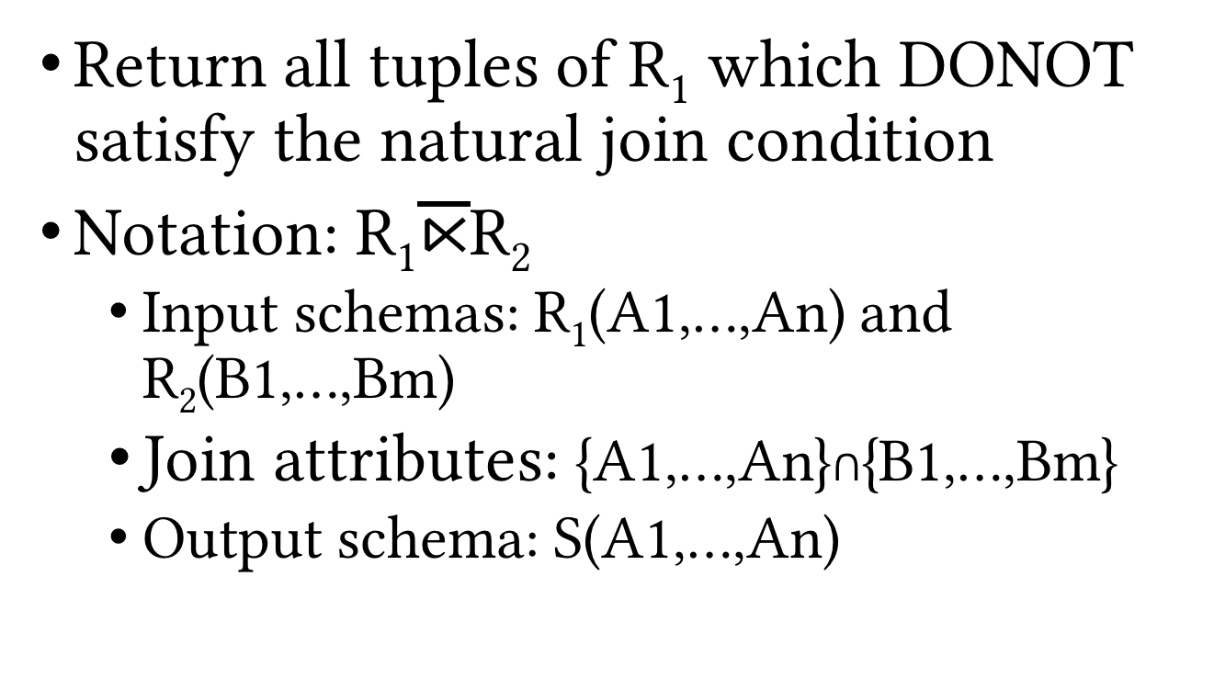
Anti-join
Return all tuples of R₁ which DONOT satisfy the natural join condition
Notation: R₁$\overline{⋉}$R₂
Input schemas: R₁(A1,…,An) and R₂(B1,…,Bm)
Join attributes: {A1,…,An}∩{B1,…,Bm}
Output schema: S(A1,…,An)

Slide 48


Anti-join (Cont.)
Example: S $\overline{⋉}$ G
SID | SName | Class | Major
5 | Moreno | 21 | PHYS
Q: Can you rewrite anti-join using other RA operations?
$$\overline{⋉}$$
S
G
SID | SName | Class | Major
17 | Smith | 21 | MATH
8 | Brown | 24 | CS
5 | Moreno | 21 | PHYS
SID | CID | Grade
8 | CS367 | A
17 | CS564 | AB

Slide 49
Inner vs. Outer Join
Inner join: non-matching tuples from either side of the join are dropped
All of the join operations we have seen so far are examples of inner join
Outer join: non-matching tuples from one or both sides of the join are included in the results
Left/right/full outer join

Slide 50
Left Outer Join
Example: S ⟕ G
Similarly, right (⟖) and full (⟗) outer joins
SID | SName | Class | Major | CID | Grade
17 | Smith | 21 | MATH | CS564 | AB
8 | Brown | 24 | CS | CS367 | A
5 | Moreno | 21 | PHYS | NULL | NULL
⟕
Q: Can you rewrite outer joins using anti-join?
S
G
SID | SName | Class | Major
17 | Smith | 21 | MATH
8 | Brown | 24 | CS
5 | Moreno | 21 | PHYS
SID | CID | Grade
8 | CS367 | A
17 | CS564 | AB

Slide 51
Division
Return every tuple in R₁ which “subsumes” every tuple of R₂
Notation: R₁/R₂
Input schemas: R₁(A1,…,An) and R₂(B1,…,Bm)
Requires {B1,…,Bm}⊆{A1,…,An}
Output schema: S(C1,…,Cp) s.t. {C1,…,Cp}={A1,…,An}-{B1,…,Bm}

Slide 52
Division (Cont.)
Example: R / M
Ratings (R)
Movies (M)
M’
M”
UserID | MName
79 | Inception
80 | Inception
123 | Inception
79 | Avatar
80 | Avatar
101 | Avatar
79 | Gravity
191 | Gravity
210 | Gravity
MName
Inception
Avatar
Gravity
MName
Inception
Avatar
MName
Inception
T = R / M’’
T = R / M’
T = R / M
UserID
79
80
UserID
79

Slide 53
Recap: Relational Operations
Basic
RA Operations
Derived and Auxiliary RA Operations
Selection (𝜎)
Projection (𝜋)
Cartesian product (×)
Set operations
Union (∪)
Difference (- or ∖)
Renaming (𝜌)
Join (⨝)
Theta, natural, …
Set operations
Intersection (∩)
Division (/)

Slide 54
A Complete Set of RA Operations
{𝜎, 𝜋, ×, ∪, -, 𝜌} is a complete set of RA operations; i.e. any other RA operation can be expressed as a sequence of operations form this set
However, there are some useful operations that cannot be expressed in RA
Hence, extended RA operations

Slide 55
Extended RA Operations
Some fancier operations that are not available in the original RA
Aggregate functions and grouping
Generalized projection

Slide 56
Aggregate Functions and Grouping
Return grouping attributes and the corresponding aggregated values
Notation: 𝛾_{B1,…,Bm,Agg(A)}(R)
Input schema: R(C1,…Cn)
Grouping attributes: {B1,…Bm}⊆{C1,…Cn}
Agg: the aggregate function
e.g. SUM, COUNT, AVG, MIN and MAX
Output schema: B1,…,Bm,Y where Y is an extra numerical attribute for the result of the aggregate function

Slide 57
Aggregate Functions and Grouping (Cont.)
Example: 𝛾_{Major,AVG(Age)}(Student)
Major | Age
CS | 22.5
BIOL | 22
𝛾_{Major,AVG(Age)}
Student
SID | Name | Age | Major
17 | Smith | 22 | BIOL
8 | Brown | 24 | CS
5 | Moreno | 21 | BIOL
23 | Boll | 23 | BIOL
7 | Bakhtiari | 21 | CS

Slide 58
Generalized Projection
Return specific attributes or functions of attributes of all rows
Notation: 𝜋_{F1,...,Fn}(R)
Input schema: R(B1,…,Bm)
F1,…,Fn: list of attributes or functions of attributes in {B1,…,Bm} to project onto
Output schema: S(F1,…,Fn)

Slide 59
Generalized Projection (Cont.)
Example: 𝜋_{Name, Major}(Student)
Name | Age-20
Smith | 2
Brown | 4
Moreno | 1
Boll | 3
Brown | 1
𝜋_{Name, Age-20}
Student
SID | Name | Class | Major
17 | Smith | 22 | MATH
8 | Brown | 24 | CS
5 | Moreno | 21 | PHYS
23 | Boll | 23 | BIOL
7 | Brown | 21 | CS

Slide 60
RA Limitations
RA cannot express transitive closure!
Example: find all the supervising relationships on all levels in the following table.
Employee
EID | Name | Sal | SupID
17 | Smith | 22000 | 23
8 | Brown | 24000 | 5
5 | Moreno | 21000 | NULL
23 | Boll | 230000 | 5
7 | Brown | 21000 | 23

Slide 61
RA Queries
There is always an example the like of which you haven’t seen before. However, the more examples you see, the less likely you’d get caught surprised.

Slide 62
Representing RA Queries
A RA query is a composition of relations (instances) using relational operations
Represent a RA query in three different ways
Expressions with operators
Sequence of assignment statements
Expression tree

Slide 63
Query Examples
User(UID, Name, Age)
Event(EID, Name, Location, StartDT, EndDT, Description,
CreatorUID, CreateDT)
Q1: what are the Names of all Events whose creators are over 18?
π_{Name}(𝜎_{Age>18}(User⨝_{UID=CreatorUID}Event))
𝜋_{Name}
𝜎_{Age > 18}
R₁=User⨝_{UID=CreatorUID}Event
R₂=𝜎_{Age>18}(R₁)
R =π_{Name}(R₂)
⨝_{UID=CreatorUID}
User
Event

Slide 64
Query Examples (Cont.)
User(UID, Name, Age)
Event(EID, Name, Location, StartDT, EndDT, Description,
CreatorUID, CreateDT)
Q1: what are the Names of all Events whose creators are over 18?
π_{Name}(𝜎_{Age>18}(User)⨝_{UID=CreatorUID}Event)
𝜋_{Name}
⨝_{UID=CreatorUID}
R₁= 𝜎_{Age>18}(User)
R₂= R₁⨝_{UID=CreatorUID}Event
R = π_{Name}(R₂)
𝜎_{Age > 18}
Event
User

Slide 65
Alternative Plans
Various algebraic rewritings (or plans) of the same query
Retrieve exactly the same data
Use the last component of the (relational) algebra (properties of operations) to create alternative plans
Cost of answering a query using various plans may significantly vary

Slide 66
Alternative Plans (Cont.)
𝜋_{Name}
𝜋_{Name}
15 tuples selected
𝜎_{Age > 68}
1500 comparisons
⨝_{UID=CreatorUID}
10⁷ comparisons
⨝_{UID=CreatorUID}
15 tuples selected
𝜎_{Age > 68}
Event
100000
tuples
100
tuples
100000
tuples
User
100
tuples
Event
User
Query optimizers use rewriting rules (based on operations properties) to find better (i.e. faster) plans to answer any given query, i.e. optimize the query execution.
More on this later …

Slide 67
Query Examples (Cont.)
Student(SID, Name, Age, Major)
GradeReport(SID, SecID, Grade)
Course(CID, Name, Credits, Department)
Prerequisite(CID, PrereqID)
Section(SecID, CID, Semester, Year, Instructor)
Q2: what are the SIDs of all Students who have taken Course “Computer Graphics” ever?

Slide 68
Query Examples (Cont.)
Student(SID, Name, Age, Major)
GradeReport(SID, SecID, Grade)
Course(CID, Name, Credits, Department)
Prerequisite(CID, PrereqID)
Section(SecID, CID, Semester, Year, Instructor)
Q3: what are the Names of all Course which are prerequisites of “Computer Graphics”?

Slide 69
Query Examples (Cont.)
Student(SID, Name, Age, Major)
GradeReport(SID, SecID, Grade)
Course(CID, Name, Credits, Department)
Prerequisite(CID, PrereqID)
Section(SecID, CID, Semester, Year, Instructor)
Q4: what are the Names of all Students getting a Grade of 85 or more in CS564 who are not CS Majors?

Slide 70
Query Examples (Cont.)
Student(SID, Name, Age, Major)
GradeReport(SID, SecID, Grade)
Course(CID, Name, Credits, Department)
Prerequisite(CID, PrereqID)
Section(SecID, CID, Semester, Year, Instructor)
Q5: what are the Names of all Students who have either taken some CS course or are CS majors?

Slide 71
Query Examples (Cont.)
Student(SID, Name, Age, Major)
GradeReport(SID, SecID, Grade)
Course(CID, Name, Credits, Department)
Prerequisite(CID, PrereqID)
Section(SecID, CID, Semester, Year, Instructor)
Q6: what is the average Grade for each Section of any CS Course offered in the Fall of 2016?

Slide 72
Other Relational Languages
Tuple relational calculus (TRC)
A subset of first-order logic
No notion of operations
Less popular today
More involved to work with

Slide 73
TRC Example
User(UID, Name, Age)
Event(EID, Name, Location, StartDT, EndDT, Description,
CreatorUID, CreateDT)
What are the Names of all Events whose creators are over 18?
π_{Name}(𝜎_{Age>18}(User⨝_{UID=CreatorUID}Event))
RA:
TRC:
{ t | ∃r ∈ Event; ∃s ∈ User; s.UID=r.CreatorID ∧ s.Age>18 ∧ t=s.Name}

Slide 74

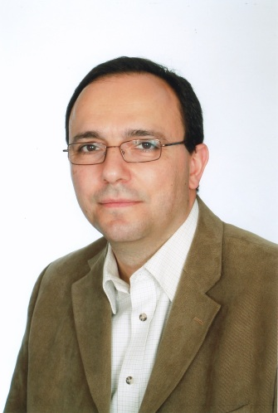

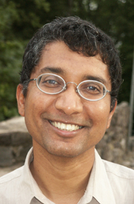
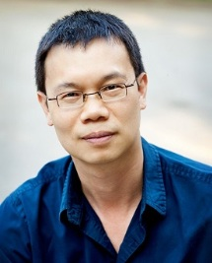
Other Relational Languages (Cont.)
Datalog
Based on AI languages such as Prolog
Used in deductive databases (90s)
Making a comeback in data integration, machine learning and cloud programming

Slide 75
Datalog Example
User(UID, Name, Age)
Event(EID, Name, Location, StartDT, EndDT,
Description, CreatorUID, CreateDT)
What are the Names of all Events whose creators are over 18?
SQL:
SELECT E.Name FROM Event AS E
WHERE E.CreatorID IN
(SELECT UID FROM User WHERE Age < 18);
π_{Name}(𝜎_{Age>18}(User⨝_{UID=CreatorUID}Event))
RA:
TRC:
{ t | ∃r ∈ Event; ∃s ∈ User; s.UID=r.CreatorID ∧ s.Age>18 ∧ t=s.Name}
Datalog:
R1(Name, Age) :- User(UID, Name, Age), Event(_,_,_,_,_,_,UID,_)
R(Name) :- R1(Name, Age) ∧ Age > 18

Slide 76
Limitations of Relational Languages
Are not Turing-complete
Some don’t have loops and recursions
Not general-purpose PLs
However, are increasingly used within other general-purpose PLs to query data

Slide 77
Recap: Relational Operations
Basic
RA Operations
Derived and Auxiliary RA Operations
Selection (𝜎)
Projection (𝜋)
Cartesian product (×)
Set operations
Union (∪)
Difference (- or ∖)
Renaming (𝜌)
Join (⨝)
Theta, natural, …
Set operations
Intersection (∩)
Division (/)

Slide 78
More SQL!
Next Up
Questions?

