Slide 1

Database Management Systems (CS 564)
Fall 2017
Lecture 28

Slide 2
Final Exam Review
Semi-leaks

Slide 3
CS 564 in a Nutshell
Requirement Analysis
Web Forms
Application Front Ends
SQL Interface
SQL Commands
Conceptual Database Design
Query Evaluation Engine
Plan Executor
Parser
Operator Evaluator
Optimizer
Logical Database Design
Transaction Manager
File and Access Methods
Recovery Manager
DBMS
Schema Refinement
Concurrency Control
Buffer Manager
Storage Manager
Lock Manager
Disk Space Manager
Physical Database Design
Index Files
Database
System Catalog
Application Development
Data Files

Slide 4
Memory Hierarchy
Volatile
Persistent
1-10
CPU
Cache
Main Memory
Price
10²-10³
Access Speed
Access Cycles
Capacity
Flash Storage
10⁵-10⁶
Magnetic Hard Disk Drive (HDD)
10⁷-10⁸
Tape

Slide 5
Storage Management
Primary (RAM) vs. secondary (disk) storage
Disk: Anatomy, accessing the disk (seek time, rotational delay, data transfer time)
Example: given various disk properties, compute rotational delay, data transfer rate, etc.
Disk Space Manager

Slide 6
Buffer Manager
Requests to buffer manager:
Request a page (pin)
Release a page when it is no longer needed (unpin)
Notify the buffer manager when a page is modified (set dirty bit)
Buffer replacement policies
Least recently used (LRU)
Clock
Most recently used (MRU)
FIFO
Random, …
Sequential flooding
Page request
RAM
Buffer Pool
Page
data
Free frame
Disk page
Disk
Example: given buffer pool size, frame/page size, access patterns/sequences and buffer page replacement policy, determine I/O cost, hit and miss rates, etc.
Buffer Manager

Slide 7
File, Page and Record Organization
File organization
Heap file (as doubly-linked list or directory)
Page organization
For fixed-length records
Packed and unpacked
For variable-length records
Record organization
Fixed-length records
Variable-length records
Two variations: delimiters vs. array of offsets
Row-store vs. column-store
Example: compare various file formats in terms of pros and cons
Disk Space Manager

Slide 8
Indexing
Alternative file/data organization
Sorted files
Using indexes
Tree-based
Good for equality and range searches
Example: B+tree
Height-balanced dynamic tree structure
Insert/delete at log_{F} N cost
Hash-based
Good for equality searches
Static hashing
Dynamic
Example: extendible (global and local depth)
Clustered vs unclustered
 | a |  | b
 | e |  | f
 | g |  | h |  | i
 | j |  | k |  | l |  | m
3 | A
 | B
 | 3
000
001
010
011
100
101
110
111
2 | C
 | D
2 | E
2
3 | G
File and Access Methods

Slide 9
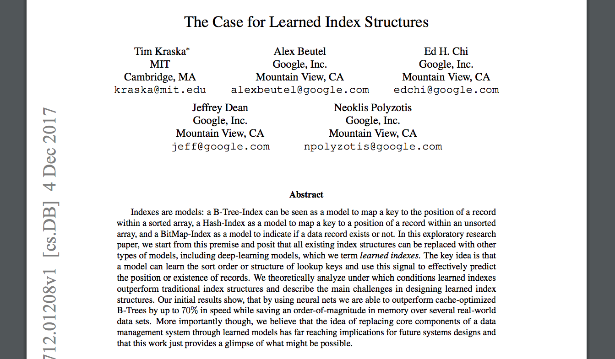
(Ubiquitous) B+tree
File and Access Methods

Slide 10
(Ubiquitous) B+tree
Height-balanced (dynamic) tree structure
Insert/delete at log_{F} N cost
F = fan-out, N = #leaf pages
Each node contains d ≤ m ≤ 2d entries (except for root where 1 ≤ m ≤ 2d)
i.e. minimum 50% occupancy
d is called the order of the tree
Supports equality and range searches efficiently
Example: given a set of data entries, create a B+tree, search for, insert and delete specific keys, and redistribute
Each node corresponds to a disk page
Index entries
In all the non-leaf nodes
(search key value, pid)
Root node
Non-leaf nodes
Leaf nodes
Data entries
Exist only in the leaf nodes
(search key value, rid) or (search key value, record)
Are sorted according to the search key
File and Access Methods

Slide 11
Extendible Hashing
Keep a directory of pointers to buckets
On overflow, double the directory (not the number of buckets)
Benefits:
Directory is much smaller than the entire index file
Only one page of data entries is split
Drawbacks:
Need overflow pages if we have key collision, i.e., multiple data entries can have the same hash value
Example: given a set of data entries, create a extendible hash index, search for, insert and delete specific keys
2 | (John, 53400, 23218564)
 | (Navneet, 54768, 60743111)
Bucket A
 | 2
00
01
10
11
2 | (Zuyu, 53409, 23200564)
Bucket B
2
Bucket C
2 | (Theo, 34411, 29010533)
Bucket D
File and Access Methods

Slide 12
CS 564 in a Nutshell
Requirement Analysis
Web Forms
Application Front Ends
SQL Interface
SQL Commands
Conceptual Database Design
Query Evaluation Engine
Plan Executor
Parser
Operator Evaluator
Optimizer
Logical Database Design
Transaction Manager
File and Access Methods
Recovery Manager
DBMS
Schema Refinement
Concurrency Control
Buffer Manager
Storage Manager
Lock Manager
Disk Space Manager
Physical Database Design
Index Files
Database
System Catalog
Application Development
Data Files

Slide 13
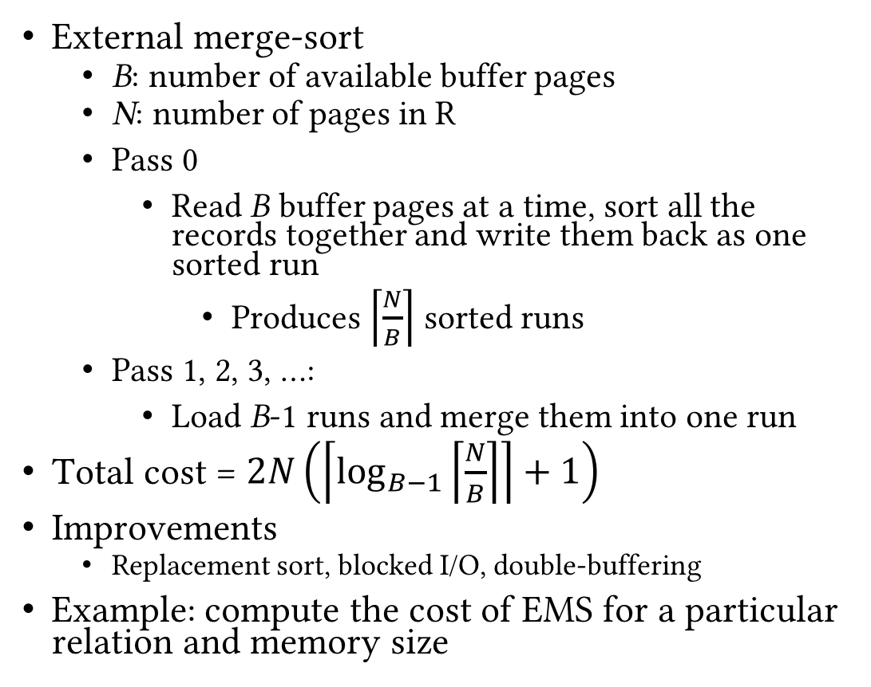
Relational Operators
External merge-sort
B: number of available buffer pages
N: number of pages in R
Pass 0
Read B buffer pages at a time, sort all the records together and write them back as one sorted run
Produces $\left\lceil \frac{N}{B}\right\rceil$ sorted runs
Pass 1, 2, 3, …:
Load B-1 runs and merge them into one run
Total cost = $2N\left(\left\lceil \log_{B−1}\left\lceil \frac{N}{B}\right\rceil \right\rceil +1\right)$
Improvements
Replacement sort, blocked I/O, double-buffering
Example: compute the cost of EMS for a particular relation and memory size
Sort
INPUT
Main memory buffers
Disk
Disk
Merge
INPUT 1
OUTPUT
INPUT 2
Disk
Main memory buffers
Disk
3,4
6,2
9,4
8,7
5,6
3,1
2
Input file
2-way
Pass 0
3,4
2,6
4,9
7,8
5,6
1,3
2
1-page runs
Pass 1
2,3
4,7
1,3
4,6
8,9
5,6
2
2-page runs
Pass 2
2,3
4,4
1,2
4-page runs
6,7
3,5
8,9
6
Pass 3
1,2
2,3
3,4
8-page runs
4,5
6,6
7,8
9
Operator Evaluator

Slide 14
Relational Operators
Logical vs physical operations
Different ways of implementing each operation
Selection operation
Access paths
Scan vs utilize matching index
Use selectivity to decide among access paths
Projection operation
Sorting-based
Variations on EMS
Hash-based
2-phase algorithm
Operator Evaluator

Slide 15
Relational Operators
Join
NLJ, BNLJ, PNLJ
INLJ, BINLJ
SMJ
HJ
Union and set difference
Sorting- and hashing-based
Aggregates
Sorting-, hashing- and index-based
Example: calculate cost of BINLJ and SMJ for two tables of given sizes
Operator Evaluator

Slide 16
Query Optimization
Plan generator and cost estimator work in tandem
Rules determine what PQPs are enumerated
Logical: algebraic rewrites of LQP
Physical: operation implementations and ordering alternatives
Cost models and heuristics help approximating the costs of the PQPs
SystemR optimizer
Optimize one query block at a time
Join optimization
Enumerate left-deep plans
Use N-pass, dynamic programming algorithm
Example: given a (set of) tables and a query, create logical plans, alternative physical plans, calculate cost of alternatives and pick the best
Optimizer

Slide 17
CS 564 in a Nutshell
Requirement Analysis
Web Forms
Application Front Ends
SQL Interface
SQL Commands
Conceptual Database Design
Query Evaluation Engine
Plan Executor
Parser
Operator Evaluator
Optimizer
Logical Database Design
Transaction Manager
File and Access Methods
Recovery Manager
DBMS
Schema Refinement
Concurrency Control
Buffer Manager
Storage Manager
Lock Manager
Disk Space Manager
Physical Database Design
Index Files
Database
System Catalog
Application Development
Data Files

Slide 18
Transaction Management
Transaction management
Transactions: bundling operations on data
Executing multiple transactions concurrently
ACID properties
Conflicts and aborts
Concurrency control
Ensuring serializability and recoverability
Locks and granularity of locks
(Strict) 2PL
Deadlocks
Isolation levels
Recovery
Logs and WAL
Stealing frames and forcing pages
Example
Given a set of transactions, create schedules
Given a set of schedules, determine conflicts
Trace (strict) 2PL on a schedule
Transaction Manager
Lock Manager
Recovery Manager

Slide 19
Transaction Management: Example
Consider the following two transactions:
T1 : R(A), W(A), R(B), W(B), Commit
T2 : R(B), R(C), W(C), W(B), Commit
Consider the following interleaved schedule of the two transactions:
R_{T1}(A), R_{T2}(B), R_{T2}(C), W_{T1}(A), R_{T1}(B), W_{T1}(B), W_{T2}(C), W_{T2}(B), Commit_{T1}, Commit_{T2}
Is the schedule serializable?
If you claim yes, write an equivalent serial (non-interleaved) execution of the two transactions.
If you claim no, explain why it is not serializable.

Slide 20
Transaction Management: Example
T1
T2
No, it is not serializable.
There is a write-write conflict on B
The update by T1 is lost, since T2 overwrites it after reading an older value of B.
Thus, it is not equivalent to either T1 → T2 or T2 → T1.
Begin
 | Begin
R_{T1}(A)
 | R_{T2}(B)
 | R_{T2}(C)
W_{T1} (A)
R_{T1} (B)
W_{T1} (B)
 | W_{T2}(C)
 | W_{T2} (B)
Commit
 | Commit

Slide 21
Good Luck with Your Final Exam!
Questions?

