Slide 1

Database Management Systems (CS 564)
Fall 2017
Lecture 14

Slide 2
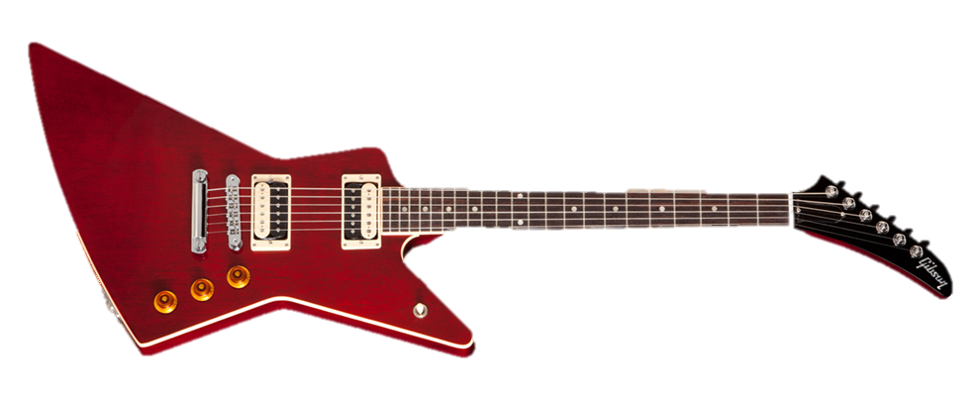
Data Storage and Buffer Management
Where it hits the metal

Slide 3
Recap
Architecture of a typical DBMS
Memory hierarchy
CPU cache, main memory, SSD, disk, tape
Disk
Anatomy
Accessing the disk
Seek time, rotational delay, data transfer time
SSD

Slide 4
Detailed DBMS Architecture
Web Forms
Application Front Ends
SQL Interface
SQL Commands
Query Evaluation Engine
Plan Executor
Parser
Operator Evaluator
Optimizer
Transaction Manager
File and Access Methods
Recovery Manager
DBMS
Concurrency Control
Buffer Manager
Storage Manager
Lock Manager
Disk Space Manager
Index Files
Database
System Catalog
Data Files

Slide 5
Memory Hierarchy
Volatile
Persistent
1-10
CPU
Cache
Main Memory
Price
10²-10³
Access Speed
Access Cycles
Capacity
Flash Storage
10⁵-10⁶
Magnetic Hard Disk Drive (HDD)
10⁷-10⁸
Tape

Slide 6
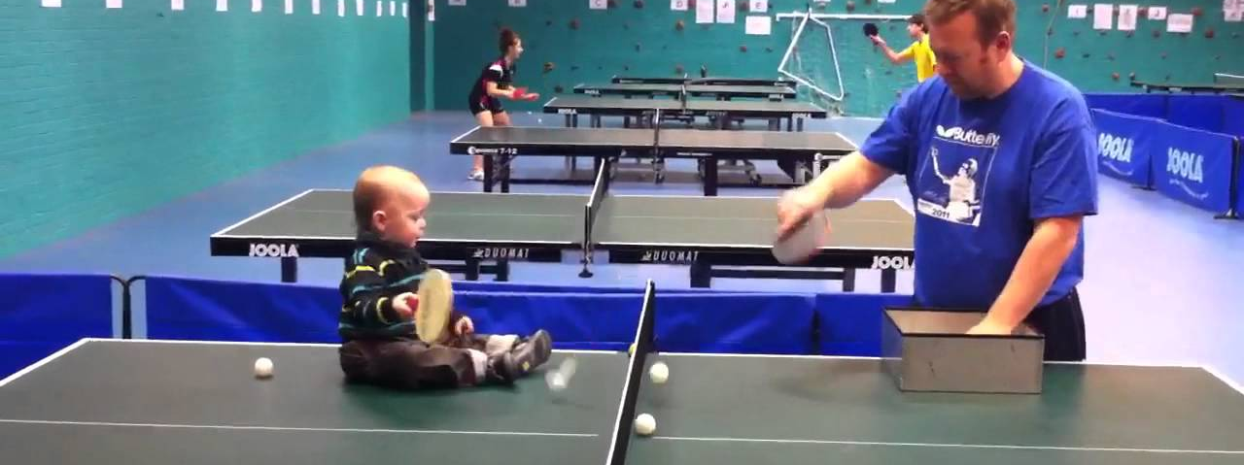

Review Exercise
Suppose a hard disk drive has a sector size of 512 bytes, 5000 tracks per surface, 50 sectors per track, and average seek time of 10 msec.
If the disk’s RPM is 5400 and one track of data can be transferred per revolution, what is the transfer rate?
Suppose the block size is chosen to be 1024 bytes. Then to store a file containing 100,000 records of 100 bytes each, how many blocks are required?

Slide 7


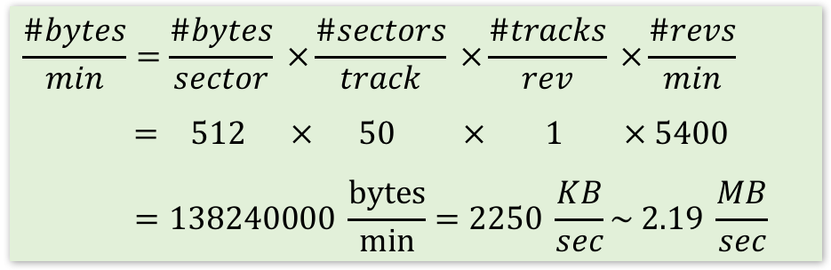
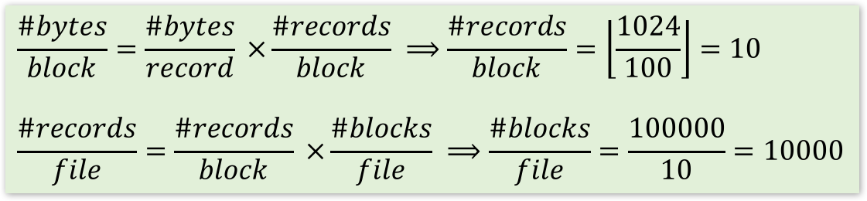
Review Exercise Answer
Suppose a hard disk drive has a sector size of 512 bytes, 5000 tracks per surface, 50 sectors per track, and average seek time of 10 msec.
$$\frac{\#bytes}{min}=\frac{\#bytes}{sector} ×\frac{\#sectors}{track} ×\frac{\#tracks}{rev} ×\frac{\#revs}{min}$$
$$= 512 × 50 × 1 × 5400$$
$$=138240000 \frac{bytes}{min}=2250 \frac{KB}{sec}\sim 2.19 \frac{MB}{sec}$$
If the disk’s RPM is 5400 and one track of data can be transferred per revolution, what is the transfer rate?
Suppose the block size is chosen to be 1024 bytes. Then to store a file containing 100,000 records of 100 bytes each, how many blocks are required?
$$\frac{\#bytes}{block}=\frac{\#bytes}{record} ×\frac{\#records}{block} ⟹\frac{\#records}{block}=\left\lfloor \frac{1024}{100}\right\rfloor =10$$
$$\frac{\#records}{file}=\frac{\#records}{block} ×\frac{\#blocks}{file} ⟹\frac{\#blocks}{file}=\frac{100000}{10}=10000$$

Slide 8
Buffer Manager
Data must be in RAM for DBMS to operate on it
However, can’t keep all pages DBMS needs in RAM
Buffer manager is in charge of bringing pages from disk to memory as needed by DBMS
Keeps a pool of slots (i.e. frames) to load pages into, i.e. buffer pool
Page request
RAM
Buffer Pool
Page
data
Disk page
Free frame
Disk

Slide 9
Buffer Manager (Cont.)
Requests to buffer manager:
Request a page
Release a page when it is no longer needed
Notify the buffer manager when a page is modified
Information saved for each frame:
Pin count: number of users of the page
Pin a page: indicate that the page is in use (⇒ pin count > 0)
Unpin a page: release the page, and also indicate whether the page is dirtied (⇒ pin count = 0)
Dirty bit: indicates whether the page has been modified and the changes need to be propagated to the disk

Slide 10
Serving a Page
When a page a requested, if:
the page is in the buffer pool, then
return a handle to the frame in the buffer pool
increment the pin count
the page is not in the buffer pool, then
choose a frame for replacement (i.e. with pin count = 0)
if the frame is dirty, write it to disk
read requested page into the chosen frame
pin the page and return a handle to it
Can you tell the number of users currently using some page in the buffer pool?

Slide 11
Buffer Replacement Policy
How to choose a frame for replacement
Least recently used (LRU)
Clock
Most recently used (MRU)
FIFO
Random, …
Replacement policy has a big impact on number of I/Os required to answer various queries
Depends on the access pattern(s) of queries accessing the data

Slide 12
Least Recently Used (LRU) Replacement Policy
Keep a queue of pointers to frames available to be replaced (i.e. pin count = 0)
Add available frame pointers to the tail of the queue
Pick the next available frame to be replaced from the head of the queue
Example
Buffer pool size = 3
#database pages on disk = 5 (A, B, C, D, E)
Determine the states of page replacement queue and the buffer pool when the following sequence of requests are submitted to the buffer manager:
Request A, modify A, request B, request B, release A, request C, release B, request D, modify D, release B, request A, request E

Slide 13
Clock Replacement Policy
Variant of LRU with lower memory overhead
N frames are ordered as a cycle
A current variable takes on values 1 to N, pointing to the next frame to be considered for replacement
A referenced bit for each page which turns on (is set to 1) when the page pin count becomes 0
Procedure: when need to load a new frame, consider the page pointed to by current
If pin count > 0, increment current (mod N)
Else if referenced = 1, set it to 0 and increment current (mod N)
Less likely to replace a recently referenced page
Else (referenced = 0 and pin count = 0), choose current page for replacement
Some sources call it the “second chance” algorithm
Repeat the previous example with clock

Slide 14
Sequential Flooding
Nasty situation caused by LRU policy when repeated sequential accesses happen
#buffer frames < #pages in file
Each page request causes an I/O!
MRU works much better in these situations
Why?

Slide 15
DBMS vs. OS File System
Q: why not let the OS handle disk space and buffer management?
A: DBMS is better at predicting reference patterns
Buffer management in DBMS requires ability to
“pin” a page in buffer pool
force a page to disk (for recovery and concurrency)
adjust the replacement policy
pre-fetch pages based on predictable access patterns
DBMS can better control the overlap of I/O with computation
Also can leverage multiple disks more effectively

Slide 16
Recap: Tables on Disk
Data is stored in tables
Each table is stored in a file on disk
Each file consists of multiple pages
Each page consists of multiple records (i.e. tuples)
Each records consists of multiple (attribute, value) pairs
Data is allocated/deallocated in increments of pages
Logically-close pages should be nearby in the disk

Slide 17
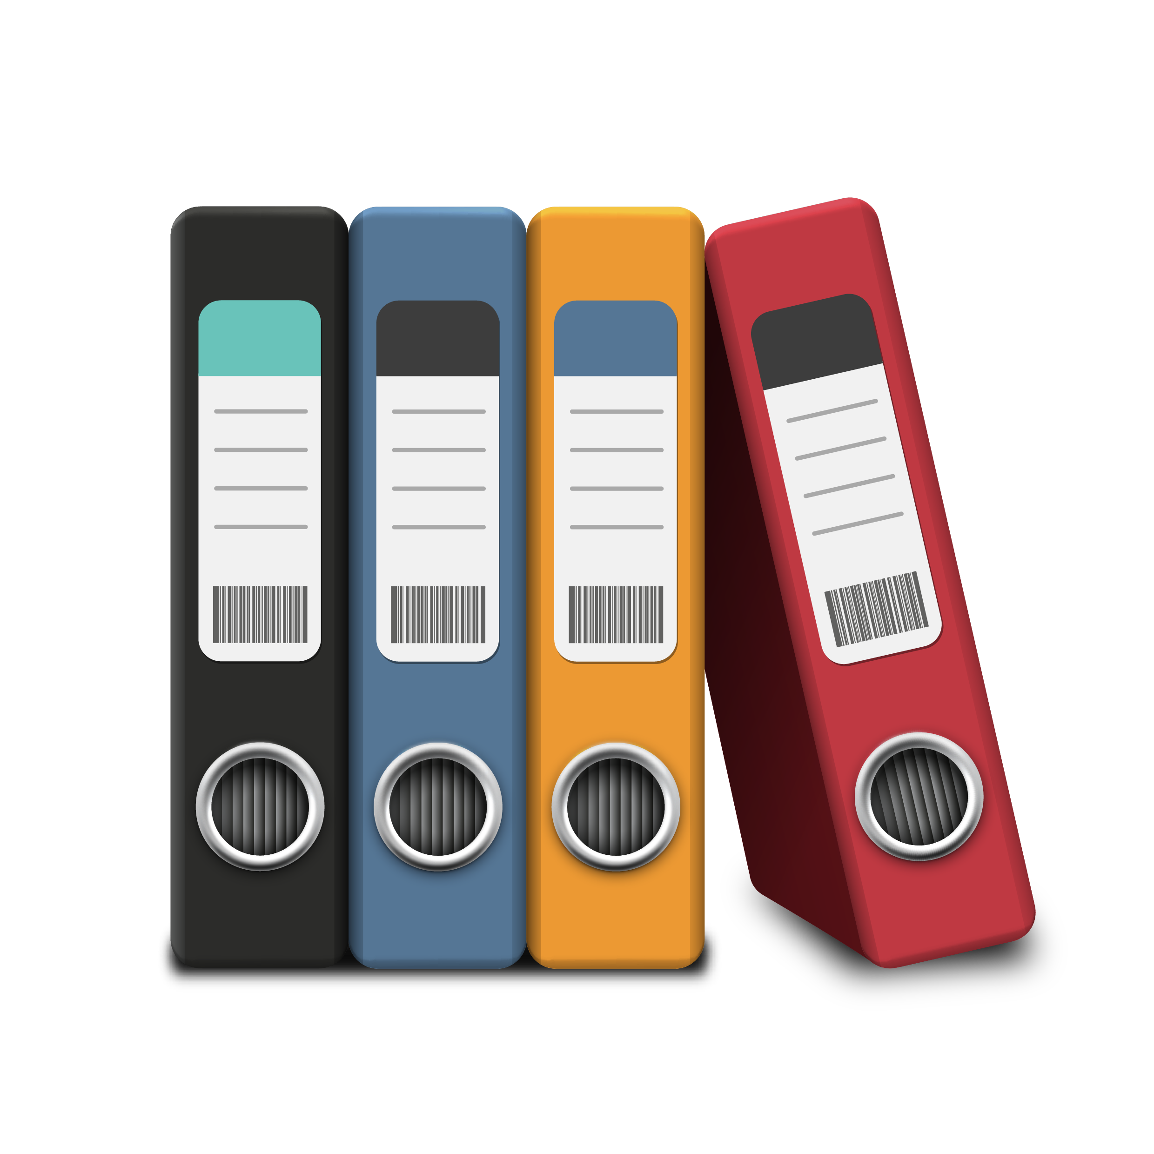

Files of (Pages of) Records
I/O is performed in page units
However, higher level data management operations require accessing and manipulating records and files of records
File = collection of pages Page = collection of records
File operations
Insert/delete/modify a record
Read a particular record (specified using a record ID)
Scan all records (possibly with some condition(s) on the records to be retrieved)
Records are organized in files using various formats, i.e. file organizations
Each file organizations makes certain operations efficient but other operations expensive

Slide 18
Unordered (Heap) File
Simplest file organization
Each page contains records in no particular order
As the file grows and shrinks, pages are allocated and de-allocated
To support record level operations, we must keep track of:
Pages in a file (using page ID (pid))
Free space on pages
Records on a page (using record ID (rid))
Operations: create/destroy file, insert/delete record, fetch a record with a specified rid, scan all records

Slide 19
Heap File Implemented as a List
(heap file name, header page id) are stored somewhere
Each (data) page has two pointers + data
Each pointer stores a pid
Pages in the free space list have “some” free space
Data
Page
Data
Page
…
Data
Page
Q: What happens with fixed- vs. variable-length records in terms of full and non-full pages?
…
Full pages
Header
Page
Q: How would you find a record with a specific rid?
Data
Page
Data
Page
…
Data
Page
Pages with
free space
…
Q: Why do you need the backward pointers?

Slide 20
Heap File Implemented Using a Page Directory
Each entry for a page also keeps track of
whether the page full or not, or
number of free bytes on the page
Can locate pages for new tuples faster
Directory is a collection of pages; linked list implementation is just one alternative
Data
Page 1
Header
Page
Data
Page 2
Data
Page N
…
Directory
Q: What happens with fixed- vs. variable-length records in terms of full and non-full pages?
Q: How would you find a record with a specific rid?

Slide 21
Page Organizations
A page as a collection of records/tuples
Queries deal with tuples
Hence, the slotted page format
A page is a collection of slots
Each slot may contain a record
rid = <pid, slot number>
Many slotted page organizations
Need to support search, insert and delete records on a page
Page organizations for various record organizations
Fixed-length records
Variable-length records
Other ways of generating rids?

Slide 22
Organization of Pages of Fixed-length Record
Packed organization
N records are always stored in the first N slots
Problem: moving records (for free space management) changes the record ID
Might not be acceptable
Slot 1
 |  |  |  | N
Slot 2
Slot 3
Free space
Number of records

Slide 23
Organization of Pages of Fixed-length Record (Cont.)
Unpacked organization
Use a bitmap to locate records in the page
Slot 1
 |  |  |  |  |  |  |  |  |  |  |  |  | … | 0 | 1 | 0 | 1 |  | M
Slot 2
Slot 3
Free space
3
2
1
Bitmap
Number of slots

Slide 24
Organization of Pages of Variable-length Record
Directory grows backwards
rid does not change if you move a record on the same page (slot number is determined by position in slot directory)
Good for fixed-length records too
Deletion: offset is set to -1
Insertion
Use any available slots
if no space is available, reorganize (move records around)
 |  |  |  |  |  |  | 120, 40 | -1, 0 | 560, 90 | -1, 0 | 0, 50 | 70, 50 | 6 |  | Book-keeping
Free
space
pointer
5
4
3
2
1
0
Slot directory
Number of slots
Slot entry: offset, record length

Slide 25
Record Organization (Format)
Recap
File organization
Heap file
As doubly-linked list
Using page directory
Page organization
For fixed-length records
Packed
Unpacked
For variable-length records
Let’s see fixed- and variable-length record formats now.

Slide 26
Fixed-length Records
All records are of the same length, number of fields and field types
These information are stored in system catalog
The address of each field can be computed from the information in the catalog
F₁
F₂
F₃
F₄
L₁ | L₂ | L₃ | L₄
Base address (B)
Address = B + L₁ + L₂

Slide 27
Variable-length Records, Option 1
Store fields consecutively
Use delimiters to denote the end of each field
Need to scan the whole record to locate a field
F₁
F₂
F₃
F₄
4 |  | $ |  | $ |  | $ |  | $
Field count
Field delimiter (special symbol)

Slide 28
Variable-length Records, Option 2
Store fields consecutively
Use an array of integer offsets in the beginning
Efficient storage of NULLs, small directory overhead, direct access to the i^{th} field
Issues with growing records (change in attribute value, add/drop attributes)
F₁
F₂
F₃
F₄

Slide 29
Motivating Example: Looking Up One Attribute
What can potentially go wrong if we use any of the previous record formats?
CREATE TABLE T (a INTEGER, b INTEGER, c VARCHAR(255), …);
SELECT a
FROM T
WHERE a > 10;

Slide 30
Column Stores
Store columns vertically
Each column of a relation is stored in a different file
Can be compressed as well
Contrast with a row store that stores all the attributes of a tuple/record contiguously
File 1
File 1
File 2
File 3
1234 | 45 | Here goes a very long sentence 1
4657 | 2 | Here goes a very long sentence 2
3578 | 45 | Here goes a very long sentence 3
1234
4657
3578
45
2
45
Here goes a very long sentence 1
Here goes a very long sentence 2
Here goes a very long sentence 3
Row store
Column store

Slide 31
Recap
Architecture of a typical DBMS
Memory hierarchy
CPU cache, main memory, SSD, disk, tape
Secondary storage (disk and SSD)
Buffer manager
Buffer replacement policies: LRU, clock, MRU, FIFO, random, …
File organization
Heap file (as doubly-linked list or directory)
Page organization
For fixed-length (packed and unpacked) and variable-length records
Record organization
Fixed-length and variable-length (two variations) records
Row-store vs. column-store

Slide 32
Indexing
Next Up
Questions?

