Slide 1

Database Management Systems (CS 564)
Fall 2017
Lecture 3

Slide 2
Relational Model: From ER to Relational Design
“There is no branch of mathematics, however abstract, which may not some day be applied to phenomena of the real world.”
- Nikolai Ivanovich Lobachevsky

Slide 3
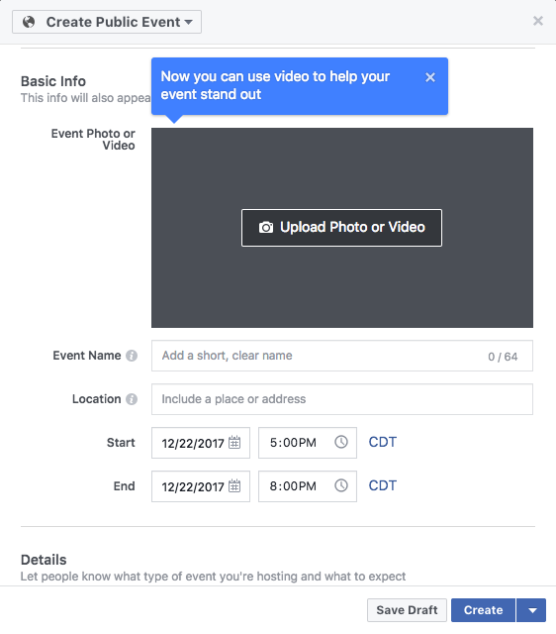
ER Modeling: Review
Example: create and RSVP to events on Facebook

Slide 4


ER Modeling: Exercise
Draw an ER diagram for “the event management subsystem of Facebook”
Two entity sets
User
Event
Two relationship sets
Create
ParticipateIn
Specify as many attributes as you can
Include as many constraints as you can
Key, participation, referential integrity, single-valued

Slide 5
ER Modeling Exercise Answer
CreateDT
UID
Name
Age
EID
Name
Location
Create
User
Event
ParticipateIn
StartDT
EndDT
Desc
RSVPDT

Slide 6


Building a Data-Driven Application
Requirement Analysis
Conceptual Database Design
Logical Database Design
Schema Refinement
Physical Database Design
Application Development

Slide 7
Data Model
How would you build a system to store, retrieve and analyze the data described by the conceptual model (i.e. ER diagram) we just developed?
Using a data model
For example, using arrays and classes in Java or C++
A data model generally describes data in three aspects:
Structure of the data
Operations on the data
Constraints on the data

Slide 8
But Why Not ER?
ER Model | Relational Model
Many concepts: entities, relationships, attributes, etc. | Has just a single concept: relation
Rich and complex graph structure | World is represented with a collection of tables
Well-suited for capturing the application requirements | Well-suited for efficient manipulations on computers
No operations defined | Elaborate algebra of relational operations
ER model is good for
understanding the world
vs.
Relational model is good for computerizing the world

Slide 9
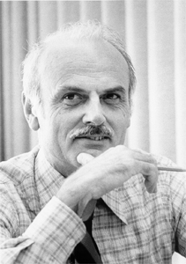
Relational Data Model
Most widely used data model today
Introduced by Ted Codd
A relational model of data for large shared data banks, E. F. Codd, Communications of the ACM, June 1970
Based on the magnificent set theory
Describe structure of the data using mathematical relations
We’ll talk about the operations and constraints later

Slide 10
Elements of Relational Model
An instance of Student relation
Student
SID | Name | Age | Major
17 | Smith | 21 | CS
8 | Brown | 24 | MATH
Relation
Tuple
Attribute
Student(SID: int, Name: string, Age: int, Major: string)
Relation name
Attribute name
Attribute domain
The schema of Student relation

Slide 11
Relational vs. Tabular
Relational Model | Tabular Data
Relation | Table
Tuple | Row
Attribute | Column
Domain | Column data type
Schema | Table header
Cardinality | Number of rows
Arity | Number of columns
Loosely speaking:
Tables are visual constructs
whereas
Relations are mathematical constructs
We are going to use these terminologies interchangeably.

Slide 12
Relational Model: A Summary
Each relation contains the description of a set of entities.
Each entity is described as a tuple of the corresponding relation.
Each tuple consists of a set of (named) attributes, each of which describes an aspect of the entity represented by the tuple.

Slide 13
Relational Model: A Summary (Cont.)
Each attribute takes its value from a domain.
A domain is a set of values from which one or more attributes can take their value
Integer (e.g. age, credits)
String (e.g. name, description)
DateTime (e.g. DOB, StartDT)
…

Slide 14
Let’s get a bit more formal:

Slide 15
Relation: Definition 1
Relation as subset of Cartesian product
Example: the Student relation
A tuple: an element of int×string×int×string
e.g. t = (17, Smith, 21, CS)
A relation: a subset of int×string×int×string
Student(SID: int, Name: string, Age: int, Major: string)

Slide 16
Relation: Definition 1 (Cont.)
Order in the tuple is important
e.g. (17, Smith, 21, CS) ≠ (17, Smith, CS, 21)
No attribute names; positional reference to attributes of tuples
Example: for t = (17, Smith, 21, CS) t[2] = Smith

Slide 17
Relation: Definition 2
Relation as a set of functions
Example: set of attribute names A = {SID, Name, Age, Major}
A tuple: a function t : A ⟶ string ∪ int such that each attribute name is mapped to its corresponding domain
e.g. t = {
A relation: a set of tuples
SID | ⟶ | 17
Name | ⟶ | Smith
Age | ⟶ | 21
Major | ⟶ | CS}

Slide 18
Relation: Definition 2 (Cont.)
Order in a tuple is not important
Referring to attributes of tuples by attribute name
Example: for t = (17, Smith, 21, CS) t.Name = Smith

Slide 19
Relation Schema and Instance
The schema of a relation consists of
Name of the relation (e.g. Student)
Name and domain of its attributes (e.g. Name: string)
An instance of a relation is a relation populated with specific tuples
Student(SID: int, Name: string, Age: int, Major: string)
Student
Student
SID | Name | Age | Major
17 | Smith | 21 | CS
8 | Brown | 24 | MATH
SID | Name | Age | Major
17 | Smith | 21 | CS
821 | Patel | 32 | BIOL
90 | Petrov | 22 | MATH
Instance 1
Instance 2

Slide 20
Relational Database Schema
Relational database schema: a collection of related relation schemas
Student(SID: int, Name: string, Age: int, Major: string)
Course(CID: string, Name: string, Credits: int, Department: string)
Section(SecID: int, CID: string, Semester: string, Year: int, Instructor: string)
Prerequisite(CID: string, PrereqID: string)
GradeReport(SID: int, SecID: int, Grade: string)

Slide 21
Relational Database
Relational database (instance): a collection of relations (i.e. relation instances) adhering to the database schema
Student
SID | Name | Age | Major
17 | Smith | 21 | CS
8 | Brown | 24 | MATH
Course
GradeReport
CID | Name | Credits | Department
CS564 | Database Management Systems | 3 | CS
MATH240 | Discrete Mathematics | 4 | MATH
CS367 | Intro to Data Structures | 3 | CS
CS764 | Adv. Database Management | 3 | CS
SID | SecID | Grade
17 | 30098 | A
17 | 40026 | AB
8 | 1005 | A
8 | 40026 | C
8 | 20006 | A
8 | 30098 | B
Section
SecID | CID | Semester | Year | Instructor
30098 | MATH240 | Fall | 2017 | Euclid
40026 | CS367 | Fall | 2016 | Dijkstra
1005 | CS367 | Spring | 2004 | Gauss
30451 | CS764 | Fall | 2017 | Patel
20006 | CS564 | Spring | 2001 | Codd
Prerequisite
CID | PrereqID
CS564 | CS367
CS764 | CS564
CS564 | MATH240

Slide 22
Recap of Relational Model
An instance of Student relation
Student
SID | Name | Age | Major
17 | Smith | 21 | CS
8 | Brown | 24 | MATH
Relation
Tuple
Attribute
Student(SID: int, Name: string, Age: int, Major: string)
Relation name
Attribute name
Attribute domain
The schema of Student relation

Slide 23
Operations on Relations
“Write” operations: create/modify data
Insert: add tuples to a relation
e.g. insert (42, Kramer, 22, CHEM) into the Student table
Delete: remove tuples from a relation
e.g. remove all course Sections offered before 1950
Modify: logically, deletes + inserts, but typically implemented as in-place updates to a relation
e.g. change all the “CS” values in Major column of Student table to “COMP SCI”

Slide 24
Operations on Relations (Cont.)
“Read” operations: access data
Select: retrieve rows from a table
e.g. select all the Students younger than 23
Project: retrieve columns from a table
e.g. show me only the Name column of the Student table
Aggregate: compute statistics on a table
e.g. show me the average Price of all the Products
And a few other (more formal) operations

Slide 25
ER to Relational Model
Getting one step closer to the machine

Slide 26
How to Convert?
K1
A11
A12
K2
A21
A22
R12
E1(K1, A11, A12)
E1
E2
R13
R23
E2(K2, A21, A22)
E3
R12(K1, K2)
K32
…
K3
K31
K32
Entity sets
Relationship sets (many-to-many)
Many-to-one relationship sets
Weak entity sets
IsA hierarchies

Slide 27
Basic Case: Entity Sets
Entity set E ⟶ Relation with attributes of E
UID
Name
Age
User(UID: string, Name: string, Age: int)
⟶
User
User
UID | Name | Age
FB1001 | William | 19
FB1002 | Yinan | 22
Entity name ⟶ Relation name
Attribute name ⟶ Attribute name
Entity set ⟶ Relation instance
Primary key ⟶ Primary key

Slide 28
Basic Case: Entity Sets (Cont.)
EID
Name
Location
Event
StartDT
EndDT
Desc
⟶
Event(EID: string, Name: string, Location: string,
StartDT: DateTime, EndDT: DateTime, Description, string)
Event
EID | Name | Location | StartDT | EndDT | Description
E2980 | Milonga at IWC | 914 Regent St | 09/22, 7PM | 09/22, 11PM | Tango Party …
E4518 | MMM 2018 | Capitol Square | 06/21, 9AM | 06/21, 9PM | Summer Solstice …

Slide 29
Basic Case: Relationship Sets
Relationship set R
between entity sets E1 and E2
⟶
Relation with primary keys of E1 and E2 and attributes of E
UID
Name
Age
EID
Name
Location
RSVPDT
User
ParticipateIn
Event
⟶
StartDT
EndDT
Desc
ParticipateIn(EID: string, UID: string, RSVPDT: DateTime)
ParticipateIn
Q: What is the primary key of the ParticipateIn relation?
A: EID, UID. Each one of them is called a foreign key.
EID | UID | RSVPDT
E4518 | FB1002 | 09/02, 9PM
E2980 | FB1002 | 12/12, 11AM

Slide 30
Foreign Key
An attribute of a relation which refers to a (primary) key of another relation
The domain of the foreign key attribute is the same as the key it references
Event
User
EID | Name | Location | StartDT | EndDT | Description
E2980 | Milonga at IWC | 914 Regent St | 09/22, 7PM | 09/22, 11PM | Tango Party …
E4518 | MMM 2018 | Capitol Square | 06/21, 9AM | 06/21, 9PM | Summer Solstice …
UID | Name | Age
FB1001 | William | 19
FB1002 | Yinan | 22
ParticipateIn
EID | UID | RSVPDT
E4518 | FB1002 | 09/02, 9PM
E2980 | FB1002 | 12/12, 11AM

Slide 31
Basic Case: Relationship Sets (Cont.)
PID
Name
Age
Rename to resolve attribute name conflicts
⟶
Collaborate(PID_PI: string, PID_CoPI: string)
Professor
Collaborate
Co-PI
PI
PID_PI | PID_CoPI
Prof007 | Prof233
Prof007 | Prof947
Prof061 | Prof007
Collaborate
Q: Any foreign keys?
A: PID_PI and PID_CoPI.

Slide 32
Many-to-One Relationship Sets
SID
Name
Age
DID
Name
Address
Major
Student
Department
⟶
Student(SID: int, Name: string, Age: int)
Department(DID: string, Name: string, Address: string)
Major(SID: int, DID: string)

Slide 33
Many-to-One Relationship Sets (Cont.)
SID
Name
Age
DID
Name
Address
Major
Student
Department
⟶
Student
Major
Department
SID | Name | Age
17 | Smith | 21
8 | Brown | 24
SID | DID
17 | MATH
8 | CS
DID | Name | Address
CS | Computer Sciences | ADD1
MATH | Mathematics | ADD2

Slide 34
Many-to-One Relationship Sets (Cont.)
SID
Name
Age
DID
Name
Address
Major
Student
Department
⟶
Student
Department
SID | Name | Class | Major
17 | Smith | 21 | MATH
8 | Brown | 24 | CS
DID | Name | Address
CS | Computer Sciences | ADD1
MATH | Mathematics | ADD2

Slide 35
Many-to-One Relationship Sets (Cont.)
Student
Department
SID | Name | Class | Major
17 | Smith | 21 | MATH
8 | Brown | 24 | CS
DID | Name | Address
CS | Computer Sciences | ADD1
MATH | Mathematics | ADD2
Q: Is Major a foreign key?
A: Yes.
Q: Is this a valid Student tuple?
A: No, because PHYS does not exist in Department.
834 | Surijit | 25 | PHYS
What?!!
Q: What if a Student has not declared a Major?
A: Then the Major column would be filled with NULL.

Slide 36
NULL: The Hairy Beast
A special value which signifies one of the following:
Nonexistent value
e.g. a Student has not declared a Major
Missing value
e.g. a Student has not entered their Height
Not applicable
e.g. a single-family Home does not have an AptNo
NULL does not mean 0, “” or NaN.
NULL ≠ NULL
824 | Fernando | 19 | NULL

Slide 37
One-to-One Relationship Sets
PID
Name
Age
DID
Name
Address
Chair
Professor
Department
⟶
Department(DID: string, Name: string, Address: string)
Professor(PID: string, Name: string, Age: int, ChairingDID: string)

Slide 38
One-to-One Relationship Sets
PID
Name
Age
DID
Name
Address
Chair
Professor
Department
⟶
Department(DID: string, Name: string, Address: string, ChairPID: string)
Professor(PID: string, Name: string, Age: int)

Slide 39
Weak Entity Sets
Number
NumRooms
DID
Name
Address
Floor
PartOf
Department
⟶
Department(DID: string, Name: string, Address: string)
Floor(Number: int, DID: string, NumRooms: int)

Slide 40
IsA Hierarchy
SID
Name
Age
Student
IsHonors
IsA
QualScore
Undergrad
Masters
Doctoral
ByThesis
Three options:
Object-oriented approach
ER approach
Terrible approach!

Slide 41
IsA Hierarchy: OO Approach
Object-oriented approach: one relation per entity set, each containing all attributes
Student(SID: int, Name: string, Age: int)
SID
Name
Age
Undergrad(SID: int, Name: string, Age: int, IsHonors: bool)
Student
⟶
IsHonors
IsA
QualScore
Masters(SID: int, Name: string, Age: int, ByThesis: bool)
Undergrad
Masters
Doctoral
ByThesis
Doctoral(SID: int, Name: string, Age: int, QualScore: float)
Good choice when each entity belongs to at most one subclass
Well-suited for queries such as “show the average age of Masters students”
Not good when many entities belong to multiple subclasses

Slide 42
IsA Hierarchy: ER Approach
ER approach: one relation per entity set, subclasses contain parent key
Student(SID: int, Name: string, Age: int)
SID
Name
Age
Student
Undergrad(SID: int, IsHonors: bool)
⟶
IsHonors
IsA
QualScore
Masters(SID: int, ByThesis: bool)
Undergrad
Masters
Doctoral
Doctoral(SID: int, QualScore: float)
ByThesis
Good choice when each entity might belong to more than one subclass
Well-suited for queries such as “show the average age of all students”

Slide 43
IsA Hierarchy: Terrible Approach
Terrible approach: one relation for the whole hierarchy, non-existent attributes filled with NULL
SID
Name
Age
Student
Student(SID: int, Name: string, Age: int , IsHonors: bool,
ByThesis: bool,
QualScore: float)
⟶
IsHonors
IsA
QualScore
Undergrad
Masters
Doctoral
ByThesis
A: Actually, this is a not-so-terrible options for the cases when many entities belong to most of the subclasses
Q: Why do we even talk about this then?!

Slide 44
IsA Hierarchy: Terrible Approach (Cont.)
Student
SID | Name | Age | IsHonors | ByThesis | QualScore
17 | Smith | 1 | TRUE | NULL | NULL
8 | Brown | 2 | FALSE | TRUE | 3.5

Slide 45
Recap: ER to Relational
K1
A11
A12
K2
A21
A22
R12
E1(K1, A11, A12)
E1
E2
R13
R23
E2(K2, A21, A22)
E3
R12(K1, K2)
K32
…
K3
K31
K32
Entity sets: relations
Relationship sets (many-to-many): relation with combined key
Many-to-one/one-to-one relationship sets: add column(s)
Weak entity sets: relation with combined key
IsA hierarchies: OO, ER and terrible approaches

Slide 46
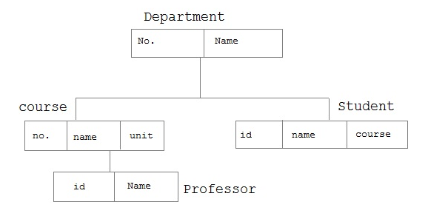
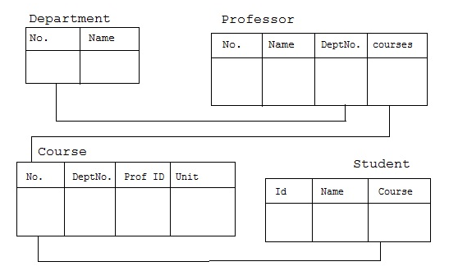
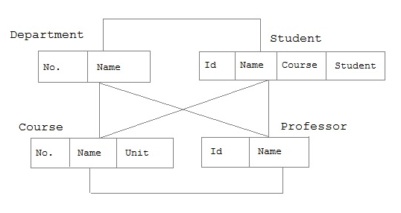
Side Note: Other Data Models
From CS 564 course description:
“What a database management system is; different data models currently used to structure the logical view of the database: relational, hierarchical, and network. Hands-on experience with relational and network-based database systems. Implementation techniques for database systems. File organization, query processing, concurrency control, rollback and recovery, integrity and consistency, and view implementation.”
Hierarchical Data Model
Relational Data Model
Network Data Model

Slide 47

SQL: Bridging the Gap Between Logical Model and Machine
Next Up
Questions?

