Slide 1

Database Management Systems (CS 564)
Fall 2017
Lecture 4

Slide 2
SQL: Bridging the Gap Between Logical Model and Machine
“It’s so easy marketers can learn it!”

Slide 3
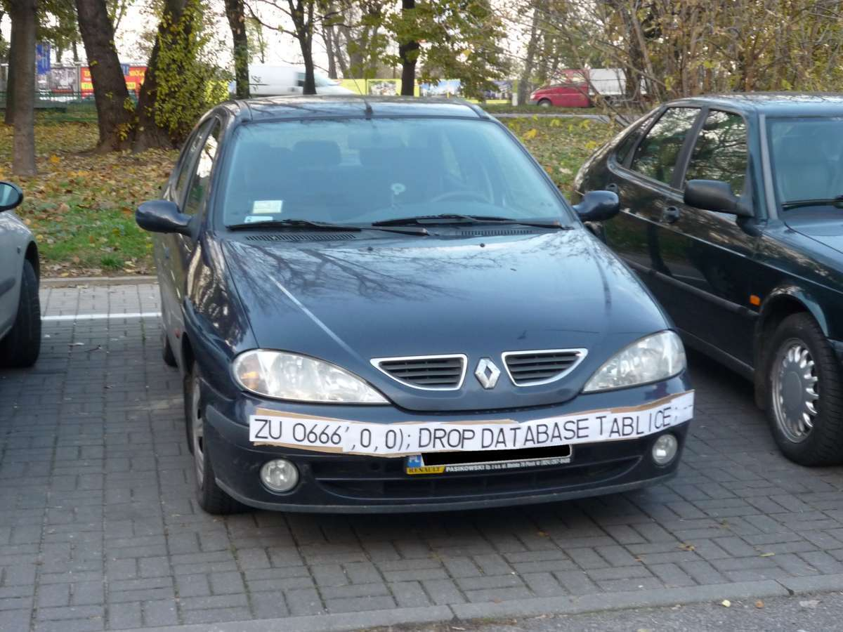

Slide 4


From Conceptual to Logical
ER diagram for “the event management subsystem of Facebook”
CreateDT
UID
Name
Age
EID
Name
Location
Create
User
Event
ParticipateIn
StartDT
EndDT
Desc
RSVPDT

Slide 5


Relational Modeling: Exercise
Create a relational database model for this ER diagram
Relations
Key constraints
Determine foreign keys
CreateDT
UID
Name
Age
EID
Name
Location
Create
User
Event
ParticipateIn
StartDT
EndDT
Desc
RSVPDT

Slide 6
Relational Modeling Exercise Answer
CreateDT
UID
Name
Age
EID
Name
Location
Create
User
Event
ParticipateIn
StartDT
EndDT
Desc
RSVPDT
User(UID: string, Name: string, Age: int)
Event(EID: string, Name: string, Location: string,
StartDT: DateTime, EndDT: DateTime, Description: string,
CreatorUID: string, CreateDT: DateTime)
ParticipateIn(EID: string, UID: string, RSVPDT: DateTime)

Slide 7
“Computerizing” the Database
To communicate the logical schema (and many more things) to an RDBMS, use SQL
Structured Query Language
Developed by Chamberlin and Boyce in early 70’s at IBM
In its 40’s, it is still the most commonly used “data language”

Slide 8
SQL
A declarative language for working with relational data
Simple English-based syntax, but precise, formal semantics
Key advantages:
Physical data independence
“How” data is stored on machine independent of “what” is stored, i.e. SQL queries
Logical data independence
Notion of views in SQL

Slide 9
SQL (Cont.)
Many standards out there
ANSI SQL, SQL92 (a.k.a. SQL2), SQL99 (a.k.a. SQL3), ….
Vendors support various subsets
We’ll discuss common features

Slide 10
Major SQL Components
Data Definition Language (DDL)
Define relational schemas
Create/alter/delete tables and their attributes
Data Manipulation Language (DML)
Insert/delete/modify tuples in tables
Query one or more tables
And others
Embedded and dynamic SQL, triggers and cursors, security, transaction management, remote database access

Slide 11

CREATE TABLE
User(UID: string, Name: string, Age: int)
CREATE TABLE User (
UID CHAR(20),
Name CHAR(50),
Age INTEGER,
PRIMARY KEY (UID));
: Create the User table.

Slide 12
CREATE TABLE (Cont.)
Event(EID: string, Name: string, Location: string,
StartDT: DateTime, EndDT: DateTime, Description: string,
CreatorUID: string, CreateDT: DateTime)
CREATE TABLE Event (
EID CHAR(20) PRIMARY KEY,
Name CHAR(50),
Location CHAR(50),
StartDT DATE,
EndDT DATE,
Description CHAR(100),
CreatorUID CHAR(20),
CreateDT DATE);
Q: How about the referential integrity constraint?

Slide 13
CREATE TABLE: Foreign Key
Event(EID: string, Name: string, Location: string,
StartDT: DateTime, EndDT: DateTime, Description: string,
CreatorUID: string, CreateDT: DateTime)
CREATE TABLE Event (
EID CHAR(20) PRIMARY KEY,
Name CHAR(50),
Location CHAR(50),
StartDT DATE,
EndDT DATE,
Description CHAR(100),
CreatorUID CHAR(20),
CreateDT DATE,
FOREIGN KEY (CreatorUID) REFERENCES User(UID));
Important: You need to turn on foreign key constraint enforcement every time you run SQLite and/or load (.open) a database.

Slide 14
CREATE TABLE: Participation
Event(EID: string, Name: string, Location: string,
StartDT: DateTime, EndDT: DateTime, Description: string,
CreatorUID: string, CreateDT: DateTime)
CREATE TABLE Event (
EID CHAR(20) PRIMARY KEY,
Name CHAR(50),
Location CHAR(50),
StartDT DATE,
EndDT DATE,
Description CHAR(100),
CreatorUID CHAR(20),
CreateDT DATE,
FOREIGN KEY (CreatorUID) REFERENCES User(UID));
Q: Does this definition enforce participation constraint of Event in Create?
A: No. We need to explicitly declare the participation constraint.

Slide 15
CREATE TABLE: Participation
Event(EID: string, Name: string, Location: string,
StartDT: DateTime, EndDT: DateTime, Description: string,
CreatorUID: string, CreateDT: DateTime)
CREATE TABLE Event (
EID CHAR(20) PRIMARY KEY,
Name CHAR(50),
Location CHAR(50),
StartDT DATE,
EndDT DATE,
Description CHAR(100),
CreatorUID CHAR(20) NOT NULL,
CreateDT DATE,
FOREIGN KEY (CreatorUID) REFERENCES User(UID));
: Create the Event table.

Slide 16
CREATE TABLE (Cont.)
ParticipateIn(EID: string, UID: string, RSVPDT: DateTime)
CREATE TABLE ParticipateIn (
EID CHAR(20),
UID CHAR(20),
RSVPDT DATE,
PRIMARY KEY (EID, UID),
FOREIGN KEY (EID) REFERENCES Event(EID), FOREIGN KEY (UID) REFERENCES User(UID) );

Slide 17
Enforcing Referential Integrity
Refresher: referential integrity constraint
Entities participating in a relationship must exist in the database
What happens if a reference tuple is deleted?
e.g. what happens to the a Student when the Department (s)he Majors in is deleted?
SID
Name
Age
DID
Name
Address
Major
Student
Department

Slide 18
Enforcing Referential Integrity (Cont.)
Three options
Refuse to allow the deletion
Delete all tuples that refer to the deleted tuple
Set the corresponding foreign key values to some default value, or in the worst case, NULL

Slide 19
Enforcing Referential Integrity (Cont.)
Refuse to allow the deletion
CREATE TABLE Student(
SID INTEGER,
Name CHAR(30),
Age INTEGER,
DID INTEGER,
PRIMARY KEY (SID),
FOREIGN KEY (DID) REFERENCES Department(DID)
ON DELETE NO ACTION);
SID
Name
Age
DID
Name
Address
Major
Student
Department

Slide 20
Enforcing Referential Integrity (Cont.)
Delete all tuples refering to the deleted tuple
CREATE TABLE Student(
SID INTEGER,
Name CHAR(30),
Age INTEGER,
DID INTEGER,
PRIMARY KEY (SID),
FOREIGN KEY (DID) REFERENCES Department(DID)
ON DELETE CASCADE);
SID
Name
Age
DID
Name
Address
Major
Student
Department

Slide 21
Enforcing Referential Integrity (Cont.)
Set to default or NULL
CREATE TABLE Student(
SID INTEGER,
Name CHAR(30),
Age INTEGER,
DID INTEGER,
PRIMARY KEY (SID),
FOREIGN KEY (DID) REFERENCES Department(DID)
ON DELETE SET DEFAULT);
SID
Name
Age
DID
Name
Address
Major
Student
Department

Slide 22
Enforcing Referential Integrity (Cont.)
ParticipateIn(EID: string, UID: string, RSVPDT: DateTime)
CREATE TABLE ParticipateIn (
EID CHAR(20),
UID CHAR(20),
RSVPDT DATE,
PRIMARY KEY (EID, UID),
FOREIGN KEY (EID) REFERENCES Event(EID), FOREIGN KEY (UID) REFERENCES User(UID) );
Q: How can we ensure that no Users ParticipateIn deleted Events?

Slide 23
Enforcing Referential Integrity (Cont.)
ParticipateIn(EID: string, UID: string, RSVPDT: DateTime)
CREATE TABLE ParticipateIn (
EID CHAR(20),
UID CHAR(20),
RSVPDT DATE,
PRIMARY KEY (EID, UID),
FOREIGN KEY (EID) REFERENCES Event(EID)
ON DELETE CASCADE,
FOREIGN KEY (UID) REFERENCES User(UID) );
: Create the ParticipateIn table.

Slide 24
Recap: DDL
CREATE TABLE
PRIMARY KEY
FOREIGN KEY
NOT NULL
ON DELETE
NO ACTION
CASCADE
SET DEFAULT or SET NULL

Slide 25
More on DDL
Other types of key constraints
Deleting tables
Altering tables
…
Will come back to these later
For now, let’s move on to DML, i.e. how to put actual data into the tables and ask questions about it!

Slide 26
DML
Provides operations to
Insert new tuples into relations
Delete tuples from relations
Modify various attributes of tuples
Ask questions about data, a.k.a. query the database

Slide 27
INSERT
Insert a single tuple
Insert multiple tuples
: Try inserting this tuple twice.
INSERT INTO User
VALUES ('U1252', 'Smith', 21);
INSERT INTO User
(<subquery>);

Slide 28
DELETE
Delete all tuples matching the a condition
Delete everything
DELETE FROM User
WHERE Age < 15;
DELETE FROM User;

Slide 29
UPDATE
Update all tuples matching a condition
UPDATE Event
SET Name=‘Superbowl LII’
WHERE Name=‘Superbowl 2018’;

Slide 30
Recap
DDL:
CREATE TABLE
PRIMARY KEY, FOREIGN KEY, NOT NULL, ON DELETE (NO ACTION, CASCADE, SET DEFAULT/NULL)
DML
INSERT
DELETE
UPDATE

Slide 31
SELECT: Retrieving Data
Basic SQL query
Natural language form: return the Name of all the Users whose Age is between 20 (inclusive) and 30 (exclusive)
SELECT Name
FROM User
WHERE Age >= 20 AND Age < 30;

Slide 32
Basic SELECT General Syntax
SELECT [DISTINCT] target-list
FROM relation-list
[WHERE condition];
Semantics
Go over all the tuples (or combinations of tuples) in the relation-list
Check whether each tuple satisfies the condition
If so, then return all the (distinct) target-list attributes of that tuple

Slide 33
SELECT (Cont.)
User
UID | Name | Age
U1001 | David | 19
U1002 | Han | 29
U2004 | Julia | 23
SELECT Name
FROM User
WHERE Age >= 20
AND Age < 30;
Name
Han
Julia

Slide 34
SELECT *
User
UID | Name | Age
U1001 | David | 19
U1002 | Han | 29
U2004 | Julia | 23
Return all attributes
SELECT *
FROM User
WHERE Age >= 20
AND Age < 30;
UID | Name | Age
U1002 | Han | 29
U2004 | Julia | 23

Slide 35
Set vs. Bag Semantics
User
UID | Name | Age
U1001 | David | 29
U1002 | Han | 29
U2004 | Julia | 23
From what Ages do we have Users?
SELECT Age
FROM User;
Age
29
29
23
Relational model: set semantics
SQL: multiset/bag semantics

Slide 36
SELECT DISTINCT
User
UID | Name | Age
U1001 | David | 29
U1002 | Han | 29
U2004 | Julia | 23
From what Ages do we have Users?
SELECT DISTINCT Age
FROM User;
Age
29
23

Slide 37
Arithmetic Expressions
In SELECT clause
In WHERE clause
AS
SELECT Name, 1.1 * Salary AS IncreasedSal
FROM Employee
WHERE Age <= 30;
Column Renaming
SELECT Name
FROM Employee
WHERE Salary / Age > 5000;

Slide 38
LIKE: Find Patterns in Strings
Course
CID | Name | Credits | Department
CS564 | Database Management Systems | 3 | CS
MATH240 | Discrete Mathematics | 4 | MATH
CS367 | Intro to Data Structures | 3 | CS
CS764 | Adv. Database Management | 3 | CS
SELECT CID, Name
FROM Course
WHERE Name LIKE ‘%Data%’;
CID | Name
CS564 | Database Management Systems
CS367 | Intro to Data Structures
CS764 | Adv. Database Management

Slide 39
LIKE: Find Patterns in Strings
Course
CID | Name | Credits | Department
CS564 | Database Management Systems | 3 | CS
MATH240 | Discrete Mathematics | 4 | MATH
CS367 | Intro to Data Structures | 3 | CS
CS764 | Adv. Database Management | 3 | CS
SELECT CID, Name
FROM Course
WHERE CID LIKE ‘CS__4’;
CID | Name
CS564 | Database Management Systems
CS764 | Adv. Database Management

Slide 40
ORDER BY: Sort Results
Student
SID | Name | Class | Major
17 | Smith | 21 | MATH
8 | Brown | 24 | CS
5 | Moreno | 21 | PHYS
23 | Boll | 21 | CS
7 | Bakhtiari | 21 | CS
SELECT Name, Class
FROM Student
WHERE Name LIKE ‘B%’
ORDER BY Class;
Name | Class
Boll | 21
Bakhtiari | 21
Brown | 24

Slide 41
ORDER BY: Sort Results (Cont.)
Student
SID | Name | Class | Major
17 | Smith | 20 | MATH
8 | Brown | 24 | CS
5 | Moreno | 21 | PHYS
23 | Boll | 21 | CS
7 | Bakhtiari | 21 | CS
SELECT Name, Class
FROM Student
WHERE Name LIKE ‘B%’
ORDER BY Class DESC,
SID ASC;
Name | Class
Brown | 24
Bakhtiari | 21
Boll | 21

Slide 42
LIMIT
Student
SID | Name | Class | Major
17 | Smith | 21 | MATH
8 | Brown | 24 | CS
5 | Moreno | 21 | PHYS
23 | Boll | 21 | CS
7 | Bakhtiari | 21 | CS
SELECT Name, Major
FROM Student
WHERE Class = 21
ORDER BY SID DESC
LIMIT 2;
Name | Major
Boll | CS
Smith | MATH

Slide 43
Recap: What Can Go in WHERE Clause
Attribute names of the relations appearing in FROM clause
Comparison operators (=, <>, <, >, <=, >=)
Arithmetic operations (+, -, /, *)
AND, OR and NOT to combine/negate conditions
Operations on strings (e.g. concatenation)
Pattern matching (s LIKE p)
Special functions for comparing dates and times

Slide 44
Recap: Basic SELECT
SELECT [DISTINCT] target-list
FROM relation-list
[WHERE condition];
SELECT *
Arithmetic expressions
LIKE
ORDER BY
LIMIT

Slide 45
Multi-relation Queries
Interesting queries often involve more than one relation
Student
Department
SID | Name | Class | Major
17 | Smith | 21 | MATH
8 | Brown | 24 | CS
5 | Moreno | 21 | PHYS
DID | Name | Address
CS | Computer Sciences | ADD1
MATH | Mathematics | ADD2
PHYS | Physics | ADD3
What are the Major Department Names of Students in Class 21?
SELECT Name
FROM Student, Department
WHERE Major = DID AND
Class = 21;
The query processor cannot tell which Name it should return.

Slide 46
Aliases
Student
Department
SID | Name | Class | Major
17 | Smith | 21 | MATH
8 | Brown | 24 | CS
5 | Moreno | 21 | PHYS
DID | Name | Address
CS | Computer Sciences | ADD1
MATH | Mathematics | ADD2
PHYS | Physics | ADD3
What are the Major Department Names of Students in Class 21?
SELECT D.Name
FROM Student S, Department D
WHERE S.Major = D.DID AND
S.Class = 21;
Name
Mathematics
Physics
Q: Do we need all the above usages of aliases?
A: No.

Slide 47
Multi-relation Queries (Cont.)
General form
Natural language semantics
Start with the Cartesian product R1×R2×…×Rn
Apply the selection conditions from the WHERE clause
Project the results onto a1,a2,…,ak
SELECT a1, a2, …, ak
FROM R1 AS x1, R2 AS x2, …, Rn AS xn
WHERE <conditions>;

Slide 48
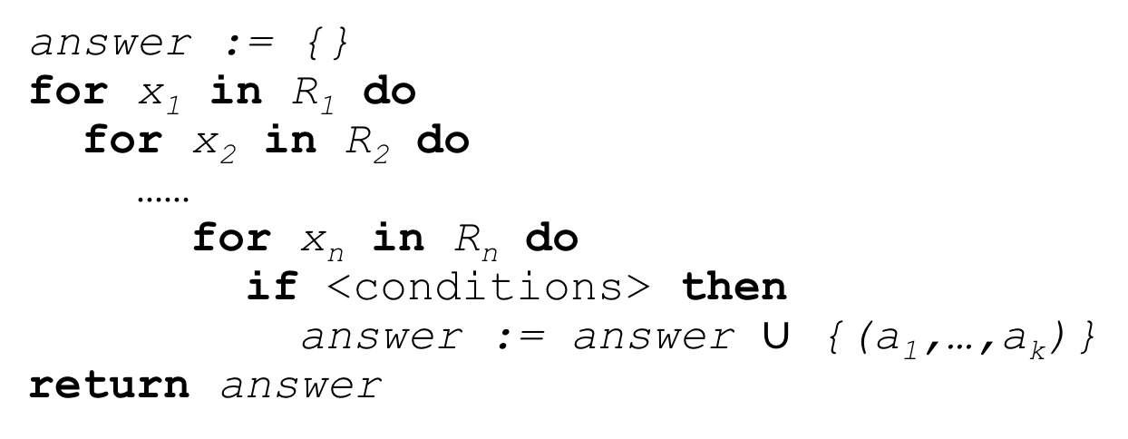
Multi-relation Queries (Cont.)
Nested loop semantics
SELECT a1, a2, …, ak
FROM R1 AS x1, R2 AS x2, …, Rn AS xn
WHERE <conditions>;
answer := {}
for x₁ in R₁ do
for x₂ in R₂ do
……
for x_{n} in R_{n} do
if <conditions> then
answer := answer $∪$ {(a₁,…,a_{k})}
return answer

Slide 49
Multi-relation Queries (Cont.)
The query processor will almost never evaluate the query using nested loops
Instead, the query optimizer figures out the most efficient way (i.e. plan) to compute it
We will discuss this later in the course when we talk about query optimization

Slide 50
SQL: Part 2
Next Up
Questions?

