Slide 1

Database Management Systems (CS 564)
Fall 2017
Lecture 23

Slide 2
Stage 4 Review: B+tree Index

Slide 3
Recap: B+tree
Height-balanced (dynamic) tree structure
Insert/delete at log_{F} N cost
F = fan-out, N = #leaf pages
Each node contains d ≤ m ≤ 2d entries (except for root where 1 ≤ m ≤ 2d)
i.e. minimum 50% occupancy
d is called the order of the tree
Supports equality and range searches efficiently
Each node corresponds to a disk page
Index entries
In all the non-leaf nodes
(search key value, pid)
Think about page and record organization
Root node
Non-leaf nodes
Leaf nodes
Data entries
Exist only in the leaf nodes
(search key value, rid) or (search key value, record)
Are sorted according to the search key

Slide 4
B+tree Node/Page Formats
Index entry
P₁ | K₁ | P₂ | K₂ | … | P_{m} | K_{m} | P_{m+1}
Non-leaf Pages
Pointer to a page with SK values < K₁
Pointer to a page with K₁ ≤ SK values < K₂
Pointer to a page with K_{m-1} ≤ SK values < K_{m}
Pointer to a page with SK values ≥ K_{m}
Data entry
P₀ | R₁ | K₁ | R₂ | K₂ | … | R_{n} | K_{n} | P_{n+1}
Leaf
Pages
Pointer to previous leaf page
Pointer to next
leaf page
Record 1
Record 2
Record n

Slide 5
Equality Search: Example
Find the record with search key value 38
index -> startScan(38, GTE, 39, LT)
 | 13 |  | 17 |  | 24 |  | 30
index -> scanNext(rid)
 | 2* | 3* | 5* | 7*
 | 14* | 16*
 | 19* | 20* | 22*
 | 24* | 27* | 29*
 | 33* | 34* | 38* | 39*
bufMgr -> readPage(file, rid.page_number, curPage)
curPage -> getRecord(scanRid).data())
bufMgr -> unPinPage(file, rid.page_number, false)

Slide 6
Range Search: Example
Find all records with search key values ≥ 15 and < 35
index -> startScan(15, GTE, 35, LT)
 | 13 |  | 17 |  | 24 |  | 30
 | 2* | 3* | 5* | 7*
 | 14* | 16*
 | 19* | 20* | 22*
 | 24* | 27* | 29*
 | 33* | 34* | 38* | 39*
index -> scanNext(rid)
bufMgr -> readPage(file, rid.page_number, curPage)
curPage -> getRecord(scanRid).data())
bufMgr -> unPinPage(file, rid.page_number, false)

Slide 7
Insertion: Example
Insert 8*
isLeaf?
No
Find entry
isLeaf?
Yes
 | 13 |  | 17 |  | 24 |  | 30
 | 2* | 3* | 5* | 7*
 | 14* | 16*
 | 19* | 20* | 22*
 | 24* | 27* | 29*
 | 33* | 34* | 38* | 39*
Find entry in leaf

Slide 8
Insertion: Example (Cont.)
Insert 8*
 | 13 |  | 17 |  | 24 |  | 30
 | 2* | 3* | 5* | 7*
 | 14* | 16*
 | 19* | 20* | 22*
 | 24* | 27* | 29*
 | 33* | 34* | 38* | 39*
Split!
Allocate new node (i.e. page)

Slide 9
Insertion: Example (Cont.)
Insert 8*
 | 13 |  | 17 |  | 24 |  | 30
 | 2* | 3* | 5* | 7*
 | 14* | 16*
 | 19* | 20* | 22*
 | 24* | 27* | 29*
 | 33* | 34* | 38* | 39*

Slide 10
Insertion: Example (Cont.)
Insert 8*
Split!
Copy up
5
 | 13 |  | 17 |  | 24 |  | 30
 | 2* | 3*
 | 14* | 16*
 | 19* | 20* | 22*
 | 24* | 27* | 29*
 | 33* | 34* | 38* | 39*
 | 5* | 7* | 8*
Distribute the keys between old and new pages:
Split into half, find where the new key lands
Update the forward pointers of old and new pages

Slide 11
Insertion: Example (Cont.)
Insert 8*
Allocate new page , populate it and update root reference
Push up
17
 | 5 |  | 13
 | 24 |  | 30
 | 2* | 3*
 | 5* | 7* | 8*
 | 14* | 16*
 | 19* | 20* | 22*
 | 24* | 27* | 29*
 | 33* | 34* | 38* | 39*

Slide 12
Insertion: Example (Cont.)
Insert 8*
 | 17
 | 5 |  | 13
 | 24 |  | 30
 | 2* | 3*
 | 5* | 7* | 8*
 | 14* | 16*
 | 19* | 20* | 22*
 | 24* | 27* | 29*
 | 33* | 34* | 38* | 39*

Slide 13
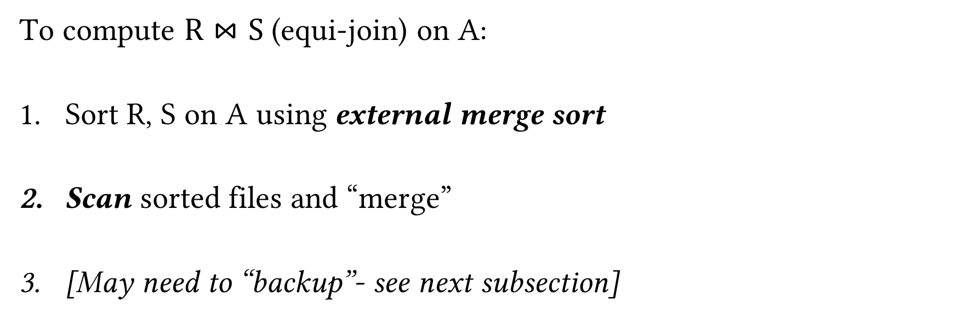
Sort Merge Join (SMJ): Basic Procedure
To compute $R⋈S$ (equi-join) on A:
Sort R, S on A using external merge sort
Scan sorted files and “merge”
[May need to “backup”- see next subsection]
Courtesy of Chris Re
Note that if R, S are already sorted on A, SMJ will be awesome!

Slide 14
SMJ Example: $R⋈S$ on A with 3 page buffer
For simplicity: Let each page be one tuple, and let the first value be A
We show the file HEAD, which is the next value to be read!
Disk
Main Memory
Courtesy of Chris Re
R
(0,a)
(5,b)
(3,j)
Buffer
S
(3,g)
(7,f)
(0,j)

Slide 15
SMJ Example: $R⋈S$ on A with 3 page buffer
1. Sort the relations R, S on the join key (first value)
Disk
Main Memory
Courtesy of Chris Re
(3,j)
(5,b)
(5,b)
(0,a)
(3,j)
R
(0,a)
Buffer
S
(7,f)
(3,g)
(0,j)
(0,j)
(7,f)
(3,g)

Slide 16
SMJ Example: $R⋈S$ on A with 3 page buffer
2. Scan and “merge” on join key!
Disk
Main Memory
Courtesy of Chris Re
(0,a)
(3,j)
(5,b)
R
(0,a)
Buffer
S
(0,j)
(3,g)
(7,f)
(0,j)
Output

Slide 17
SMJ Example: $R⋈S$ on A with 3 page buffer
2. Scan and “merge” on join key!
Disk
Main Memory
Courtesy of Chris Re
R
(0,a)
(3,j)
(5,b)
Buffer
S
(0,j)
(3,g)
(7,f)
(0,a)
(0,j)
(0,a,j)
Output

Slide 18
SMJ Example: $R⋈S$ on A with 3 page buffer
2. Scan and “merge” on join key!
Disk
Main Memory
Courtesy of Chris Re
(0,a)
(3,j)
(5,b)
R
(3,j)
(5,b)
Buffer
S
(0,j)
(3,g)
(7,f)
(3,g)
(7,f)
(3,j,g)
Output
(0,a,j)

Slide 19
SMJ Example: $R⋈S$ on A with 3 page buffer
2. Done!
Disk
Main Memory
Courtesy of Chris Re
(0,a)
3,j
5,b
R
(3,j)
(5,b)
Buffer
S
(0,j)
3,g
7,f
(3,g)
(7,f)
Output
(0,a,j)
(3,j,g)

Slide 20
Multiple tuples with Same Join Key: “Backup”
1. Start with sorted relations, and begin scan / merge…
Disk
Main Memory
Courtesy of Chris Re
(0,a)
3,j
5,b
R
(0,a)
(0,j)
(0,b)
Buffer
S
(0,j)
(0,j)
3,g
7,f
(0,g)
(7,f)
Output

Slide 21
Multiple tuples with Same Join Key: “Backup”
1. Start with sorted relations, and begin scan / merge…
Disk
Main Memory
Courtesy of Chris Re
(0,a)
3,j
5,b
R
(0,j)
(0,b)
Buffer
S
(0,j)
3,g
7,f
(0,g)
(7,f)
(0,a)
(0,j)
(0,a,j)
Output

Slide 22
Multiple tuples with Same Join Key: “Backup”
1. Start with sorted relations, and begin scan / merge…
Disk
Main Memory
Courtesy of Chris Re
(0,a)
(0,j)
5,b
R
(0,j)
(0,b)
Buffer
S
(0,j)
(0,g)
7,f
(0,g)
(7,f)
(0,a)
(0,a,g)
Output
(0,a,j)

Slide 23
Multiple tuples with Same Join Key: “Backup”
1. Start with sorted relations, and begin scan / merge…
Disk
Main Memory
Courtesy of Chris Re
(0,a)
0,j
5,b
R
(0,j)
(0,b)
Buffer
S
(0,j)
0,g
7,f
(0,j)
(0,g)
(7,f)
(0,j)
Output
(0,a,j)
(0,a,g)
Have to “backup” in the scan of S and read tuple we’ve already read!

Slide 24
Backup
At best, no backup → scan takes N_{R}+N_{S} reads
e.g. if no duplicate values in join attribute
At worst, e.g. full backup each time → scan could take N_{R}*N_{S} reads!
e.g. if all duplicate values in join attribute, i.e. all tuples in R and S have the same value for the join attribute
Roughly: For each page of R, we’ll have to back up and read each page of S…
Often not that bad however
Courtesy of Chris Re

