Slide 1
MEC-E5001 Mechatronic Machine Design Project Work Crane Hook Sway Simulation and Control
Group R: Waqas Ahmad– Adel Ansari
Instructor: Professor Kari Tammi
Department of Mechanical Engineering, Aalto University

Slide 2
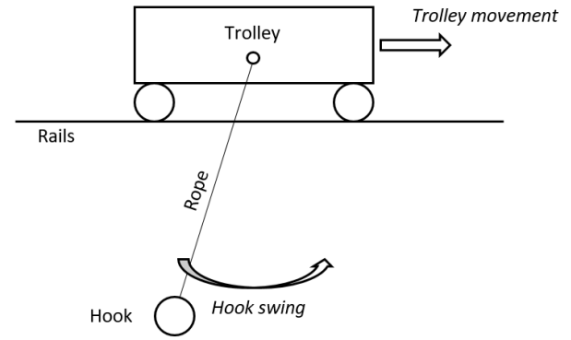
Presentation Overview
Introduction and Numeric Modelling
CAD Modelling
Components
Simulation model and control
Closure

Slide 3
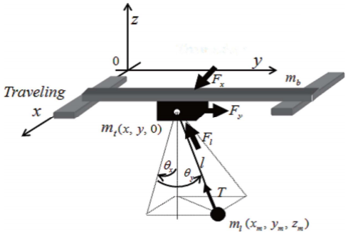
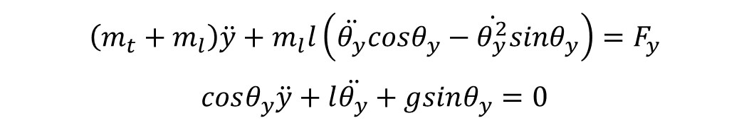

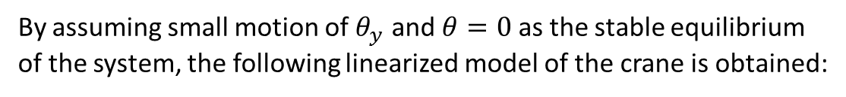
1. Introduction and Numeric Modelling
The non-linear dynamic model of crane is derived using Lagrange equations as follow:
$$\left(m_{t}+m_{l}\right)\ddot{y}+m_{l}l\left(\ddot{θ_{y}}cosθ_{y}−\dot{θ_{y}^{2}}sinθ_{y}\right)=F_{y}$$
$$cosθ_{y}\ddot{y}+l\ddot{θ_{y}}+gsinθ_{y}=0$$
By assuming small motion of $θ_{y}$ and $θ=0$ as the stable equilibrium of the system, the following linearized model of the crane is obtained:
$$\left(m_{t}+m_{l}\right)\ddot{y}+m_{l}l\ddot{θ_{y}}=F_{y}$$
$$\ddot{y}+l\ddot{θ_{y}}+gθ_{y}=0$$
Reference: http://pep.ijieee.org.in/journal_pdf/11-203-145266708028-33.pdf

Slide 4

1. Introduction and Numeric Modelling
The state space model of the crane can be obtained as:
$$\dot{X}=Ax+Bu$$
$$Y=Cx+Du$$

Slide 5
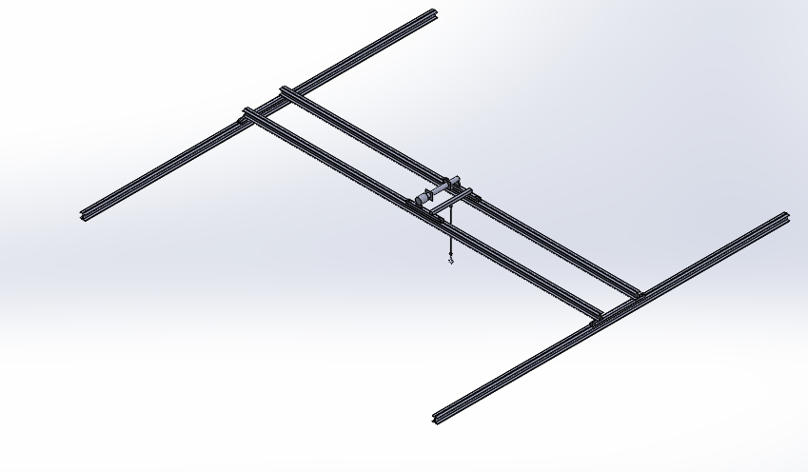
2. CAD Modelling

Slide 6
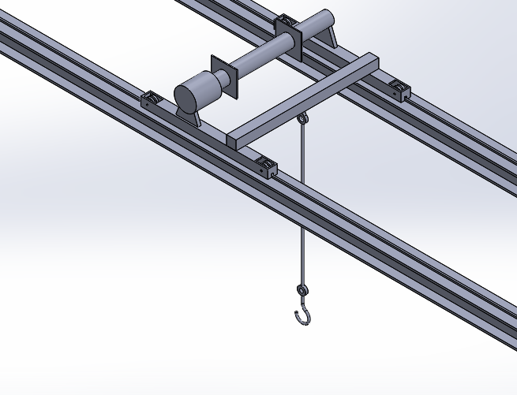
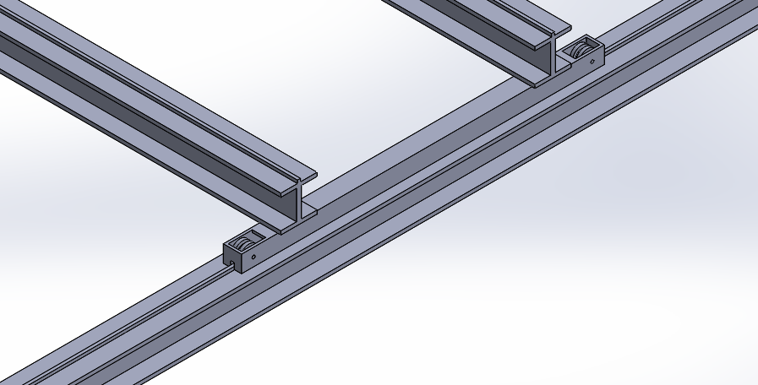
2. CAD Modelling

Slide 7
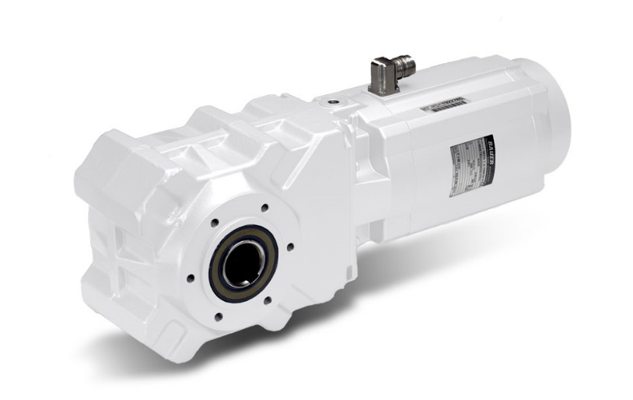
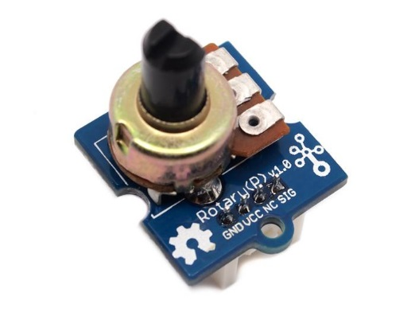
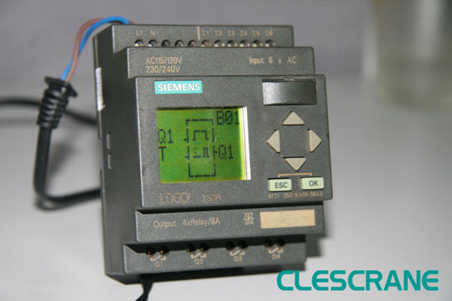
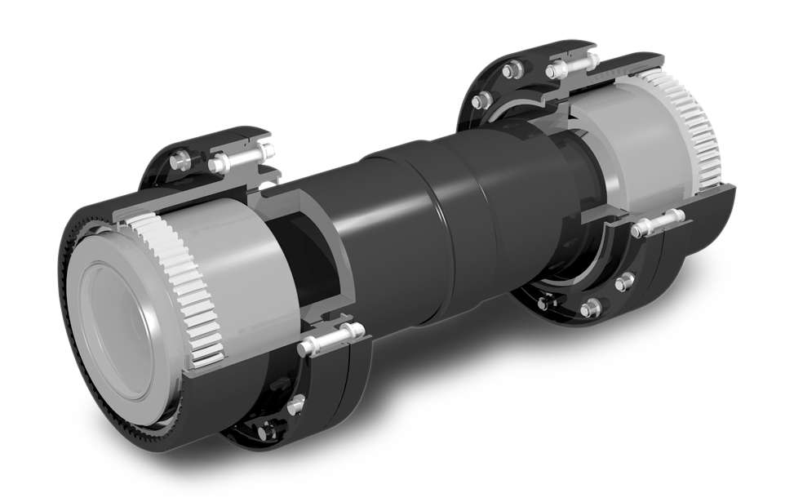
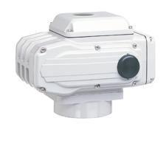
3. Components
AsepticDRIVE | Bauer Gear Motor
The angle of the “rope” will be measured by using a SeeedStudio Grove Rotary Angle Sensor and analog potentiometer.
Power rating 0,37 -2,2 kW
PLC Controller (CLESCRANE)
Amerigear® Class I Gear | Ameridrives
CRANE® 44000 Electric Actuators

Slide 8
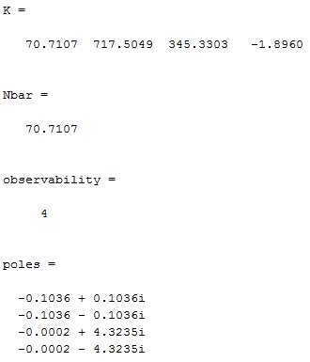
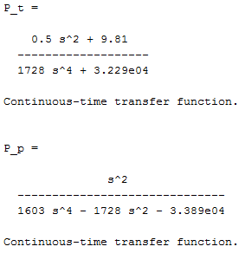
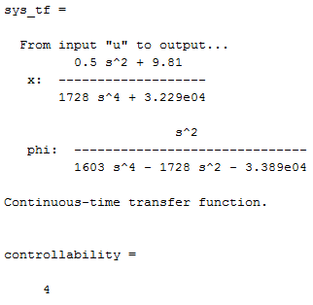
4. Simulation model and control
l=0.5 %:0.5:3.0 % rope length
v=20 % Trolly max speed [m/min]
L_2=9 % Trolly movement range [meters]
m_t=250 % Trolly weigth [kg]
m_max=3200 % Lifting capacity
m_hook=5 % hook wight
m_l=m_max+m_hook;
g=9.81;
s=tf('s')
P_t=(l*s^2+g)/((m_t+m_l)*l*s^4+(m_t*g+m_l*g-m_l*l))
P_p=s^2/(m_l*l*s^4-(m_t+m_l)*l*s^2-(m_t*g+m_l*g))

Slide 9
4. Simulation model and control

Slide 10
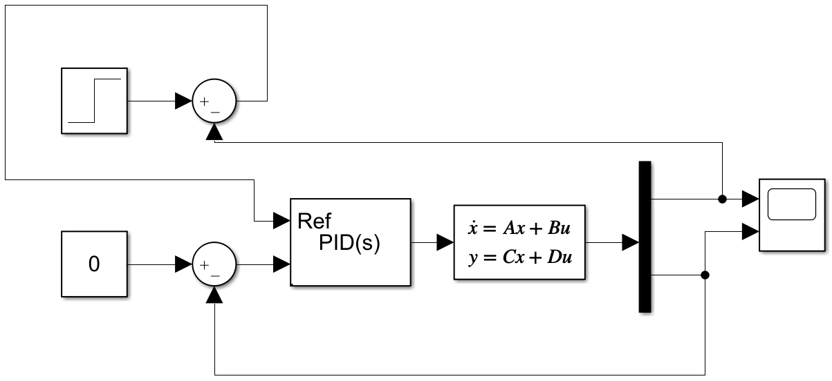
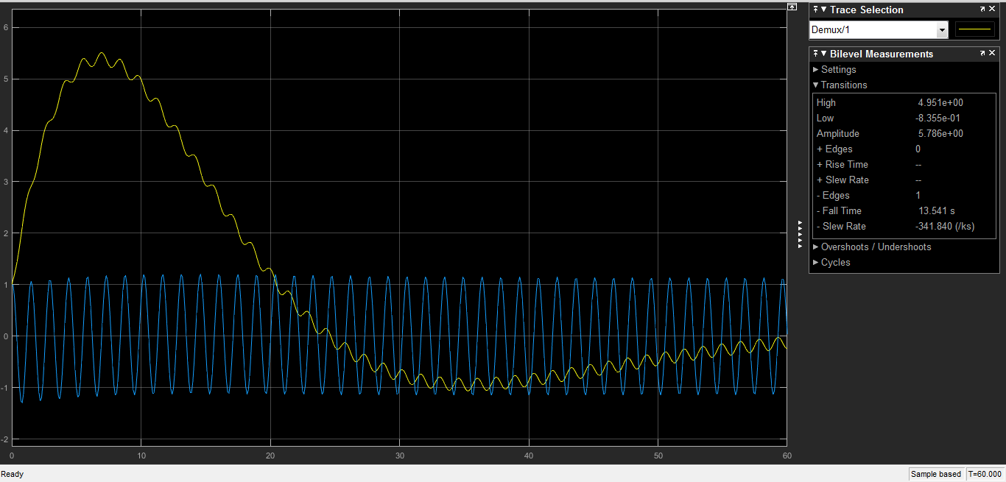
4. Simulation model and control

Slide 11

5. Closure

