Slide 1
Department Gathering October 2025
Multi-agent AI with Autogen for Digital Twins​
TEAM 4✨
(Sagar, An, Arne, Jan Erik, Adela, Tor Arne )

Slide 2
Workshop goals
Build Smart Agents with AutoGen following Agentic Design Patterns
Multi-Agent Systems combined with by Knowledge Graphs and Heterogenous Databases for Increased Observability and Monitoring
AI-based Assisstant for Cognitive Digital Twins

Slide 3
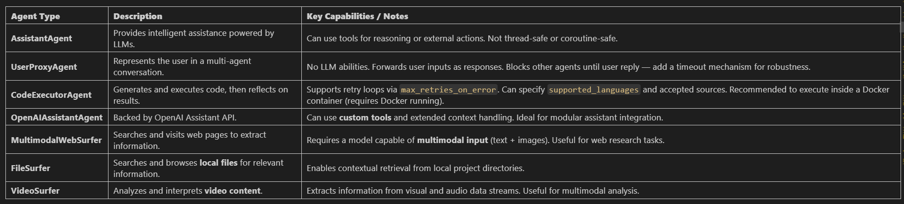
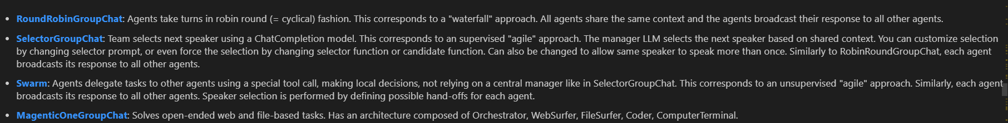
Built-in Autogen Agents
Autogen Teams

Slide 4
Motivation & Case
Problem statement: many interconnected devices that collect, monitor, and exchange data. As networks grow in size and complexity, the volume and heterogeneity of data they generate pose challenges for the effective management of IoT systems.
Solution: increase system observability using a combination of Multi-Agent Systems, Large Language Models and Knowledge Graphs.

Slide 5
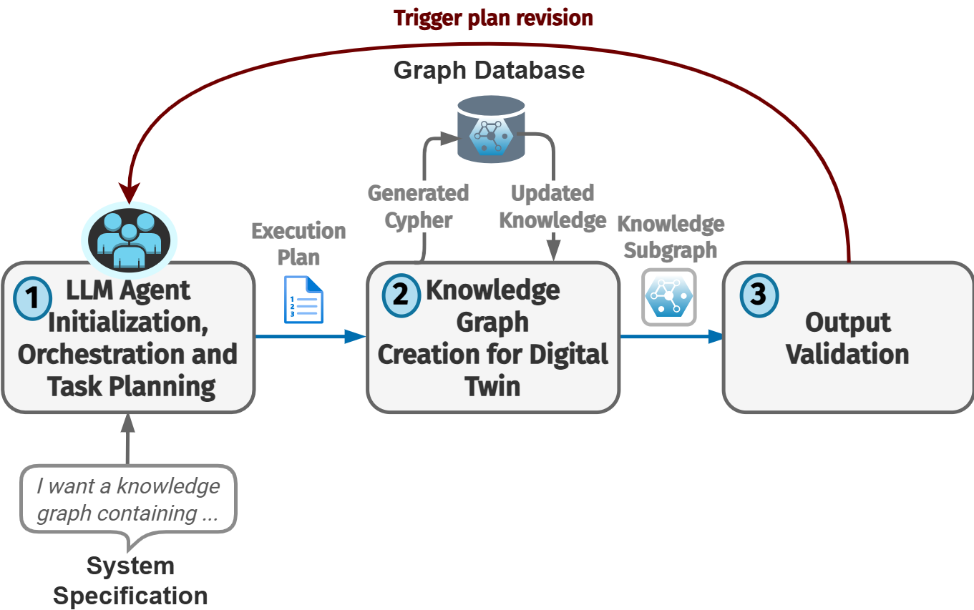
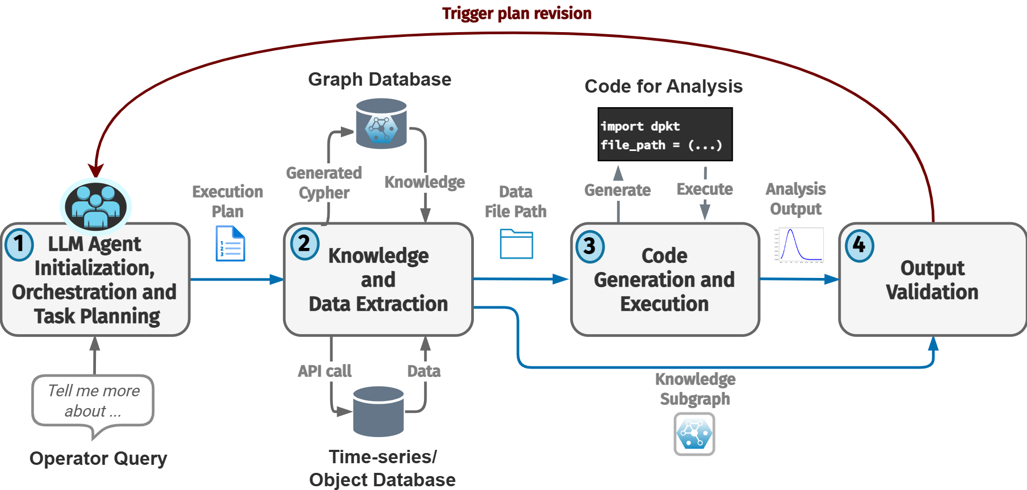
Motivation & Case
a. Knowledge Creation
b. Knowledge Extraction + Data analysis

Slide 6
Motivation & Case
a. Knowledge Creation
b. Knowledge Extraction + Data analysis
How to do this (efficiently too)?

Slide 7
Setup
Connection to databases (e.g MinIO, InfluxDB, Neo4j)
Multi-agent framework (e.g. AutoGen)
LLM access (e.g. via OpenAI API, Ollama)
Data

Slide 8
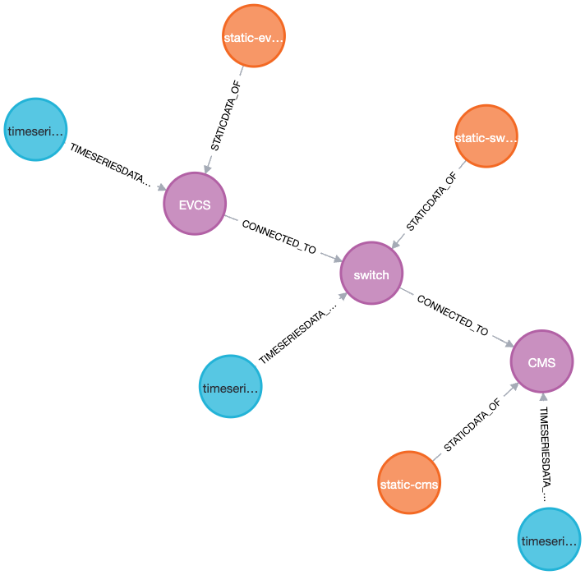
Demonstration

Slide 9
Demonstration
1. User: What is the summary of the static PCAP in CMS?
2. The static PCAP data linked to the CMS asset can be found at the endpoint: static-cms. If you need a summary or content from this static PCAP, please access this bucket.
3. [MinIO] ✅ File '20230511_Denial_of_Charge_IdTag_filtered_pcaplabelled.pcap' downloaded to data_exports\20230511_Denial_of_Charge_IdTag_filtered_pcaplabelled.pcap
4-. import pyshark
def summarize_pcap(file_path):
cap = pyshark.FileCapture(file_path, only_summaries=True)
(…)
def main():
file_path = r"data_exports\20230511_Denial_of_Charge_IdTag_filtered_pcaplabelled.pcap"
summarize_pcap(file_path)
5. Your code is well-structured for summarizing a PCAP file. Here’s what it will do for data_exports\20230511_Denial_of_Charge_IdTag_filtered_pcaplabelled.pcap:
- Count all packets.
- Count frequency of protocols.
- List unique source and destination IP addresses (with 5 samples each)
(…) If you want to extend the summary (for example, adding port information or time duration), let me know!
6. Summary of PCAP: data_exports\20230511_Denial_of_Charge_IdTag_filtered_pcaplabelled.pcap
Total packets: 14321
Protocols: {'TCP': 9124, 'UDP': 5021, 'ARP': 159, 'ICMP': 15, 'DNS': 2}
Unique Source IPs: 26
Unique Destination IPs: 19
Sample Source IPs: ['192.168.1.10', '192.168.1.5', '192.168.1.1', '10.0.0.2', '172.16.0.8']
Sample Destination IPs: ['192.168.1.1', '192.168.1.10', '192.168.1.5', '10.0.0.2', '172.16.0.1’]
7. Plan execution summary:
1. graph_operator_agent: Located the static PCAP linked to CMS at endpoint "static-cms".
2. filepath_fetcher: Retrieved file at data_exports\20230511_Denial_of_Charge_IdTag_filtered_pcaplabelled.pcap.
3. code_generator_agent: Ran analysis code on the file and produced the following summary:
**PCAP Summary for CMS:**
- Total packets: 14,321
- Protocol breakdown: TCP (9,124), UDP (5,021), ARP (159), ICMP (15), DNS (2)
(…) **Task complete.**
TERMINATE

Slide 10
Discussions we’ve had
What did the participants produce?
We followed a pre-planned workflow for this workshop, however we varied some of the inputs and agent configurations to observe how this impacts the behaviour of the agents.
Knowledge graphs were produced following a DB schema of choice.

Slide 11
Discussions we’ve had
2) What are the benefits and drawbacks?
Benefits:
Relatively easy to implement/prototype due to high level of abstraction (low-code).
Can expand to large agentic architectures due to nesting possiblities: wrapping agents as Tools.
LLMs get tool access and ability to perform actions (executing functions e.g. API call).
Good for building autonomous solution.
Knowledge graphs are versatile.
Drawbacks:
Hard to fully control behaviour and sensitivity to small changes.
Hallucinations
Debugging takes some time
3) Are there variations in the results among participants – and if so, why?
In practice we did observe different outputs because of the non-determinism of the tool, even when running the same query and configuration.

Slide 12
Discussions we’ve had
4) What does the department need to do to adopt these tools?
Mostly motivation to do so ☺ and some time/resources set aside for setting it up.
5) Any other barriers to implementation.
Difficult to setup in short time (issues encountered with venvs, databases restarting, versioning …)
Autogen has some implementation particularities which sometimes requires some tinkering/workarounds (forcing agents, not being able to access moderators, no structured inputs - just outputs).

Slide 13
THANK YOU ❣️

