Slide 1
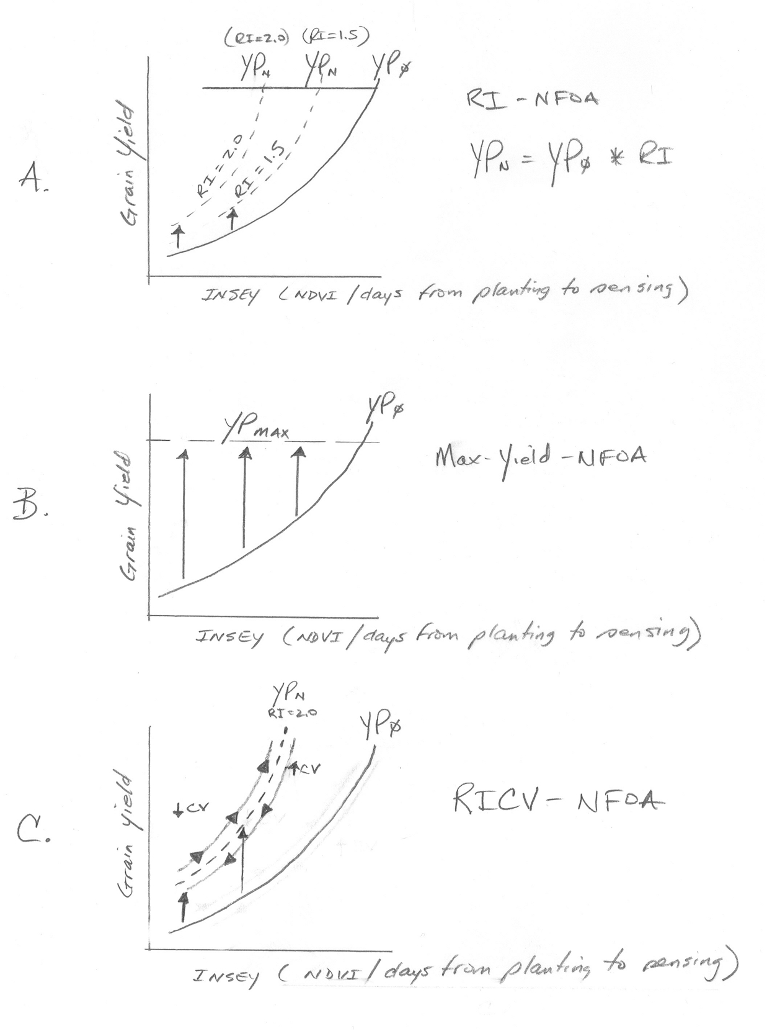

Slide 2
YP_{N}
YP_{N}
YP₀
YP_{MAX}
RI=1.5
Grain yield
RI=2.0
A
RI-NFOA
YP_{N}=YP₀ * RI
INSEY (NDVI/days from planting to sensing)
Nf = (YP₀*RI) – YP₀))/Ef

Slide 3
YP₀
YP_{MAX}
Grain yield
B
Max Yield-NFOA
INSEY (NDVI/days from planting to sensing)
Nf = (YP_{MAX}-YP₀)/Ef

Slide 4
RI=2.0
YP₀
YP_{N}
YP_{MAX}
Grain yield
CV
C
RICV-NFOA
CV
INSEY (NDVI/days from planting to sensing)
Nf = ((YP₀*RI)*(100-CV/100-CV_{lim})) – YP₀/Ef
CV_{lim} = 40 (wheat)
CV>40, YP0*RI cannot increase

Slide 5
RI=2.0
YP₀
YP_{N}
YP_{MAX}
Ht
Ht
Grain yield
RI-Height-NFOA
INSEY (NDVI/days from planting to sensing)
Nf = ((YP₀*RI)*(H_{max}/days from planting)) – YP₀/Ef
H_{obs}/days from planting

