Slide 1
15.S60 visualization in R
Angie King
January 13, 2015

Slide 2
why visualization?
"the picture-examining eye is the best finder we have of the wholly unanticipated”
-John Tukey
see relationships, structures, distributions, outliers, patterns, behaviors, dependencies, outcomes

Slide 3
high level outline
understand your data + intro to ggplot
about 90 minutes
understand your model
about 45 minutes
communicate your findings + best practices
About 20 minutes

Slide 4
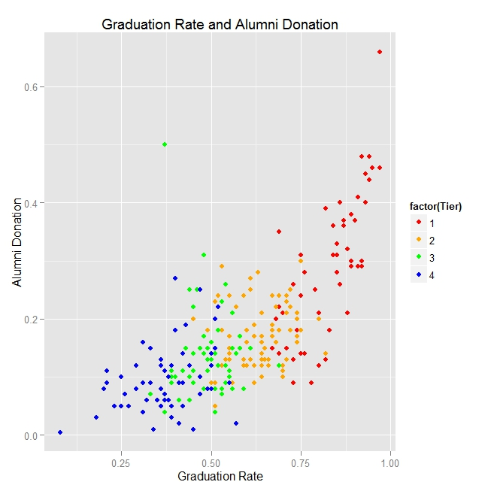
draw a scatterplot. color by factor.
Notes:
http://blogs.bgsu.edu/statgraphicssishi/2013/04/19/r-package-ggplot2/
Ratings for National Universities based on a 2001 survey. Data available in learnEDA R package

Slide 5
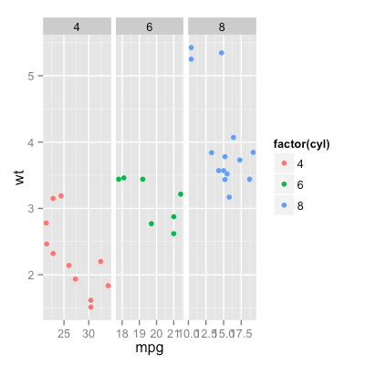
facet to explore categories.

Slide 6
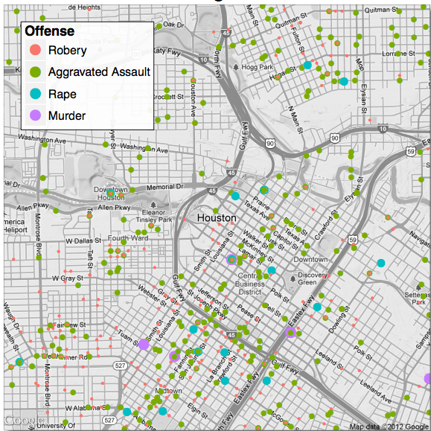
add data to a map. edit point size.
Crime in
Houston TX
Notes:
Great reference on ggmap (including this plot): http://stat405.had.co.nz/ggmap.pdf

Slide 7
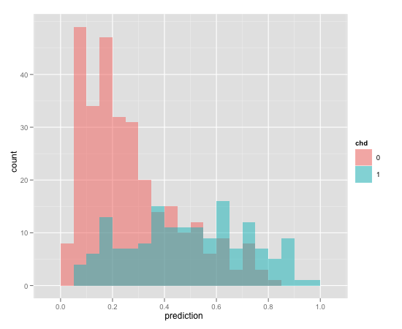
make a histogram. overlay.

Slide 8
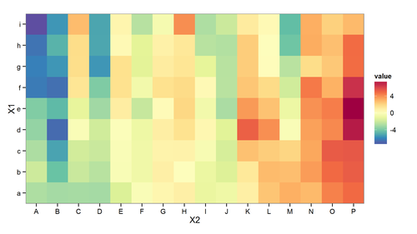
make a heat map. choose colors.

Slide 9
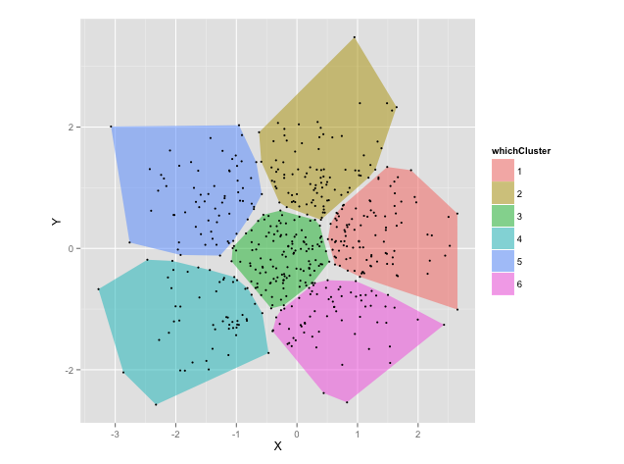
show the 2-d convex hull

Slide 10
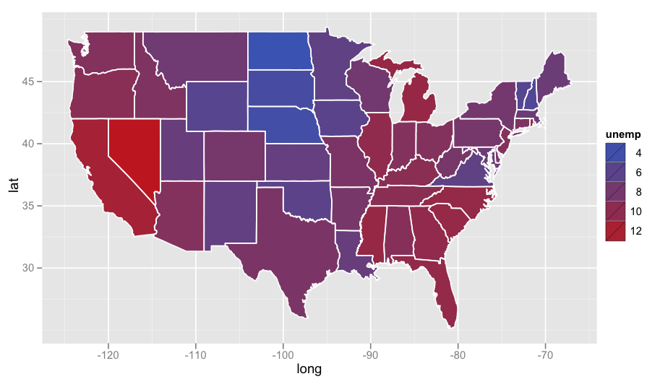
color a map according to data
US unemployment rate, 2011
Notes:
Oct 2011
http://www.r-bloggers.com/visualizing-unemployment-data/

Slide 11
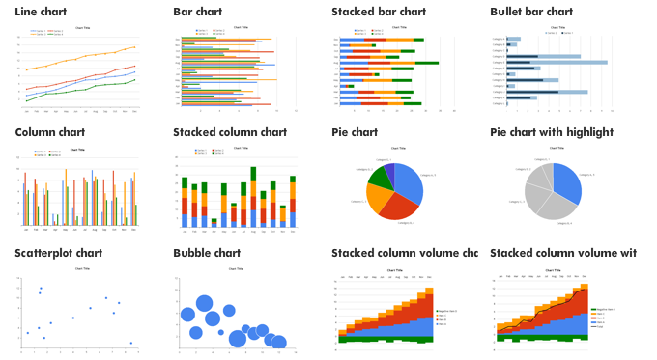
choose the right visualization

Slide 12
datasets we’ll explore today
anscombe’s quartet
iris dataset
election data
airport data
flights data

Slide 13
section 1 – understand data
scatterplots
clusters
map data
histograms
heat maps
Others you could investigate: box plots, cluster dendrograms, time series data, networks,…

Slide 14
what is ggplot?
“ggplot2 is a plotting system for R, based on the grammar of graphics, which tries to take the good parts of base and lattice graphics and none of the bad parts. It takes care of many of the fiddly details that make plotting a hassle (like drawing legends) as well as providing a powerful model of graphics that makes it easy to produce complex multi-layered graphics.”
-Hadley Wickham, creator, www.ggplot2.org

Slide 15
what is a data visualization?
A mapping of data properties to visual properties
Data properties are usually numerical or categorical
Visual properties can be (x,y) coordinates, colors, sizes, shapes, heights, etc

Slide 16
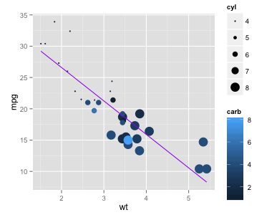
example: motor trends
mtcars:
mpg ➔ y-axis
wt ➔ x-axis
carb ➔ color
cyl ➔ size
Regression equation
➔ purple line

Slide 17
graphics in base R vs ggplot
In base R, each mapping of data properties to visual properties is its own special case
Graphics composed of simple elements like points, lines
Difficult to add elements to existing plots
In ggplot, the mapping of data properties to visual properties is done by adding layers to the plot, starting with the raw data

Slide 18
grammar of graphics
ggplot graphics consist of at least 3 elements:
Data, in a data frame
Aesthetic mapping (aes) describing how variables in the data frame are mapped to graphical attributes
color, shape, scale, x-y axes, subset groupings…
Geometric objects (geoms) determine how values are rendered graphically
points, lines, boxplots, bars, polygons, …

Slide 19
example: motor trends
mtcars:
mpg ➔ y-axis
wt ➔ x-axis
carb ➔ color
cyl ➔ size
Regression equation
➔ purple line

Slide 20
other potential layers
Statistical Transformations (stat)
(smoothing, binning in a histogram, regression lines,...)
Facets to create lattices of plots
(ex: plot each patient individually)
A coordinate system (cartesian coordinates, log coordinates, polar coordinates, map projections, …)
Scales (adjust size scales, color scales, etc)
Notes:
Guides???

Slide 21
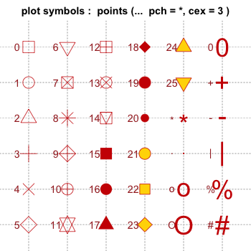
point shapes in R

Slide 22
exercise 1
Plot sepal length vs. petal length in a scatterplot and title the graph.

Slide 23
exercise 2
Change the size of points, by petal width.

Slide 24
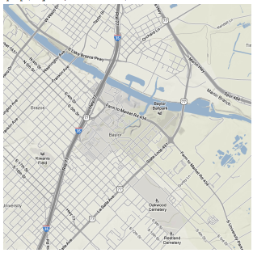
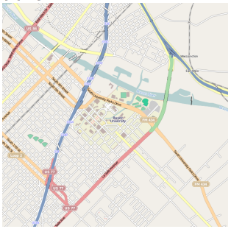
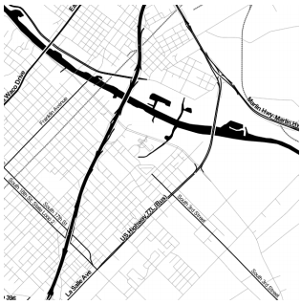
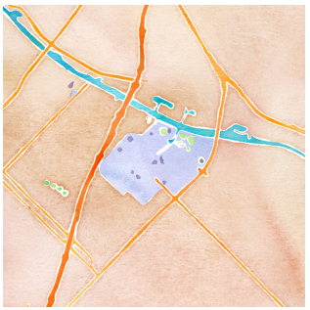
the ggmap package
source = “google”,
maptype = “terrain”
source = “stamen”,
maptype = “toner”
source = “osm”
source = “stamen”,
maptype =
“watercolor”

Slide 25
exercise 3
Plot the airports on a map of the United States.
Change the node size to be relative to the total number of flights out of the airport.
Hint: First create a frequency table of flights by Origin using “table” and turn this into a data frame. Then merge the frequency and top20airport data frames.

Slide 26
exercise 4
Plot a histogram of “TaxiOut” which is the time spent in the airplane sitting on the runway waiting to take off.
Make bin sizes 5 minutes long.
Facet it by whether or not there was weather delay. You will need to create this variable yourself and add it to the flights data frame – make sure it is a factor.
What do you notice?

Slide 27
section 2 – understand your model
add a regression line to a scatterplot
visualize output of clustering model by drawing convex hulls of clusters
plot the output of logistic regression on a map
Other model output to visualize:
CART trees and partitions, Markov processes, linear regression diagnostic plots, branch & bound trees, plots of IP solver time to optimality, ...

Slide 28
exercise 5
Draw a 99% confidence interval instead.
Make the regression line hot pink and large enough to show up.
Bonus: Change the x-axis tick marks to an interval of 1 unit.
Hint: ?scale_x_continuous

Slide 29
the electoral college
The United States has 50 states
Each assigned a number of electoral votes based on population
Most votes: 55 (California)
Least votes: 3 (multiple states)
Reassigned periodically based on population change
Winner takes all: candidate with the most votes in a state gets all its electoral votes
Candidate with most electoral votes wins election

Slide 30
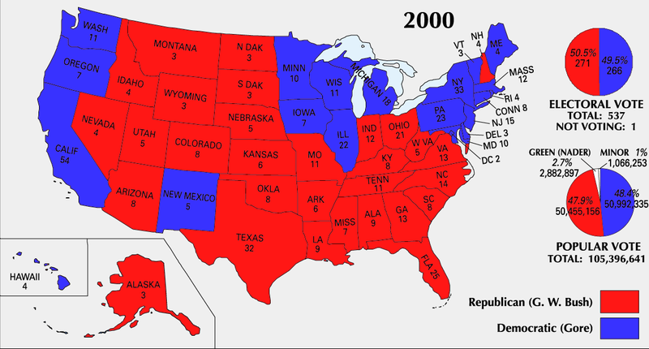
2000 Election: Bush vs. Gore
Notes:
Image source: http://commons.wikimedia.org/wiki/File:ElectoralCollege2000-Large.png

Slide 31

election prediction
Goal: Use polling data to predict state winners
Then-New York Times columnist Nate Silver famously took on this task for the 2012 election
Notes:
Image source: http://commons.wikimedia.org/wiki/File:Nate_Silver_2009.png

Slide 32
polling data
Dependent variable: Republican
1 if republican won state, 0 if democrat
SurveyUSA: polled R% - polled D%
DiffCount: polls with R winner - polls with D winner

Slide 33
exercise 6
Plot prediction results as a gradient according to logistic regression probabilities. Change the legend's title to "Prediction 2012” using the name parameter.
How do you think visualizations should best represent uncertainty? Discuss with your neighbor.

Slide 34
section 3 – communicate
colors
best practices
common pitfalls
next steps: making visualizations dynamic, interactive
Others you could investigate: fonts, themes, text annotations, …

Slide 35
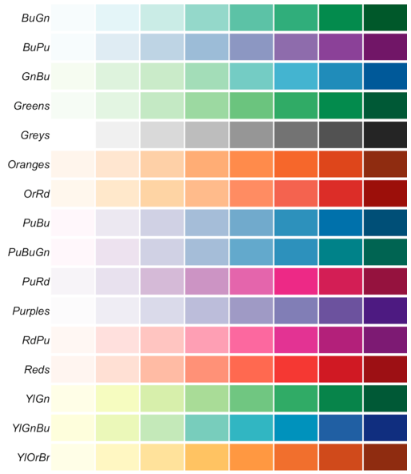
sequential palettes
For ordered data that progresses from low to high values

Slide 36
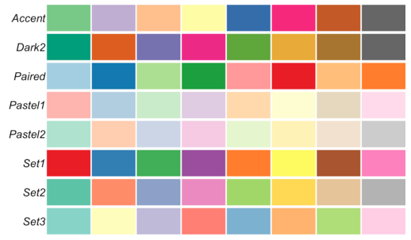
qualitative palettes
Best for categorical data

Slide 37
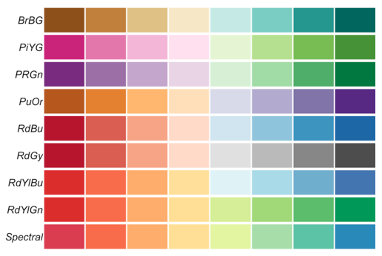
diverging palettes
Emphasize extremes

Slide 38
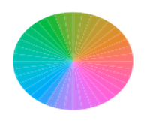
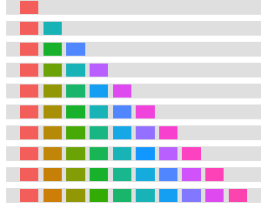
ggplot default color selection
Maximal dispersion along ggplot’s color wheel

Slide 39
a good visualization…
accurately conveys data
distills and summarizes
helps to discern relationships
takes into account audience considerations
Notes:
Audience considerations: what do colors mean to this audience? What icons? What graphs are they used to seeing? Color blindness!

Slide 40
bad visualizations…
too much information
display choices distort reality
inconsistent scales, ordering, placement
too many colors/patterns/styles
absolute values vs. percentages

Slide 41
4 C’s of critiquing graphics
content
construction
context
consumption
Notes:
4C’s borrowed liberally from Hadley Wickham’s slides (http://courses.had.co.nz/), which are licensed for reuse under the Creative Commons License http://creativecommons.org/licenses/by-nc/3.0/us/
Maps from http://junkcharts.typepad.com/junk_charts/2014/05/how-effective-visualization-brings-data-alive.html

Slide 42
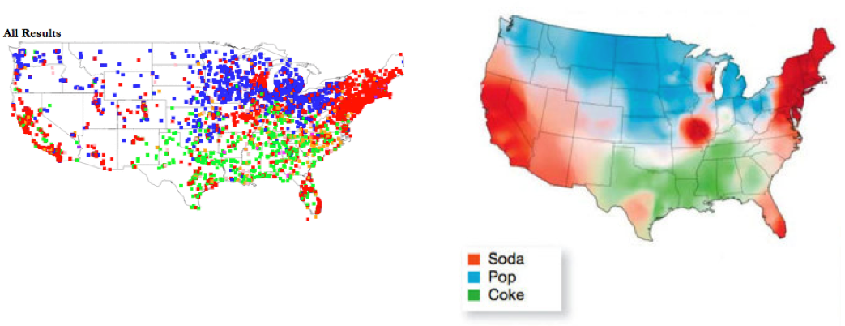
soda, pop, or coke?
Notes:
Maps from http://junkcharts.typepad.com/junk_charts/2014/05/how-effective-visualization-brings-data-alive.html

Slide 43
content
what data/variables does the graphic display?
what non-data is present?
what is the essence of the graphic and what is a helpful extra?
what is missing / what other data would be useful?
where did the data come from?
Notes:
4C’s borrowed liberally from Hadley Wickham’s slides (http://courses.had.co.nz/), which are licensed for reuse under the Creative Commons License http://creativecommons.org/licenses/by-nc/3.0/us/
Maps from http://junkcharts.typepad.com/junk_charts/2014/05/how-effective-visualization-brings-data-alive.html

Slide 44
construction
what type of plot is it?
how are variables mapped to aesthetics?
how is non-data used?
are there multiple layers?
Notes:
4C’s borrowed liberally from Hadley Wickham’s slides (http://courses.had.co.nz/), which are licensed for reuse under the Creative Commons License http://creativecommons.org/licenses/by-nc/3.0/us/
Maps from http://junkcharts.typepad.com/junk_charts/2014/05/how-effective-visualization-brings-data-alive.html

Slide 45
context
why was the graphic created?
what story is it telling?
what is it trying to make you think?
is there a hidden agenda?
Notes:
4C’s borrowed liberally from Hadley Wickham’s slides (http://courses.had.co.nz/), which are licensed for reuse under the Creative Commons License http://creativecommons.org/licenses/by-nc/3.0/us/
Maps from http://junkcharts.typepad.com/junk_charts/2014/05/how-effective-visualization-brings-data-alive.html

Slide 46
consumption
is it aesthetically pleasing?
how good is the signal-to-noise ratio?
did it help you understand relationships in the data?
are you satisfied?
Notes:
4C’s borrowed liberally from Hadley Wickham’s slides (http://courses.had.co.nz/), which are licensed for reuse under the Creative Commons License http://creativecommons.org/licenses/by-nc/3.0/us/
Maps from http://junkcharts.typepad.com/junk_charts/2014/05/how-effective-visualization-brings-data-alive.html

Slide 47
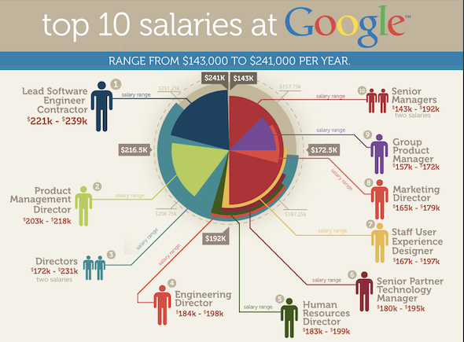
exercise 7: analyze the 4 C’s

Slide 48
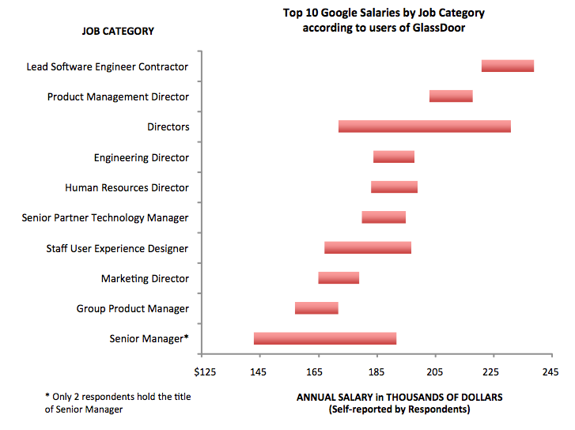
bar chart version
Notes:
Junkcharts.typepad.com

Slide 49
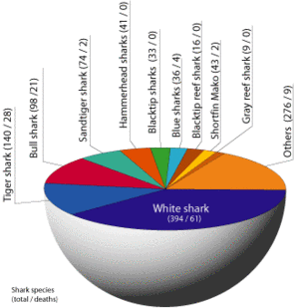
considerations to keep in mind
Does the y-axis start from zero?
Is everything labeled that needs to be?
Are there redundant/meaningless elements?
Is the natural interpretation of the data correct?
Is this the only way to present the data?

Slide 50
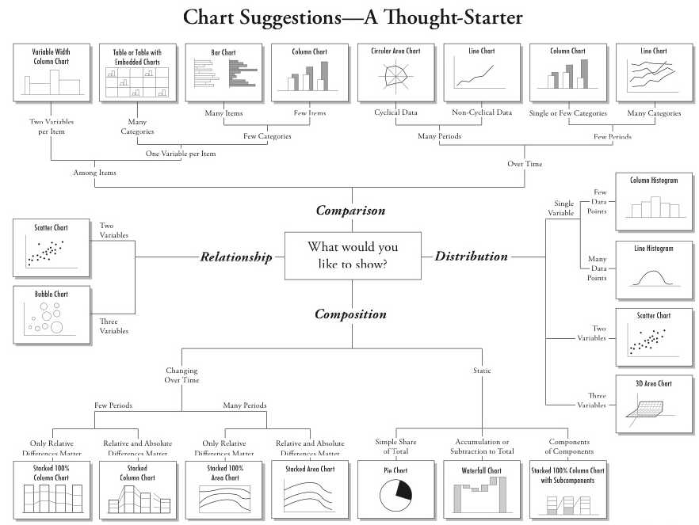
Notes:
http://extremepresentation.typepad.com/files/choosing-a-good-chart-09.pdf

Slide 51
next steps…dynamic, interactive

Slide 52
references for visualization in R
R Graphics Cookbook by Winston Chang
Same content available online
http://www.cookbook-r.com/
docs.ggplot2.org
ggmap
http://stat405.had.co.nz/ggmap.pdf
shiny
http://www.rstudio.com/shiny

Slide 53
other visualization tools
d3.js
Tableau
network visualization → coming Thursday!
map visualization
QGIS, ArcGIS, …
GrUMPy for mathematical programming
branch and bound, polyhedra, cutting planes…
Notes:
arcGIS windows only
QGIS open source, very tightly integrated with R, interface to open street maps

Slide 54
we have covered
ggplot’s grammar of graphics
Understand your data
scatterplot (size, shape, color, use a map as background)
heat map
histogram – concept of faceting
Understand your model
add a regression line to a scatterplot
classification output – color a map
draw the convex hull of a set of points
Communicate
colors
best practices
pitfalls
More advanced
references
other tools
what’s next: dynamic, interactive visualizations

