Slide 1
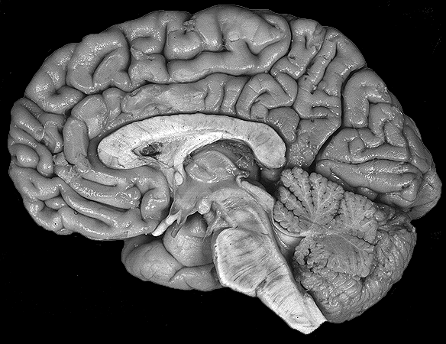

Slide 2
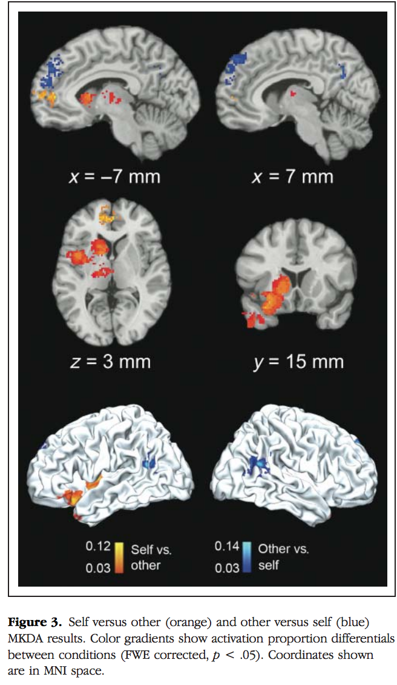

Slide 3
More automated a priori way of distinguishing function between spatially distinct areas of cortex?
Neurosynth
Problem: features – are they sensible?

Slide 4
Features
Neurosynth
ROI2
Studies
ROI1
S x V
S x F
MACHINE LEARNING
ROI1
ROI2
99% ACCURACY!!

Slide 5
In practice
Overall work flow ✔
Need to learn Python! ✔
Extract ROIs ✔
Implement ML ✔
  Scikit-learn
Make code pretty, commented, and modularized ✔
Optimize feature selection & normalization

Slide 6
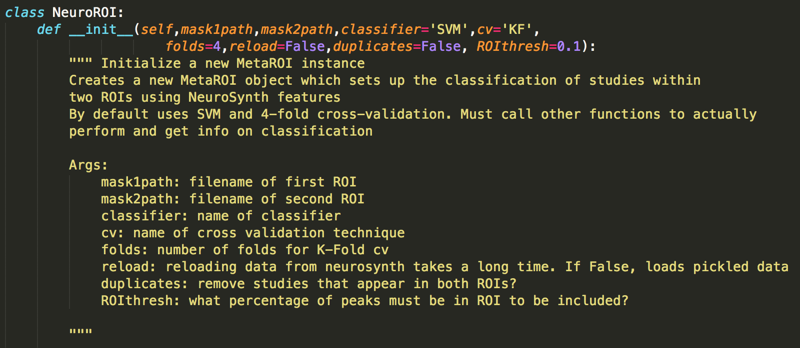

Slide 7
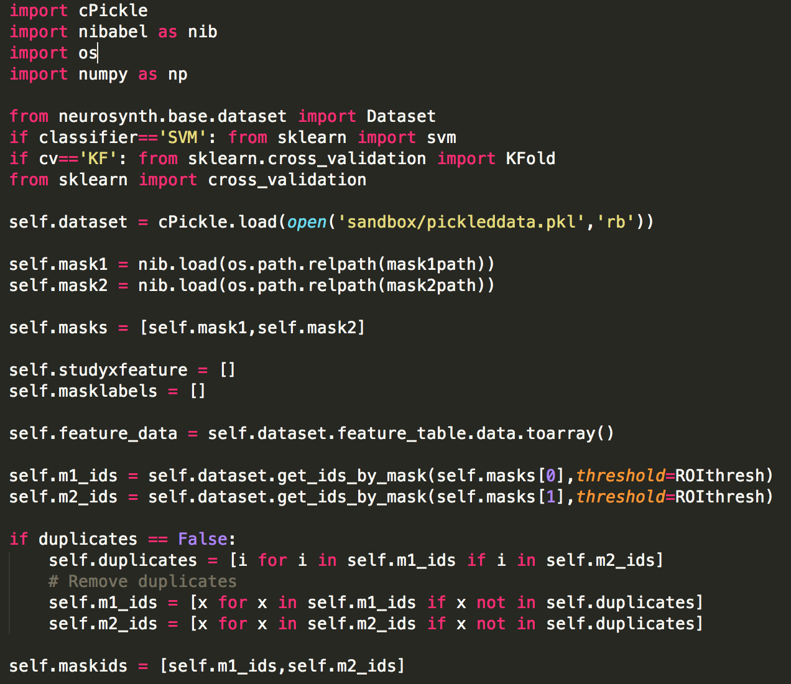

Slide 8
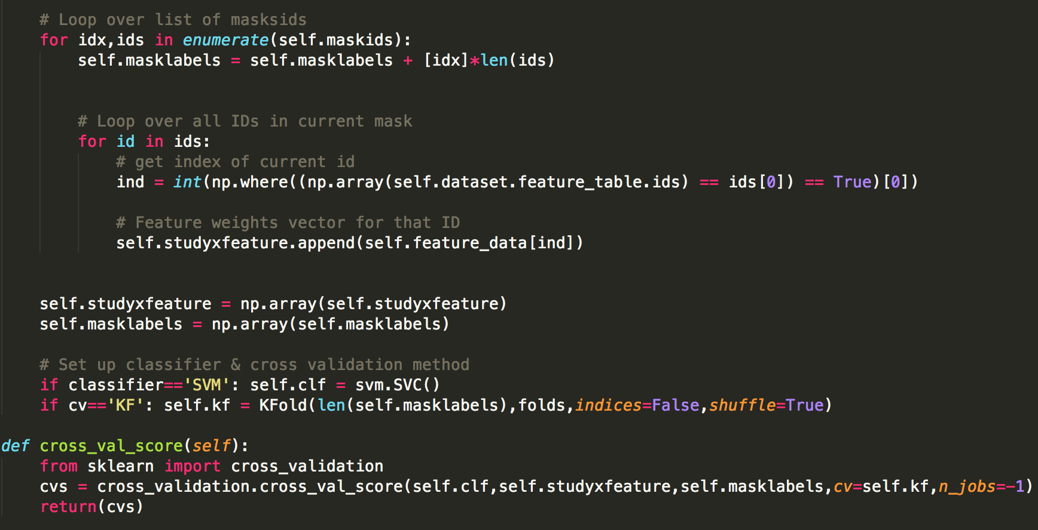

Slide 9
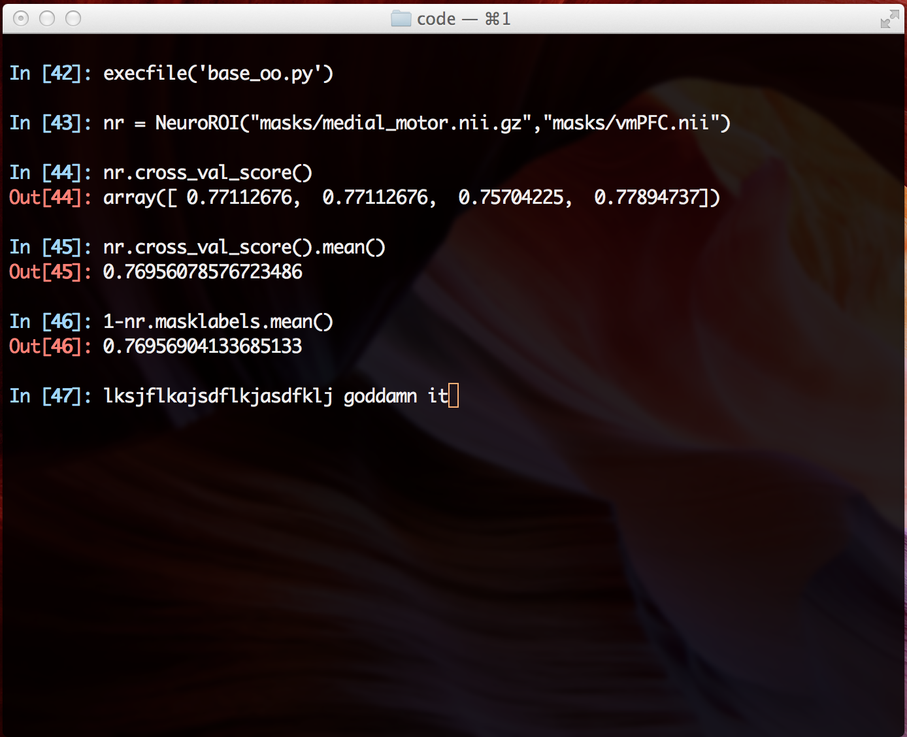

Slide 10
Theoretical issues
Feature selection
  Cognitive atlas? First start w/ reasonable words
  Look into automated ways to tell me which features help
Need to tune parameters
  Threshold levels for inclusion of studies/features
  ML parameters

