Slide 1
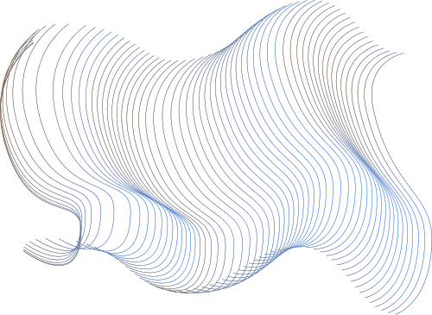
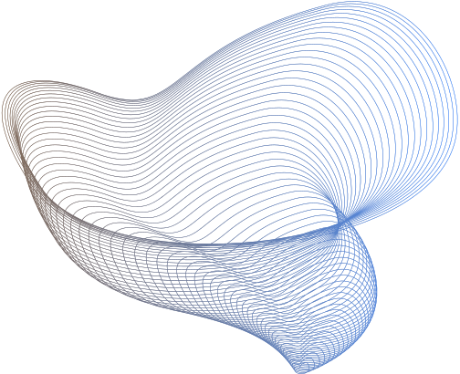
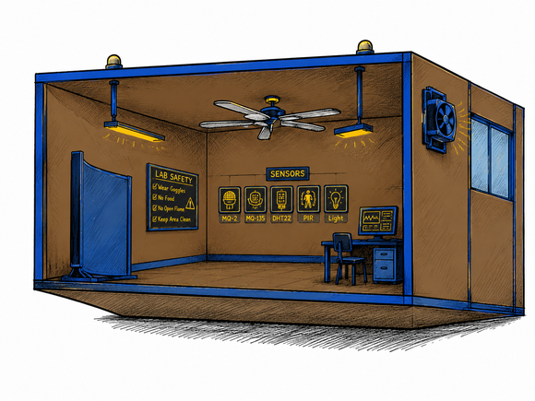
ALG1 - 3.IS
Adaptive Lab Guardian
WHEN 7 AI MODELS TEAM UP TO PROTECT A LAB

Slide 2
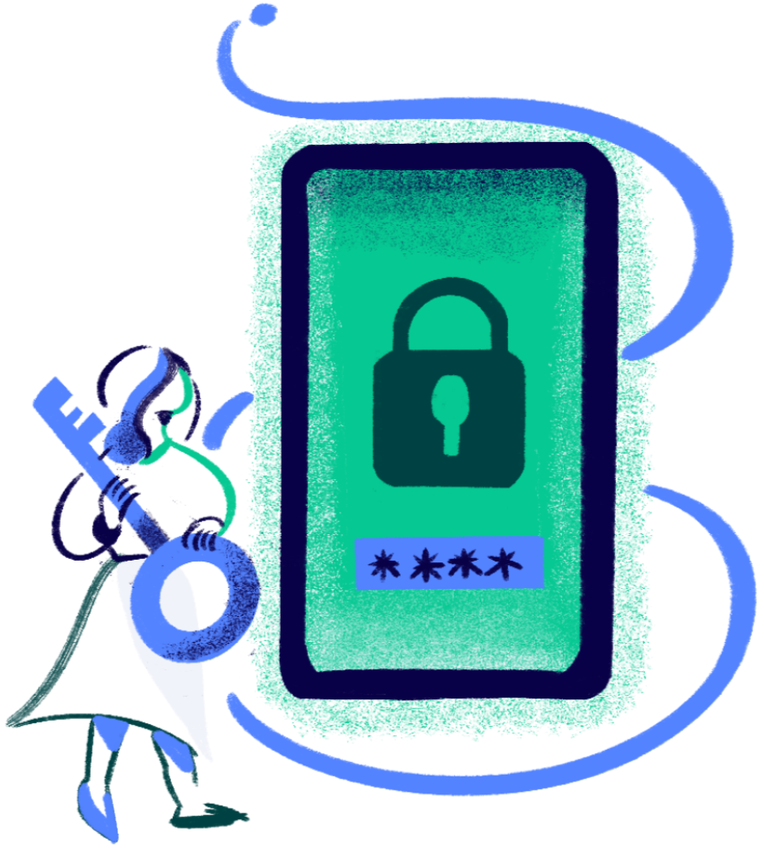
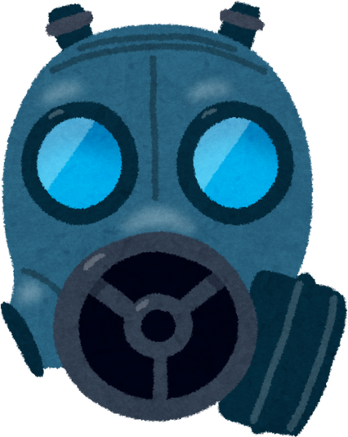
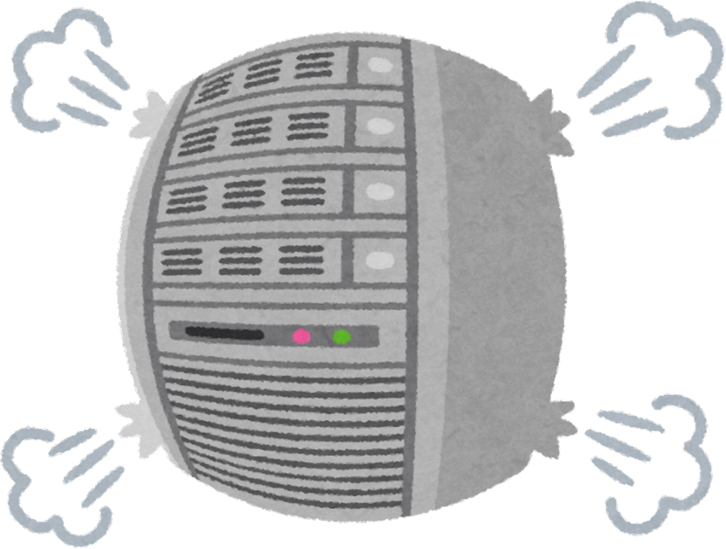
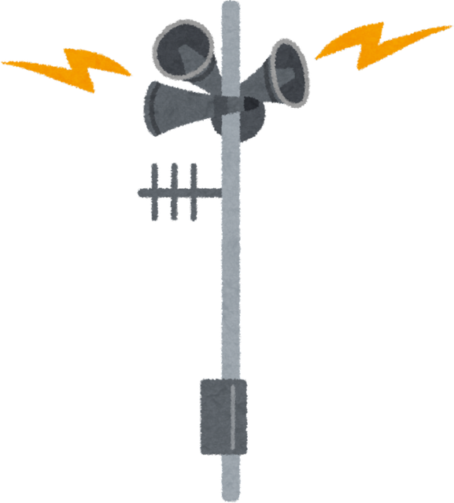
01
What happens when no one is watching ?
Chemical gas leakage
Equipment overheating
Unauthorized access
Delayed emergency response
TRADITIONAL SYSTEMS WAIT FOR HUMANS TO REACT. ALG-1 DOESN'T WAIT.

Slide 3

02
The Idea
In a quiet night inside a university laboratory, everything seemed stable and normal machines running softly and environmental readings within safe ranges.
But then, subtle irregularities began to appear.
A slight increase in temperature, minor fluctuations in air quality, and unexpected motion detected at an unusual time. Individually, they seemed insignificant—but together, they indicated the beginning of a potential problem.
Instead of waiting for a human response, the system immediately started analyzing the situation as a whole, combining all signals to understand what was really happening.
A decision was made within seconds whether to trigger a safety response, activate a control mechanism, or ignore the event if it was within acceptable limits.
The situation was handled in real time, and every outcome became feedback for the system to improve its future responses.
What began as small, almost unnoticed changes marked the first moment the environment required intelligent awareness to prevent escalation.

Slide 4
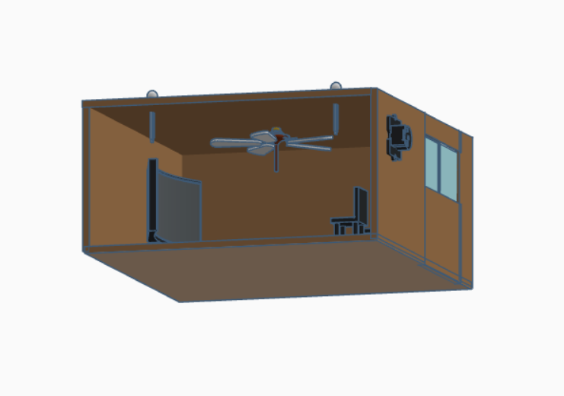




03
What is ALG ?
Instead of just watching a laboratory, ALG-1 tries to understand it.
A smart system where multiple AI models work together to interpret what is happening in real time and respond accordingly.
Inside this intelligence, the laboratory can shift between different “states” of reality:
Normal / Stable
Crowded / Thermal Activity
Chemical Hazard
Security Breach

Slide 5











04
How It Works
Sense
01
Collects real-time sensor data via ESP32 and sends it to the cloud.
Act
04
FROM RAW SENSORS TO SMART DECISIONS
Triggers actuators in real time.
Analyze
02
Applies AI models to extract patterns and detect anomalies.
Learn
05
Improves future decisions using feedback and updates.
Decide
03
choose the best action based on system state.

Slide 6
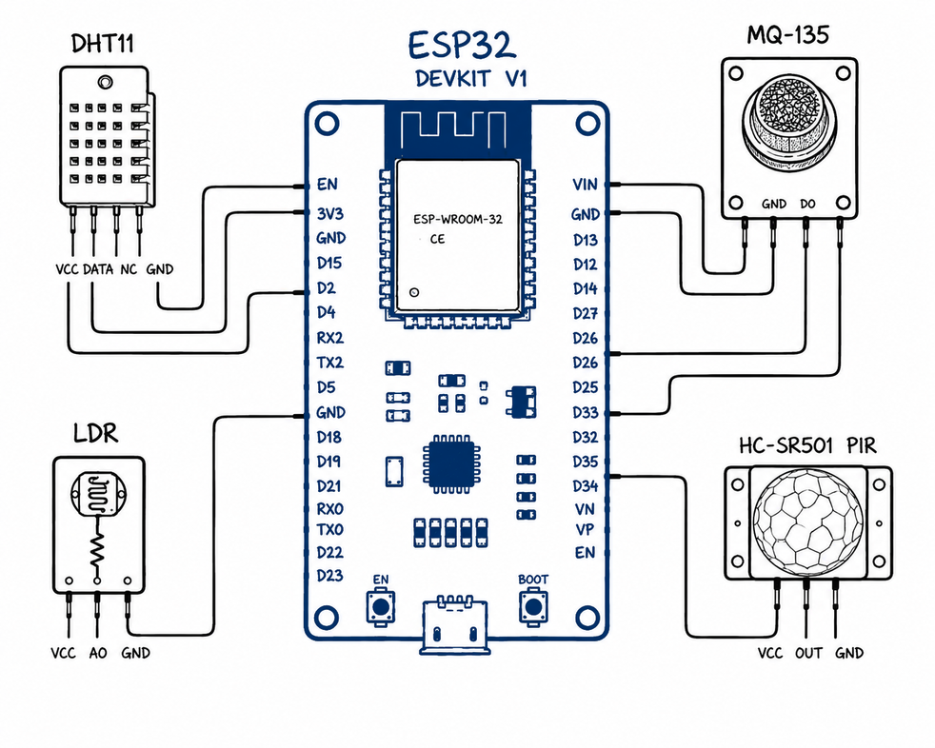
05
Sense
Temperature & Humidity
Air Quality
Motion Detection
Light Levels
EVERY 5 VARIABLES, CAPTURED CONTINUOUSLY, FEEDING THE BRAIN IN REAL-TIME

Slide 7

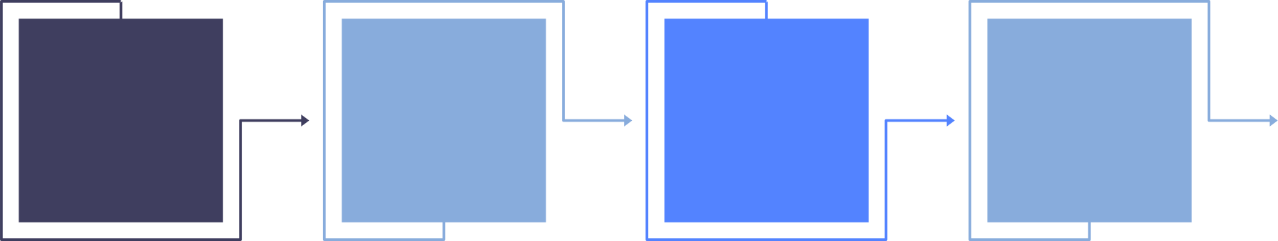




06
ANALYZE
PCA
GNN
SOM
RBF
ART
Noise Reduction
relationships
Classification
Trend
Novelty Detection
Reduces data dimensionality while retaining 97.31% of the total variance, ensuring efficient and reliable analysis.
Determines how events, such as gas leaks, may propagate across different sensor locations.
Classifies sensor conditions into predefined categories.
Distinguishes between gradual changes (slow drift) and abrupt anomalies (sudden spikes) to improve event detection.
Identifies unusual or previously unseen situations, enabling early warning for unexpected events.
MAKING SENSE OF THE NOISE

Slide 8


07
Decide
Fuzzy Logic Engine
Risk Quantification
Situation Classification
Aggregates outputs from PCA, GNN, SOM, RBF, and ART2 using 27 fuzzy rules to generate a unified assessment.
Produces a 0–100% Risk Score representing the severity level derived from all sensor analyses.
Converts the calculated risk into actionable states :
Normal - Warning - Critical
DECIDE: 27 RULES, ONE VERDICT

Slide 9
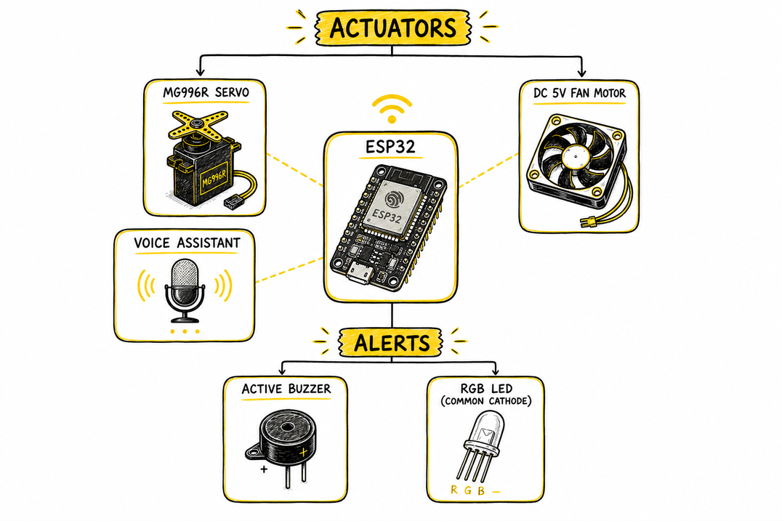
08
Act
FROM DECISION TO ACTION IN MILLISECONDS

Slide 10
09
The Response Matrix
Routine
Ventilation
Chemical
Security Breach
Led | Green | Yellow | Red | Red
Fan | OFF | ON | OFF | ON
Alarm | OFF | OFF | ON | ON
Window | OFF | ON | OFF | ON

Slide 11
10
Learn
Continuously improving system performance through adaptive learning and optimization.
The DQN Reinforcement Learning agent continuously refines actuator control policies, achieving a 98.4% success rate while minimizing unnecessary actuator switching (Actuator Chatter) and reducing energy consumption.
The Genetic Algorithm optimizes decision thresholds based on environmental feedback, such as setting Gas Warning
Threshold = 44.52%, ensuring a balance between sensitivity and false alarms.
DQN (RL)
Genetic
ENABLES THE SYSTEM TO EVOLVE AND IMPROVE AFTER EACH OPERATIONAL CYCLE.

Slide 12
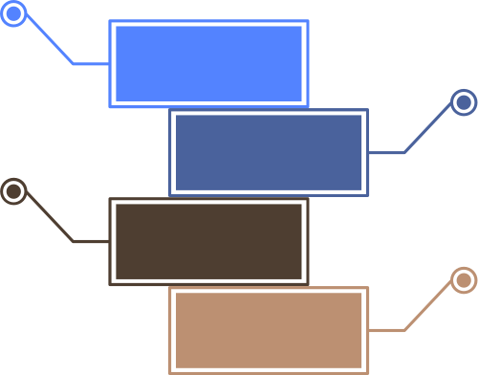



11
What We Learned Along the Way
Dataset
We ran the sensors live in the lab to capture real-world ranges, then generated a realistic synthetic dataset in Python to train all 7 models.
01
Balancing
More models = more intelligence, but also more latency. We had to optimize each model's complexity to keep the pipeline real-time.
02
Real-time
Running PCA, GNN, SOM, RBF, and ART2 in sequence then Fuzzy Logic and RL had to happen in milliseconds, not seconds.
03
False alarms
Tuning the Fuzzy Logic rules
(27 of them) to minimize the 6.1% false alert rate took multiple training cycles.
04

Slide 13




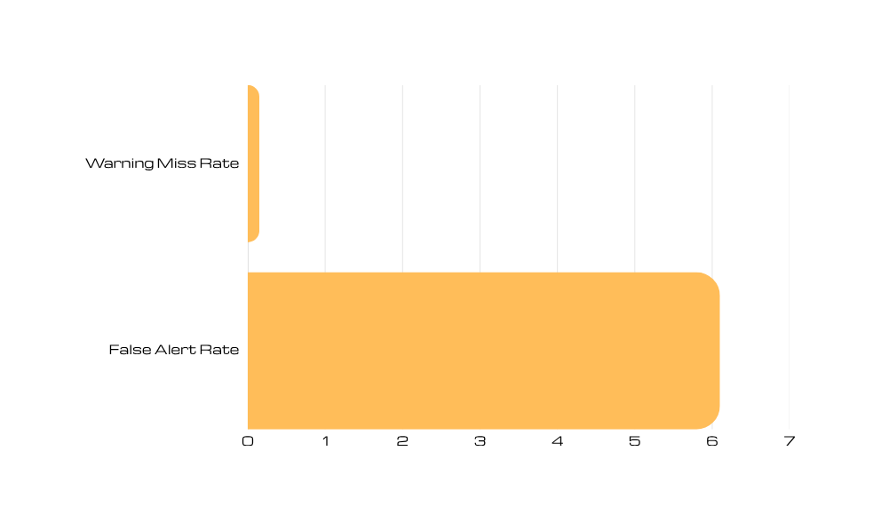
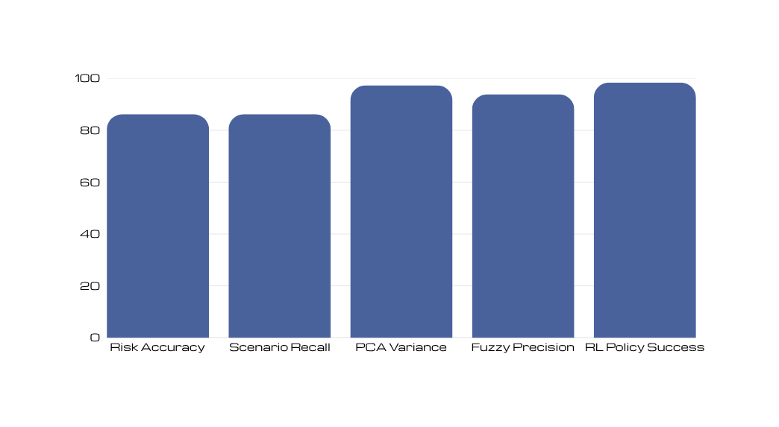
12
Real Results
DQN policy success (98.4%)
Risk classifier accuracy
(86.2%)
PCA variance coverage
(97.3%)
Warning miss rate
(0.15%)

Slide 14
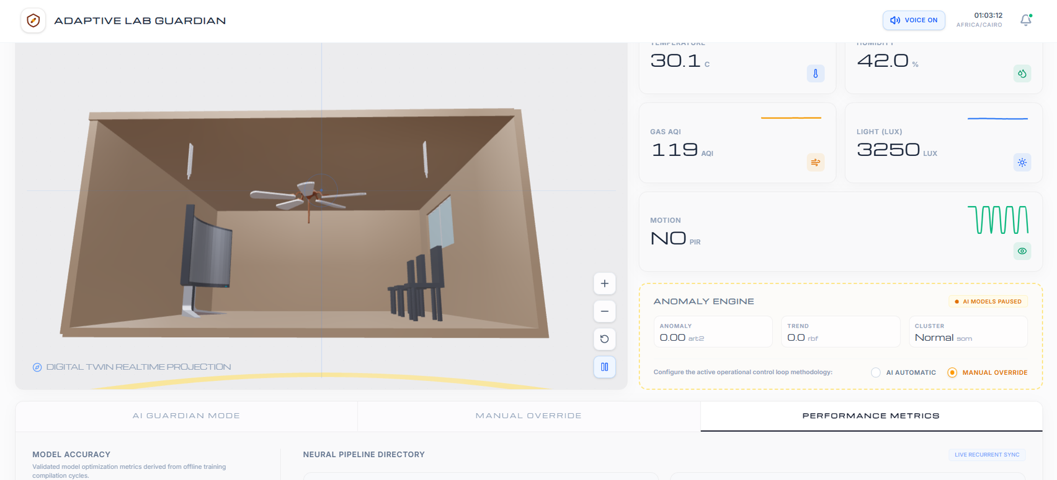
13
ALG combines Edge hardware, real-time AI, and modern web technology into one intelligent safety system — built to protect what matters when no one is watching.
Explore the full architecture, code and Live Demo on GitHub

Slide 15
Thank You
Thoughts ? Questions ? Let's connect

