Slide 1
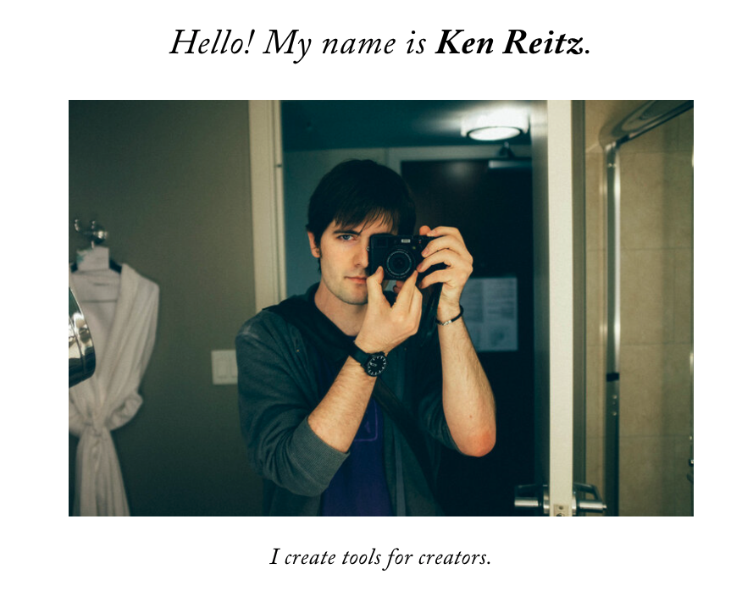
wrapper
header
nav-menu-bar
Albert Teng
About
Portfolio
Blog
Demo
Contact
content
main
https://kenreitz.org/
footer

Slide 2
Functions waiting to Implement:
Sign up
Login
Shopping cart
Reservation System (booking conference room with time slot.)
Blog: use Medium temporarily.

Slide 3








Website Structure
web
Docker-compose
Proxy-server
db

Slide 5
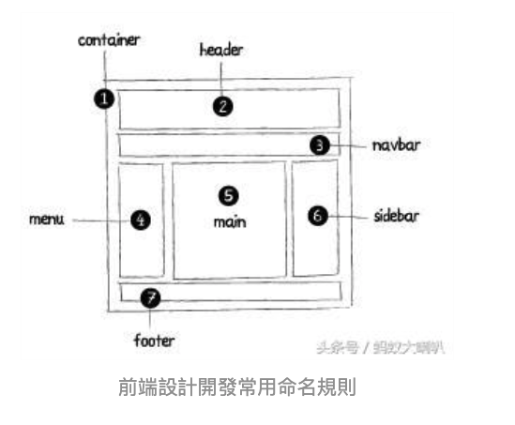
Ref name
頂部:header 內容:content/container 尾部:footer 選單:nav/navigation 側欄:sidebar 欄目:column 頁面控制整體佈局寬度:wrapper 主要區域(通常為頁面主要內容部份):primary 次要區域(通常為次選單):secondary
https://kknews.cc/zh-tw/code/o98bjvm.html
https://ezcshi.pixnet.net/blog/post/13294937

