Slide 1


In Defense of Sparse Tracking: Circulant Sparse Tracker
Tianzhu Zhang^{1,2},
Adel Bibi¹, Bernard Ghanem¹
1
2

Slide 2
Sparse based Tracking
P1: Have high computational cost
P2: Less than promising tracking performance
Circulant Sparse Tracker
A1: Reduce particles using circular shifts
A2: Solve efficiently in the Fourier domain
P3: Limited feature representation
A3: Adopt high dimensional features

Slide 3
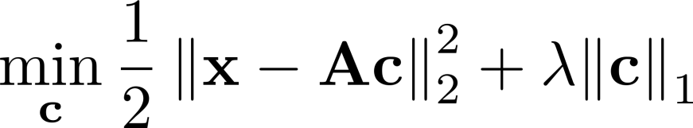
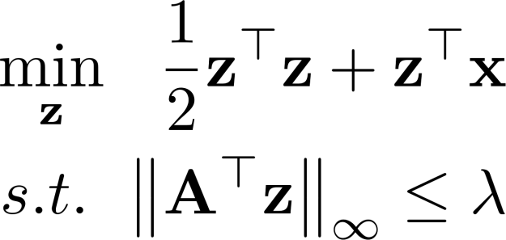



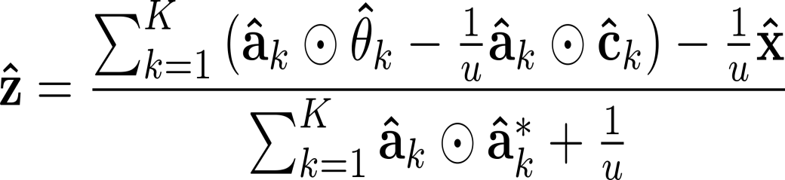
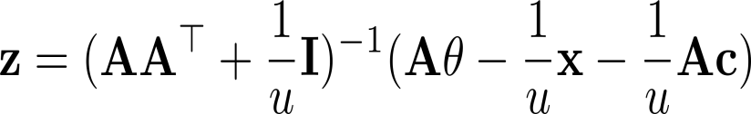

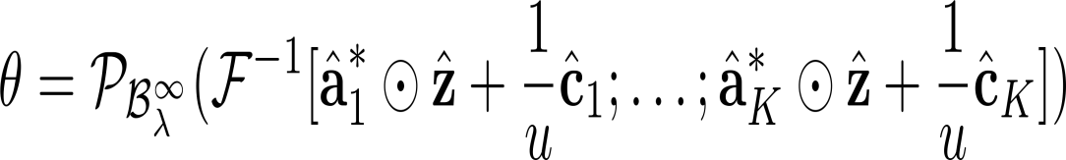
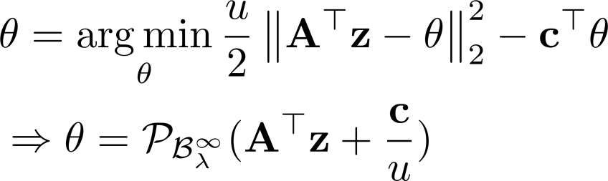


Primal Formulation
Dual Formulation
Circulant
Time Domain
Here, the inverse Fourier transform is for each k
Fourier Domain

Slide 4
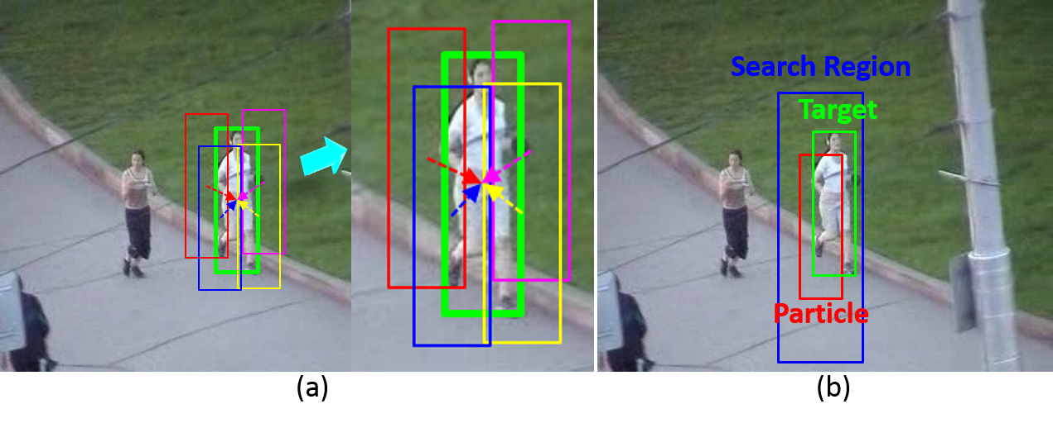
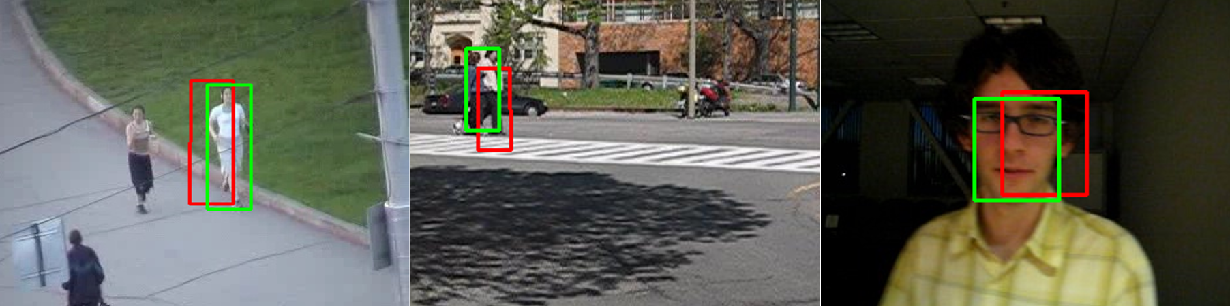

Slide 5
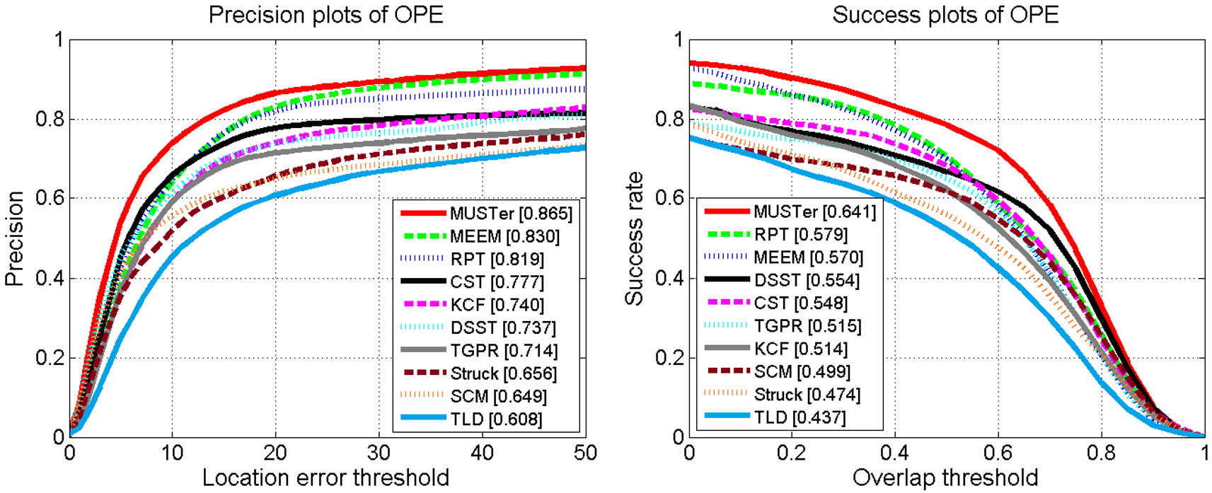
Experimental Results

