Slide 1


Case Study One
Smart building
Task:
Build a model achieving the desired outcome, quantify its performance, describe your approach and recommend a way forward to your management.
Data provided can be used to build a classification model, which detects the presence of a person in a room
Climate control, Lights and others could be switched off automatically, if model determines that no person is present

Slide 2
Methodological approach
JUPYTER NOTEBOOK
PYTHON SCRIPT
Checks missing values
Checks dtypes
Checks temporal distribution of variables
Checks correlation matrix
Extracts some extra features from date
Trains a cross-validated model
Finds optimal model and hyperparameters
Saves performances metrics and graphs

Slide 3
Methodological approach
Model:
Preprocessing : Optimal Binning Method
Technique for discretizing continuous features that determines cutpoints to maximize separation between classes
Enhances model performance and interpretability.
Transforms continuous features for capturing non-linear relationships, handling outliers, and improving discriminatory power.
Cross Validation(CV): Stratified Kfold CV
Target is imbalanced
Logistic Regression (LR) and Random Forest were tested
LR tests L1 and L2 (Ridge) to regularize and avoid overfitting
Points of attention:
CO2 can be affected by windows opened
CO2 is correlated to temperature, and could be affected by external temperature, i.e. seasonality
Should be careful with derived features
Data used is during the same month
Usually a time series data should be analysed with a temporal cross-validation to avoid time-leakage (however target is not temporally evenly distributed)
Performance is really high without too much work
Could be a trap however performance stays high in the validation dataset (never seen during training)
Possible improvements:
Usage of Partykit to analyze features interactions
Output coefficients for interpretability of LR
Use shapley values to understand how input variables contribute to output predictions.
Remove some of the features to avoid usage of some of the sensors
Performance is kept
Cost decreases
Quantify the amount of money saved by switching off the light and heater when no person is present
Models performances output file could be done using MLflow

Slide 4

Case Study Two
Task:
Operationalize the model in a cloud environment, setup drift monitoring for both model and data and ensure automated retraining as a self-healing mechanism in case model performance drifts too far.
The solution cannot be done as a “one-click” solution as it requires many different actions with specific conditions

Slide 5



Running context
Deployment architecture in a cloud environment
Artifacts
Scripts
Input/Output
GitHub
DockerHub
CSV train
AWS ECS
Docker Image
Deploy model
Training
Model
App FastAPI (public IP:URL)
App FastAPI

Slide 6
Automate retraining
CSV training
data
CSV new data
Trained model
Running context
Artifacts
Scripts
Drift analysis
Input/Output
no
Is covariate drift?
OR
Is model drift
yes
Is performance drift?
no
GitHub Actions
yes
Training data = training+new
DockerHub
Retrain
AWS ECS
Model
Docker Image
Deploy model
APP FastAPI
App FastAPI (public IP:URL)

Slide 7
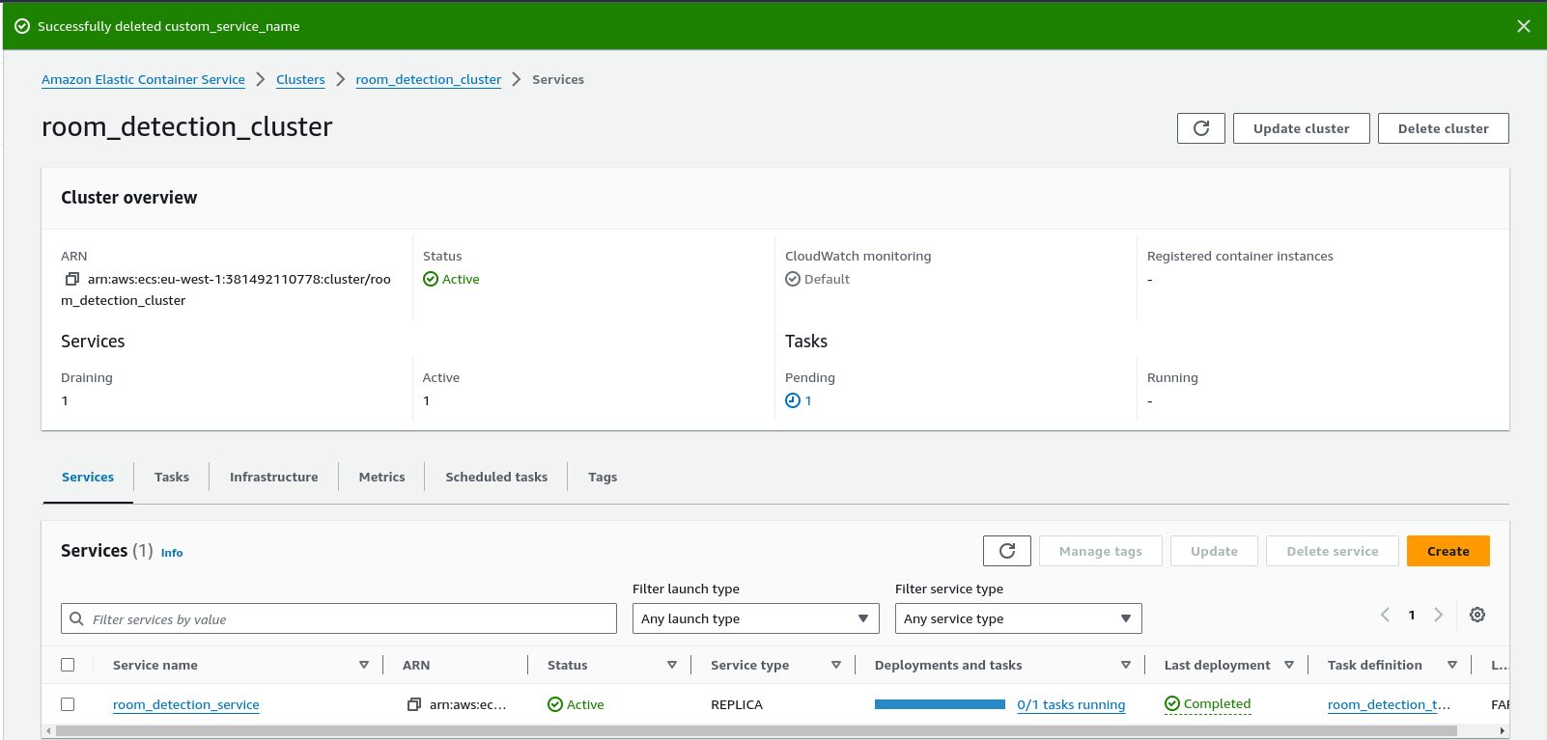
Cluster

Slide 8
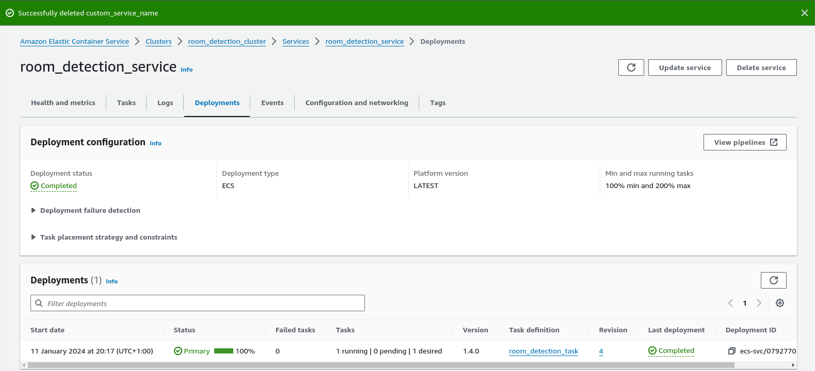
Service

Slide 9
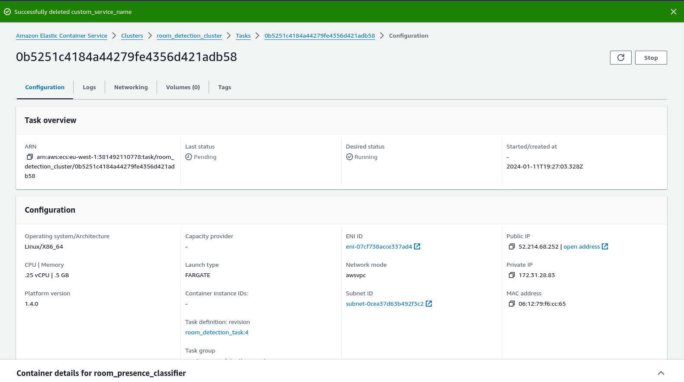
Task

Slide 10
Improvements
At the moment data is sent to Github, which is not advised
Ideally, the new data is kept in a DataBase (Postgres) and queries the model response by sending lists of jsons to the Swagger API.
The drift detection algorithm can then be linked to the DB
Drift detection can be activated with batches of data or with a time scheduler
Pip is used to install requirements, but conda and poetry can be better choices especially if developer are using machines with different OS
Inference system should accept a downtime of 0.1% only
Can be quantified with FastAPI, which returns errors
Can be solved by scaling application using Kubernetes or some Load Balancers type of logic
Pytest, unitary tests could be added
Linters, isort, Flake8 and Black could be run

Slide 11

https://github.com/adelchi91/room_presence_detector

Slide 12
High availability of the model
To ensure high level of availability :
Multi-AZ Deployment:
Deploy your ECS cluster and tasks in multiple Availability Zones (AZs). AWS Fargate allows you to distribute your tasks across multiple AZs for increased fault tolerance. This helps ensure that if one AZ experiences issues, the application continues to run in another.
Auto Scaling:
Set up auto scaling for your ECS service. Configure auto scaling policies based on metrics such as CPU utilization or request rates. This ensures that your application scales horizontally to handle increased traffic and maintains availability during periods of high demand.
Service Discovery:
Use AWS Elastic Load Balancer (ELB) to distribute traffic across multiple tasks and instances. ELB automatically detects unhealthy instances and redirects traffic to healthy ones, improving availability. Consider using AWS Route 53 for DNS-based service discovery.

Slide 13
AWS ECS steps
ECS Cluster:
Purpose: An ECS cluster is a logical grouping of tasks or services. It is a pool of EC2 instances or Fargate resources on which you can run Docker containers.
Why it's needed: ECS needs a cluster to manage the deployment and scaling of containerized applications. The cluster provides the underlying infrastructure where your containers will be deployed.
How it works: When you deploy a task or a service to ECS, it gets scheduled onto the instances within the cluster. The cluster ensures the distribution and load balancing of tasks.
ECS Task:
Purpose: An ECS task is the smallest deployable unit in ECS. It represents a set of containers that are scheduled together on the same instance.
Why it's needed: Tasks define what containers should run together and how they should interact. They provide a way to package and run multiple containers as a single application.
How it works: When you define a task, you specify the Docker image for each container, the resources each container needs, and how the containers should communicate. Tasks are then scheduled onto instances within the ECS cluster.

Slide 14
AWS ECS steps
ECS Service:
Purpose: An ECS service is a higher-level abstraction that allows you to run and maintain a specified number of tasks simultaneously.
Why it's needed: While tasks define what containers to run, services define how many tasks should be running and how they should be managed (e.g., scaling, rolling updates).
How it works: A service ensures that the desired number of tasks is running at all times. It also provides features like load balancing across tasks, automatic scaling, and rolling updates. The service maintains the desired state, and ECS takes care of managing and maintaining the specified number of tasks.
In summary:
Cluster: Provides the infrastructure for running containers.
Task: Represents a set of containers and their configuration.
Service: Manages and maintains a specified number of tasks, providing features like load balancing and scaling.

