Slide 1
Final Presentation
Project 3: University Library Use in Health Sciences and STEM Fields
University of Michigan in Ann Arbor
Adele Chase, Javier Martínez Rodríguez, Xiao Zeng
Notes:
2:14 is the overview
Color check: https://adasitecompliance.com/ada-color-contrast-checker/

Slide 2
TABLE OF CONTENTS
01
02
03
Project
Overview
Individual Projects
Q&A

Slide 3
Project Overview
01

Slide 4
U-M Library Campus-Wide Survey
Conducted in the winter of 2023-24.
It included faculty members of all types (e.g., instructional, clinical, research), graduate students, house officers, and staff members.
The survey asked about the use of library spaces, physical and electronic materials of all types, and services such as consultation, document delivery, library workshops, and more.
Notes:
In the winter of 2023-24, the University of Michigan Library launched its first-ever campus-wide survey. The survey included faculty members of all types (e.g., instructional, clinical, research), graduate students, house officers, and staff members, including those working in health sciences and STEM fields. The survey asked about the use of library spaces, physical and electronic materials of all types, and services such as consultation, document delivery, library workshops, and more.

Slide 5
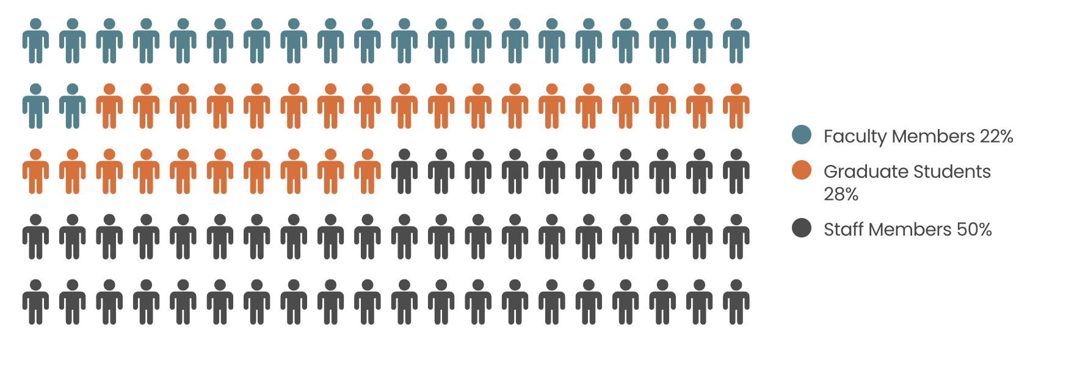
The Dataset
Distribution - Participants in Health Sciences and STEM
Notes:
The data set contains a large number of active researchers. The dataset includes:
535 faculty members in health sciences and STEM fields
670 graduate students in health sciences and STEM fields
1,204 staff members who have direct involvement in patient care.

Slide 6

Project Objective
To describe in a comprehensive manner how those in health sciences and STEM fields experience the academic library, and how the academic library can meet newly-identified needs of its user populations.

Slide 7
Individual Projects
02

Slide 8
Adele Chase

Slide 9
Research Question
Are there differences in how faculty, researchers, and graduate students of different racial backgrounds in the health sciences and STEM perceive and use the library, its collections, research support, and instruction support?
Objective
To identify areas where UMich Libraries can implement more inclusive policies and services

Slide 10
Overview

Slide 11
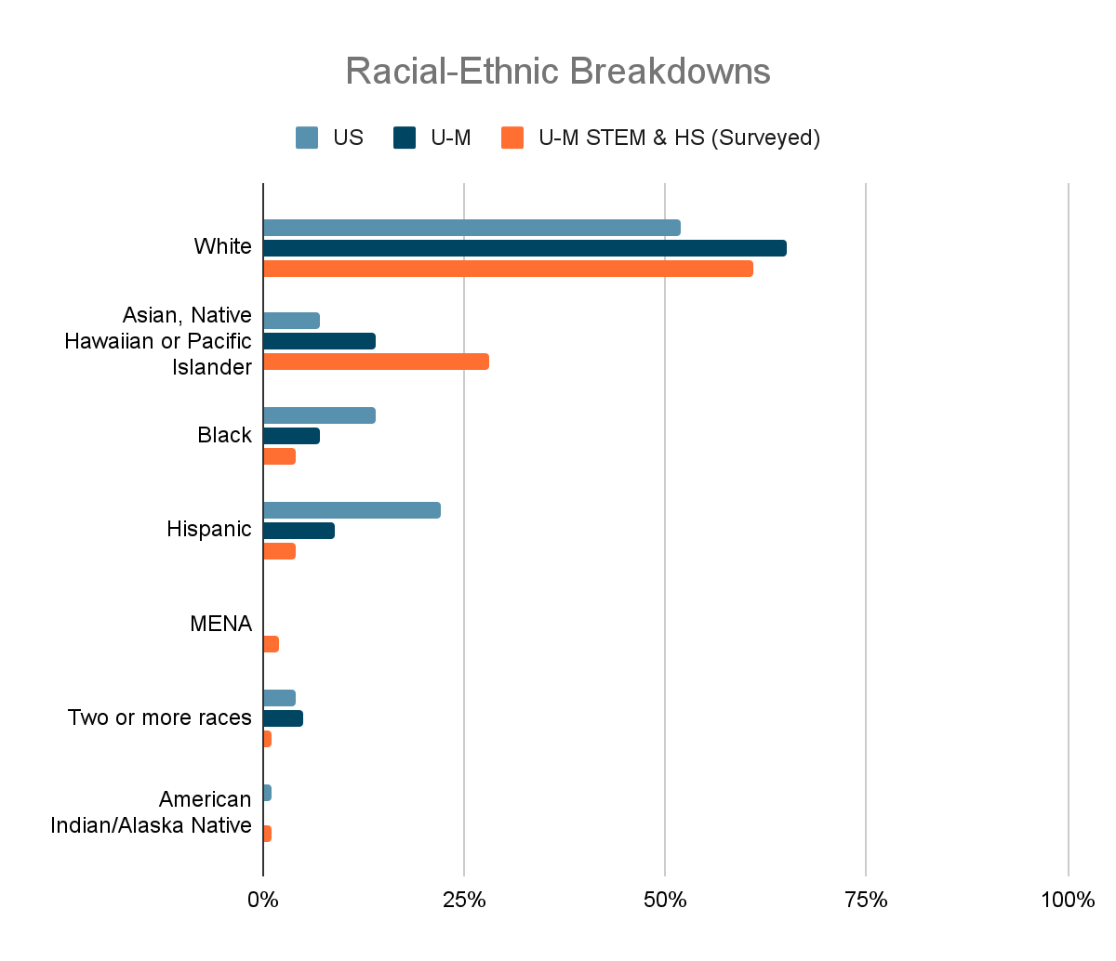
Notes:
These are not direct comparisons, but I wanted to show how skewed representation is in our survey data.
For across, the US and at the University of Michigan, those are statistics for graduate students only.
The U-M survey information includes health sciences and STEM faculty, researchers, and graduate students.
Overrepresentation of White respondents compared to all grad students in the US, but they’re slightly underrepresented compared to the overall population of graduate students at UMich
You can see also that Asian respondents are vastly overrepresented in our survey data, and Black and Hispanic/Latinx respondents especially are vastly underrepresented.
There was no data for Middle Eastern and North African respondents broken out as their own group in the US and UMich data, and the numbers for MENA, multiracial and Native American respondents and graduate students is low.
Low numbers for Hispanic, MENA, Multiracial, and Native American respondents in the survey data made this analysis challenging.

Slide 12
Results

Slide 13
General Perceptions
Belonging, Safety, Welcoming, and Diversity
Notes:
A sense of belonging means that you can comfortably be your authentic self where you are. What is most true of you when you are in U-M library spaces?
I very often or always feel a sense of belonging
Safety can be defined as freedom from the threat of physical or emotional harm. When you are inside of a U-M library building (or near an entrance), how safe do you feel, personally?
Very safe
Based on your own experience, how welcoming does the library seem to you when you visit in person ?
Very welcoming
The U-M library serves a very diverse community (with regard to aspects of identity such as ethnicity, race, gender, sexual orientation, and many more). Based only on your own experience, how respectful of that diversity is the library (in person and/or online)?
Very respectful

Slide 14
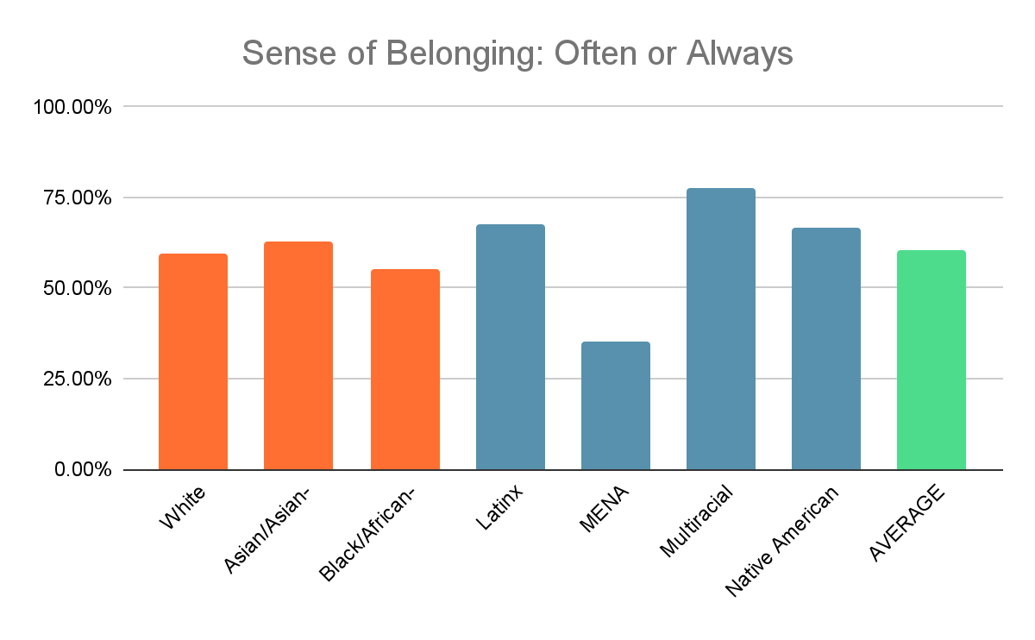
Notes:
I wanted to take a little more of a granular look at this data. The responses for the top two most satisfied responses, so mostly and very satisfied, basically, were already analyzed, and there were no significant differences found between racial groups.
* Latinx, MENA, Multiracial, and Native Americans had very few responses, so it is difficult to draw any conclusions from the data for these groups. I have mainly analyzed white, asian, black library users
*highlighted White, Asian, Black, and the average for easy comparison across the next 4 slides.
A sense of belonging means that you can comfortably be your authentic self where you are. What is most true of you when you are in U-M library spaces?
I very often or always feel a sense of belonging
Sense of Belonging - often or always
White 59.30%
Asian/Asian-American 63.00%
Black/African-American 55.30%
Latinx 67.50%
MENA 35.30%
Multiracial 77.80%
Native American 66.70%
AVERAGE 60.40%

Slide 15
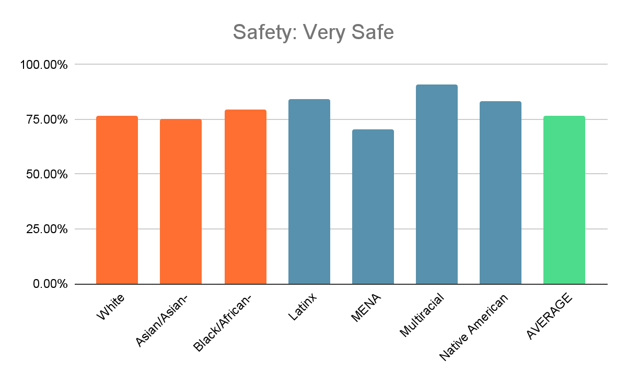
Notes:
Safety can be defined as freedom from the threat of physical or emotional harm. When you are inside of a U-M library building (or near an entrance), how safe do you feel, personally?
Very safe
Safety - Very Safe
White 76.80%
Asian/Asian-American 75.30%
Black/African-American 79.50%
Latinx 84.20%
MENA 70.60%
Multiracial 90.90%
Native American 83.30%
AVERAGE 76.80%

Slide 16
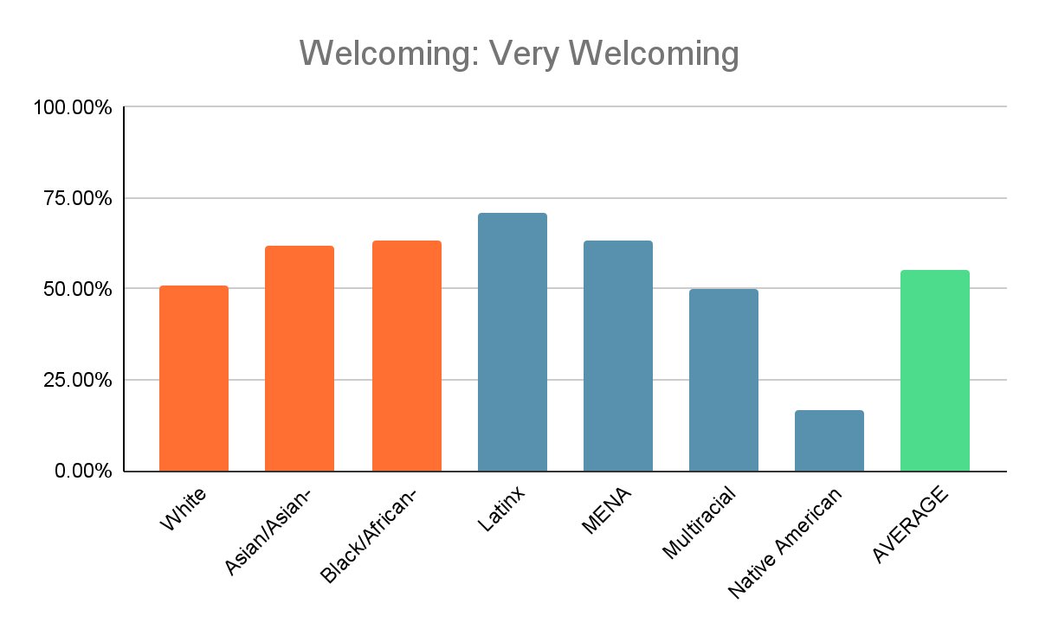
Notes:
Based on your own experience, how welcoming does the library seem to you when you visit in person ?
Very welcoming
Note: The percentage for White people compared to Asian & Black
White 50.90%
Asian/Asian-American 61.80%
Black/African-American 63.20%
Latinx 71.10%
MENA 63.50%
Multiracial 50.00%
Native American 16.70%
AVERAGE 55.30%

Slide 17
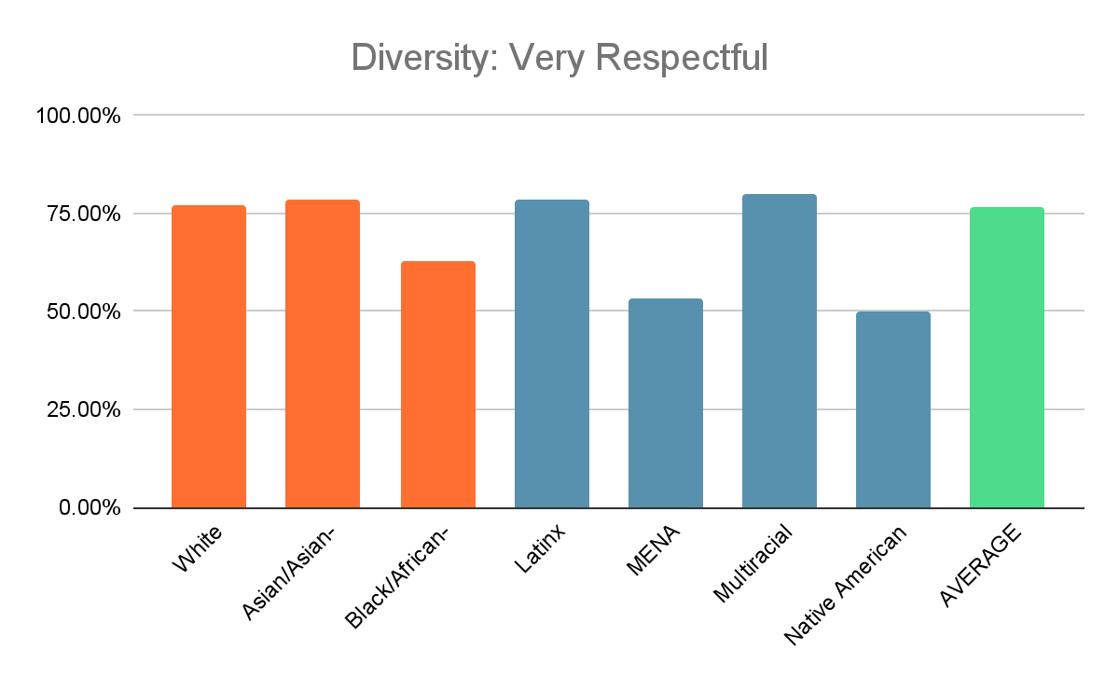
Notes:
The U-M library serves a very diverse community (with regard to aspects of identity such as ethnicity, race, gender, sexual orientation, and many more). Based only on your own experience, how respectful of that diversity is the library (in person and/or online)?
Very respectful
Point out lower Black - significant
Diversity - Very Respectful
White 77.20%
Asian/Asian-American 78.50%
Black/African-American 62.90%
Latinx 78.40%
MENA 53.30%
Multiracial 80.00%
Native American 50.00%
AVERAGE 76.60%

Slide 18
Discussion: General Perceptions
Averages were high across the board:
  60.4% always or often felt a sense of belonging.
  76.8% felt very safe.
  55.3% felt that the libraries are welcoming.
  76.6 felt the libraries are very respectful of diversity
A lower percentage of Black/African-American respondents felt the libraries are very respectful of diversity.
A lower percentage of White library users felt that libraries were very welcoming.

Slide 19
How does gender affect perceptions?
Males have a slightly higher sense of belonging than females, with the largest gender gap among Black/African-American respondents.
Males feel significantly safer than females, indicating a notable gender disparity in perceived safety, particularly among White respondents.
Males feel more welcomed than females, with the largest gap seen among Black/African-American respondents.
Females have a more positive view of the library's respect for diversity compared to males, with a significant gap between male and female Black/African-American respondents.
Notes:
Respect for Diversity (by Race and Gender)
Asian/Asian-American:
Females: 81.0%
Males: 75.0%
Black/African-American:
Females: 75.0%
Males: 36.4%
White:
Females: 78.4%
Males: 76.3%

Slide 20
Collection use, Instruction Support, and Research Support
Notes:
A sense of belonging means that you can comfortably be your authentic self where you are. What is most true of you when you are in U-M library spaces?
I very often or always feel a sense of belonging
Safety can be defined as freedom from the threat of physical or emotional harm. When you are inside of a U-M library building (or near an entrance), how safe do you feel, personally?
Very safe
Based on your own experience, how welcoming does the library seem to you when you visit in person ?
Very welcoming
The U-M library serves a very diverse community (with regard to aspects of identity such as ethnicity, race, gender, sexual orientation, and many more). Based only on your own experience, how respectful of that diversity is the library (in person and/or online)?
Very respectful

Slide 21
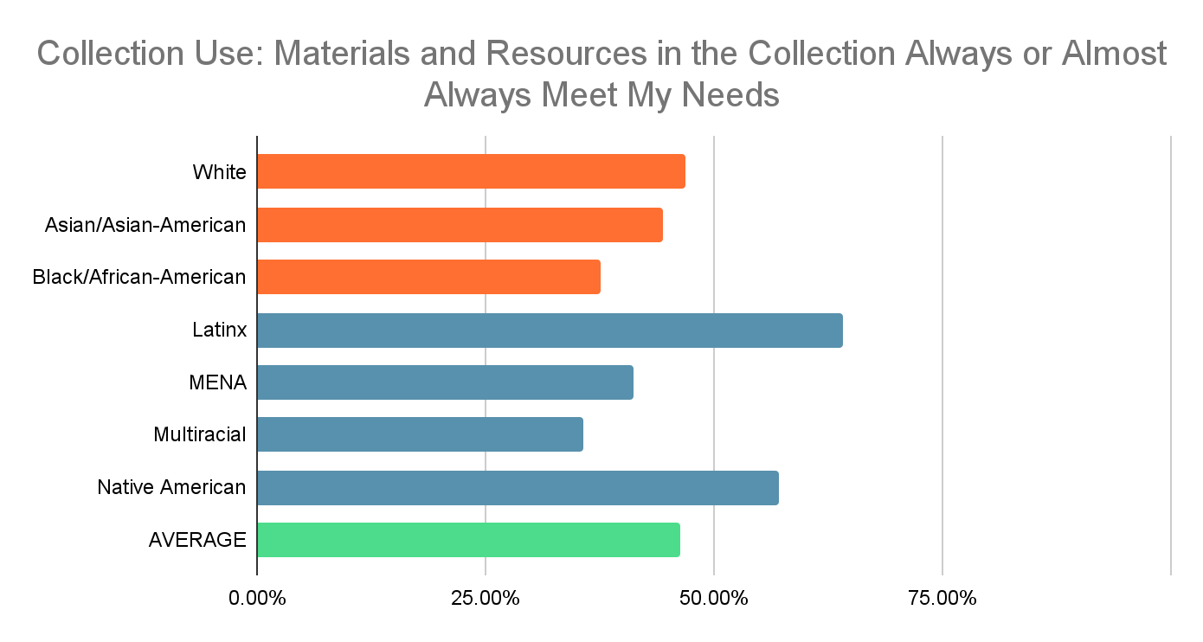
Notes:
White 46.90%
Asian/Asian-American 44.40%
Black/African-American 37.50%
Latinx 64.10%
MENA 41.20%
Multiracial 35.70%
Native American 57.10%
AVERAGE 46.30%
Do not meet my needs at all Rarely meet my needs Sometimes meet my needs Usually meet my needs Always or almost always meet my needs
White 0.60% 0.20% 3.30% 49.00% 46.90%
Asian/Asian-American 0.00% 0.70% 6.60% 48.30% 44.40%
Black/African-American 0.00% 0.00% 2.50% 60.00% 37.50%
Latinx 0.00% 0.00% 5.10% 30.80% 64.10%
MENA 0.00% 5.90% 0.00% 52.90% 41.20%
Multiracial 0.00% 0.00% 7.10% 57.10% 35.70%
Native American 0.00% 0.00% 0.00% 42.90% 57.10%
AVERAGE 0.40% 0.40% 4.20% 48.70% 46.30%

Slide 22
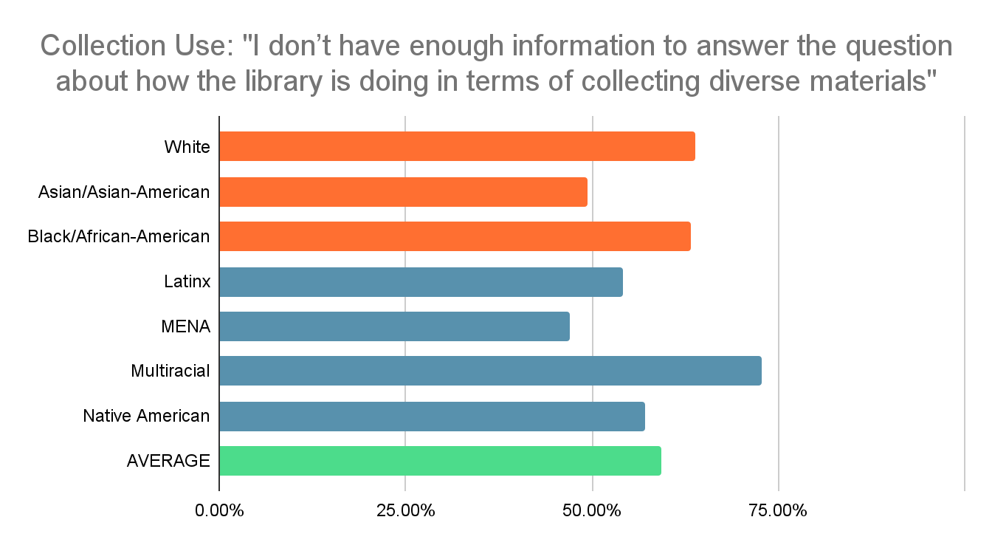
Notes:
White 63.80%
Asian/Asian-American 49.50%
Black/African-American 63.20%
Latinx 54.10%
MENA 47.10%
Multiracial 72.70%
Native American 57.10%
AVERAGE 59.30%

Slide 23
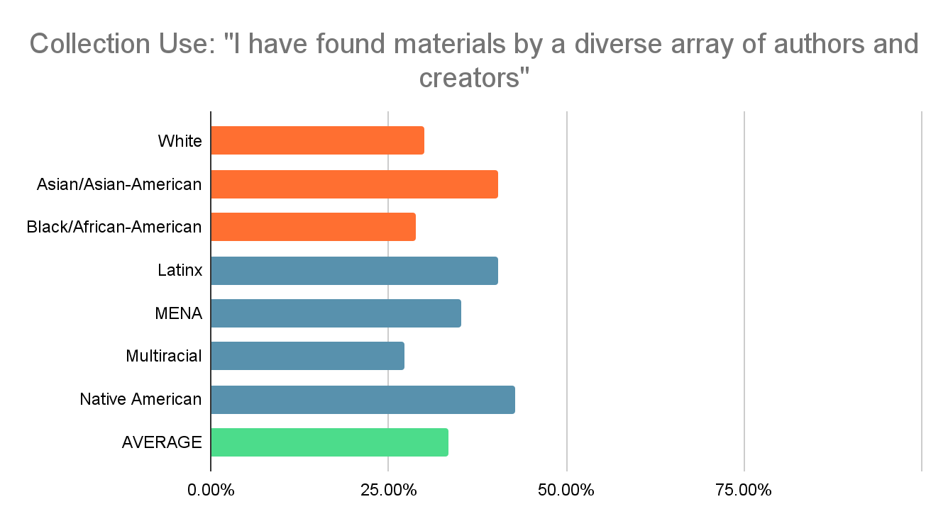
Notes:
Note: Higher satisfaction levels for Black users
I have found materials by a diverse array of authors and creators
White 30.10%
Asian/Asian-American 40.40%
Black/African-American 28.90%
Latinx 40.50%
MENA 35.30%
Multiracial 27.30%
Native American 42.90%
AVERAGE 33.40%

Slide 24
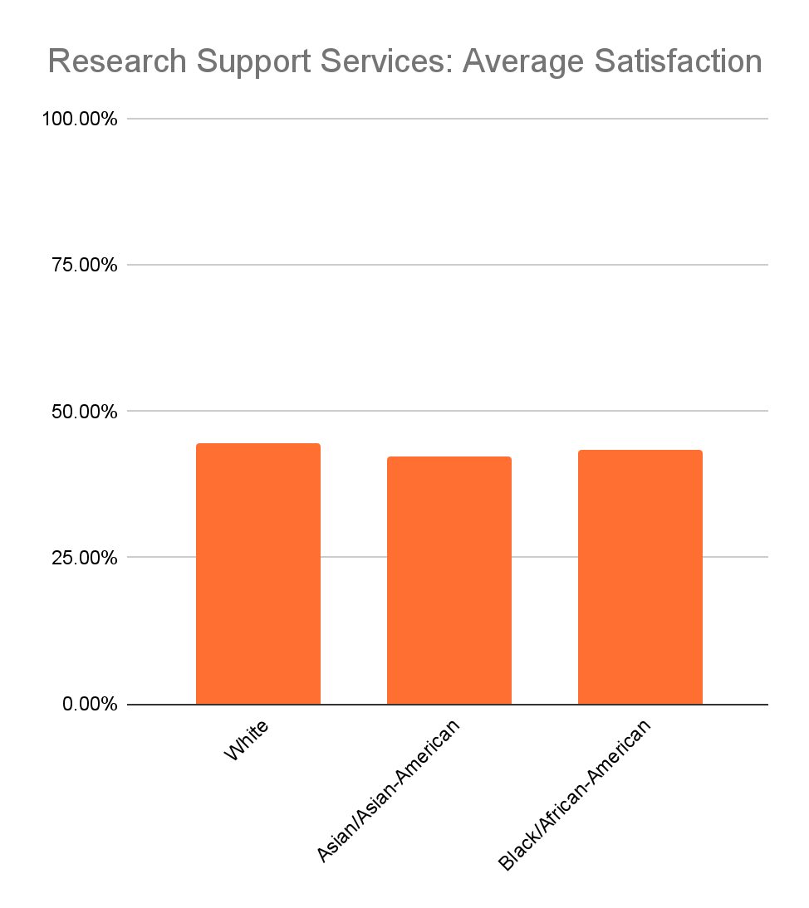
This averages the percentage of each racial group who reported the highest satisfaction level for the following research support services:
Consultation with experts or subject specialists
Digital scholarship
Online research guides
Funding and grants info
Research impact
Deep Blue
Publishing
Data visualizations
Notes:
Note that there were very few responses for these questions, so we can’t conclude much from this data, but the numbers are similar for the three racial groups with the most data.

Slide 25
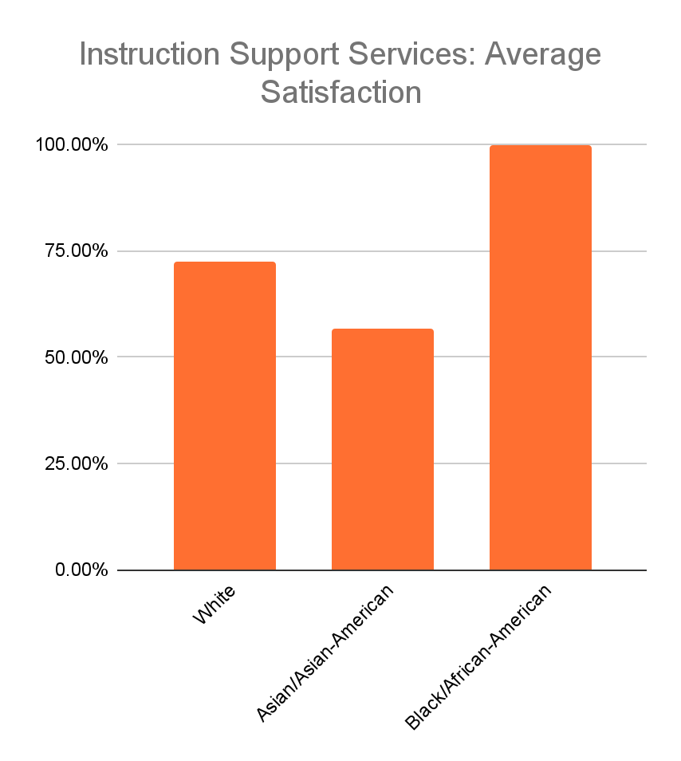
This averages the percentage of each racial group who reported the highest satisfaction level for the following instruction support services:
Help designing curriculum
Course-relevant library services information
Group instruction
Tailored student consultations
Information evaluation guidance for students
Providing tools or materials

Slide 26
Discussion: Collection Use, Research Support, and Instruction Support
The results indicate a need to improve research support services.
  Mixed satisfaction with digital scholarship service, data visualization support.
The results are broadly similar across racial groups, but there were very few responses for each of these questions, especially the questions on research support and instruction support.

Slide 27
Key Findings

Slide 28
“Inclusion for All” Framework
When implementing diversity initiatives, it is important to minimize backlash from dominant groups, which negatively impacts people from intentionally marginalized backgrounds.
Goal: To achieve inclusion without triggering reactance from dominant groups.
Source: Brannon, T. N., Carter, E. R., Murdock‐Perriera, L. A., & Higginbotham, G. D. (2018). From backlash to inclusion for all: Instituting diversity efforts to maximize benefits across group lines. Social issues and policy review, 12(1), 57-90. https://doi.org/10.1111/sipr.12040
Notes:
Brannon, T. N., Carter, E. R., Murdock‐Perriera, L. A., & Higginbotham, G. D. (2018). From backlash to inclusion for all: Instituting diversity efforts to maximize benefits across group lines. Social issues and policy review, 12(1), 57-90. https://doi.org/10.1111/sipr.12040

Slide 29
Evidence of backlash to diversity Initiatives?
Some evidence of lower engagement or satisfaction among white respondents on two key items:
  Whether the library has a welcoming atmosphere
  Finding materials by creators from diverse backgrounds
Some evidence of lower engagement or satisfaction among Black/African-American respondents on the diversity of materials in the collection
No strong evidence of widespread backlash, but these numbers are worth keeping an eye on in the future.
Notes:
These observations align with Brannon’s criteria for an environment in which dominant group backlash against diversity efforts and foment.

Slide 30
Sources of backlash and how to address them:
Perceived Restriction of Independence
  Solution: Provide choice and autonomy
Preference for the Status Quo and Colorblindness
  Solution: Structured environments for intergroup interactions
Beliefs that Racial and Other Social Equalities Have Been Reached
  Solution: Teach background on racial inequality. Emphasize fairness and legitimacy of diversity efforts
Notes:
Perceived Restriction of Independence:
Well-intentioned inclusion efforts may be seen as restricting autonomy, leading to reactance.
Solution: Provide opportunities for choice and autonomy within structured inclusion efforts.
Preference for the Status Quo and Colorblindness:
Dominant group members often prefer to avoid discussions on race, leading to resistance to diversity efforts.
Solution: Create structured, supportive environments for intergroup interactions to ease discomfort and anxiety. - remember that library users must still feel like they have choices within the structured environment
Beliefs that Racial and Other Social Equalities Have Been Reached
Dominant group members may perceive diversity efforts as unfair advantages for marginalized groups.
Solution: Teaching students about historical injustices and their impact on today. Emphasize fairness and legitimacy in diversity efforts to foster a shared understanding of persistent inequalities

Slide 31
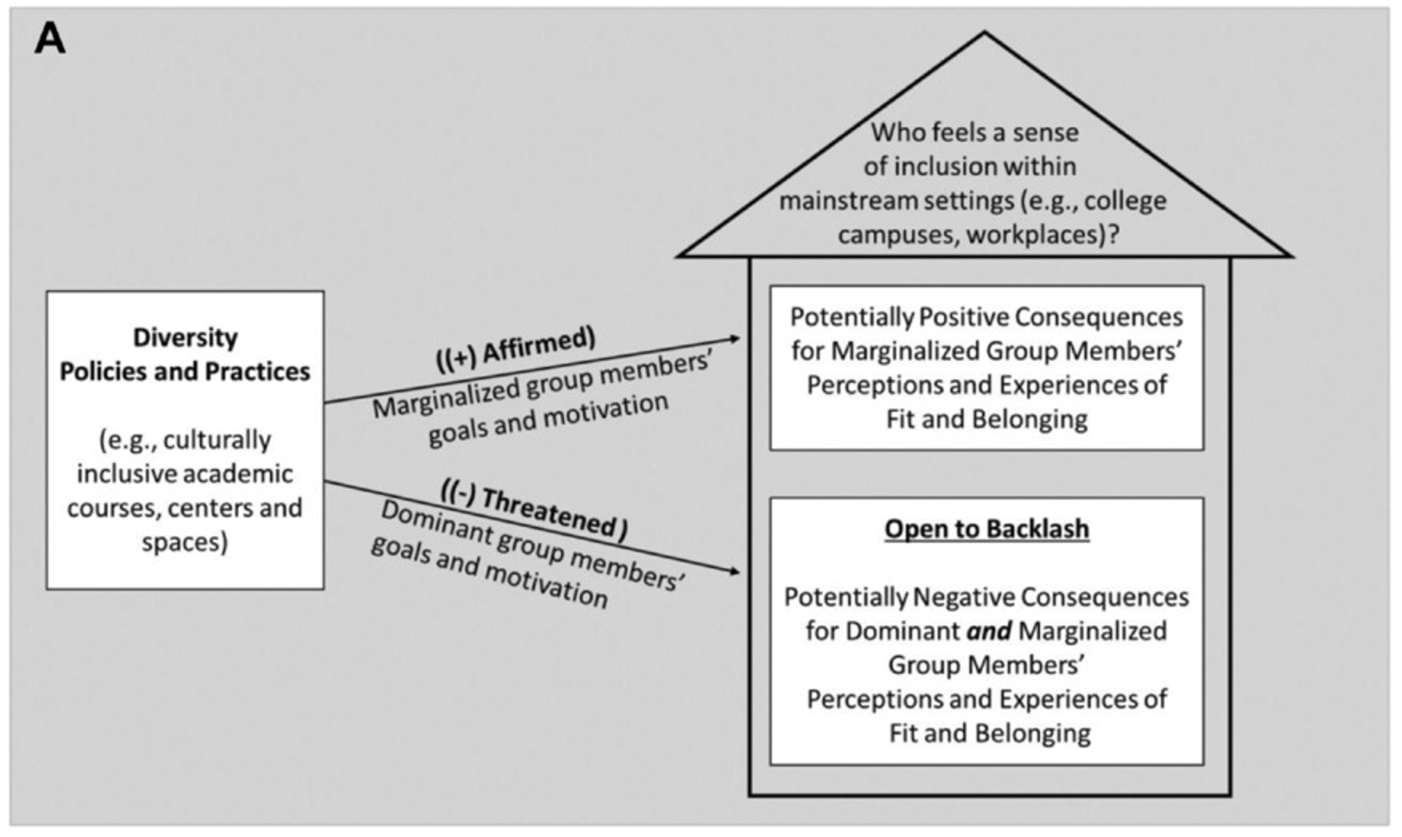
“Inclusion for All” Framework
Notes:
Brannon, T. N., Carter, E. R., Murdock‐Perriera, L. A., & Higginbotham, G. D. (2018). From backlash to inclusion for all: Instituting diversity efforts to maximize benefits across group lines. Social issues and policy review, 12(1), 57-90. https://doi.org/10.1111/sipr.12040

Slide 32
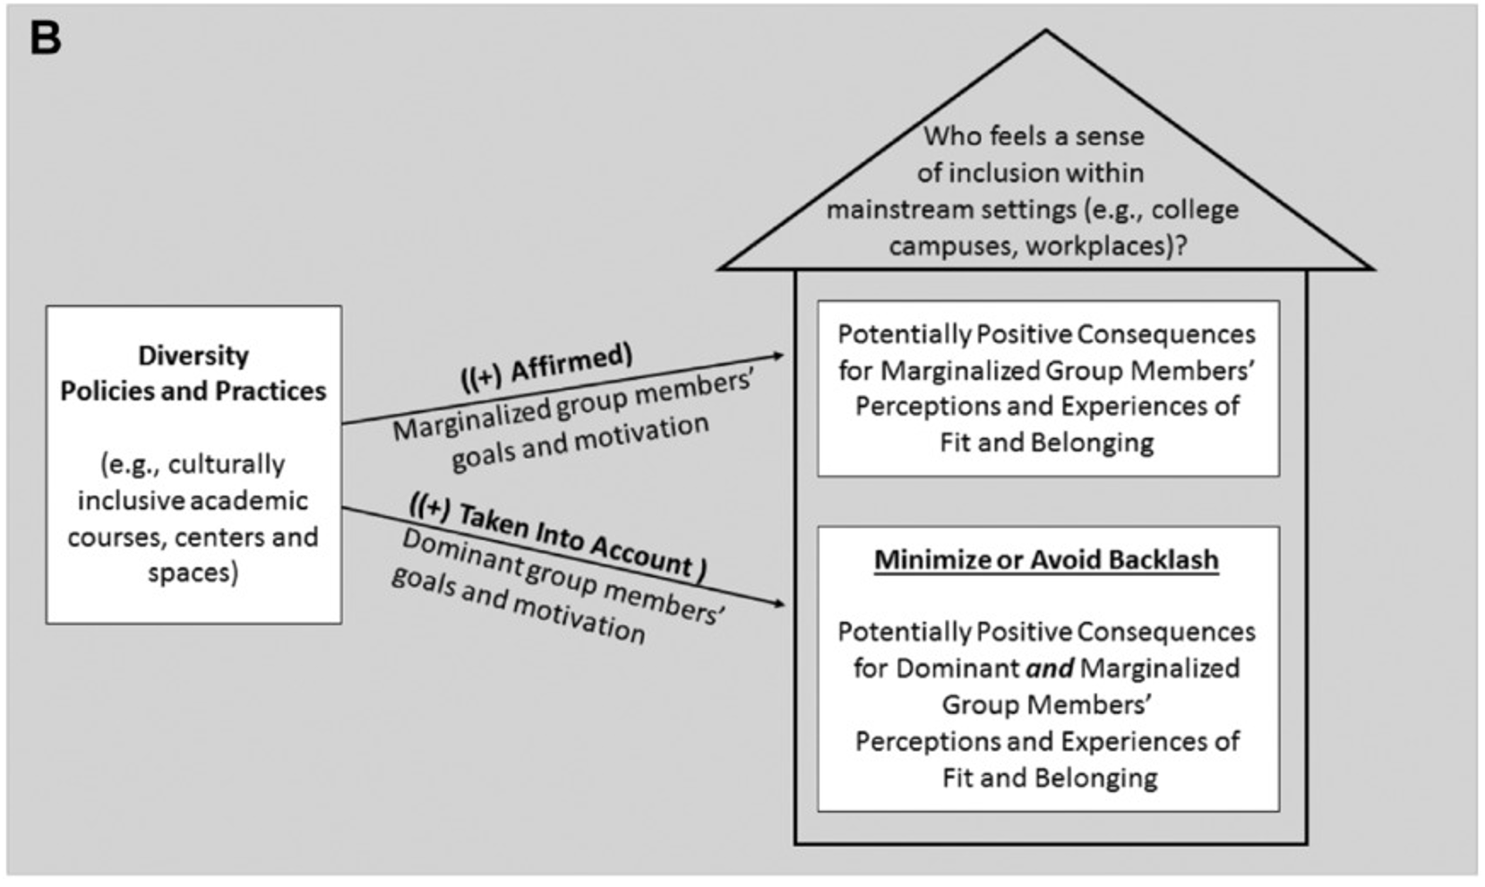
“Inclusion for All” Framework
Notes:
Brannon, T. N., Carter, E. R., Murdock‐Perriera, L. A., & Higginbotham, G. D. (2018). From backlash to inclusion for all: Instituting diversity efforts to maximize benefits across group lines. Social issues and policy review, 12(1), 57-90. https://doi.org/10.1111/sipr.12040

Slide 33
Javier Martínez Rodríguez

Slide 34
Question and Objective
Question
What existing library services can be leveraged to promote sponsored research in Medical and Health Sciences at the University of Michigan in Ann Arbor?
Objective
General Objective: to identify library services that can serve as a gateway for increased visibility of services to seek research funding.

Slide 35
The library is “a key campus player in supporting research activities throughout the research life cycle.”
“The campus library can serve as a central information resource [...], providing information to connect funding needs with potential funders.”
Librarians and researchers agree: funding seeking consultations are a valuable service for the library to provide but there can be a lack of knowledge on the library’s capacity to do this.
(Bryant et al., 2020, p.12)
(Downing, 2009, p. 5)
(Vaughan et al., 2013)

Slide 36
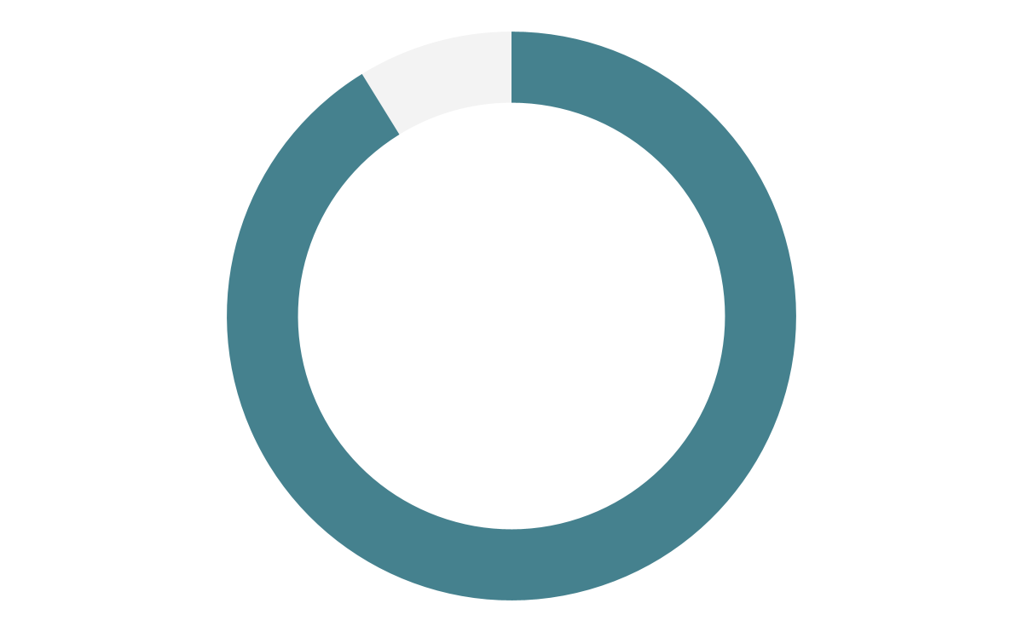
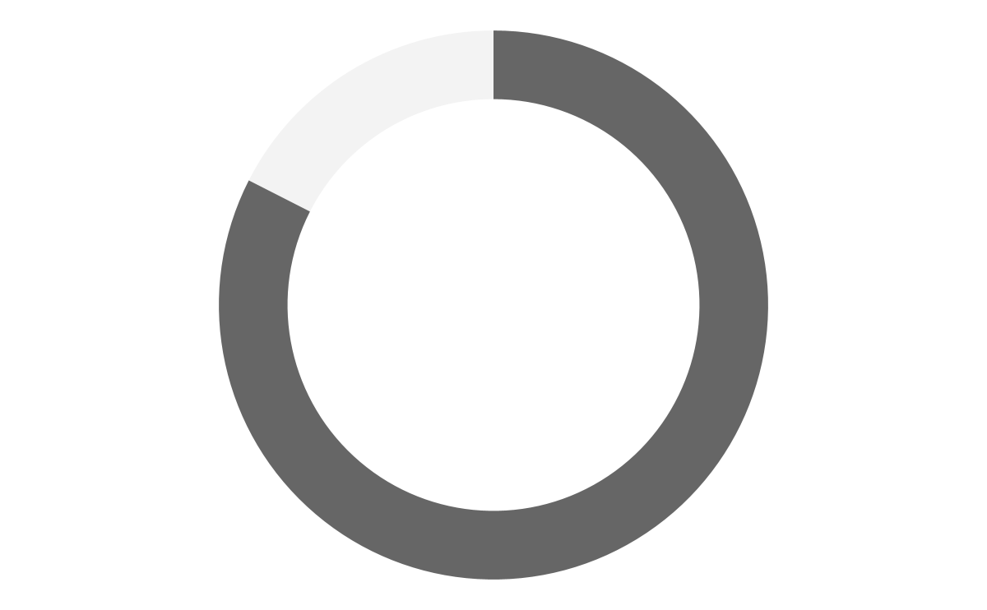
91.2%
82.5%
of researchers in HS-STEM who use library resources to seek funding have published their work.

Slide 37
Context
Research Funding and Grants Guide.
  “campus-wide solution to help faculty locate funding resources, identify grant-writing training opportunities, and locate special events focused on finding funding opportunities.” (Rosenzweig et al., 2016, p.52)
Funding Search Consultations
  “offer personalized, expert funding and grant search consultation to University of Michigan faculty and staff.” (MLibrary, University of Michigan, 2024).
What other library services can be leveraged to increase visibility of these existing resources?

Slide 38
Methodology
Type of Research:
Quantitative Analysis of data from the U-M Library Campus-Wide Survey.
Data delimitation:
“What is your most primary role at U-M?”
  Selected one of the following: “Faculty member, Graduate student, Postdoctoral fellow, Visiting researcher or scholar, House officer.”
During the past two years, have you been the leader of an original research or creative project? (As a principal investigator, a project director, a lead author, a dissertation writer, a project grant awardee, etc.)
  Selected “Yes”.
“What broad category (or categories) best describe your research and academic work?”
  Selected “Medical and Health Sciences”.
“In your research and creative work, do you engage in any of the following activities?”
  Selected “Seeking funding”.

Slide 39
Results

Slide 40
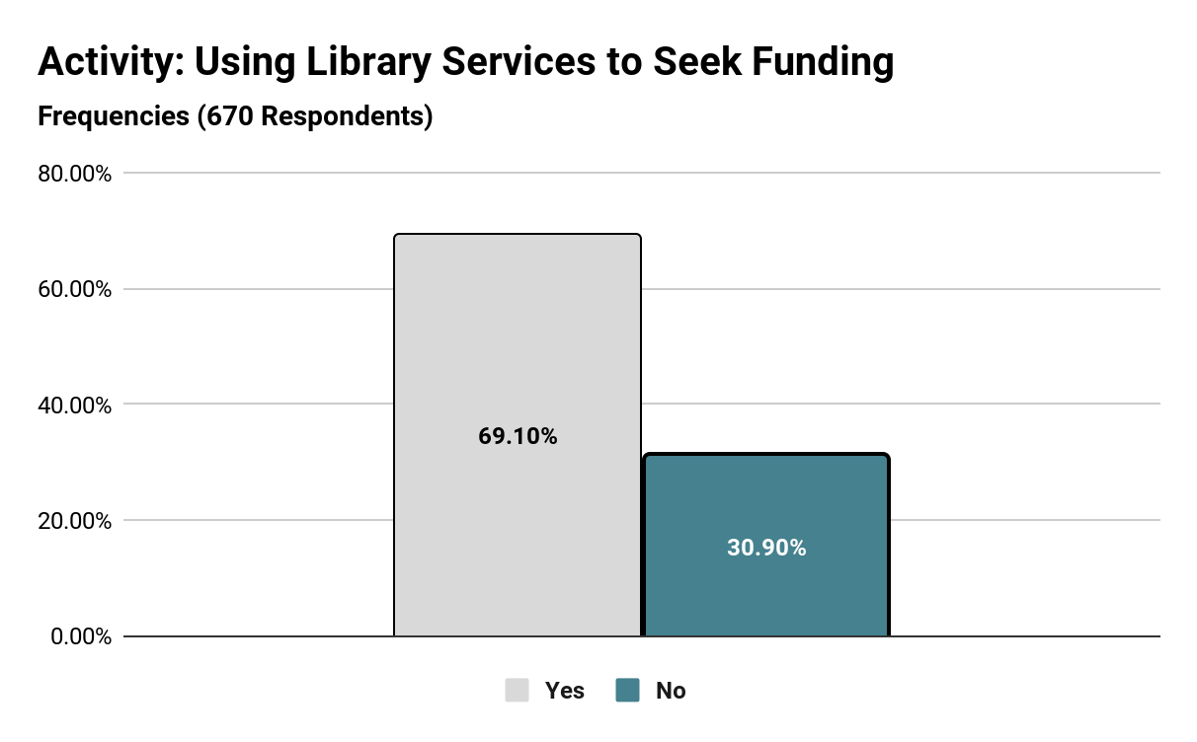

Slide 41
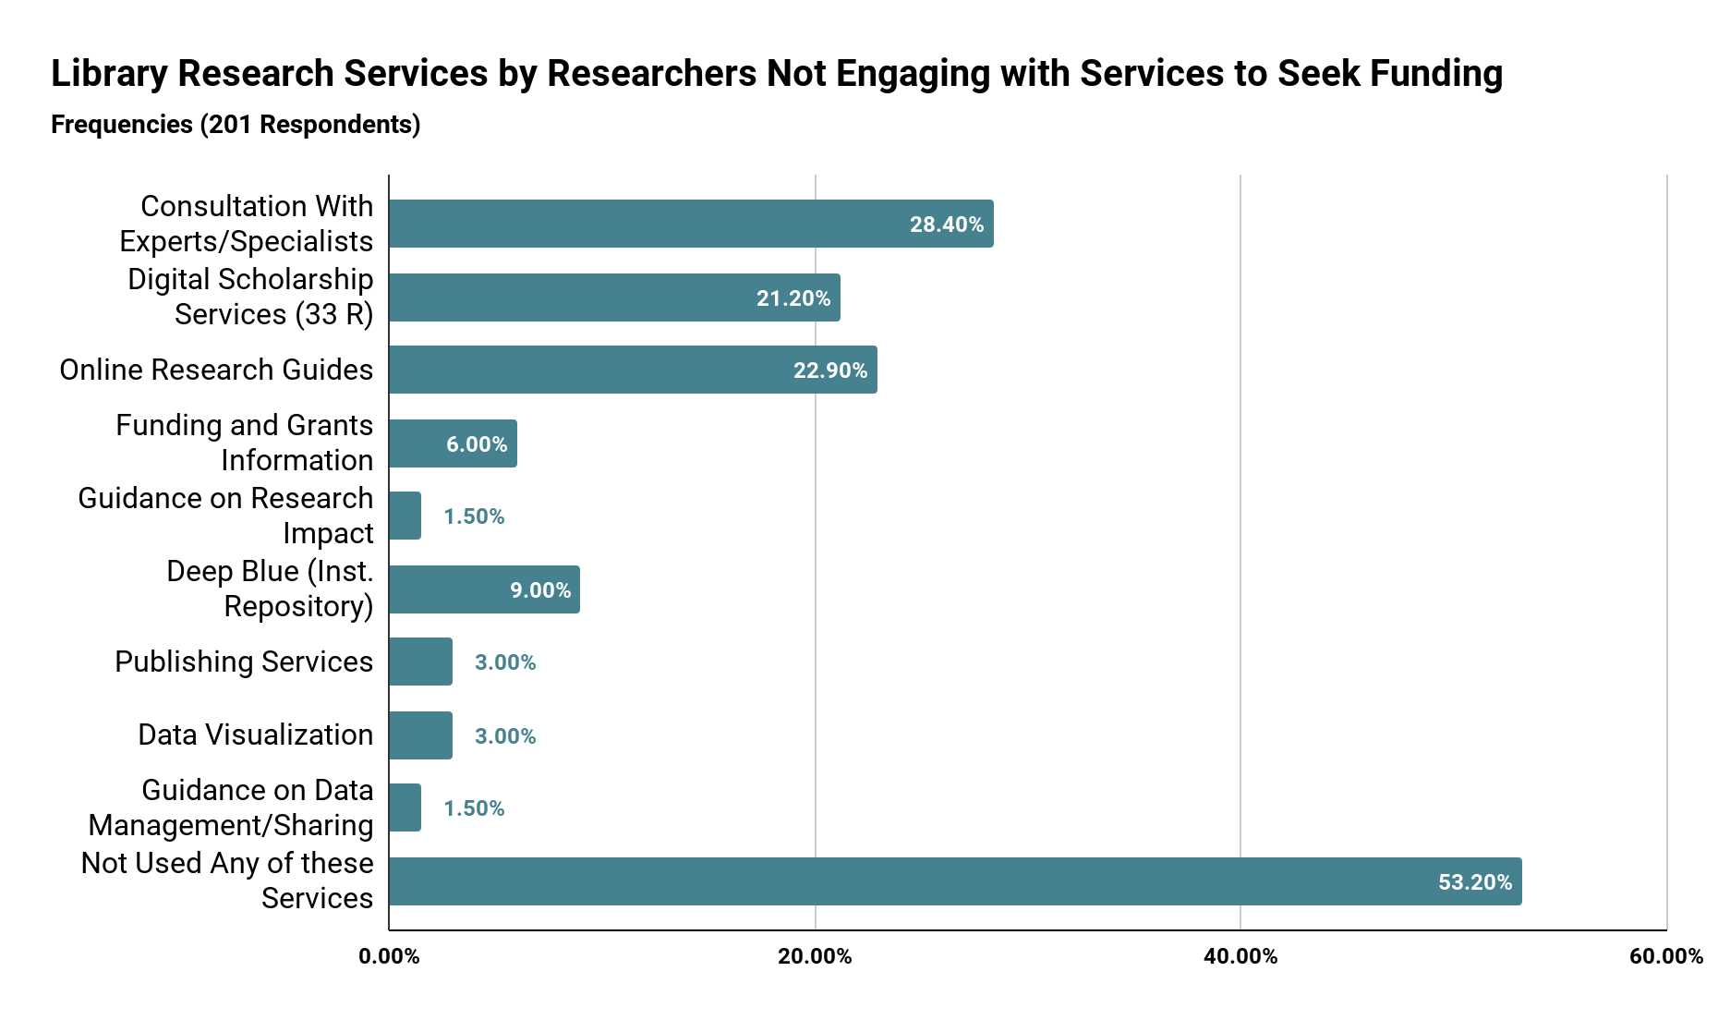
Notes:
Lack of awareness and underuse of library research guides are problems for the overall campus community.

Slide 42
Insights
1
2
Observation
Recommendation
Consultations with Experts/Specialists is the most frequently used service.
Exploring this service as a gateway to promoting/increasing visibility for grant seeking assistance services.
Those who do not use services to seek funding, do not use any research services at the library.
Outreach to these participants to increase access to all library services is necessary.
Important consideration: the ability to extrapolate these observations to the rest of Health and Medical Sciences community at U-M is limited by the number of respondents left after data delimitation.

Slide 43
Challenges | Successes | Next Steps
Becoming familiar with SPSS. Considering all the different ways to approach this topic and narrowing down to a feasible project. Managing the timeline for this project with competing priorities. | I was able to develop observations based on data analysis. I was able to create data visualizations to illustrate my arguments. I have created connections with members of my project team and the team at U-M. I have a new understanding of my strengths and limitations as a future data professional. | Continue to learn about statistics. Continue to learn about data tools. Reflect, in-depth, on my experience and consider how this can be submitted for conferences or other resource sharing opportunities. Continue to grow my network.

Slide 44
References
Bryant, R., Dortmund, A., & Lavoie, B. F. (2020). Social Interoperability in Research Support: Cross-campus Partnerships and the University Research Enterprise. OCLC Research.
Downing, K. (2009). Show Me the Money! An Academic Library’s Role in the Art of GrantSeeking on Campus and in the Community. https://alair.ala.org/server/api/core/bitstreams/0e0d2727-2ab1-4f73-91f5-f083ba1938ea/content
MLibrary, University of Michigan. (2024, February 8). Find Funding - Research Funding and Grants Guide - Research Guides at University of Michigan Library. Research Guides. Retrieved July 29, 2024, from https://guides.lib.umich.edu/c.php?g=283405&p=1887268
Rosenzweig, M., Smith, J. E., Curtis, A., & Puffenberger, A. (2016, Jan 21). Simplifying the Process for Finding Research Funding: A Cross-Campus Collaboration at a Large Academic Institution. Medical Reference Services Quarterly, 35(1), 52-63. 10.1080/02763869.2016.1117289
Vaughan, K. T., Hayes, B. E., Lerner, R. C., McElfresh, K. R., Romito, D., Reeves, L. H., & Morris, E. N. (2013, Oct). Development of the research lifecycle model for library services. Journal of the Medical Library Association : JMLA, 101(4), 310-314. 10.3163/1536-5050.101.4.013

Slide 45
Xiao Zeng
Notes:
13 min

Slide 46
Research Question
How can the U-Mich Library address information-seeking behavior issues and make improvements to better support the interdisciplinary research needs in the Health and STEM fields, bridging the gap between researchers engaged in higher interdisciplinary studies and those involved in fewer interdisciplinary studies?
RQ 1. What are the common information-seeking behaviors among researchers in interdisciplinary studies in Health and STEM fields?
RQ 2. What issues do these researchers encounter in accessing and utilizing library resources?
RQ 3. What improvements can be made to library services to better support interdisciplinary research in these fields?

Slide 47
Objective
The objective of this research is to propose improvements that can enhance the library's support for interdisciplinary research and bridging the gap between different numbers of interdisciplinary studies.

Slide 48
Methodology
Research Method: Mixed Method
Tools:
SPSS (quantitative data & qualitative free text response)
Google Sheet
Google Looker Studio
Dataset:
Delimited Dataset
Created crosstabs
Conducted Chi-Square and Correlation tests
Analyzed qualitative survey responses.
Notes:
This study employed a mixed-methods approach to analyze data from the University of Michigan Library Campus Survey. The survey gathered 15,116 responses (86.9% completion rate) from students, faculty, and staff. I utilized quantitative survey data from the Research and Creative Scholarship (RCS) section and qualitative responses to free-text questions.
The analytical process involved several steps: (1) Delimiting the dataset using SPSS to isolate relevant responses; (2) Creating crosstabs to analyze relationships between interdisciplinary involvement frequency (2-6 disciplines), and various information-seeking behaviors related to research activities, information sources, and adequate level; (3) Conducting chi-square tests to explore significant relationships; (4) Performing qualitative analysis on survey responses, focusing on reasons for not using or being dissatisfied with library resources and services.

Slide 49
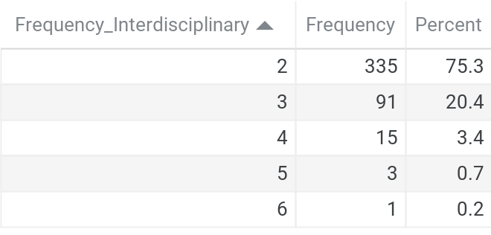
Frequency of Interdisciplinary Research Respondents
445/15,116 Survey Results
Filter:
In Engineering, Natural Sciences, and Medical and Health field.
Involved in research in recent two years
Inverse relationship between number of disciplines involved and the number of respondents.
Notes:
Add a context of What is the number of people in one discipline.
Similar and different than people who are doing one.
Compare the one and (4-6).

Slide 50
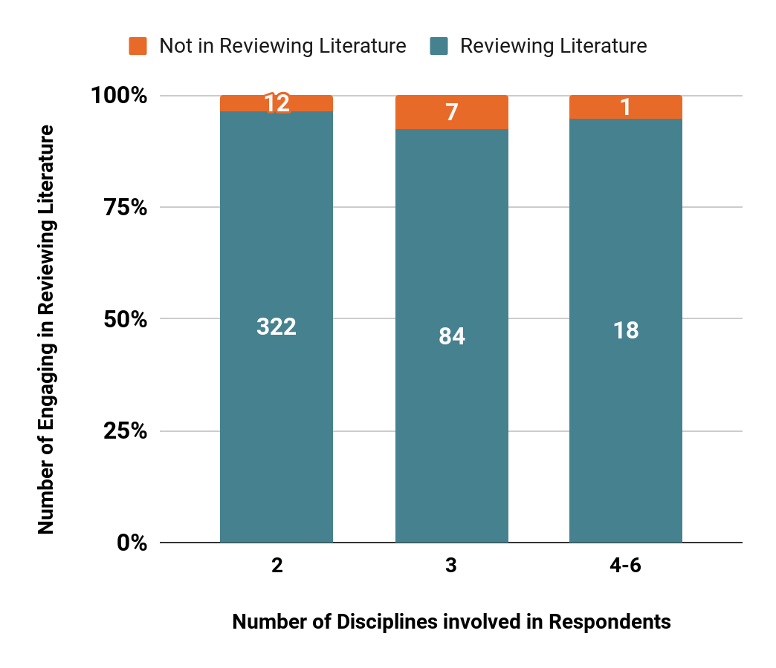
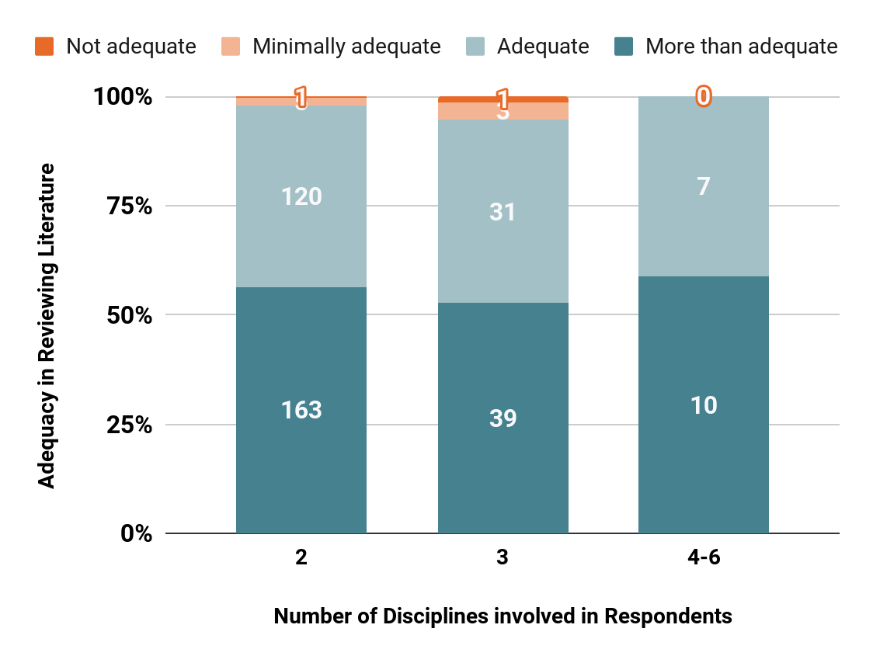
Research Activities: Reviewing Literature
RQ 1. What are the common information-seeking behaviors among researchers in interdisciplinary studies in Health and STEM fields?
Above 75% of respondents in Reviewing Literature rate their competence in this activity’s adequacy as satisfactory or better.

Slide 51
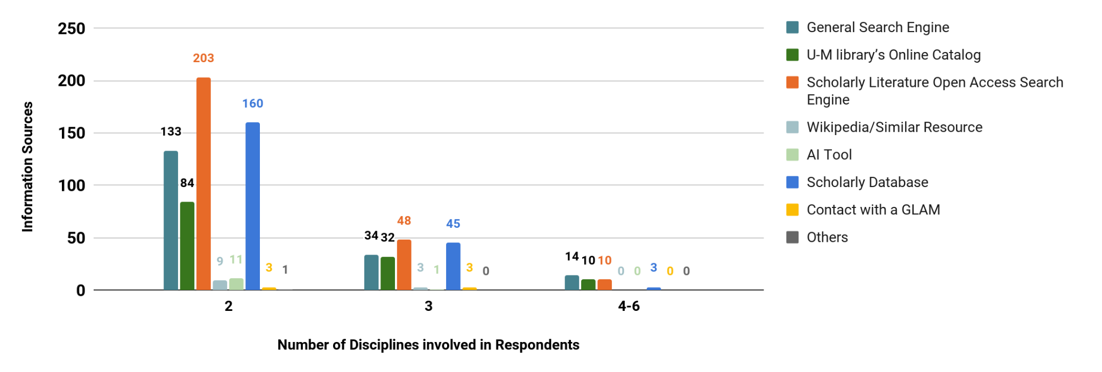
Research Activities: Reviewing Literature
Information Resources Background Materials
RQ 1. What are the common information-seeking behaviors among researchers in interdisciplinary studies in Health and STEM fields?
Scholarly Literature Open Access Search Engine is the most frequently used sources in majority of the interdisciplinary research.
General Search Engine, U-M Library’s Online Catalog, and Scholarly Database are less frequently used.
Though as the number of disciplines increases, these major resources are still being used.

Slide 52
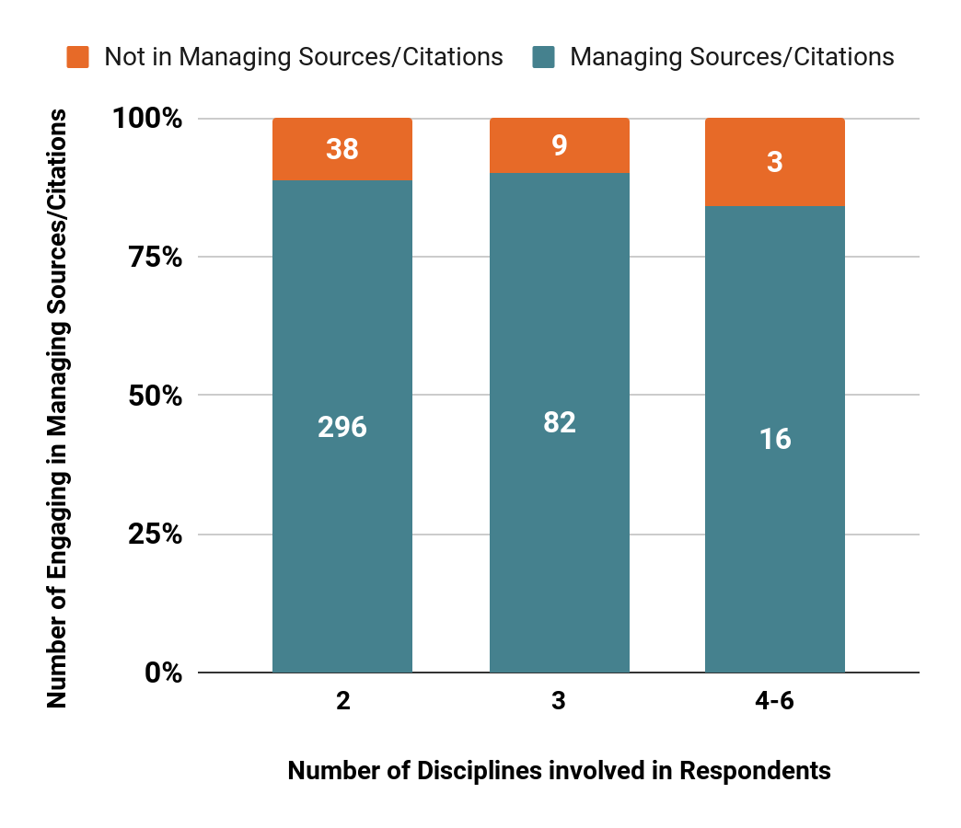
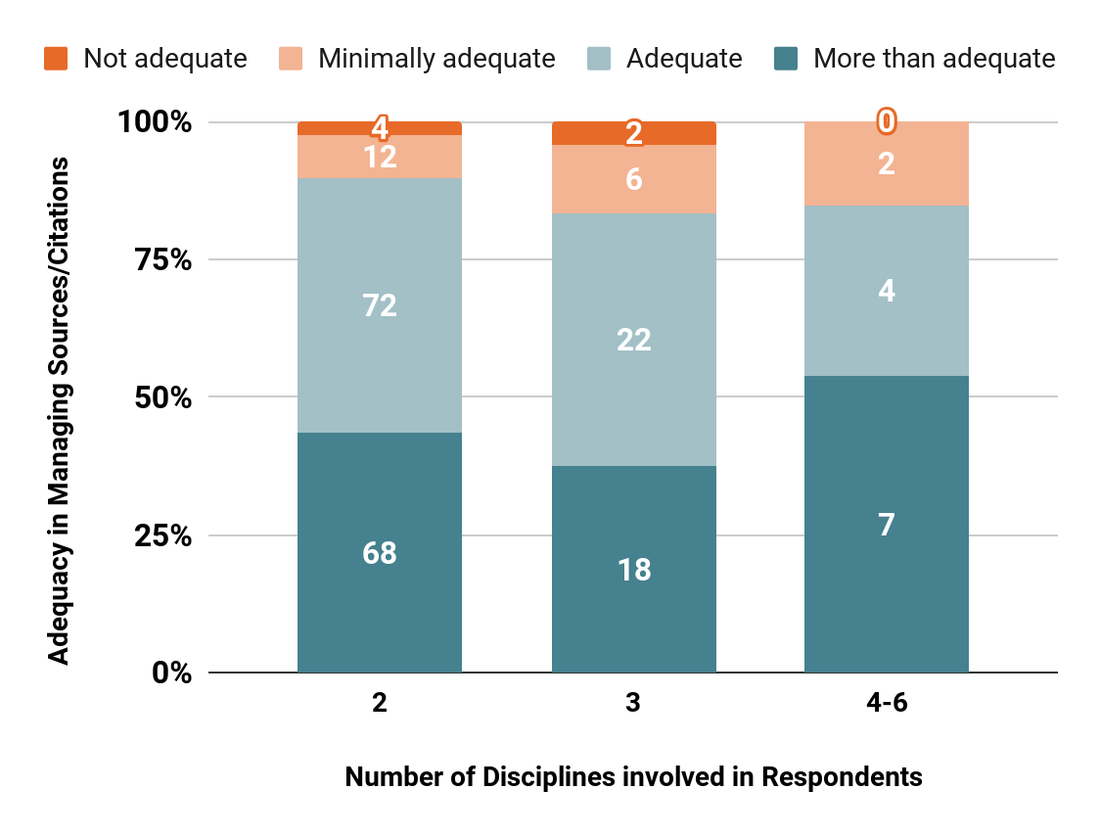
Research Activities: Managing Sources/Citations
RQ 1. What are the common information-seeking behaviors among researchers in interdisciplinary studies in Health and STEM fields?
Over 75% of respondents involved in Managing Sources/Citations rate their competence in this activity’s adequacy as satisfactory or better.
Notes:
More clear on the language and adequacy

Slide 53
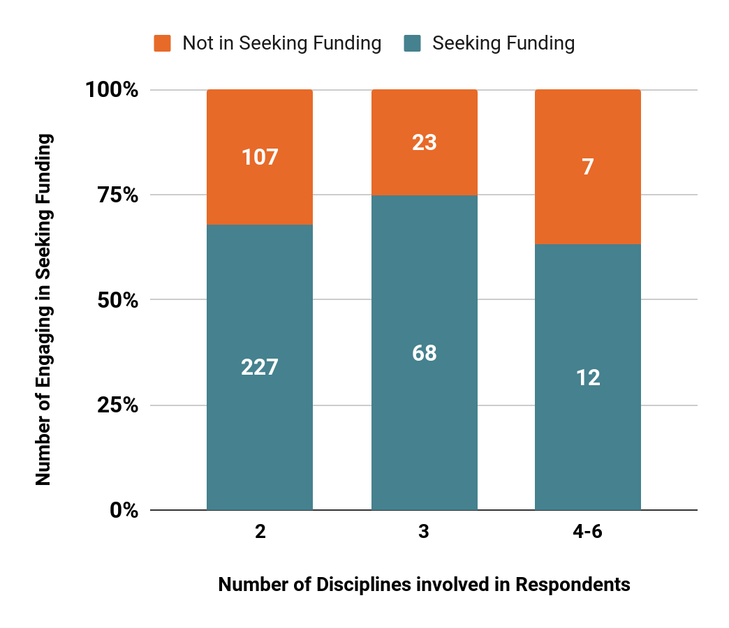
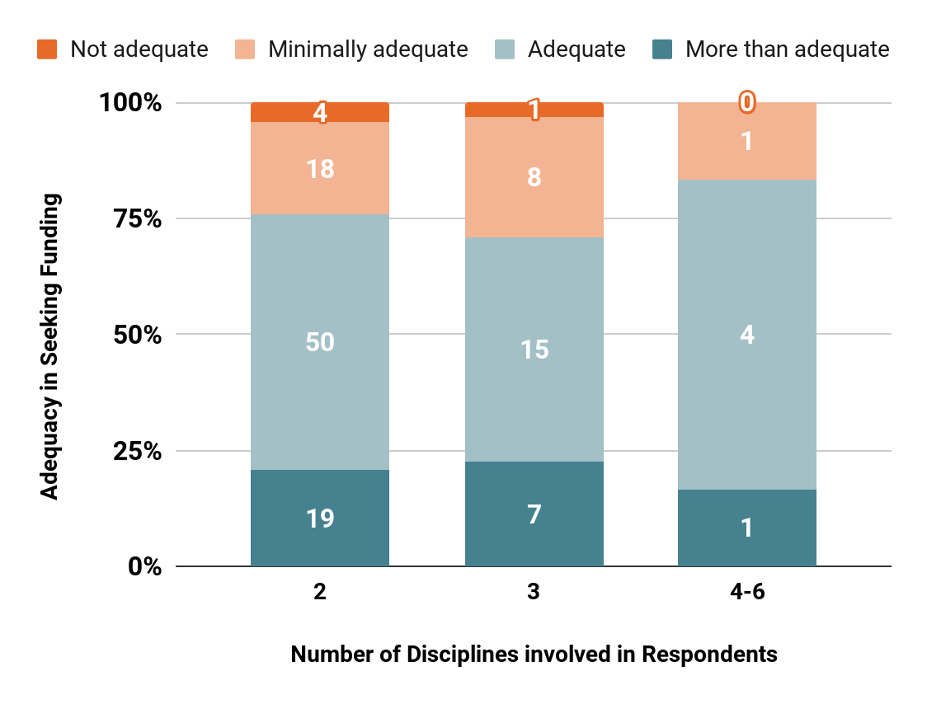
Research Activities: Seeking fundings
RQ 1. What are the common information-seeking behaviors among researchers in interdisciplinary studies in Health and STEM fields?
Between 50%-75% of respondents in Seeking Funding rate their competence in this activity’s adequacy as satisfactory or better.

Slide 54
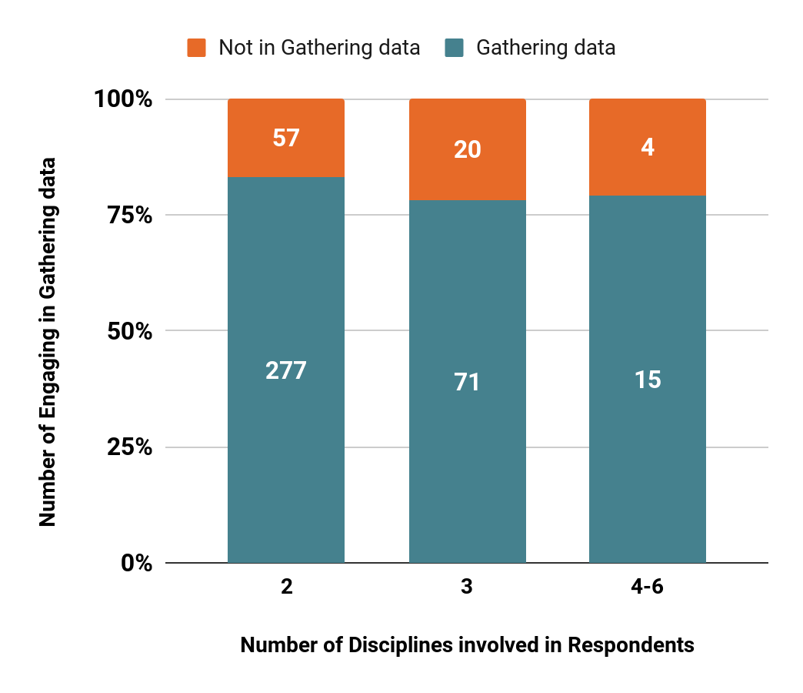
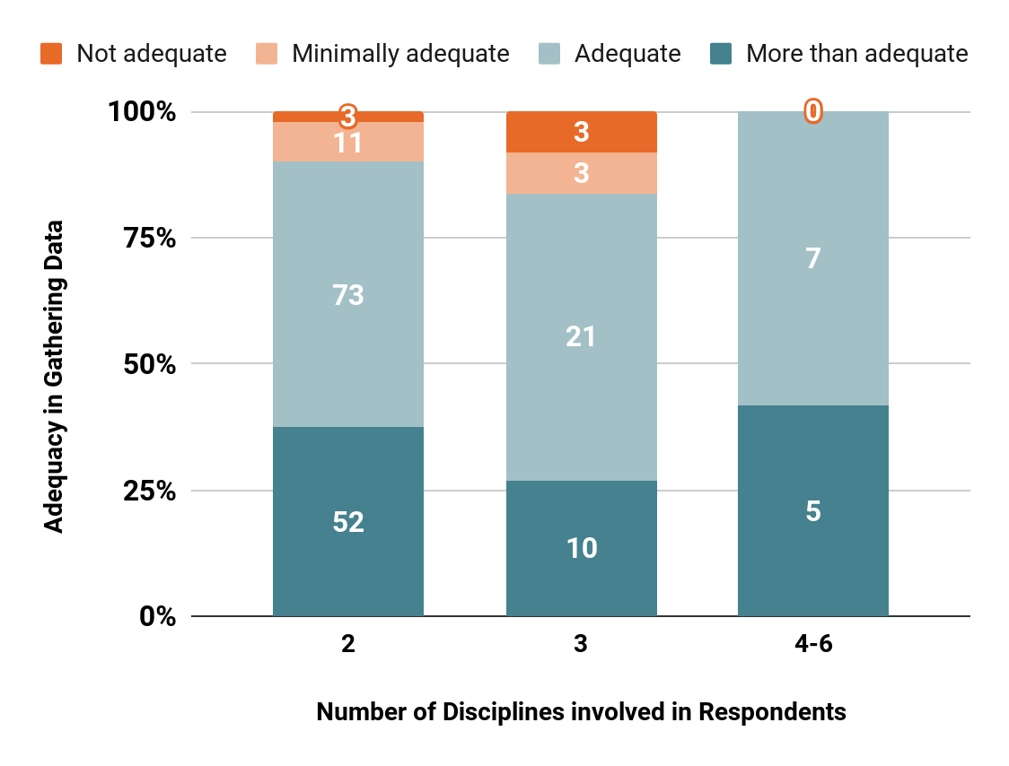
Research Activities: Gathering Data
RQ 1. What are the common information-seeking behaviors among researchers in interdisciplinary studies in Health and STEM fields?
Above 75% of respondents in Gathering Data rate their competence in this activity’s adequacy as satisfactory or better.
Notes:
Via analyzing the research activities, the observation is that researchers at UMich are actively engaged in a variety of information-seeking activities, primarily reviewing literature, managing sources, gathering data, seeking funding, and sharing data. Researchers’ adequacy to these activities is generally seen as adequate, with notable strengths in supporting literature review and data gathering activities.
General search engines, U-M library's online catalog, and scholarly databases are the most commonly used sources for background material.

Slide 55
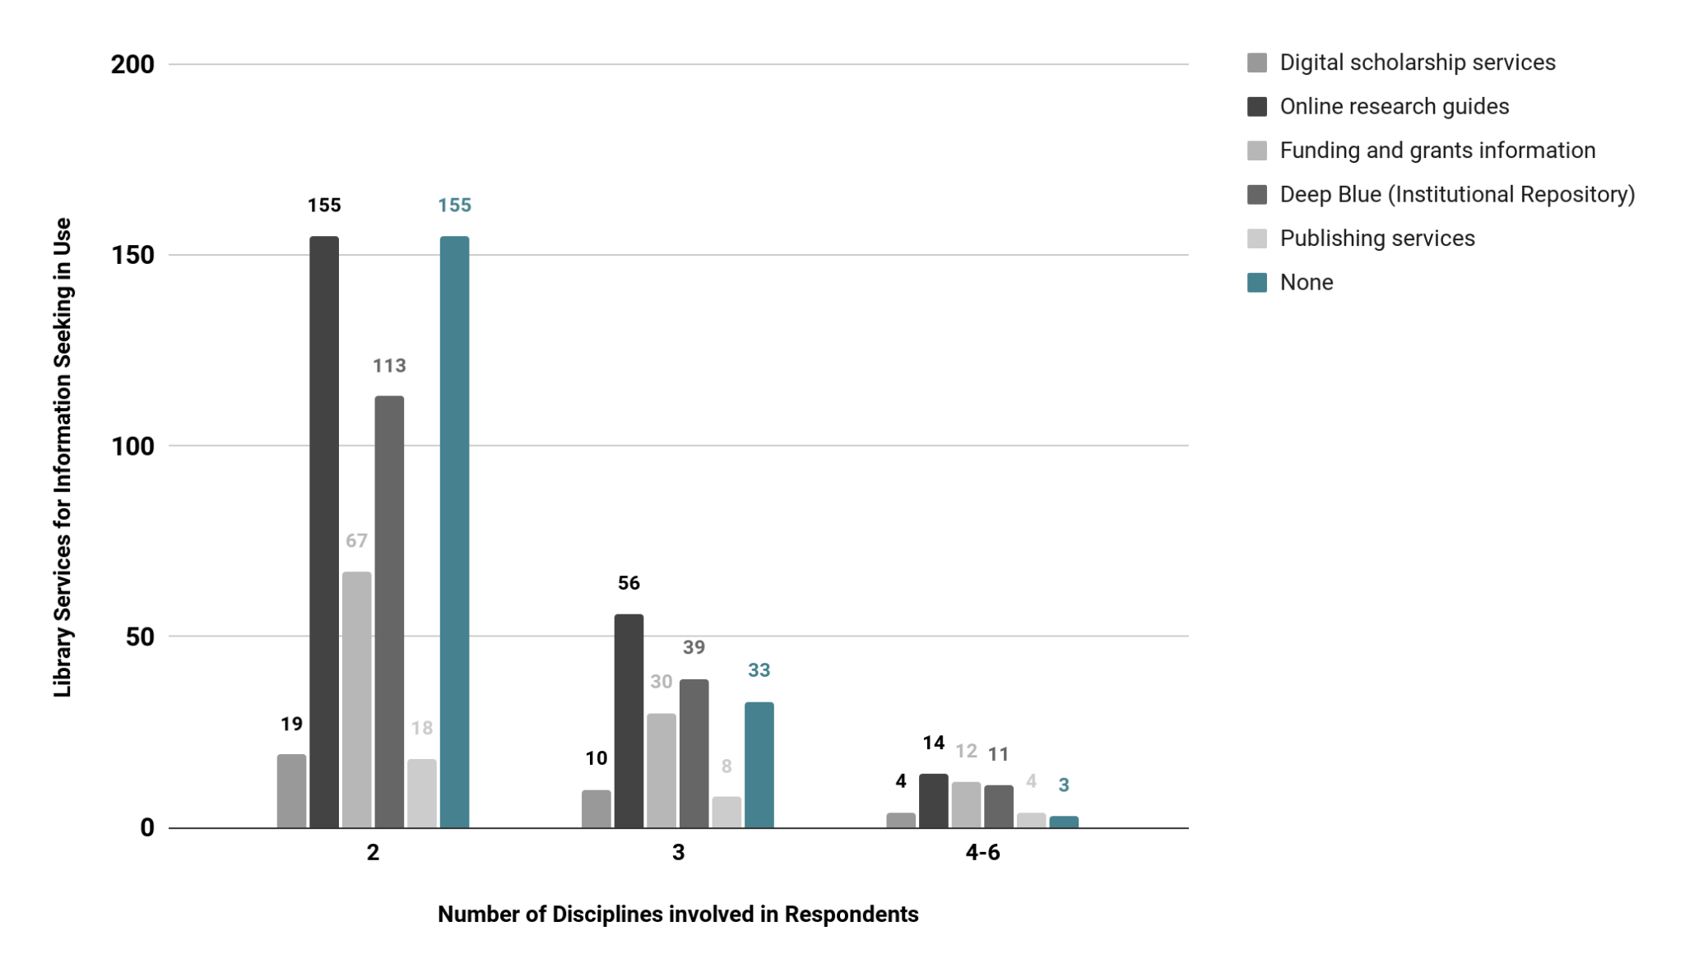
Library Services Used
RQ 2. What issues do these researchers encounter in accessing and utilizing library resources?
Notes:
Knowing how researchers conduct research activities for information seeking, let's now look at what library resources these activities link to.
So, Let's take a look at this chart, which outlines the library services used by researchers based on the number of disciplines they are involved in. The y-axis represents the frequency of use for various library services related to information seeking, while the x-axis shows the number of disciplines involved in respondents.
As we can see, services like Online Research Guides and Institutional Repositories like Deep Blue are top two commonly used across different disciplines. Services like Digital Scholarship, Funding and Grants Information, and publishing services have less in use.
However, I'd like to draw your attention to the 'None' category, represented by the blue bars. This category indicates respondents who did not utilize any library services for research information-seeking. Notice that even in this digital age, a significant number of researchers—155 in total involved in two discipline, 33 in three disciplines, and 3 in 4-6 disciplines research—reported not using any of the listed library services. This data point highlights a gap in engagement and suggests that there might be underlying issues or barriers that prevent these researchers from accessing or utilizing the library's resources. Understanding and addressing these barriers is essential for improving the overall effectiveness of the library services.

Slide 56
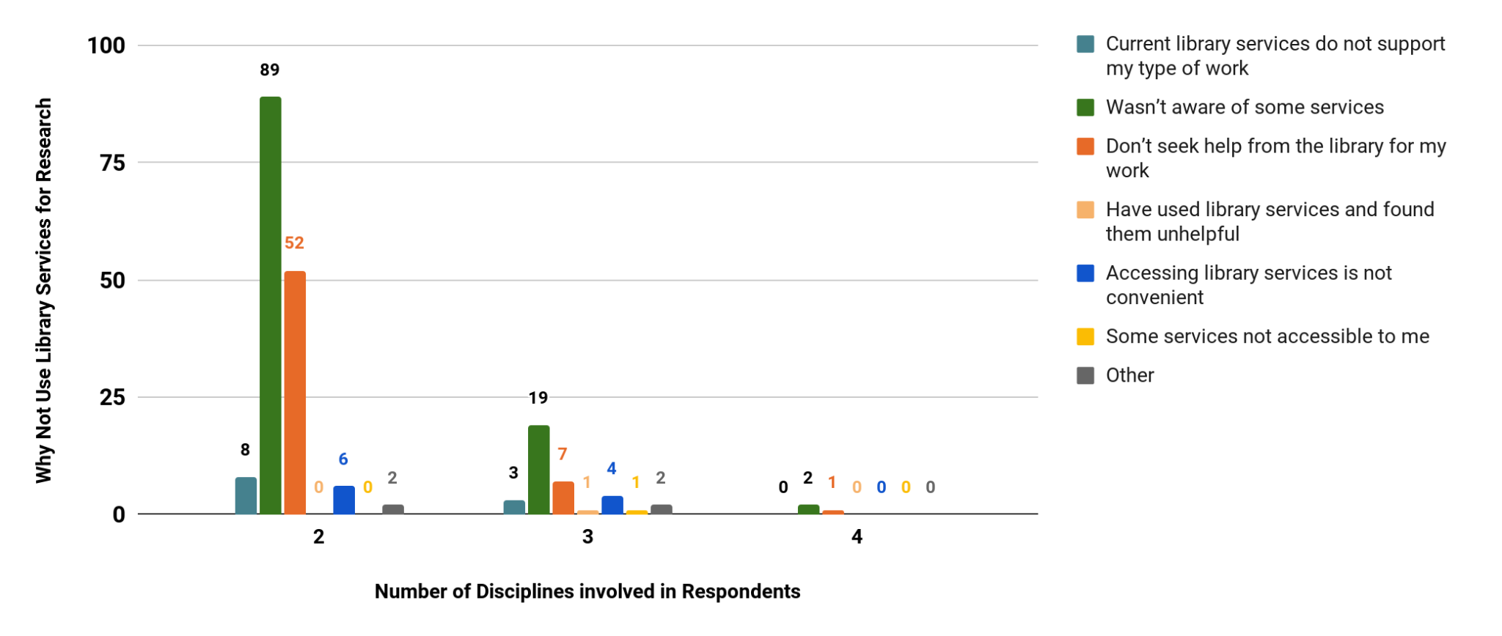
Why not use library services?
RQ 2. What issues do these researchers encounter in accessing and utilizing library resources?
Notes:
While there are many respondents who prefer to use library service for RESEARCH, there are some who indicate that they do not use library service. Focusing on those who didn’t use library service doing research activities on information seeking. This chart illustrates why they don’t use library services.
Top reason is Lack of Awareness: The highest number of respondents (89 for two disciplines) indicated that they were unaware of some services, suggesting a significant knowledge gap.
Second highest, A considerable number of respondents (52 for two disciplines) stated that they do not seek help from the library for their work, possibly indicating a preference for alternative resources or self-sufficiency.
Irrelevance of Services: Some respondents felt that the current library services do not support their type of work, though this reason was less frequently cited compared to the lack of awareness and independence from library resources.
Other Issues: A few respondents mentioned issues like finding the services unhelpful, inconvenient access, or lack of accessibility to certain services, though these reasons were not as commonly reported.
We can see the similar trends among different number of disciplines.

Slide 57
Qualitative Responses:
RQ 2. What issues do these researchers encounter in accessing and utilizing library resources?
Awareness of services
Comment 1: "I feel like it is hard to find information on how I can analyze my data using the library's resources. I don't even know if the information exists. I usually go to CSCAR for analysis of my data. The campus feels very disconnected and I don’t know how the library can tie into any of this."
Comment 2: "I signed up to get alerts of funding and none of the suggested funding sources apply to me. I was unaware that the library could assist with the other research-related tasks and want to know more about specifically how they can help with these."
Accessing library services is not convenient
Comment 1: "The most helpful was meeting with a librarian. The websites are too confusing to navigate sometimes."
Comment 2: "Since physical browsing of engineering books has been removed, could you please have an online browsing option where the book offerings are sorted by topic with titles listed? The search tools are really really bad."

Slide 58
Summary
RQ 3. What improvements can be made to library services to better support interdisciplinary research in these fields?
Overall, there’s a similar trends from different numbers of interdisciplinary research respondents.
Respondents are actively engaged in a variety of information-seeking activities, primarily reviewing literature, managing sources, gathering data, seeking funding, and sharing data.
The library's support in research is generally seen as adequate and satisfied.
General search engines, U-M library's online catalog, and scholarly databases are the most commonly used sources for background material.
Improving awareness, ease to access, and demonstrating the relevance and usefulness of library services can increase the utilization.

Slide 59
Recommendations
RQ 3. What improvements can be made to library services to better support interdisciplinary research in these fields?
Awareness of services
Developing Clear LibGuides and tutorials
Promoting needed services to increase awareness of services
Hosting info session, email campaigns, and library websites
Accessing library services is not convenient
Improving search functionality
Promoting the new web structure
Customized support services
Making workshops and personalized consultations available for respondents in higher interdisciplinary research

Slide 60
Challenges | Successes | Next Steps
Learning SPSS and statistical methods on making analysis. Looking for the best approach and exam relationships across variables. | SPSS Data delimitation Data visualization Data storytelling Communication with team and mentor | Refining my current research results. Spending more time on literature review Organizing into an article, seeking opportunities for conference and publications. Continue to grow my network.
Notes:
Revise this

Slide 61
Question &
Answer
03

Slide 62
THANK YOU.
This project has been funded with Federal funds from the National Library of Medicine (NLM), National Institutes of Health (NIH), under cooperative agreement number UG4LM01234 with the University of Massachusetts Chan Medical School, Lamar Soutter Library. The content is solely the responsibility of the authors and does not necessarily represent the official views of the National Institutes of Health.

