Slide 1
SECOND SPRINT
Scrum Masters:
Adelen And ELijah
Happy Valentine’s Day! <3

Slide 2
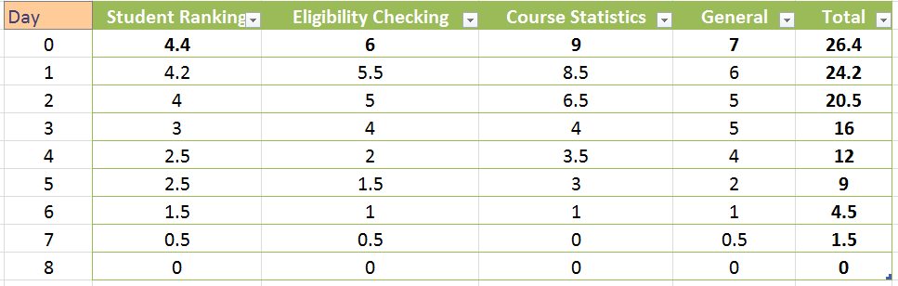
Hours Remaining Per Day
Total:
26.4 hours for the whole sprint.
Happy Valentine’s Day! <3

Slide 3
Overall burndown
(Encompasses all modules)
Happy Valentine’s Day! <3

Slide 4
Per module burndown
Happy Valentine’s Day! <3

Slide 5

Sprint’s Techniques!
Power Partners \mmm/
ScrumMasters Duo
YinYang
Friendship is Magic
Happy Valentine’s Day! <3

Slide 6

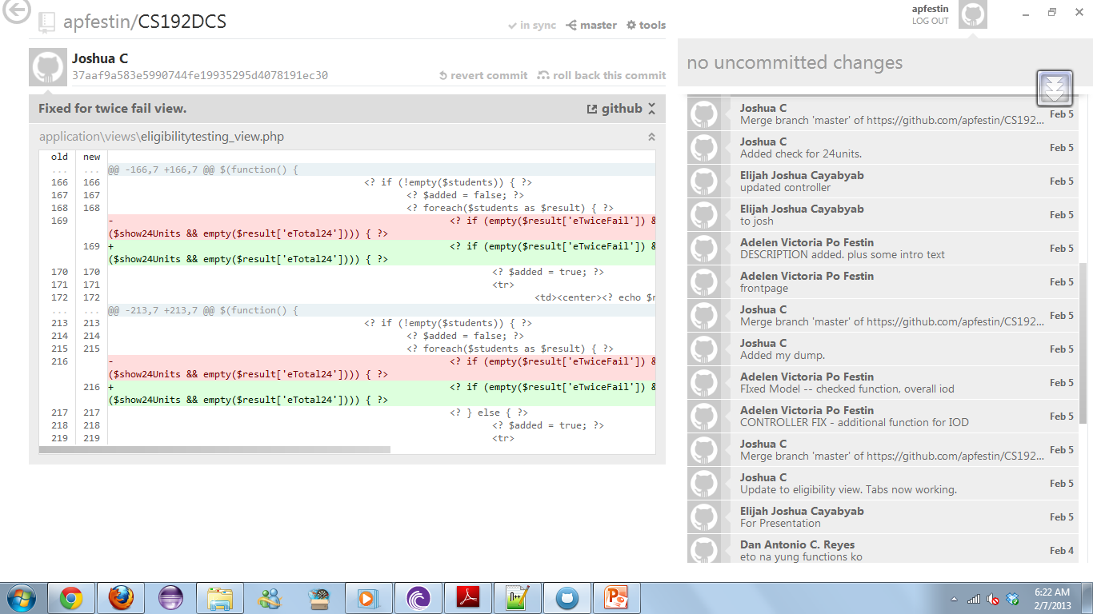
Sprint’s Techniques!
Utilization of GITHUB.

Slide 7
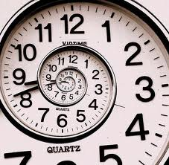
Sprint’s Obstacles ;__;
Schedule
Other Subjects’ Reqts.
Clarifications, issues.
Repetition of work.
Happy Valentine’s Day! <3

Slide 8

Possible Solutions ~
Formulate special cases sooner and clarify them asap.
Coordinate well regarding files and updates.
Happy Valentine’s Day! <3

Slide 9
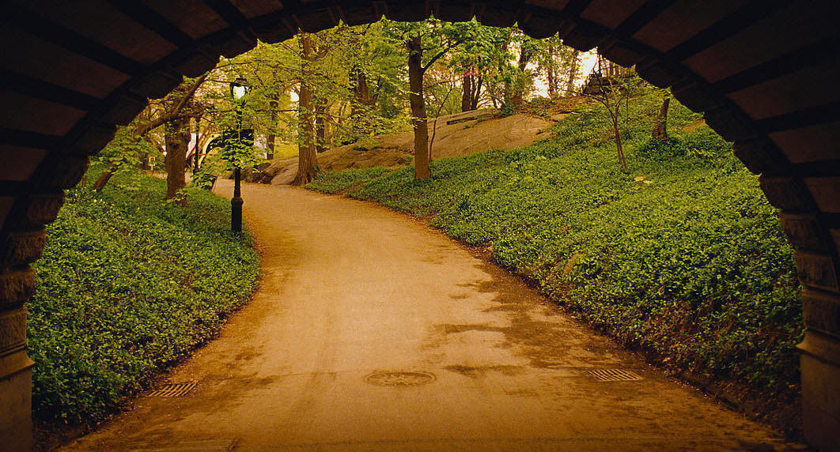
Sprint Retrospective
Looking back…

