Slide 1





STOCK
TRADING PITCH
GROUP 18

Slide 2

TABLE
OF CONTENTS
1
Stock Selection
5
Performance
2
Strategy Features
6
Weaknesses
3
Indicators Used
7
Strengths
4
Variations during different market conditions
8
Conclusion

Slide 3

1
STOCK
SELECTION

Slide 4
1) Select Top 5 Sectors by Median Trading Volume from 2010 to 2016
S&P SECTORS
Consumer Discretionary (XLY)
Consumer Staples (XLP)
Health Care (XLV)
Industrials (XLI)
Information Technology (XLK)
Materials (XLB)
Real Estate (XLRE)
Communication Services (XLC)
Utilities (XLU)
Financials (XLF)
Energy (XLE)
SHORTLISTED SECTORS
Financials (XLF)
Energy (XLE)
Industrials (XLI)
Utilities (XLU)
Information Technology (XLK)

Slide 5
2) Identify Top 10 Holdings from the 5 chosen sector’s ETF and Filter for Those with Higher Medium Trading Volume
RATIONALE
We check for stock medium trading volume * 3 > sector’s ETF trading volume and shortlist stocks in the respective sectors that pass this check
This ensures that we identify stocks with the highest trading volume since a higher volume often means better liquidity, allowing us to trade the stock easily and market orders can be executed almost instantly in our strategy.

Slide 6
3) Sort the Stocks by Decreasing Volatility and select one Stock From Each Sector That Has A < 0.60 Correlation Coefficient to The Other Chosen Stocks’ Returns
RATIONALE
We aim to diversify and choose stocks from different sectors to ensure more stable returns and less overall risk.
By training our strategy on a range of price patterns, it could be more adaptable to diverse market conditions, enhancing its robustness over time.
We choose stocks with higher volatility which indicates a greater potential for price movements, aligning with the strategy’s goal to capture active price fluctuations.

Slide 7
2
STRATEGY
FEATURES

Slide 8
FEATURES
Varied phases
Cooldown
Stop Loss
Carry out different strategy for different phases (volatile vs non volatile)
Volatility is determined by VIX index with a rolling window of 75, with high VIX determined as when it is in the upper quartile (0.75)
Cooldown is implemented after every buy and sell to prevent overtrading
Cooldown period is longer (10 days) during non-volatile period compared to volatile period (3 days)
Stop loss is varied for different phases (volatile and non-volatile period)
Use of ATR and different multiplier for different economic conditions to determine stop loss price

Slide 9
ATR for Stop Loss
 | Volatile Period | Non-Volatile Period
How is it Calculated? | VIX is high during this period, therefore we set a low multiplier of 1. Long position stop loss: Entry price - (ATR * multiplier) Short position stop loss: Entry price + (ATR * multiplier) | VIX is low during this period, therefore we set a high multiplier of 1..5 Long position stop loss: Entry price - (ATR * multiplier) Short position stop loss: Entry price + (ATR * multiplier)
Additional Information | Rolling window used for optimisation | Rolling window used for optimisation
How is it Used? | The multiplier helps tailor the stop-loss level to suit different market conditions, such as high VIX and low VIX Non-volatile Stop Loss: Smaller fluctuations are expected, a larger multiplier can widen the stop-loss, reducing the likelihood of triggering stops during minor price movements, which can possibly cause great losses Volatile Stop Loss: a smaller multiplier tightens the stop loss, reducing potential losses by closing positions more quickly if prices start to move in the opposite direction.

Slide 10
Cooldown
 | Volatile Period | Non-Volatile Period
How is it Calculated? | Cooldown is set lower at 3 days | Cooldown is set higher at 10 days
Additional Information | NA | NA
How is it Used? | Non volatile Cooldown: To ensure meaningless trades are not executed. Prices are generally more stable which renders frequent trades useless. Volatile Cooldown: To ensure quick exits/re-entry when price reversal is detected.

Slide 11
3
INDICATORS
USED

Slide 12
INDICATORS
STMA & LTMA
RSI5
EMA5 & EMA10
Optimized STMA and LTMA windows
Go long when STMA>LTMA, Go short when STMA<LTMA
5 Day RSI
Optimized rolling window period to determine upper/lower quartile of RSI
(EMA5- EMA10) Difference which is weighted
Utilises the weighted difference between EMA5 and EMA10 to determine a price reversal

Slide 13
INDICATORS FOR
VOLATILE STRATEGY
 | RSI-5 | Weighted EMA Difference
How is it Calculated? | Upper (0.75) and Lower (0.25) Thresholds are determined by quantiles of 20 day RSI-5 | Weighted average (EMA5 - EMA10) of 5 day rolling window
Additional Information | Rolling window used for optimisation Aim: Maximise returns of each stock by timing entries better | NIL
How is it Used? | Buy Signal: Weighted EMA Difference of T < Weighted EMA Difference of T-1 Cross under Lower RSI Threshold Sell Signal: Weighted EMA Difference of T < Weighted EMA Difference of T-1 Cross above Upper RSI Threshold

Slide 14
INDICATORS FOR
NON-VOLATILE STRATEGY
 | LTMA & STMA
How is it Calculated? | SMA indicator with long rolling windows are used to filter out noise and capture steady trends.
Additional Information | Parameter tuning done Aim: Find the set of LTMA and STMA windows that time entries better during non-volatile period
How is it Used? | STMA > LTMA: it indicates upward momentum, triggering a long position. STMA < LTMA: it indicates a potential down trend, triggering a short position.

Slide 15
4
VARIATION DURING
DIFFERENT MARKET
CONDITIONS

Slide 16
VOLATILE
Buy Condition
Sell Condition
Stop Loss
Narrowing Weighted EMA Difference
RSI below lower quantile threshold
Indicates oversold conditions
Narrowing Weighted EMA Difference
RSI above upper quantile threshold
Indicates overbought conditions
Lower stop-loss multiplier to tighten the stop-loss
Allows for quicker exit positions if priced reverse unexpectedly

Slide 17
NON-VOLATILE
Buy Condition
Sell Condition
Stop Loss
STMA > LTMA
Signals the start of an uptrend
LTMA > STMA
Signals the start of a downtrend
Higher stop-loss multiplier to widen the stop-loss and lower stop loss price
Reduces the impact of small fluctuations that are not indicative of significant reversals

Slide 18
4
VARIABLE PARAMETERS
OF THE STRATEGY

Slide 19
PARAMETER OPTIMISATION
ATR Window
RSI Rolling
Window
STMA LTMA
Window
VARIATIONS: 15, 10, 15
VARIATIONS: 10, 15, 20
VARIATIONS: [25, 50], [50, 100]
CHOSEN: 15
CHOSEN: 20
CHOSEN: [25, 50]
We run a set of parameters to find the best possible combination of rsi_window, best_atr_window, best_stma_window, best_ltma_window for our training period. We subsequently utilise these parameters on our testing period

Slide 20
5
PERFORMANCE

Slide 21
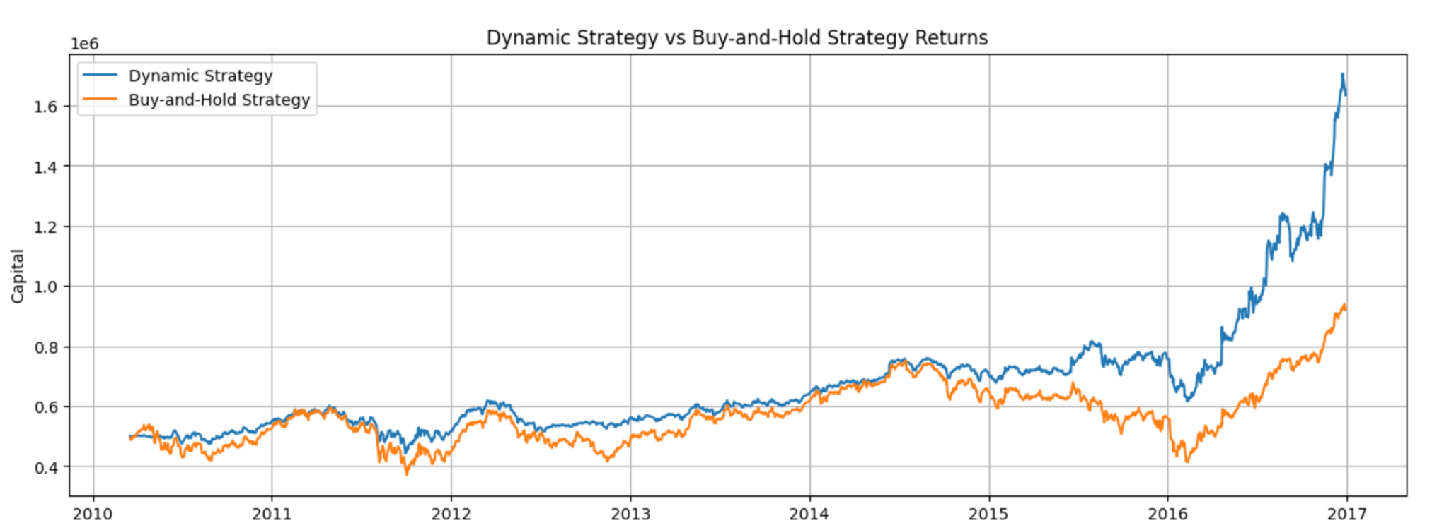
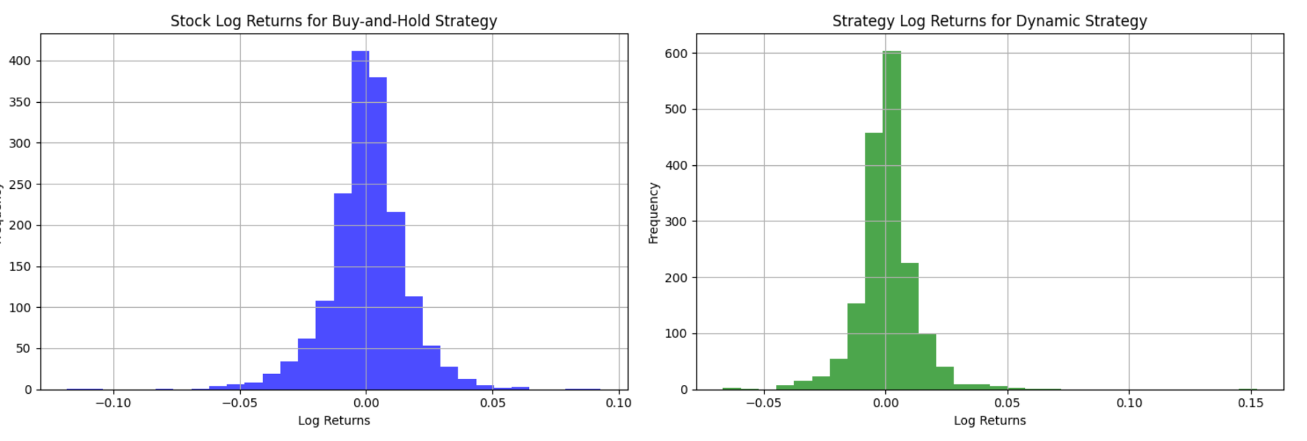
Training
BUY-AND-HOLD STRATEGY:
ANNUALISED RETURNS: 0.094122
RETURN ON INVESTMENT: 0.841149
DYNAMIC STRATEGY:
ANNUALISED RETURNS: 0.190729
RETURN ON INVESTMENT: 2.269219

Slide 22
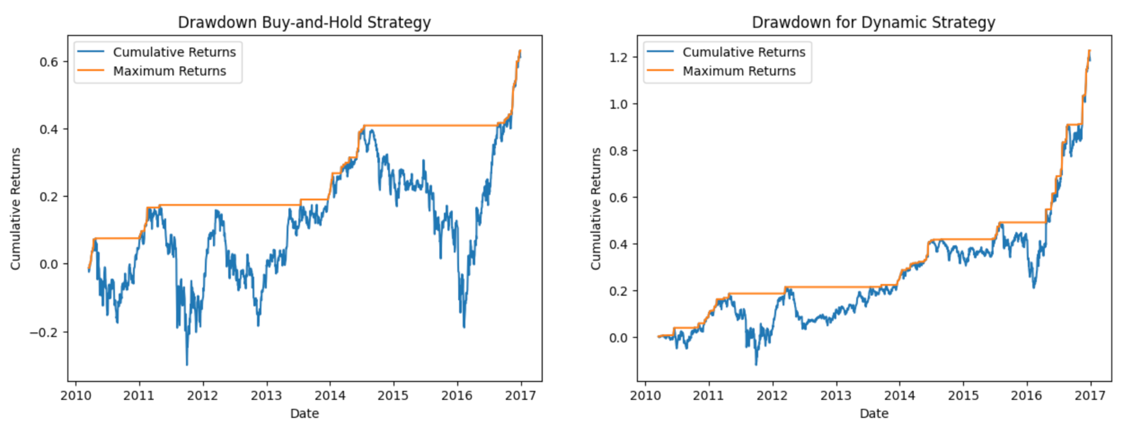
Training
MAX DRAWDOWN: 0.597539
MAX DRAWDOWN: 0.306728

Slide 23
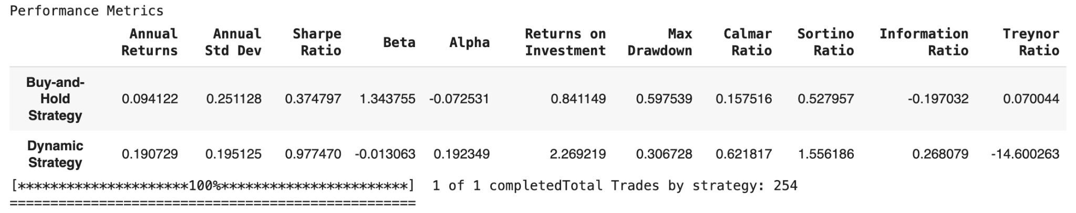
Training

Slide 24
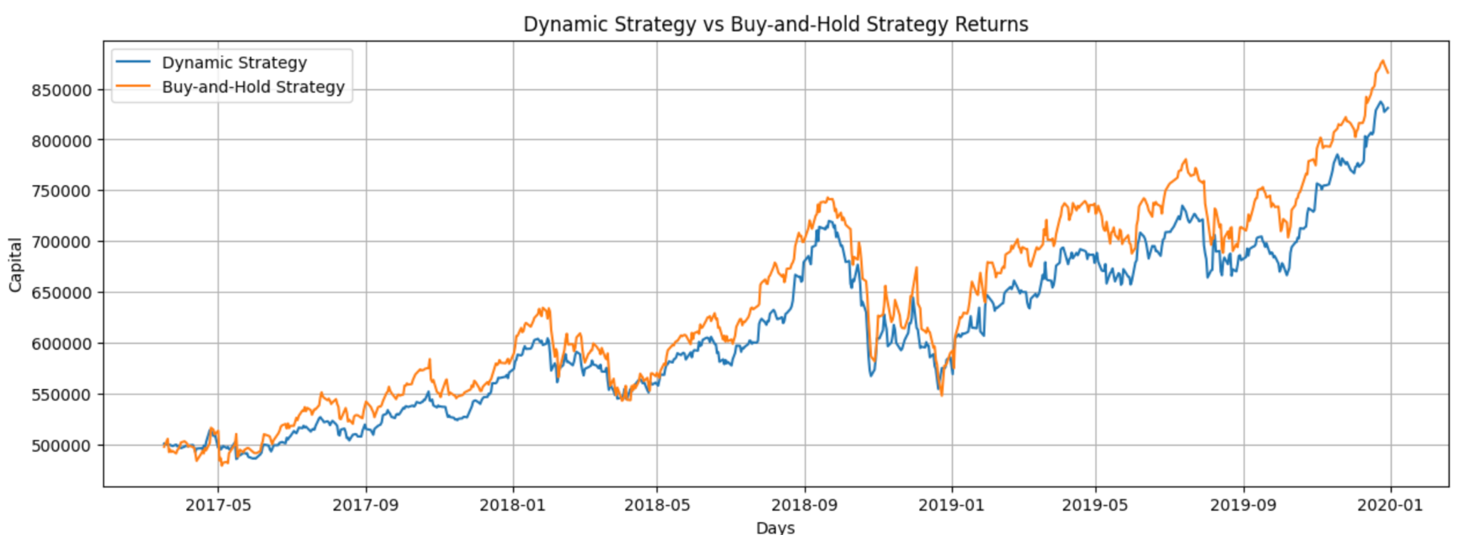
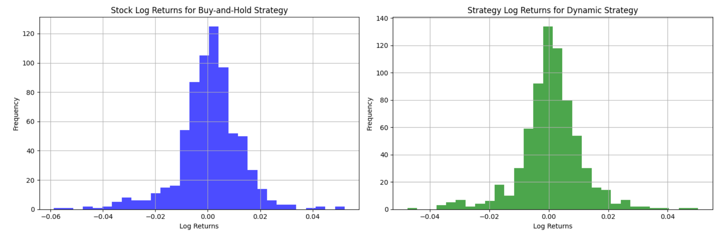
Testing
BUY-AND-HOLD STRATEGY:
ANNUALISED RETURNS: 0.217871
RETURN ON INVESTMENT: 0.731652
DYNAMIC STRATEGY:
ANNUALISED RETURNS: 0.200024
RETURN ON INVESTMENT: 0.661883

Slide 25
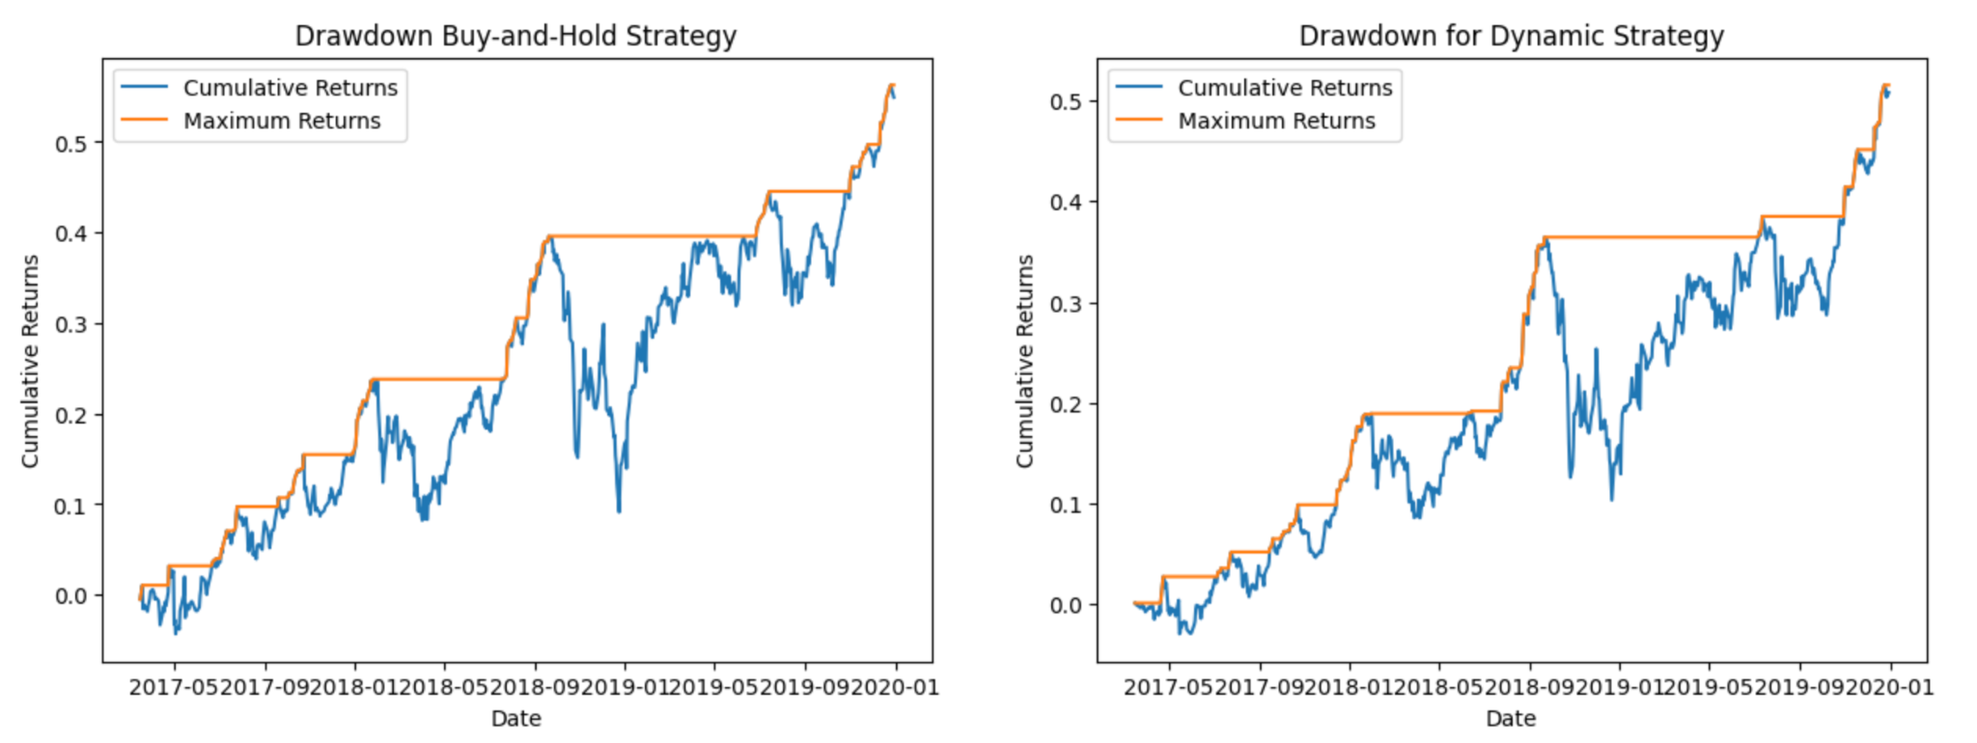
Testing
MAX DRAWDOWN: 0.304676
MAX DRAWDOWN: 0.261074

Slide 26
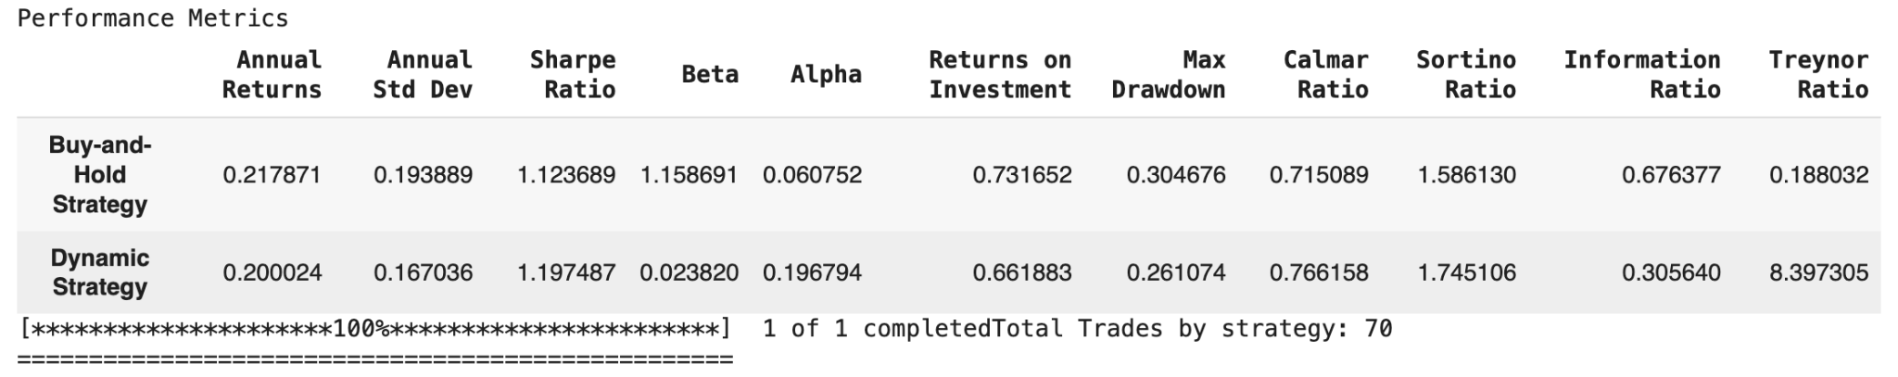
Testing

Slide 27
6
WEAKNESSES

Slide 28
Weaknesses
Generalising
Greedy approach
EMA Indicator
Used VIX to determine whether all stocks are experiencing volatility
A volatile market does not necessarily mean the stock is experiencing volatility
Greedy stop loss approach to recover losses by entering the opposite position after stop loss is triggered
Depending on trend continuation, may potentially cause losing streak in trades
No take profit which might incur losses of chances to maximise profits
EMA is sensitive to price changes and therefore it takes less time to confirm entry which allows us to capture key trading opportunities. However , it can create false entry signals
HOWEVER, using more confirmation signals can may cause less timely trades to be made.

Slide 29
7
Strengths

Slide 30
Strengths
Lookback period
Dynamic stop loss
Optimization
Use of rolling windows as lookback period to calculate indicators e.g RSI, VIX
Uses more recent data to calculate indicators allows better reflection of current market conditions
Adjusted stop loss levels based on market conditions
Makes stop loss dynamic which allows more risks to be taken during non-volatile periods and less risk during volatile periods
Optimize parameters to find the best windows that works for the stocks selected

Slide 31
8
CONCLUSION

Slide 32
THANK YOU

