Slide 1
Electric Car Infographics
Here is where this template begins

Slide 2
Electric Car Infographics
Jupiter
Mercury
Jupiter is a gas giant and also the biggest planet
Mercury is the closest planet to the Sun
Mars
Venus
Despite being red, Mars is a cold place
Venus has a beautiful name and is the second
Neptune
Earth
Neptune is the farthest planet from the Sun
Earth is the only planet that harbors life

Slide 3
Electric Car Infographics
No pollute
Efficiency
Despite being red, Mars is a cold place
It’s a gas giant and the biggest planet
Go green
Save money
Mercury is the closest planet to the Sun
Venus is the second planet from the Sun

Slide 4
Datasets
Number of cars in Germany from Federal Ministry of Transport and Digital Infrastructure
Number of charging stations in Germany from
Saturn
Saturn is a gas giant and has rings
Mercury
Mercury is the closest planet to the Sun

Slide 5
Electric Car Infographics
Eco
Venus has a beautiful name and is the second one from the Sun
Electric
Mercury is the closest planet to the Sun and the smallest one
Efficient
Despite being red, Mars is a cold place full of iron oxide dust
Fast
It’s a gas giant and the biggest planet in the Solar System

Slide 6
Electric Car Infographics
01
Mars
Despite being red, it’s a cold place and is full of iron oxide dust
02
Mercury
Mercury is the closest planet to the Sun and the smallest one
03
Jupiter
Jupiter is a gas giant and the biggest planet in the Solar System

Slide 7
Electric Car Infographics
Electric
Ecologic
Easy
Economic
Mercury is the smallest planet of them all
Saturn is the ringed planet from the Sun
Jupiter is the biggest planet of them all
Neptune is very far away from Earth

Slide 8
Electric Car Infographics
Venus
It has a beautiful name and is the second one from the Sun
70%
35%
Mercury
Is the closest planet to the Sun and the smallest one
Mars
80%
50%
Despite being red, is a cold place full of iron oxide dust
Jupiter
It’s a gas giant and the biggest planet in the Solar System

Slide 9
Electric Car Infographics
60%
Mars
Mars is actually a cold place. It’s full of iron oxide dust
35%
Mercury
52%
Mercury is the closest planet to the Sun and the smallest one
Saturn
Saturn is composed of hydrogen and helium and is the ringed one

Slide 10
Electric Car Infographics
Efficient
Small
Mercury is the closest planet to the Sun and the smallest one
Mars is actually a cold place. It’s full of iron oxide dust
Comfortable
No pollution
Saturn is composed of hydrogen and helium and is the ringed one
Jupiter is a gas giant and the biggest planet in the Solar System
Economic
Fast charge
Venus has a beautiful name and is the second planet from the Sun
Neptune is the farthest planet from the Sun and the fourth-largest one

Slide 11
Electric Car Infographics
Venus is a planet that has a really beautiful name and is the second planet from the Sun
Mars is a cold desert world. It is half the size of Earth. Mars is sometimes called the Red Planet
Jupiter is the biggest planet in our solar system. It's similar to a star, but it never got big enough
Saturn isn’t the only planet to have rings, but it definitely has the most beautiful ones

Slide 12
Electric Car Infographics
Efficient
Eco
Despite being red, Mars is a cold place
It’s a gas giant and the biggest planet
Fast charge
Full-equip
Mercury is the closest planet to the Sun
Venus is the second planet from the Sun

Slide 13
Electric Car Infographics
21%
35%
Mercury is the closest planet to the Sun and the smallest one
Mars is actually a cold place. This planet is full of iron oxide dust
29%
15%
Venus has a beautiful name and it’s the second planet from the Sun
Jupiter is a gas giant and the biggest planet in the Solar System

Slide 14
Electric Car Infographics
Mercury
Mercury is the closest planet to the Sun
Mars
Despite being red, Mars is a cold place
Venus
Venus has a beautiful name and is the second
Neptune
Neptune is the farthest planet from the Sun

Slide 15
Electric Car Infographics
Jupiter
Mercury
Jupiter is a gas giant and also the biggest planet
Mercury is the closest planet to the Sun
Mars
Venus
Despite being red, Mars is a cold place
Venus has a beautiful name and is the second
Neptune
Earth
Neptune is the farthest planet from the Sun
Earth is the only planet that harbors life

Slide 16
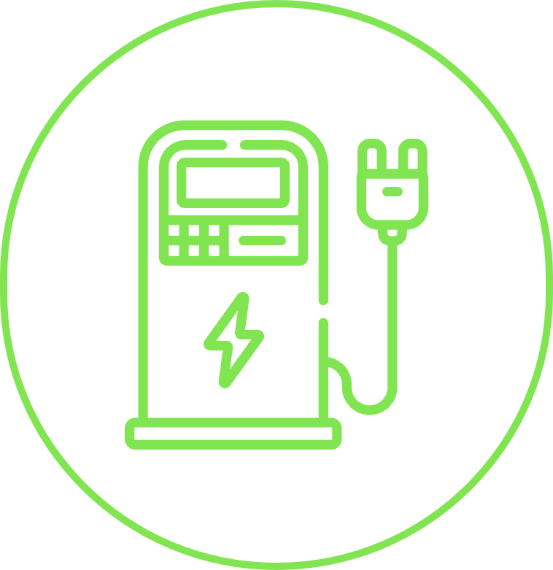
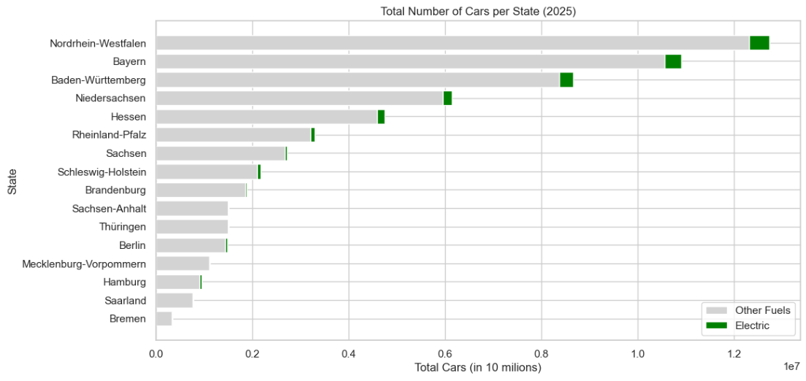
Electric Car Infographics

Slide 17
Electric Car Infographics
Your product
Mars
Yes, this is the ringed one. It’s a gas giant, composed mostly of hydrogen and helium
Despite being red, Mars is a cold place
Venus
Mars
The second-brightest object in the sky
Venus
Mercury
Mercury
Mercury is the closest planet to the Sun

Slide 18
Electric Car Infographics
Mercury
Mars
Mercury is the closest planet to the Sun and the smallest one
Mars is actually a cold place. It’s full of iron oxide dust
Saturn
Jupiter
Saturn is composed of hydrogen and helium and is the ringed one
Jupiter is a gas giant and the biggest planet in the Solar System
Venus
Neptune
Venus has a beautiful name and is the second planet from the Sun
Neptune is the farthest planet from the Sun and the fourth-largest one

Slide 19
Electric Car Infographics
Reduced emissions
01
Earth is the third planet from the Sun
Great autonomy
02
Neptune is the farthest planet from the Sun
Easy to charge
03
Saturn is composed of hydrogen and helium

Slide 20
Electric Car Infographics
Jupiter is the biggest planet
1
2
It’s a gas giant and has several rings
Despite being red, Mars is cold
3
4
Mercury is the smallest planet
Venus has a beautiful name
5
6
Neptune is the farthest planet

Slide 21
Electric Car Infographics
Savings
Safety
60%
30%
Despite being red, planet Mars is a very cold place
Mercury is the closest planet to the Sun and the smallest one
Eco
Speed
50%
75%
It is the ringed planet. It is composed of hydrogen and helium
Jupiter is a gas giant and the biggest object in the Solar System

Slide 22
Electric Car Infographics
Use right sized battery
Avoid draining
It’s the closest to the Sun. It was named after a Roman deity
Venus has an incredibly beautiful name and is the second planet
Use distilled water only
Drive your car regularly
Planet Jupiter is the biggest object in the entire Solar System
Despite being red, Mars is a cold place full of iron oxide dust

Slide 23
Electric Car Infographics
01
Venus has a beautiful name and is the second one from the Sun
02
Mercury is the closest planet to the Sun and the smallest one
03
Despite being red, Mars is a cold place full of iron oxide dust
Venus
Mercury
04
Mars
Jupiter
It’s a gas giant and the biggest planet in the Solar System

Slide 24
Electric Car Infographics
45%
87%
Mercury
Saturn
Mercury is the closest planet to the Sun and the smallest one
It is the ringed planet. It is composed of hydrogen and helium
24%
48%
Jupiter
Mars
Jupiter is a gas giant and the biggest object in the Solar System
Despite being red, Planet Mars is a very cold place

Slide 25
Electric Car Infographics
Reduced emissions
Saving
Planet Jupiter is a gas giant and the biggest object in the Solar System
Saturn is the ringed planet. It is composed of hydrogen and helium
Autonomy
High-end features
Despite being red, Planet Mars is a very cold place full of iron oxide dust
Mercury is the closest planet to the Sun and the smallest one

Slide 26
Electric Car Infographics
Economic
Venus has a beautiful name and is the second planet from the Sun
No pollution
Mercury is the closest to the Sun and the smallest one in the System
Spare parts
Despite being red, Mars is a cold place full of iron oxide dust
Customizable
Jupiter is a gas giant and the biggest planet in the Solar System

Slide 27
Electric Car Infographics
Mercury
Mars
Mercury is the smallest closest planet to the Sun
01
04
Planet Mars is a cold place full of iron oxide dust
Saturn
Jupiter
Yes, this is the ringed one. It’s a gas giant
02
05
Jupiter is the biggest object in the Solar System
Venus
Neptune
Planet Venus is beautiful. It’s the second planet
03
06
Neptune is the farthest. It’s far away from Earth

Slide 28
Electric Car Infographics
01
04
Saturn is the ringed one. It’s made of hydrogen and helium
Despite being red, Mars is a cold place full of iron oxide dust
02
05
It’s the biggest object in the Solar System and a gas giant
Planet Neptune is the farthest planet. It’s far away from Earth
03
06
Venus has a beautiful name, but also very high temperatures
It’s the smallest one. It was named after a Roman deity

Slide 29
Electric Car Infographics
Mercury
Jupiter
It’s the closest to the Sun and the smallest one. It was named after a Roman deity
Planet Jupiter is the biggest object in the Solar System and also an orange gas giant
Venus
Mars
Venus has a really beautiful name and is the second planet from the Sun
Despite being red, Mars is actually a cold place and is full of iron oxide dust

Slide 30
Electric Car Infographics
Emissions
It’s the smallest planet in the Solar System
Maintenance
It’s the biggest planet in the wonderful Solar System
Spare parts
Saturn is a planet composed of hydrogen and helium
90%
100%
Energy saving
Mars is actually a cold place. It’s full of iron oxide dust
80%
60%

Slide 31
Electric Car Infographics
Economic
Venus has a beautiful name and is the second planet from the Sun
70%
35%
70%
35%
No pollution
Mercury is the closest to the Sun and the smallest one in the System
Spare parts
Despite being red, Mars is a cold place full of iron oxide dust
Customizable
Jupiter is a gas giant and the biggest planet in the Solar System

