Slide 1
Javascript

Slide 2
Porquê javascript?
The JavaScript language was initially created for web browsers. Since then, it has evolved and become a language with many uses and platforms.
A platform may be a browser, or a web-server, or a washing machine, or another host. Each of them provides platform-specific functionality. The JavaScript specification calls that a host environment.
A host environment provides platform-specific objects and functions additional to the language core. Web browsers give a means to control web pages.

Slide 3
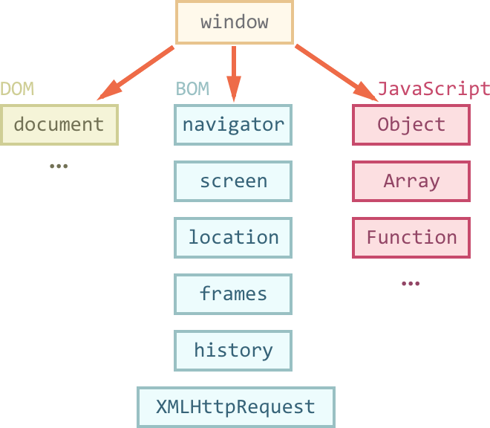
Ambiente do browser

Slide 4
Significado das Siglas
Document Object Model (DOM)
The document object gives access to the page content. We can change or create anything on the page using it.
document.body.style.background = "red"; setTimeout(() => document.body.style.background = "", 1000);
Browser Object Mode (BOM)
BOM are additional objects provided by the browser (host environment) to work with everything except the document

Slide 5
DOM (informação complementar)
http://javascript.info/dom-nodes
http://javascript.info/dom-navigation
http://javascript.info/searching-elements-dom

