Slide 1
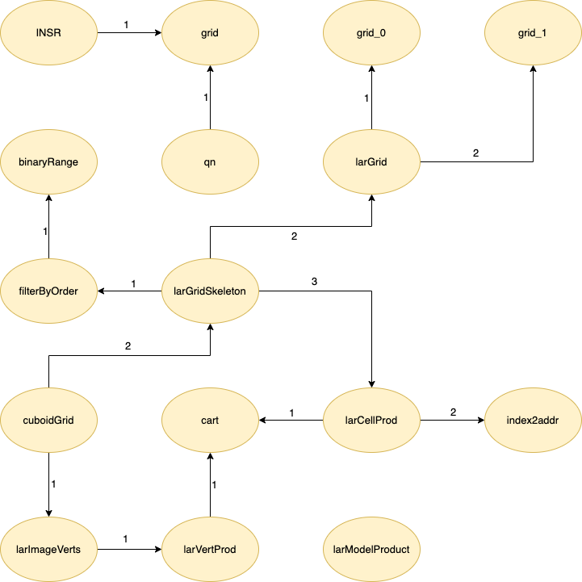

largrid.jl
LAR cuboids & simplices
Alessandro Dell’Oste, Maurizio Brini, Manuel Granchelli

Slide 2
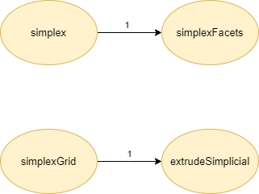
simplexn.jl
LAR cuboids & simplices
Alessandro Dell’Oste, Maurizio Brini, Manuel Granchelli

Slide 3
API
largid.jl
simplexn.jl
function simplex(n, fullmodel=false)
function extrudeSimplicial(model::Lar.LAR, pattern)
function simplexGrid(shape)
function simplexFacets(simplices)
function INSR(f)
function grid(sequence...)
function qn(n::Int)
function grid_0(n::Int)::Array{Int64,2}
function grid_1(n)
function larGrid(n::Int)
function cart(args)::Array{Tuple,1}
function larVertProd(vertLists::Array{Array{Int64,2},1})::Array{Int64,2}
function index2addr( shape::Array{Int64,2} )
function larCellProd(cellLists::Array{Cells,1})::Cells
function filterByOrder(n::Int)Array{Array{Array{Int8,1},1},1}
function larGridSkeleton(shape)
function larImageVerts( shape::Array{Int,1} )::Array{Int64,2}
function cuboidGrid( shape, filled=false )
function larModelProduct( modelOne, modelTwo )
LAR cuboids & simplices
Alessandro Dell’Oste, Maurizio Brini, Manuel Granchelli

