Slide 1

.

Slide 2
Buzz

Slide 3
BuzzBar

Slide 4


Slide 5
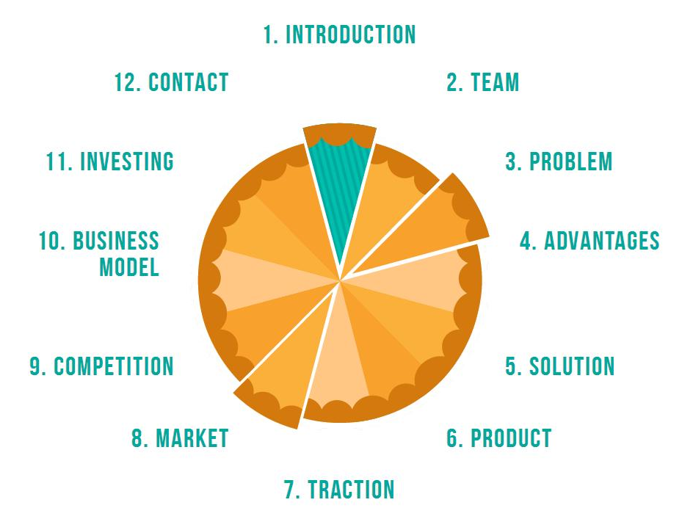

Slide 6

Introduction (The Story)

Slide 7

Team (take simple photos)

Slide 8

Problem

Slide 9
Problems
Capabilities
limited (static)
Content Search
Time consuming
Online video platforms
Poor Interactivity
Difficult
Finding relevant content/comment
Notes:
Price
is important for customers booking travel online
Airlines
leave you with limited options
Online travel platforms
are not flexible and leave you with precise dates
Difficult
to make people meet in certain place

Slide 10
Advantages
Interactive
Multi-platforms
Analytical
Integrated

Slide 11
Solution
A comment bar (plug-in) where users can comment visually on the relevant video content and share with friends, family and colleagues smartly.

Slide 12
Product
Screen shots
Demo

Slide 13

Traction

Slide 14

Market

Slide 15

Investing

