Slide 1
PSYCHO-GPA GPA recognition
Adel, Alina, Farida

Slide 2



MEMBERS
Farida
-analyst
-data collector
Adel
-manager
-coder
Alina
-coder
-tester

Slide 3

PAIN

Slide 4
PAIN
Student
-GPA?
-PROBLEMS?
-HOW TO DECIDE?
University
SELECTION COMMITTEE?
FOCUS ON STUDENTS PSYCHOLOGY?
ACADEMIC
PERFORMANCE
VS
PSYCHOLOGY

Slide 5

IDEA

Slide 6






IDEA

Slide 7
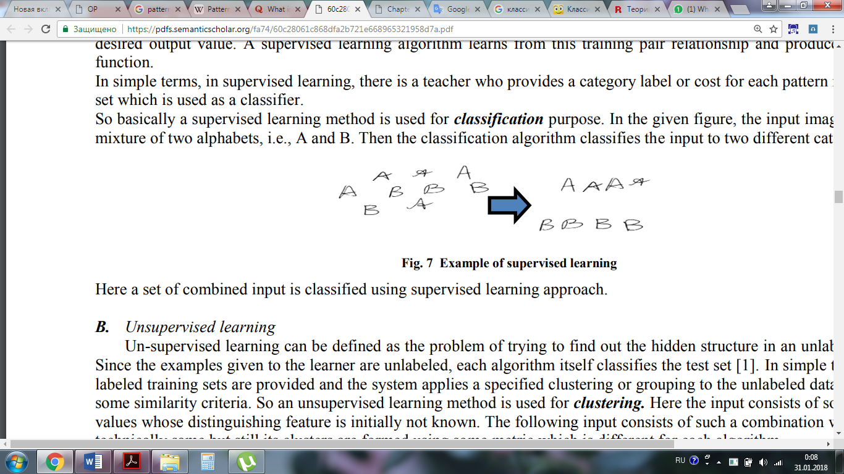
SUPERVISED LEARNING(CLASSIFICATION)
Example of supervised learning

Slide 8
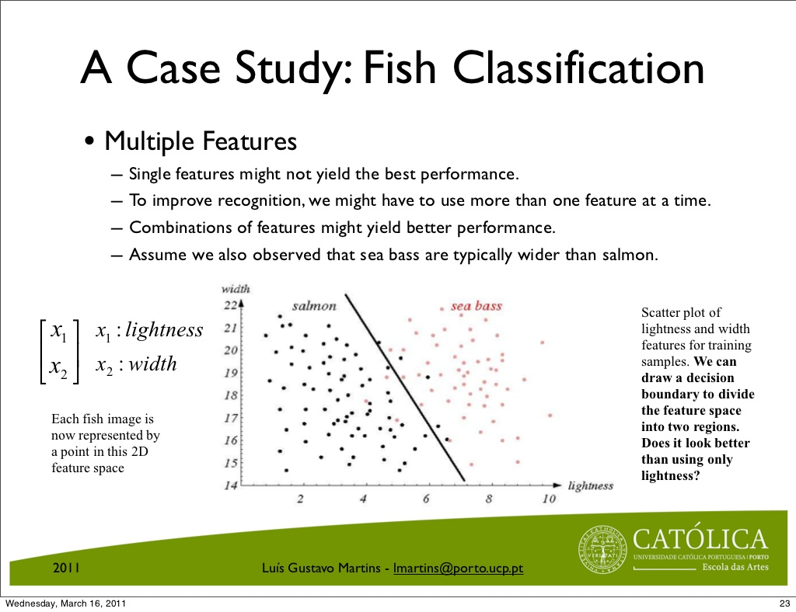
CLASSIFICATION ALGORITHM
assign each input value to one of a given set of classes

Slide 9
DATASET
GPA | Q1 | Q2 | Q3 | Q4 | Q5 | Q6 | Q7 | Q8
Excellent | 1 | 1 | 3 | 1 |  |  |  | …..
High | 2 | 1 | 1 | 1
Middle | 3 | 3 | 2 | 1
Low | 1 | 2 | 2 | 1
…..

Slide 10


EXPECTATIONS
OUR PROJECT

