Slide 1

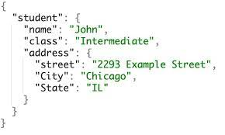
MongoDB is a NoSQL database storage that stores data in a separate and JSON file, where data are stored in a collection instead of a normal table.
Example of mongoDB collection

Slide 2
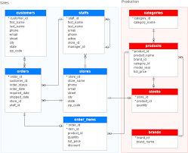

SQL DATABASE
It is a structured set of info that is easily accessed and can be managed by several users using DBMS
Examples of SQL is ORACLE AND MySQL

Slide 3
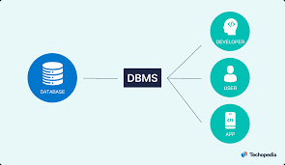
DBMS
DataBase Management System that is used to store info in database that can find and sort these info

Slide 4
Difference between MongoDB and SQL
MongoDB are no relational, but SQL are relational
MongoDB have no predefined schema, so it is more flecible tham SQL
MongoDB are stored in collections, but SQL are stored in table-based
MongoDB are stored in JSON documents while SQL in structured vertical documents

