Slide 1
AVR EMBEDDED SYSTEMS
REAL-TIME
CLOCK & TIMING UNIT
A compact embedded platform for clock, calendar, alarms and timing control.
14 : 12 : 12
RTC • AVR
Graduation Project | ATmega32 | I2C / TWI

Slide 2
01 • TEAM
Project Team
Prepared and developed as an AVR embedded-systems graduation project.
Adel Wael Adel
Yousef Mahmoud Elsayed
Abdullah Mohammed Abdullah
ADVANCED REAL-TIME CLOCK SYSTEM • AVR EMBEDDED PROJECT
02

Slide 3
02 • PURPOSE
Project Overview
01
What we built
02
Four timing modes
A multi-function real-time clock centered on an ATmega32, with
an LCD interface and push-button control.
Clock & calendar, programmable alarm, stopwatch,
and countdown timer.
03
Core hardware
04
Design approach
ATmega32 + RTC module + 16×2 LCD + push buttons + buzzer.
Separate hardware drivers from application logic through
a layered embedded-software structure.
ADVANCED REAL-TIME CLOCK SYSTEM • AVR EMBEDDED PROJECT
03

Slide 4
03 • PROJECT CHOICE
Why This Project?
01
Useful in practice
02
More than a clock
Time-dependent control appears in consumer devices
, industrial systems and automation.
The design combines four useful timing functions rather
than stopping at basic time display.
03
Full-stack embedded work
04
Ready to extend
The project brings together peripherals, communication,
firmware and a user interface.
The same architecture can support reminders, scheduling and
automated device control.
ADVANCED REAL-TIME CLOCK SYSTEM • AVR EMBEDDED PROJECT
04

Slide 5
04 • SYSTEM HARDWARE
Hardware Building Blocks
01
ATmega32
02
RTC module
Main controller responsible for application flow, input handling,
timing and peripheral coordination.
DS1307 / DS3231 family used to retain current time and calendar
information through I2C/TWI.
03
16×2 character LCD
04
Push buttons + buzzer
Provides continuous feedback for time, date, operating mode and
timer values.
Buttons handle navigation and adjustments; the buzzer supplies
audible notifications.
ADVANCED REAL-TIME CLOCK SYSTEM • AVR EMBEDDED PROJECT
05

Slide 6
05 • HOW THE PARTS CONNECT
System Architecture
01
RTC → ATmega32
02
ATmega32 → LCD
The RTC supplies real-time and calendar data over the two-wire
I2C/TWI interface.
The controller formats the current state and presents it on the
16×2 display.
03
Buttons → ATmega32
04
ATmega32 → Buzzer
User actions select modes and change settings such as time,
date and alarm values.
The controller triggers audible feedback when an alarm or
countdown reaches its target.
ADVANCED REAL-TIME CLOCK SYSTEM • AVR EMBEDDED PROJECT
06

Slide 7
06 • MAIN FEATURES
Functional Modes
01
Clock & calendar
02
Programmable alarm
Shows hours, minutes, seconds and full date, with manual
adjustment available.
User sets an alarm target, enables it, and receives a buzzer
notification when the time matches.
03
Stopwatch
04
Countdown
Independent count-up measurement with start, pause/stop
and reset controls.
User defines a duration; the remaining time updates live and
the buzzer sounds at zero.
ADVANCED REAL-TIME CLOCK SYSTEM • AVR EMBEDDED PROJECT
07

Slide 8
07 • MODE 01
Clock & Calendar
The clock mode is the foundation: the RTC provides the reference while the MCU handles presentation and user adjustment.
01
Continuous timekeeping
02
Display format
The RTC maintains current time and date independently of the
main application loop.
Time is shown as HH : MM : SS; the calendar
uses DD / MM / YY.
03
Manual correction
04
Communication
The user can adjust clock and calendar values through the
push-button interface.
ATmega32 reads and writes RTC data through I2C/TWI.
ADVANCED REAL-TIME CLOCK SYSTEM • AVR EMBEDDED PROJECT
08

Slide 9
08 • MODE 02
Alarm Workflow
01
Set target
02
Enable
Choose the desired alarm hour, minute and related settings.
Turn the alarm function on; its state remains visible on the LCD.
03
Monitor
04
Alert & silence
The application continuously checks the RTC against the
configured target.
When the values match, the buzzer sounds and the user can
acknowledge the notification.
ADVANCED REAL-TIME CLOCK SYSTEM • AVR EMBEDDED PROJECT
09

Slide 10
09 • MODE 03
Stopwatch Operation
01
Start
02
Pause / stop
Begin elapsed-time measurement from the current zero state.
Freeze the displayed value whenever the measurement needs
to be interrupted.
03
Reset
04
Live display
Return the stopwatch to 00 : 00 : 00.
The LCD provides continuous feedback while elapsed time
is being measured.
ADVANCED REAL-TIME CLOCK SYSTEM • AVR EMBEDDED PROJECT
10

Slide 11
10 • MODE 04
Countdown Timer
01
Choose duration
02
Run / pause
Adjust hours, minutes and seconds before starting.
Start the countdown and pause it when required.
03
Track remaining time
04
Finish alert
The LCD updates the remaining duration in real time.
At 00:00:00 the buzzer notifies the user that the interval has ended.
ADVANCED REAL-TIME CLOCK SYSTEM • AVR EMBEDDED PROJECT
11

Slide 12
11 • MCU ROLE
ATmega32: The Control Center
01
Application management
02
Input handling
Runs the main program and selects the active operating mode.
Reads push-button states and translates them into user commands.
03
Timing services
04
Peripheral coordination
Uses hardware timers and periodic ticks for software timing operations.
Controls communication with the LCD, RTC and buzzer.
ADVANCED REAL-TIME CLOCK SYSTEM • AVR EMBEDDED PROJECT
12

Slide 13
12 • COMMUNICATION
RTC Communication via I2C / TWI
01
Two-wire link
02
Master / slave flow
SDA carries data while SCL provides the synchronization clock.
The ATmega32 acts as the controller and communicates
with the RTC device.
03
Calendar data
04
Why it fits
The exchange includes seconds, minutes, hours, day, month and year.
Only two signal lines are needed for reliable serial communication
with the RTC.
ADVANCED REAL-TIME CLOCK SYSTEM • AVR EMBEDDED PROJECT
13

Slide 14
13 • INTERACTION
User Interface Flow
01
1 — Choose a mode
02
2 — Edit values
Move between Clock, Alarm, Stopwatch and Countdown using
the buttons.
Select the relevant time, date, alarm or duration field.
03
3 — Change values
04
4 — Confirm visually
Increase or decrease the selected value with dedicated controls.
The LCD immediately reflects the current state and user actions.
ADVANCED REAL-TIME CLOCK SYSTEM • AVR EMBEDDED PROJECT
14

Slide 15
14 • SOFTWARE
Layered Firmware Design
01
MCAL
02
HAL
DIO, Timer, Global Interrupt and I2C/TWI drivers interface directly
with ATmega32 peripherals.
LCD, Keypad and RTC drivers hide hardware details and expose simpler
functions to the application.
03
Main application
04
Separation of concerns
Coordinates clock, alarm, stopwatch and countdown behavior.
Each layer depends on the one beneath it, making the code
easier to maintain and test.
ADVANCED REAL-TIME CLOCK SYSTEM • AVR EMBEDDED PROJECT
15

Slide 16
15 • DRIVER LAYER
MCAL: Low-Level Drivers
01
DIO driver
02
Timer driver
Configures pins, reads button states, enables pull-ups and drives
outputs.
Uses CTC mode to generate periodic interrupts and a system
millisecond tick.
03
Global Interrupt driver
04
I2C / TWI driver
Enables or disables global interrupts safely for asynchronous events.
Provides the SDA/SCL communication path between the
ATmega32 and RTC.
ADVANCED REAL-TIME CLOCK SYSTEM • AVR EMBEDDED PROJECT
16

Slide 17
16 • HIGH-LEVEL LOGIC
HAL + Application Layer
01
LCD driver
02
RTC driver
Initializes the display and sends commands, characters and strings.
Reads/writes time and date and handles Decimal ↔ BCD conversion.
03
Application modes
04
Calendar logic
Coordinates Clock, Alarm, Stopwatch and Countdown functions.
Includes the required date handling, including leap-year behavior.
ADVANCED REAL-TIME CLOCK SYSTEM • AVR EMBEDDED PROJECT
17

Slide 18
17 • EXECUTION LOOP
Runtime Sequence
01
Power on
02
Read & show
Initialize LCD, RTC, timer and all required I/O.
Fetch current RTC information and refresh the LCD.
03
Process input
04
Execute & repeat
Read button states and determine the selected mode or
requested change.
Run the active mode, trigger the buzzer when required,
then continue the loop.
ADVANCED REAL-TIME CLOCK SYSTEM • AVR EMBEDDED PROJECT
18

Slide 19
18 • PROTEUS
Simulation & Verification
Proteus was used as the integration environment before final hardware implementation.
01
RTC link
02
LCD behavior
Check data exchange and I2C timing between the MCU and RTC.
Confirm the displayed values and refresh behavior.
03
Button response
04
Timing + alerts
Validate button detection and debouncing behavior.
Verify alarm triggering, stopwatch/countdown behavior
and buzzer activation.
ADVANCED REAL-TIME CLOCK SYSTEM • AVR EMBEDDED PROJECT
19

Slide 20
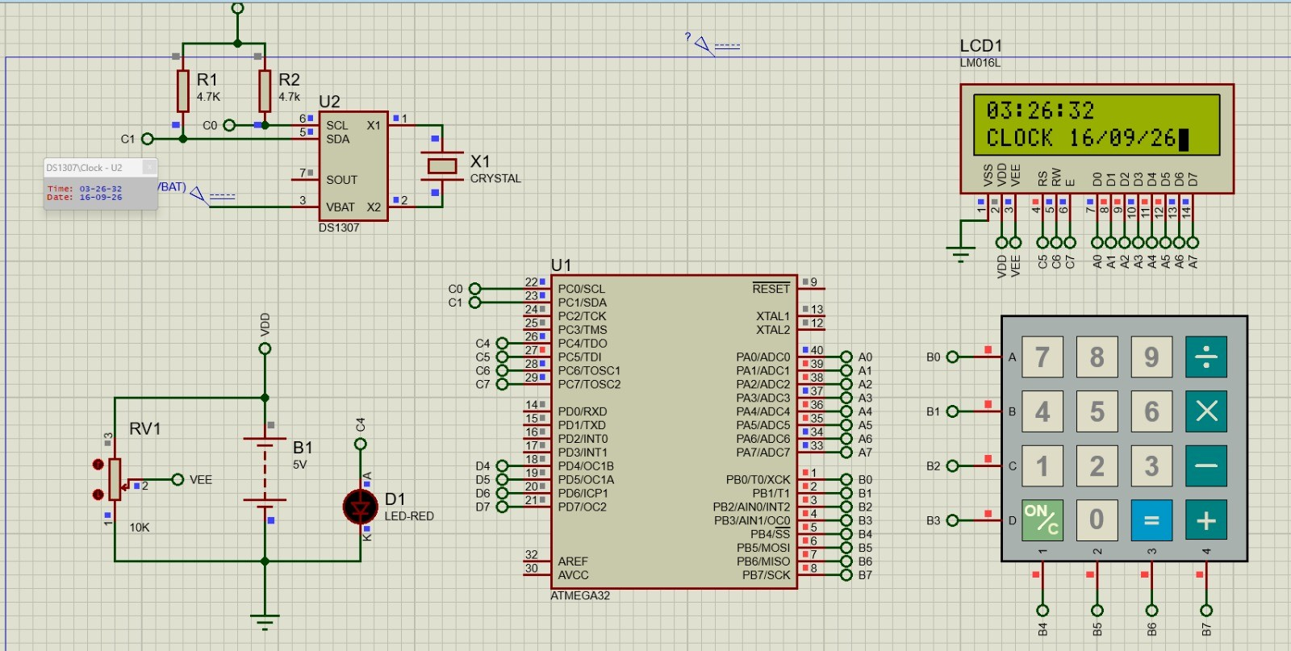
18.5 • PROTEUS
Simulation & Verification
ADVANCED REAL-TIME CLOCK SYSTEM • AVR EMBEDDED PROJECT
20

Slide 21
19 • REAL-WORLD USE
Broader Applications
01
Reminder products
02
Time-management tools
Scheduled alerts for routine activities and important events.
Meeting, study, exercise and cooking timers.
03
Home automation
04
Industrial control
Start or stop devices at predefined times.
Support time-dependent machine actions and process scheduling.
ADVANCED REAL-TIME CLOCK SYSTEM • AVR EMBEDDED PROJECT
21

Slide 22
THANK YOU :)
Real-time clock • Alarm • Stopwatch • Countdown
ATmega32 • RTC • LCD • I2C/TWI
Yousef Mahmoud Elsayed • Adel Wael Adel • Abdullah Mohammed Abdullah
2026 copyright @EDRA
Sufa, void and john was here

