Slide 1
Client tanımlama ve client silme
Adem akkuş
Bilişim teknoojileri öğretmeni
https://github.com/ademakkus/
https://www.linkedin.com/in/ademakkus/
https://www.instagram.com/akkusadem19/
https://www.facebook.com/akkusadem19

Slide 2
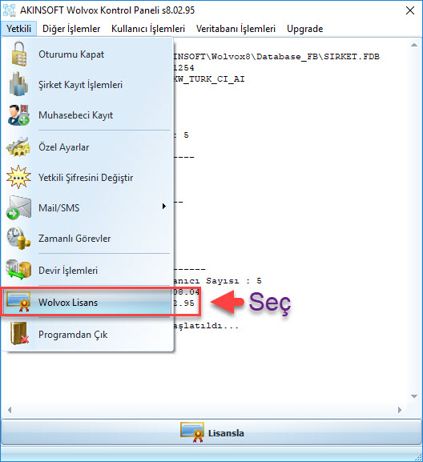
Client silme

Slide 3
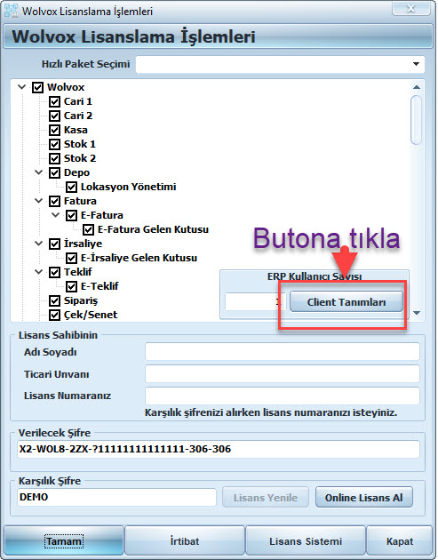
Client silme

Slide 4
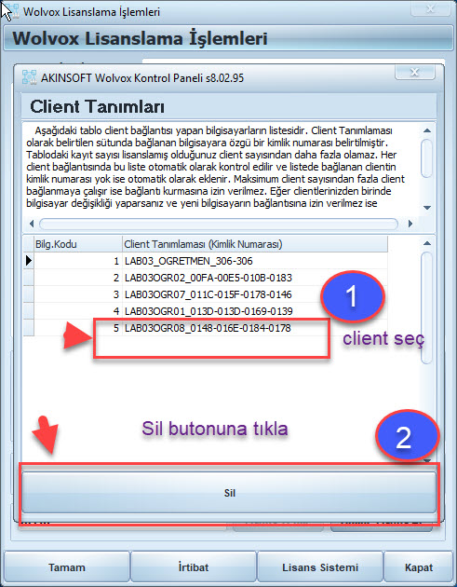
Client silme

Slide 5
teşekkürler
https://github.com/ademakkus/
https://www.linkedin.com/in/ademakkus/
https://www.instagram.com/akkusadem19/
https://www.facebook.com/akkusadem19

