Slide 1
STOK GRUP TANIMLARI
https://github.com/ademakkus/
https://www.linkedin.com/in/ademakkus/
https://www.instagram.com/akkusadem19/
https://www.facebook.com/akkusadem19
ADEM AKKUŞ
Bilişi Teknolojileri Öğretmeni

Slide 2
STOK GRUP TANIMLARI

Slide 3
Agenda Style
01
Contents
Get a modern PowerPoint Presentation that is beautifully designed. I hope and I believe that this Template will your Time.
02
Contents
Get a modern PowerPoint Presentation that is beautifully designed. I hope and I believe that this Template will your Time.
03
Contents
Get a modern PowerPoint Presentation that is beautifully designed. I hope and I believe that this Template will your Time.
04
Contents
Get a modern PowerPoint Presentation that is beautifully designed. I hope and I believe that this Template will your Time.

Slide 4
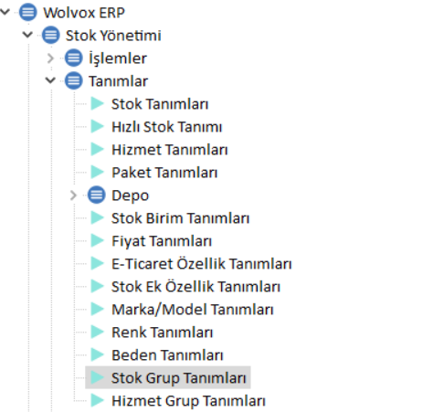
STOK GRUP TANIMLARI

Slide 5
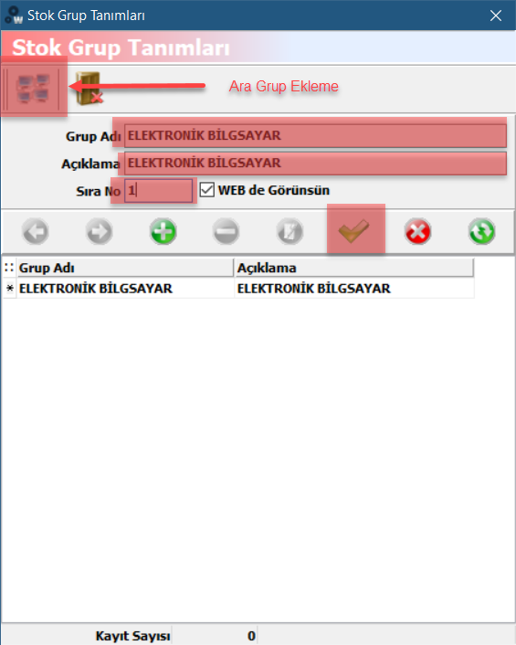
STOK GRUP TANIMLARI

Slide 6
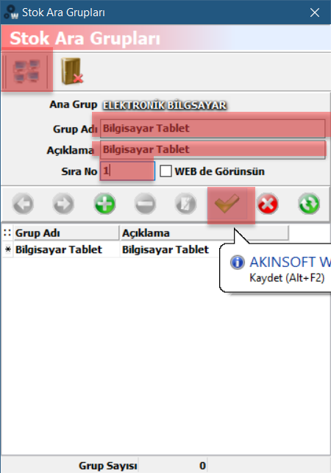
STOK GRUP TANIMLARI – ARA GRUPLAR

Slide 7
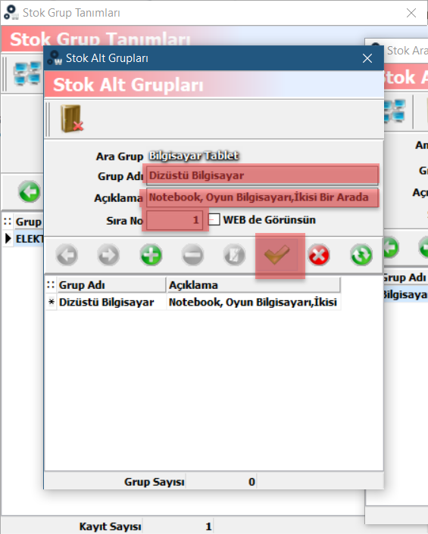
STOK GRUP TANIMLARI – ALT GRUPLAR

Slide 8
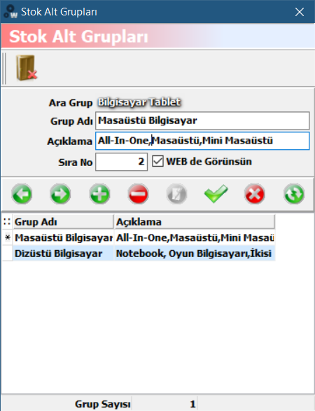
STOK GRUP TANIMLARI – ALT GRUPLAR

Slide 9
THANK YOU
ADEM AKKUŞ
https://github.com/ademakkus/
https://www.linkedin.com/in/ademakkus/
https://www.instagram.com/akkusadem19/
https://www.facebook.com/akkusadem19

