Slide 1

IRENE LLC
Defensive Security Solution
Virtual Space Industries (VSI) — Full Evidence Edition
SOC Analyst Team | Splunk SIEM | Vagrant VM + Docker
PLATFORM
ENV
ATTACK DATE
Splunk SIEM
Vagrant VM + Docker
March 25, 2020
Protecting VSI's network from cyberattacks that interrupt business operations
Notes:
Full evidence edition — includes real Splunk screenshots, attack summaries, dashboards, and project summary from VSI's March 25, 2020 attack.

Slide 2
Presentation Overview
01
Reports — Apache
06
Screenshots — Windows Attack Logs
HTTP Methods, Top 10 Domains & HTTP Response Code reports
Real Splunk search results from March 25, 2020 attack
02
Images of Reports — Apache
07
Screenshots — Apache Attack Logs
Real Splunk screenshots: HTTP Methods table, Top Domains, Response chart
Real Splunk search results showing Ukraine-origin brute force attack
03
Alerts — Apache
08
Attack Summary — Apache
International Activity (baseline 45, threshold 55) & HTTP Post (baseline 2, threshold 5)
1,296 POST requests from Ukraine; firewall & mitigation recommendations
04
Dashboards — Apache
09
Attack Summary — Windows
HTTP Methods, Geo Map, Top 10 Countries, URL Chart
User_A locked out, User_K password reset, User_J successful login
05
Reports & Dashboards — Windows
10
Project 3 Summary
Signatures, Severity Levels, Success/Failed Activities; Timechart & Pie charts
Overall findings and final recommendations from Irene LLC

Slide 3
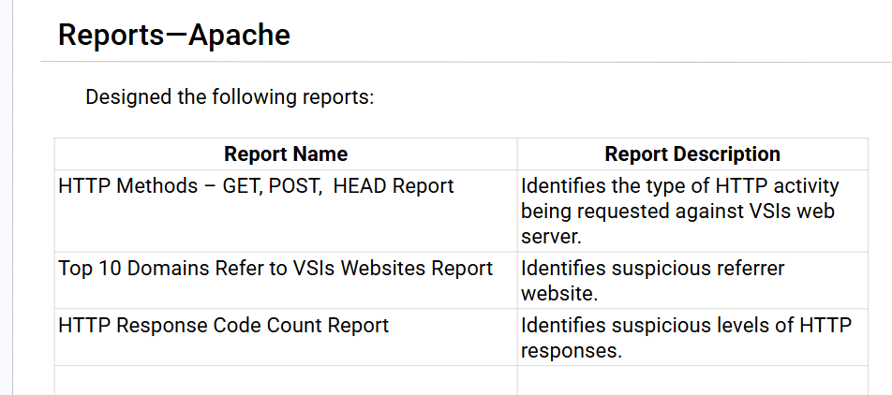
SECTION 01
Reports — Apache
Designed the following reports to monitor VSI's Apache web server:
HTTP Methods Report
GET, POST, HEAD — identifies type of HTTP activity against VSI's web server
Top 10 Domains Report
Identifies suspicious referrer websites linking to VSI
HTTP Response Code Report
Identifies suspicious levels of HTTP responses (4xx, 5xx spikes)

Slide 4
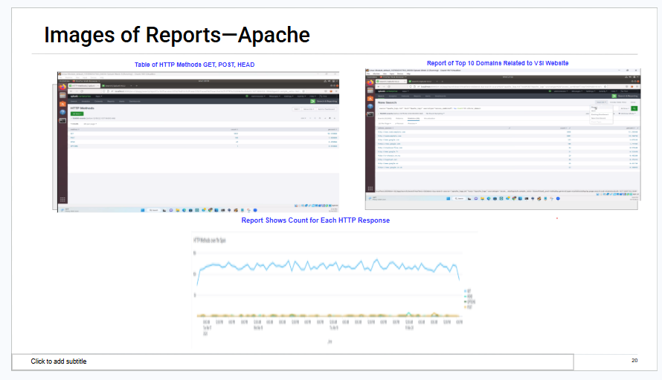
SECTION 02
Images of Reports — Apache
Real Splunk screenshots from VSI's Apache web server logs
Notes:
Image shows: Table of HTTP Methods GET/POST/HEAD, Report of Top 10 Domains Related to VSI Website, and line chart showing HTTP Response Code counts over time.

Slide 5
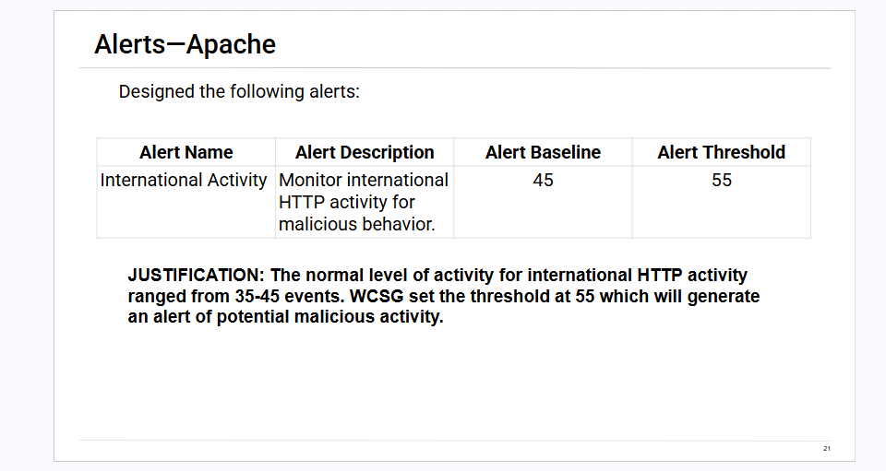
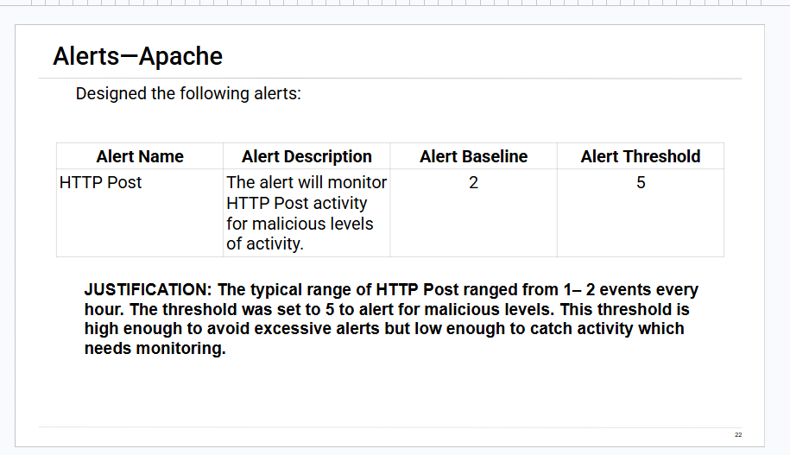
SECTION 03
Alerts — Apache
Designed the following alerts with justified baselines and thresholds:
Notes:
Left: International Activity alert — baseline 45, threshold 55. Right: HTTP Post alert — baseline 2, threshold 5. Both thresholds set to minimize false positives while catching malicious activity.

Slide 6
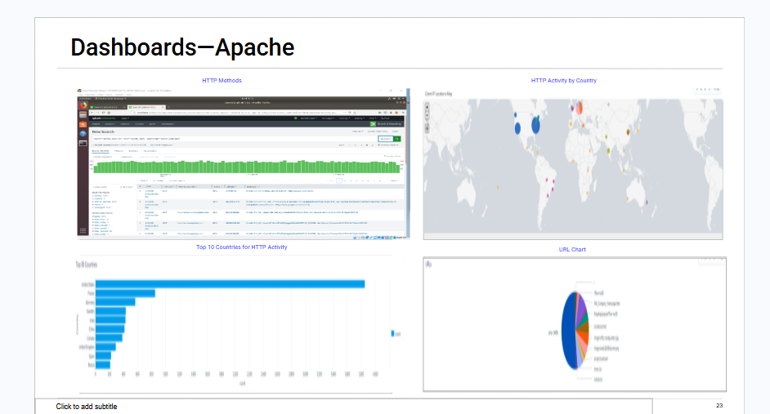
SECTION 04
Dashboards — Apache
HTTP Methods | HTTP Activity by Country (Geo Map) | Top 10 Countries | URL Chart
Notes:
Apache dashboard shows: HTTP Methods bar chart (Splunk), HTTP Activity by Country geo map, Top 10 Countries for HTTP Activity bar chart, and URL pie chart.

Slide 7
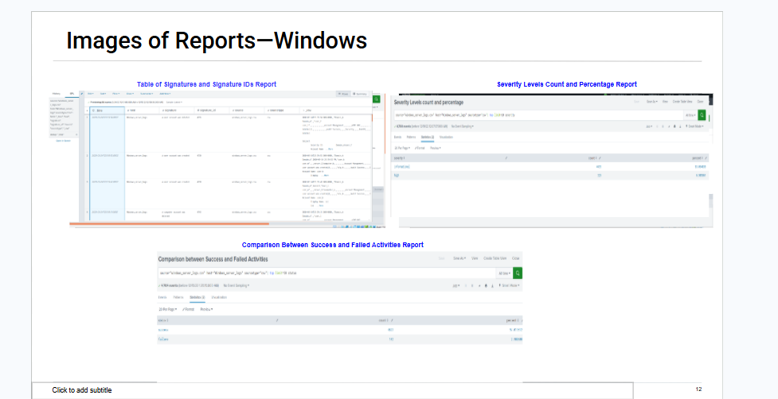
SECTION 05
Images of Reports — Windows
Table of Signatures & Signature IDs | Severity Levels Count & Percentage | Comparison: Success vs Failed Activities
Notes:
Windows reports show: Signature ID table with event details, Severity Level count/percentage breakdown, and comparison between successful and failed login activities.

Slide 8
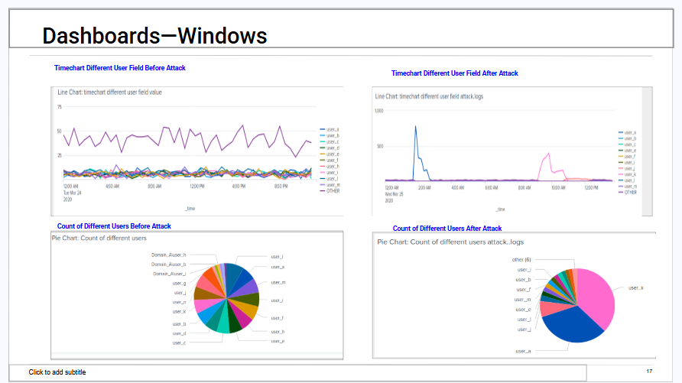
SECTION 05 cont.
Dashboards — Windows
Timechart Different User Field (Before & After Attack) | Count of Different Users Pie Chart (Before & After Attack)
Notes:
Windows dashboards compare before/after attack: timechart shows spike in user activity on March 25; pie chart shows distribution of user accounts affected.

Slide 9
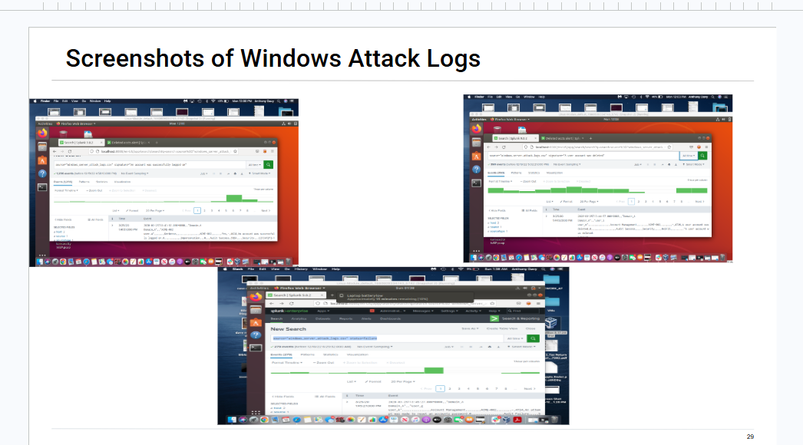
SECTION 06
Screenshots — Windows Attack Logs
Splunk search results — sourcetype=windows_server_attack_logs | Attack Date: March 25, 2020
Notes:
Three Splunk screenshots showing Windows attack log search results: account lockout signatures, password reset attempts, and successful login anomalies detected on March 25, 2020.

Slide 10
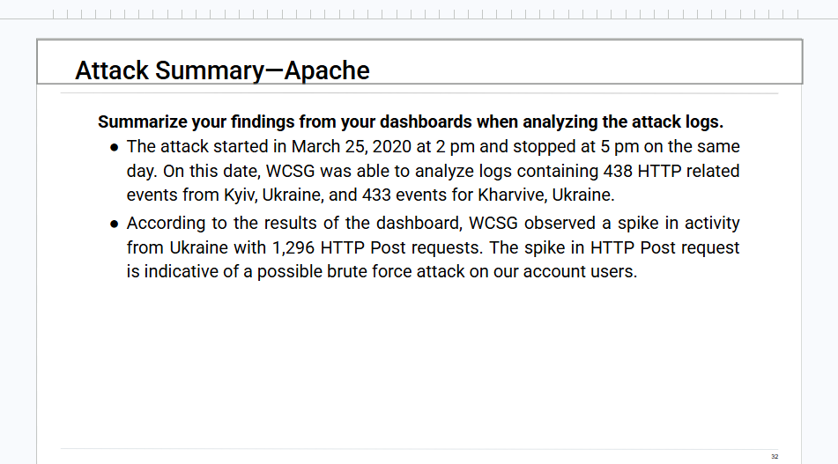
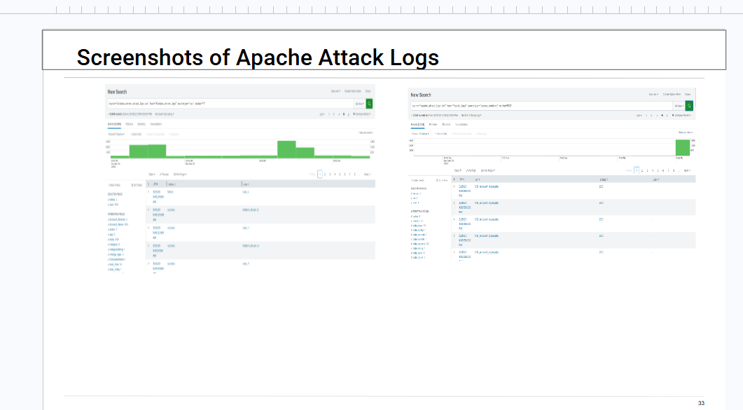
SECTION 07
Screenshots — Apache Attack Logs
Splunk search results — sourcetype=apache_attack_logs | Attack Date: March 25, 2020 | Origin: Ukraine
Notes:
Apache attack log screenshots show: HTTP POST spike to /VSI_Account_logon.php, 1,296 total POST requests, top countries showing Ukraine with highest traffic.

Slide 11
SECTION 08
Attack Summary — Apache
Findings from Reports
Irene LLC Recommendations
▸ Attack on March 25, 2020 — originated from Kyiv & Kharvive, Ukraine
✔ Block ALL HTTP traffic from Kyiv & Kharvive, Ukraine via firewall rules
▸ 1,296 HTTP POST requests to /VSI_Account_logon.php (brute force)
✔ Block any IP generating 5+ POST requests to /VSI_Account_logon.php
▸ 438 events from Kyiv, Ukraine; 433 events from Kharvive, Ukraine
▸ Attack ran from 2:00 PM to 5:00 PM on March 25, 2020
✔ Threshold of 55 for international activity was correct — avoid false positives
▸ Ukraine had the most international traffic during the attack
✔ HTTP Post threshold of 5 was correct (baseline 1–2/hr)
Notes:
Apache attack summary from images 13, 14, and 15. Attack originated from Ukraine targeting the VSI account login page with 1,296 POST requests.

Slide 12
SECTION 09
Attack Summary — Windows
User_A
LOCKED OUT
User_K
PASSWORD RESET
User_J
COMPROMISED
Account locked out due to brute force password attempts
Detected: 12:00 AM – 3:00 AM, March 25, 2020
Signature: 'A user account was locked out' peaked at 896
Suspicious password reset attempts detected
Detected: 8:00 AM – 11:00 AM, March 25, 2020
Signature: 'Attempt to reset account password' peaked at 1,256
Successful unauthorized login — account stolen
Detected: 10:50 AM – 12:30 PM, March 25, 2020
Signature: 'Account successfully logged on' peaked at 196
Irene LLC Recommendations
✔ Lock accounts after 5 incorrect attempts
✔ Enforce MFA on all accounts
✔ Block IP after 2 consecutive lockouts
✔ Blacklist IPs with 3+ bad logins from non-VSI addresses
✔ Limit password reset attempts
Notes:
Windows attack summary from images 8–11. Three users impacted on March 25, 2020. User_J's account was fully compromised (successful unauthorized login).

Slide 13
SECTION 10
Project 3 Summary
Overall findings from the March 25, 2020 attack on Virtual Space Industries
🏢 Scope
Several VSI users impacted during the March 25, 2020 coordinated attack
🔑 User_K
Password reset attempt — no evidence attacker was successful
🔒 User_A
Account locked out — attacker brute-forced to steal account credentials
⚠️ User_J
Account fully COMPROMISED — attacker successfully logged in and stole account
👥 Other Users
Multiple accounts had credentials created or changed during the attack window
🌍 Origin
Most attack traffic originated from Ukraine — firewall rule to block HTTP traffic from Ukraine recommended
Notes:
Final project summary from image 19. Covers all three compromised users, attack origin (Ukraine), and overall recommendations.

Slide 14

Irene LLC
Securing VSI — One Log at a Time
✔ Apache Reports, Alerts & Dashboard — Analyzed & Documented
✔ Windows Reports, Alerts & Dashboard — Analyzed & Documented
✔ Screenshots of Real Splunk Attack Logs Embedded
✔ Attack Summaries (Apache & Windows) — Findings & Recommendations
✔ Project 3 Overall Summary — Ukraine origin, 3 users impacted
Questions?

