Slide 1
PRE-DEFENSE · PFE 2026
Ask the DAM.
Get the answer.
With proof.
An AI agent that turns the African Development Bank's Delegation of Authority Matrix into instant, grounded answers
Adem Mrabet · Polytech Intl · Supervisor: [name]
Notes:
[0:00-0:45] HOOK. Do not read the slide. Say: 'Imagine you are a new employee at the Bank and need to know who must approve a mission program. The answer lives in a document of hundreds of pages. I built an agent that answers in two seconds, and shows its source.' Then introduce yourself, the internship at the African Development Bank (April to October) and announce the plan: we follow CRISP-DM, six phases, and you will see the live product twice.

Slide 2



A 200-page matrix nobody can search
Who approves? Who checks? Who must be informed?
Minutes lost, every time
A wrong answer has a price
Every task in the DAM has an answer, but it is buried in a dense PDF table.
Staff scroll, cross-reference footnotes and ask colleagues, who may also guess.
An unapproved decision is a governance and compliance risk for a development bank.
Generic chatbots cannot be the answer: they invent roles that sound right.
Business
Data
Preparation
Modeling
Evaluation
Deployment
Notes:
[0:45-1:45] BUSINESS UNDERSTANDING. Explain what the DAM is: the document that says who initiates, approves, checks and is informed for each task. Tell one concrete story. Land the key sentence: a plain LLM hallucinates plausible roles, which is unacceptable in governance. This is why the project is not 'just a chatbot'.

Slide 3
Our promise, in three measurable goals
Precise
Success looks like
1
Every answer traces to a node of the DAM. No source, no answer.
Right role,
right level,
right footnote.
Instant
2
Natural language, typos and four languages: French, Spanish, Portuguese, Arabic.
Not a demo that sounds smart: an assistant a Bank employee can rely on.
Trusted
3
Honest refusal when the question is outside the document.
Business
Data
Preparation
Modeling
Evaluation
Deployment
Notes:
[1:45-2:30] Three goals. Precise, instant, trusted. Be ready for the question: how do you measure precise? Answer: unit tests on known nodes plus the grounding check on every generated answer (see Evaluation). Be honest that a larger benchmark of questions is the next step.

Slide 4
Inside the document: 459 tasks, 2,108 relations
459
2,108
6
Dirty data in,
wrong answer out.
tasks parsed from the PDF
links between them
action codes: Initiate, Approve, Check, Verify, Inform, more
What made it hard
So the real work of this project was the data, not the model.
Footnote digits look like level digits once text is extracted
Rows split across pages, merged cells hide roles
Tasks point to each other: "See 1.117.2"
Business
Data
Preparation
Modeling
Evaluation
Deployment
Notes:
[2:30-3:30] DATA UNDERSTANDING. Key message: the quality of the answer is decided before any AI is involved. Give the superscript example: a footnote '1' next to level '2' reads as 21 in plain text extraction. Mention that action codes and cross-references were discovered by exploring the PDF, not assumed.

Slide 5
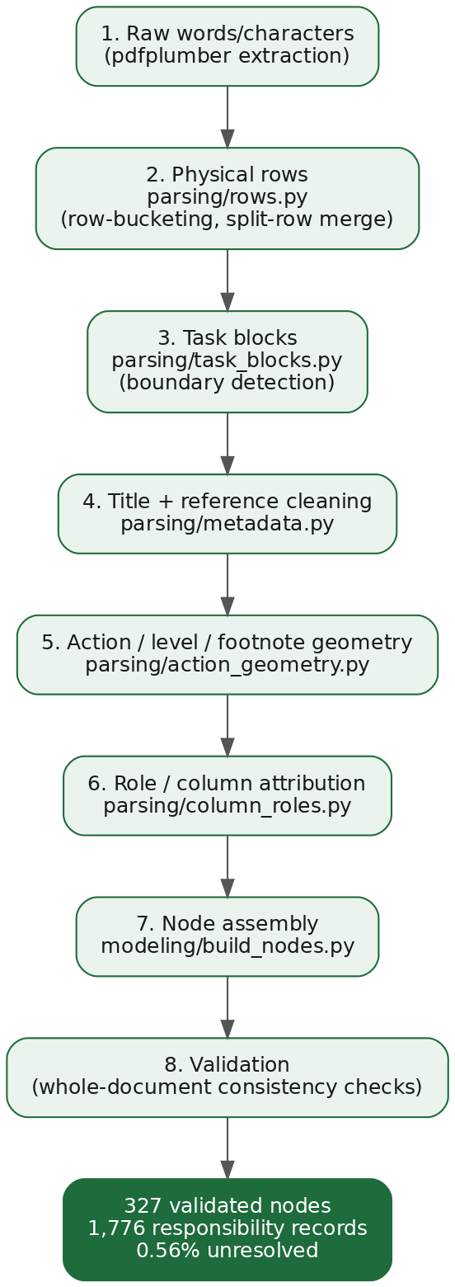
From a PDF to a clean, typed knowledge base
1
Read characters, not words
pdfplumber exposes size and position, so footnotes are told apart from levels.
2
Rebuild rows and task blocks
Merged and split rows are reassembled into one task each.
3
Validate with Pydantic
Typed contract between parser and graph: bad data fails loudly.
4
Cache as nodes.json
Parse once at build time, so the free hosting tier does not run out of memory.
Business
Data
Preparation
Modeling
Evaluation
Deployment
Notes:
[3:30-5:00] DATA PREPARATION. Walk the four steps with one example each. Justify the choices briefly: pdfplumber because of character geometry, Pydantic because the schema is one place to change, caching because Render ran out of memory when parsing on every start (a real incident). Do not list libraries for their own sake.

Slide 6
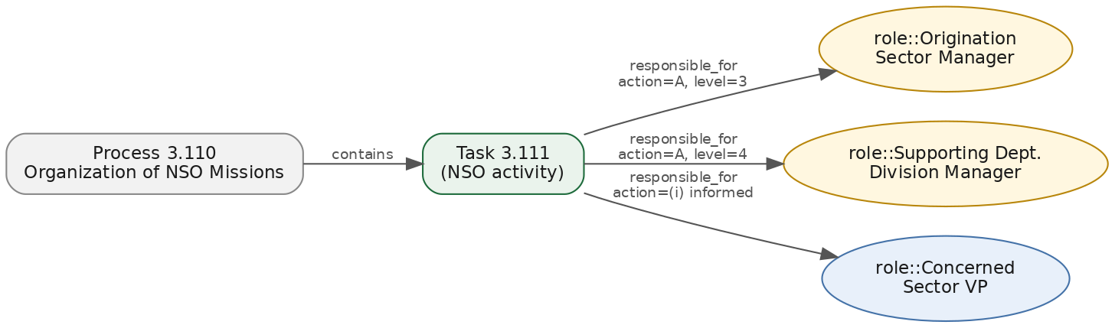
A graph that knows who does what
NetworkX
MultiDiGraph
Parallel edges: one role can act on one task in several ways.
Exact
Semantic
Honest
Type 2.126: resolved with certainty, confidence 1.0.
Describe the task: TF-IDF finds it, with an explainable score.
Unknown id: it says so instead of guessing.
Business
Data
Preparation
Modeling
Evaluation
Deployment
Notes:
[5:00-6:30] MODELING, part 1. Three retrieval outcomes. Why TF-IDF and not embeddings: short keyword-rich titles, no GPU, no labelled data, scores you can explain to a jury. Why a graph: relations such as 'see 1.117.2' are followed automatically. Typo tolerance is deterministic (difflib), works offline.

Slide 7
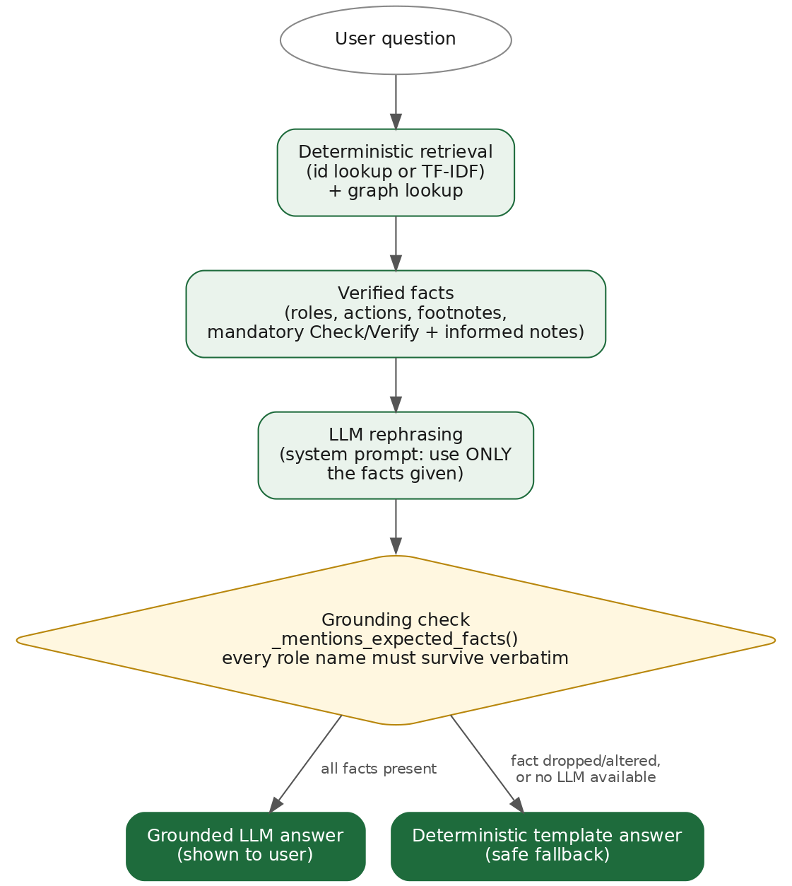
The AI talks. The matrix decides.
1
Facts come from the graph
The LLM never sees the whole document, only the retrieved node.
2
Strict prompt, low temperature
It may rephrase. It may not add a role.
3
Grounding check
If an expected role is missing from the answer, we discard it.
4
Deterministic fallback
Groq, Ollama or no LLM at all: the answer is always available.
Business
Data
Preparation
Modeling
Evaluation
Deployment
Notes:
[6:30-7:30] MODELING, part 2. This is the slide that answers 'why should we trust it'. Be candid about the limit: the grounding check verifies required roles are present, it does not yet detect an added role. That is on the roadmap. Mention hybrid LLM: Groq in the cloud by default, Ollama locally for data that must not leave the machine.

Slide 8

See it work: ask like a human
In this clip
"who approves 2.126"
Same answer from a plain description
Typos? Still right
French question, French answer
"what happens with 9.999.999": honest refusal
DEMO 1: the core agent
Insert screen recording here · 0:50
Business
Data
Preparation
Modeling
Evaluation
Deployment
Notes:
[7:30-9:00] DEMO 1, about 50 seconds of video. Talk over it live, do not let it play silently. Point at: the Check/Verify and informed parties are added automatically; the language badge; the refusal. If the video fails, you have the live app as a backup (Auto mode, hosted instance already warmed up).

Slide 9
Built for a team, not just a demo
In this clip
Sign in, history saved per user
Share a conversation by QR code
Voice question, spoken answer
Upload a document and ask about it
KPI dashboard by chapter
DEMO 2: the platform
Insert screen recording here · 0:50
Business
Data
Preparation
Modeling
Evaluation
Deployment
Notes:
[9:00-10:30] DEMO 2, about 50 seconds of video. Features beyond Q&A: auth, sharing with live notifications, voice via Whisper, attachments (PDF, Word, images through a vision model), dashboard. Pick two to talk about, not all five.

Slide 10
Tested, broken, fixed, tested again
137
Bug found | Fix
Invalid code matched an unrelated task | Explicit invalid-id outcome
Note parser stripped digits before hyphens | Pattern corrected, references followed
Action questions swallowed by follow-up logic | Intent checked before context carry-over
LLM answers rejected too often | Grounding check tuned, fallback kept
Free hosting ran out of memory | Nodes cached at build time
automated tests, parser to API
Real bugs, found by testing real questions
Not hidden. Each one became a regression test.
Next: a benchmark of gold questions to put a precision figure on the agent.
Business
Data
Preparation
Modeling
Evaluation
Deployment
Notes:
[10:30-12:00] EVALUATION. Be honest and confident: the jury respects a student who names the limit. 137 tests is a code-quality number, not an accuracy number. Say so, then say the next step is a gold set of questions with expected roles to measure precision (answers the supervisor's KPI request). Pick two bugs and tell them as stories.

Slide 11



Shipped: secure, containerised, live
Docker
Cloud hosted
One command runs app, frontend and local LLM.
FastAPI + React, Postgres on Neon, files on S3-compatible storage.
Secure by design
Multilingual UI
bcrypt, JWT, rate-limited login, admin-only routes, Google and Microsoft sign-in.
The interface switches to the language you type in.
Business
Data
Preparation
Modeling
Evaluation
Deployment
Notes:
[12:00-13:00] DEPLOYMENT. One sentence per card. Mention honestly that rate limiting and real-time notifications are per-process today, and would move to Redis for multi-instance production.

Slide 12
What the Bank gets
Seconds instead of minutes.
Sources instead of guesses.
Now
Next
Later
Live product, 137 tests, four languages
Gold-question benchmark, stronger grounding check
Other Bank matrices, Redis for scale
Thank you. Questions?
Notes:
[13:00-14:00] CLOSE. Three sentences: what was built, what is honestly missing, what comes next. End on the value: seconds instead of minutes, sources instead of guesses. Then stop talking and invite questions. Total 14 minutes leaves a 1 minute buffer under the 15 minute limit.

