Slide 1
PRE-DEFENSE · PFE 2026
Ask the DAM.
Get the answer.
With proof.
An AI agent that turns the African Development Bank's Delegation of Authority Matrix into instant, grounded answers
Adem Mrabet · Polytech Intl · Supervisor: [name]
Notes:
SPEECH - Title (0:00 to 0:45)
Good morning, everyone. My name is Adem Mrabet, and I am a student at Polytech International.
Imagine you are a new employee at the African Development Bank. You need to know who has to approve a mission program. The answer exists, but it sits in a document of 79 pages. Now imagine you type your question, and two seconds later you get the answer, with its source.
That is what I built during my internship, from April to October: an AI agent that turns the Bank's Delegation of Authority Matrix into instant, trustworthy answers.
I will walk you through the project following the six phases of CRISP-DM, and you will see the product live twice. Let's start with the problem.

Slide 2



A 79-page matrix nobody can search
Who approves? Who checks? Who must be informed?
Minutes lost, every time
A wrong answer has a price
Every task in the DAM has an answer, but it is buried in a dense PDF table.
Staff scroll, cross-reference footnotes and ask colleagues, who may also guess.
An unapproved decision is a governance and compliance risk for a development bank.
Generic chatbots cannot be the answer: they invent roles that sound right.
Business
Data
Preparation
Modeling
Evaluation
Deployment
Notes:
SPEECH - The problem (0:45 to 1:45)
The document is called the Delegation of Authority Matrix, or DAM. For every task in the Bank, it says who initiates it, who approves it, who checks it, and who must be informed.
[Point to the three cards, one at a time.]
First, the questions are simple: who approves? who checks? who is informed? But the answers are buried in a dense 79-page table.
Second, this costs time. People scroll, follow footnotes, and ask colleagues, who sometimes guess.
Third, and this is the important one, a wrong answer has a price. If someone thinks they have the authority to approve something and they do not, that is a governance and compliance risk.
You may think: why not use ChatGPT? Because a generic chatbot invents roles that sound right. In a bank, "sounds right" is not good enough. So the real challenge was not building a chatbot. It was building an assistant that never says something the document does not say.

Slide 3
Our promise, in three measurable goals
Precise
Success looks like
1
Every answer traces to a node of the DAM. No source, no answer.
Right role,
right level,
right footnote.
Instant
2
Natural language, typos and four languages: French, Spanish, Portuguese, Arabic.
Not a demo that sounds smart: an assistant a Bank employee can rely on.
Trusted
3
Honest refusal when the question is outside the document.
Business
Data
Preparation
Modeling
Evaluation
Deployment
Notes:
SPEECH - Objectives (1:45 to 2:30)
I translated this into three goals.
One: precise. Every answer must trace back to a specific task in the matrix. No source, no answer.
Two: instant. You can ask in natural language, you can make typos, and you can write in French, Spanish, Portuguese or Arabic.
Three: trusted. If the question is outside the document, the agent says so honestly.
My definition of success is simple: the right role, the right level, the right footnote. Not a demo that sounds smart, but an assistant a Bank employee can rely on.

Slide 4
Inside the document: 327 nodes, 132 roles, 2,108 links
327
132
2,108
Dirty data in,
wrong answer out.
nodes parsed from the PDF: tasks, processes, chapters
distinct roles, linked to the tasks they act on
links: 1,776 role-to-task, 322 hierarchy, 10 refs
What made it hard
So the real work of this project was the data, not the model.
Footnote digits look like level digits once text is extracted
Rows split across pages, merged cells hide roles
Tasks point to each other: "See 1.117.2"
Business
Data
Preparation
Modeling
Evaluation
Deployment
Notes:
SPEECH - Data understanding (2:30 to 3:30)
Now the data. The matrix is a PDF. After parsing, it contains 327 nodes: 3 chapters, 35 processes, 138 tasks, 102 child tasks and 49 threshold variants. Add the 132 distinct roles and the graph has 459 vertices and 2,108 relationships, with action codes such as Initiate, Check and Verify, Review, Approve and Informed.
It was harder than it looks. Let me give you one example. In the PDF, a footnote number is printed as a small superscript next to a level number. When you extract the text normally, the footnote "1" next to the level "2" becomes "21". The text is wrong, and nothing warns you.
Also, rows are split across pages, merged cells hide roles, and tasks point to each other, for example "see 1.117.2".
Dirty data in, wrong answer out. So most of the real work of this project was on the data, not on the AI model.

Slide 5
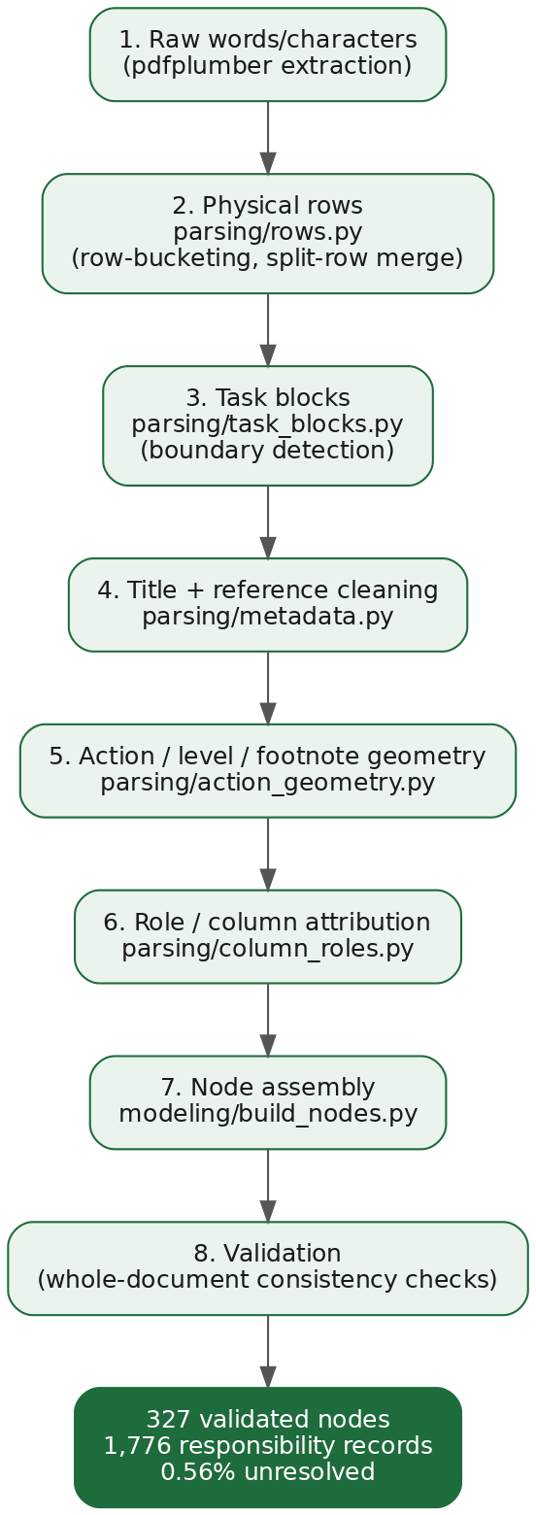
From a PDF to a clean, typed knowledge base
1
Read characters, not words
pdfplumber exposes size and position, so footnotes are told apart from levels.
2
Rebuild rows and task blocks
Merged and split rows are reassembled into one task each.
3
Validate with Pydantic
Typed contract between parser and graph: bad data fails loudly.
4
Cache as nodes.json
Parse once at build time, so the free hosting tier does not run out of memory.
Business
Data
Preparation
Modeling
Evaluation
Deployment
Notes:
SPEECH - Data preparation (3:30 to 5:00)
Here is how I turned the PDF into a clean knowledge base, in four steps.
Step one: I read characters, not words. The library pdfplumber gives me the size and position of every character, so I can tell a footnote from a level.
Step two: I rebuild the rows and group them into one block per task, which fixes the split and merged rows.
Step three: every task is validated with Pydantic. It is a typed contract between the parser and the rest of the system. If the data is wrong, it fails loudly instead of silently.
Step four: I save the result as a cached file. Why? Because during deployment on the free hosting tier, parsing the PDF at every start ran out of memory. I parsed once at build time, and the problem disappeared.
Each tool was chosen for one reason, not because it was popular.

Slide 6
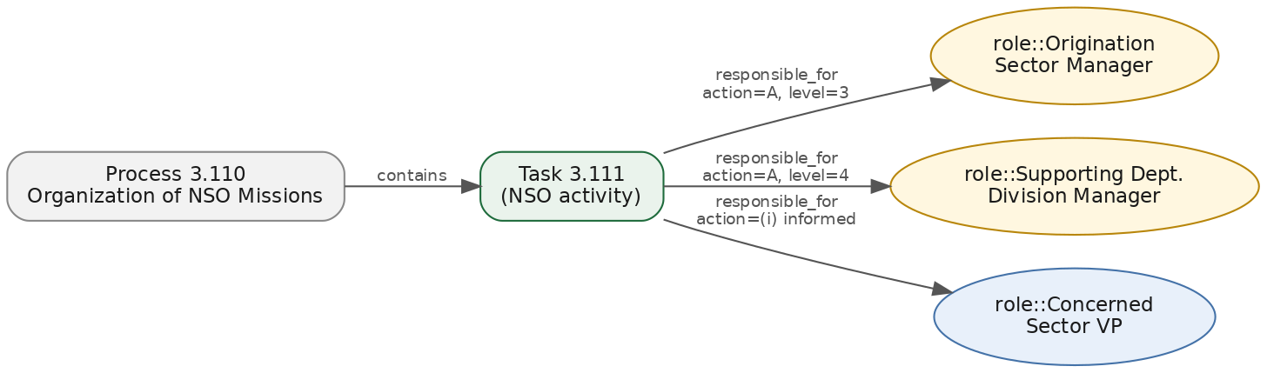
A graph that knows who does what
NetworkX
MultiDiGraph
Parallel edges: one role can act on one task in several ways.
Exact
Semantic
Honest
Type 2.126: resolved with certainty, confidence 1.0.
Describe the task: TF-IDF finds it, with an explainable score.
Unknown id: it says so instead of guessing.
Business
Data
Preparation
Modeling
Evaluation
Deployment
Notes:
SPEECH - Modeling, the graph and retrieval (5:00 to 6:30)
Now the modeling. The 327 nodes and 132 roles are stored in a graph, using NetworkX. A task is connected to the roles that act on it, and the connection says how: responsible, level, action code. One role can act on one task in several ways, so I use a multi-graph that allows parallel links.
When a question arrives, there are three possible outcomes. [Point to the three cards.]
Exact: if you type an id like 2.126, it is resolved with certainty.
Semantic: if you describe the task, I use TF-IDF to find it. I chose it over embeddings for three reasons: titles are short and keyword-rich, it needs no GPU and no labelled data, and I can explain every score.
Honest: if the id does not exist, the agent says so, instead of guessing.
Typos are corrected with a deterministic method based on string similarity, so it also works offline.

Slide 7
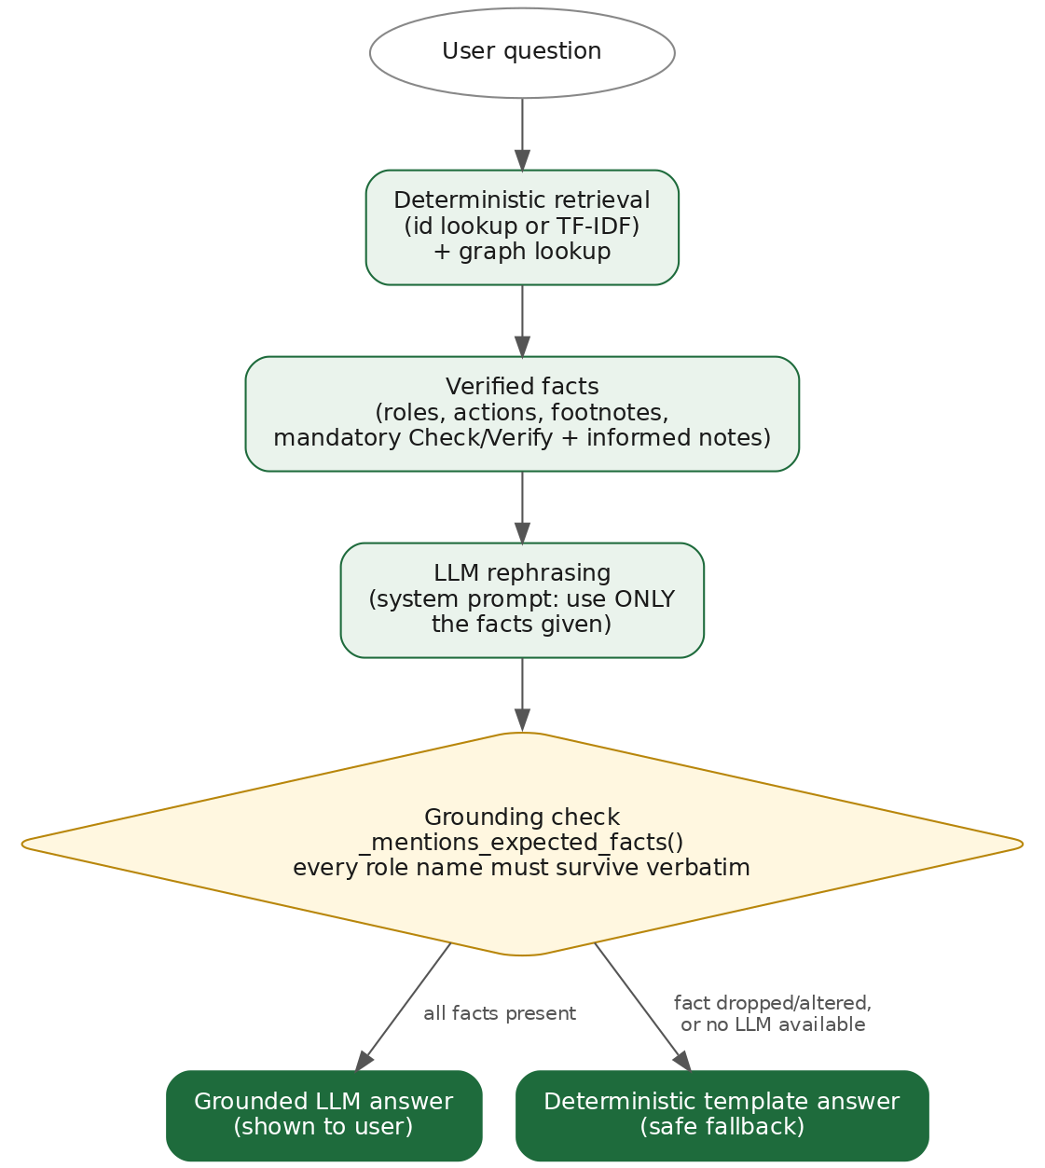
The AI talks. The matrix decides.
1
Facts come from the graph
The LLM never sees the whole document, only the retrieved node.
2
Strict prompt, low temperature
It may rephrase. It may not add a role.
3
Grounding check
If an expected role is missing from the answer, we discard it.
4
Deterministic fallback
Groq, Ollama or no LLM at all: the answer is always available.
Business
Data
Preparation
Modeling
Evaluation
Deployment
Notes:
SPEECH - Modeling, grounded AI (6:30 to 7:30)
This is the slide that answers: why should we trust it?
The language model never reads the whole document. It receives only the facts of the task that was retrieved. Its prompt is strict, with a low temperature: it may rephrase, it may not add a role.
Then a grounding check compares the answer with the facts. If an expected role is missing, I throw the answer away and return a deterministic template answer instead. So the user always gets a correct answer, even if the language model is down.
I want to be honest about one limit: today, the check verifies that the required roles are present. It does not yet detect an extra role that was added. That is my first improvement.
The system is hybrid: Groq in the cloud by default, and Ollama locally for cases where data must not leave the machine.

Slide 8

See it work: ask like a human
In this clip
"who approves 2.126"
Same answer from a plain description
Typos? Still right
French question, French answer
"what happens with 9.999.999": honest refusal
DEMO 1: the core agent
Insert screen recording here · 0:50
Business
Data
Preparation
Modeling
Evaluation
Deployment
Notes:
SPEECH - Demo 1: landing, login, chat (7:30 to 9:00)
[Landing page appears. Let the animation play for two seconds.]
"This is the landing page of the application. Two entry points: the Chat, where you ask questions, and the Dashboard, where you see the matrix at a glance."
[Click the Chat card. The login page appears.]
"Both are protected. When I click Chat, I am asked to sign in, because this tool is for Bank staff. I can use my email, or Google, or Microsoft."
[Sign in. The chat opens.]
"I am in. LLM mode is on Auto, and my conversations are saved to my account. Let's ask a first question."
[Type `who approves 2.126`, press Enter.]
"Who approves task 2.126?"
[Answer appears. Move the cursor over the approver, then the Check/Verify and informed lines.]
"The agent names the approver. And look: it also tells me who must check and verify, and who must be informed. In the matrix, those steps are mandatory, so the agent shows them every time, even if I only asked about the approver."
[Type `who needs to be informed for quarterly mission program`.]
"Now I do not give an id. I describe the task in words."
[Answer appears.]
"Same task, found from its name."
[Type `who aproves the qaurterly mision program`.]
"Now with two typos."
[Answer appears.]
"Same correct answer. The correction is deterministic, so it works even offline."
[Type the French question. Show the language badge.]
"And in French. The answer comes in French, and the interface follows."
[Type `what happens with 9.999.999`.]
"One last question, an id that does not exist."
[Refusal appears. Pause two seconds.]
"The agent refuses. It does not guess. This refusal is a feature, not a failure: every real answer must come from a real row of the matrix."
Bridge: "That is the agent. Now let's see the rest of the platform."

Slide 9
Built for a team, not just a demo
In this clip
Sign in, history saved per user
Share a conversation by QR code
Voice question, spoken answer
Upload a document and ask about it
KPI dashboard by chapter
DEMO 2: the platform
Insert screen recording here · 0:50
Business
Data
Preparation
Modeling
Evaluation
Deployment
Notes:
SPEECH - Demo 2: platform and dashboard (9:00 to 10:30)
[Still in the chat. Open the conversation sidebar.]
"Every conversation is saved in the sidebar, so a user can come back to it later."
[Click Share. The QR code appears.]
"I can share a conversation with a colleague through a QR code. They scan it, and they are notified live."
[Close the modal. Click the mic, ask a question aloud, then click speak-aloud on the answer.]
"I can ask by voice, and have the answer read back to me. This helps staff who are on the move."
[Attach the test file, ask a question about it.]
"And I can upload a document, for example a Word file or a PDF, and ask questions about it."
[Go back to the landing page. Click the Dashboard card. If the login page appears, sign in again.]
"Back on the landing page, I now click Dashboard. The same protection applies: access is only for authenticated users."
[Dashboard opens. Pick a chapter in the filter.]
"The dashboard gives a view of the whole matrix. I can filter by chapter, and every card and chart updates."
[Click a bar in the action-code chart. The roles chart changes.]
"If I click an action code, for example Approve, I see which roles approve the most. And these two coverage indicators are real data-quality signals about the extraction: the average responsibilities per task, and the share of tasks with no direct responsibility."
Bridge: "So we have a working product. The next question is: how do I know it is correct? Let's talk about evaluation."

Slide 10
Tested, broken, fixed, tested again
137
Bug found | Fix
Invalid code matched an unrelated task | Explicit invalid-id outcome
Note parser stripped digits before hyphens | Pattern corrected, references followed
Action questions swallowed by follow-up logic | Intent checked before context carry-over
LLM answers rejected too often | Grounding check tuned, fallback kept
Free hosting ran out of memory | Nodes cached at build time
automated tests, parser to API
Real bugs, found by testing real questions
Not hidden. Each one became a regression test.
Next: a benchmark of gold questions to put a precision figure on the agent.
Business
Data
Preparation
Modeling
Evaluation
Deployment
Notes:
SPEECH - Evaluation (10:30 to 12:00)
Now, evaluation. I have 137 automated tests covering the parser, the graph, the agent, authentication and the API.
But I will be clear: 137 tests measure code quality, not answer accuracy.
What taught me the most were real bugs, found by testing real questions. [Point to the table, pick two.]
For example, an invalid code was matching an unrelated task. Now it returns an explicit "invalid id" result. Another: questions about action codes were swallowed by my follow-up logic, so I now check the intent first. And as I said, the free hosting ran out of memory, so I cached the parsed data. Every bug became a regression test.
The next step is a benchmark: a set of questions with the expected roles, to give you a precision figure. I already know how to build it, and it is the first thing I would do next.

Slide 11



Shipped: secure, containerised, live
Docker
Cloud hosted
One command runs app, frontend and local LLM.
FastAPI + React, Postgres on Neon, files on S3-compatible storage.
Secure by design
Multilingual UI
bcrypt, JWT, rate-limited login, admin-only routes, Google and Microsoft sign-in.
The interface switches to the language you type in.
Business
Data
Preparation
Modeling
Evaluation
Deployment
Notes:
SPEECH - Deployment (12:00 to 13:00)
For deployment, everything is containerized with Docker: one command starts the application, the frontend and the local model.
In the cloud, the backend is FastAPI, the frontend is React, the database is Postgres on Neon, and files are stored on S3-compatible storage.
Security: hashed passwords, tokens, rate-limited login, admin-only routes.
And the interface adapts to the language the user types in.
One honest remark: rate limiting and live notifications work per process today. For several servers, I would move them to Redis.

Slide 12
What the Bank gets
Seconds instead of minutes.
Sources instead of guesses.
Now
Next
Later
Live product, 137 tests, four languages
Gold-question benchmark, stronger grounding check
Other Bank matrices, Redis for scale
Thank you. Questions?
Notes:
SPEECH - Conclusion (13:00 to 14:00)
To conclude. What did the Bank get? A live product, tested, in four languages. What is missing? A precision benchmark and a stronger grounding check. What comes next? Other Bank matrices, and a scalable setup.
Seconds instead of minutes. Sources instead of guesses.
Thank you for your attention. I am happy to answer your questions.

