Slide 1
PRE-DEFENSE · PFE 2026
Ask the DAM.
Get the answer.
With proof.
An AI agent that turns the African Development Bank's Delegation of Authority Matrix into instant, grounded answers
Adem Mrabet · Polytech Intl · Supervisor: [name]
Notes:
SPEECH - Title (0:00 to 0:40)
Good morning, everyone. My name is Adem Mrabet, and I am a student at Polytech International.
Imagine you are a new employee at the African Development Bank. You need to know who has to approve a mission program. The answer sits in a document of 79 pages. Now imagine you type your question, and two seconds later you get the answer, with its source.
That is what I built during my internship: an AI agent that turns the Bank's Delegation of Authority Matrix into instant, trustworthy answers.
I will follow the six phases of CRISP-DM, and you will see the product live. Let's start with the problem.

Slide 2



A 79-page matrix nobody can search
Who approves? Who checks? Who must be informed?
Minutes lost, every time
A wrong answer has a price
Every task in the DAM has an answer, but it is buried in a dense PDF table.
Staff scroll, cross-reference footnotes and ask colleagues, who may also guess.
An unapproved decision is a governance and compliance risk for a development bank.
Generic chatbots cannot be the answer: they invent roles that sound right.
Business
Data
Preparation
Modeling
Evaluation
Deployment
Notes:
SPEECH - The problem (0:40 to 1:30)
The Delegation of Authority Matrix, or DAM, says for every task who initiates it, who approves it, who checks it, and who must be informed.
[Point to the three cards.]
The questions are simple, but the answers are buried in a dense 79-page table. People scroll, follow footnotes, and ask colleagues, who sometimes guess. And a wrong answer has a price: if someone thinks they can approve something and they cannot, that is a governance and compliance risk.
You may think: why not ChatGPT? Because a generic chatbot invents roles that sound right. In a bank, "sounds right" is not good enough. So the challenge was to build an assistant that never says something the document does not say.

Slide 3
Our promise, in three measurable goals
Precise
Success looks like
1
Every answer traces to a node of the DAM. No source, no answer.
Right role,
right level,
right footnote.
Instant
2
Natural language, typos and four languages: French, Spanish, Portuguese, Arabic.
Not a demo that sounds smart: an assistant a Bank employee can rely on.
Trusted
3
Honest refusal when the question is outside the document.
Business
Data
Preparation
Modeling
Evaluation
Deployment
Notes:
SPEECH - Objectives (1:30 to 2:05)
Three goals. Precise: every answer traces back to a task in the matrix. Instant: natural language, typos, and four languages, French, Spanish, Portuguese and Arabic. Trusted: if the question is outside the document, the agent says so.
Success means the right role, the right level, the right footnote. Not a demo that sounds smart, but an assistant a Bank employee can rely on.

Slide 4
Inside the document: 327 nodes, 132 roles, 2,108 links
327
132
2,108
Dirty data in,
wrong answer out.
nodes parsed from the PDF: tasks, processes, chapters
distinct roles, linked to the tasks they act on
links: 1,776 role-to-task, 322 hierarchy, 10 refs
What made it hard
So the real work of this project was the data, not the model.
Footnote digits look like level digits once text is extracted
Rows split across pages, merged cells hide roles
Tasks point to each other: "See 1.117.2"
Business
Data
Preparation
Modeling
Evaluation
Deployment
Notes:
SPEECH - Data understanding (2:05 to 2:55)
The matrix is a PDF. After parsing, it contains 327 nodes: chapters, processes, tasks, child tasks and threshold variants. Add the 132 distinct roles, and the graph has 459 vertices and 2,108 relationships.
It was harder than it looks. In the PDF, a footnote is a small superscript next to a level number. Extract the text normally and the footnote "1" next to the level "2" becomes "21". Nothing warns you. Rows are also split across pages, and tasks point to each other, like "see 1.117.2".
Dirty data in, wrong answer out. Most of the real work was on the data, not on the AI model.

Slide 5
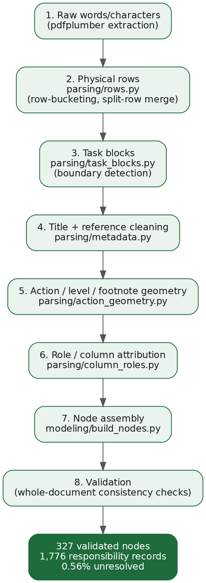
From a PDF to a clean, typed knowledge base
1
Read characters, not words
pdfplumber exposes size and position, so footnotes are told apart from levels.
2
Rebuild rows and task blocks
Merged and split rows are reassembled into one task each.
3
Validate with Pydantic
Typed contract between parser and graph: bad data fails loudly.
4
Cache as nodes.json
Parse once at build time, so the free hosting tier does not run out of memory.
Business
Data
Preparation
Modeling
Evaluation
Deployment
Notes:
SPEECH - Data preparation (2:55 to 4:10)
Four steps turn the PDF into a clean knowledge base.
One: I read characters, not words. The library pdfplumber gives the size and position of every character, so I can tell a footnote from a level.
Two: I rebuild the rows and group them into one block per task.
Three: every task is validated with Pydantic, a typed contract between the parser and the rest of the system. Wrong data fails loudly.
Four: I cache the result. On the free hosting tier, parsing the PDF at every start ran out of memory, so I parse once at build time.
Each tool was chosen for one reason, not because it was popular.

Slide 6
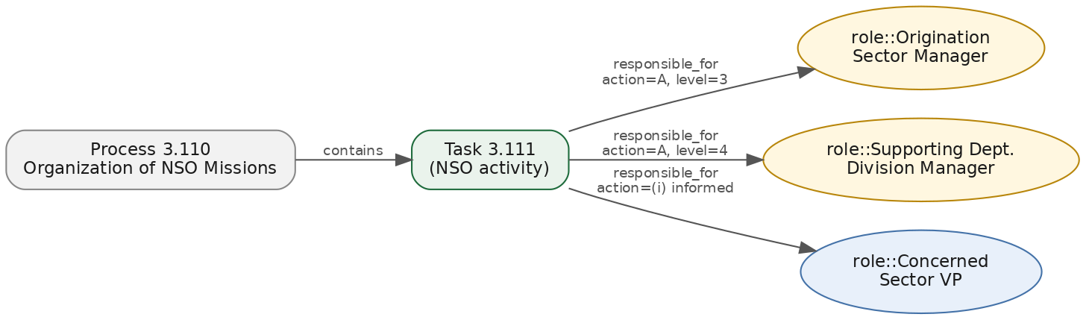
A graph that knows who does what
NetworkX
MultiDiGraph
Parallel edges: one role can act on one task in several ways.
Exact
Semantic
Honest
Type 2.126: resolved with certainty, confidence 1.0.
Describe the task: TF-IDF finds it, with an explainable score.
Unknown id: it says so instead of guessing.
Business
Data
Preparation
Modeling
Evaluation
Deployment
Notes:
SPEECH - Modeling, the graph and retrieval (4:10 to 5:25)
The nodes and roles are stored in a graph with NetworkX. A role is linked to a task, and the link carries the action code and the level. One role can act on a task in several ways, so I use a multi-graph with parallel links.
A question has three possible outcomes. [Point to the cards.]
Exact: an id like 2.126 is resolved with certainty.
Semantic: if you describe the task, TF-IDF finds it. I chose it over embeddings because titles are short and keyword-rich, it needs no GPU and no labelled data, and I can explain every score.
Honest: if the id does not exist, the agent says so.
Typos are corrected by a deterministic method, so it works offline.

Slide 7
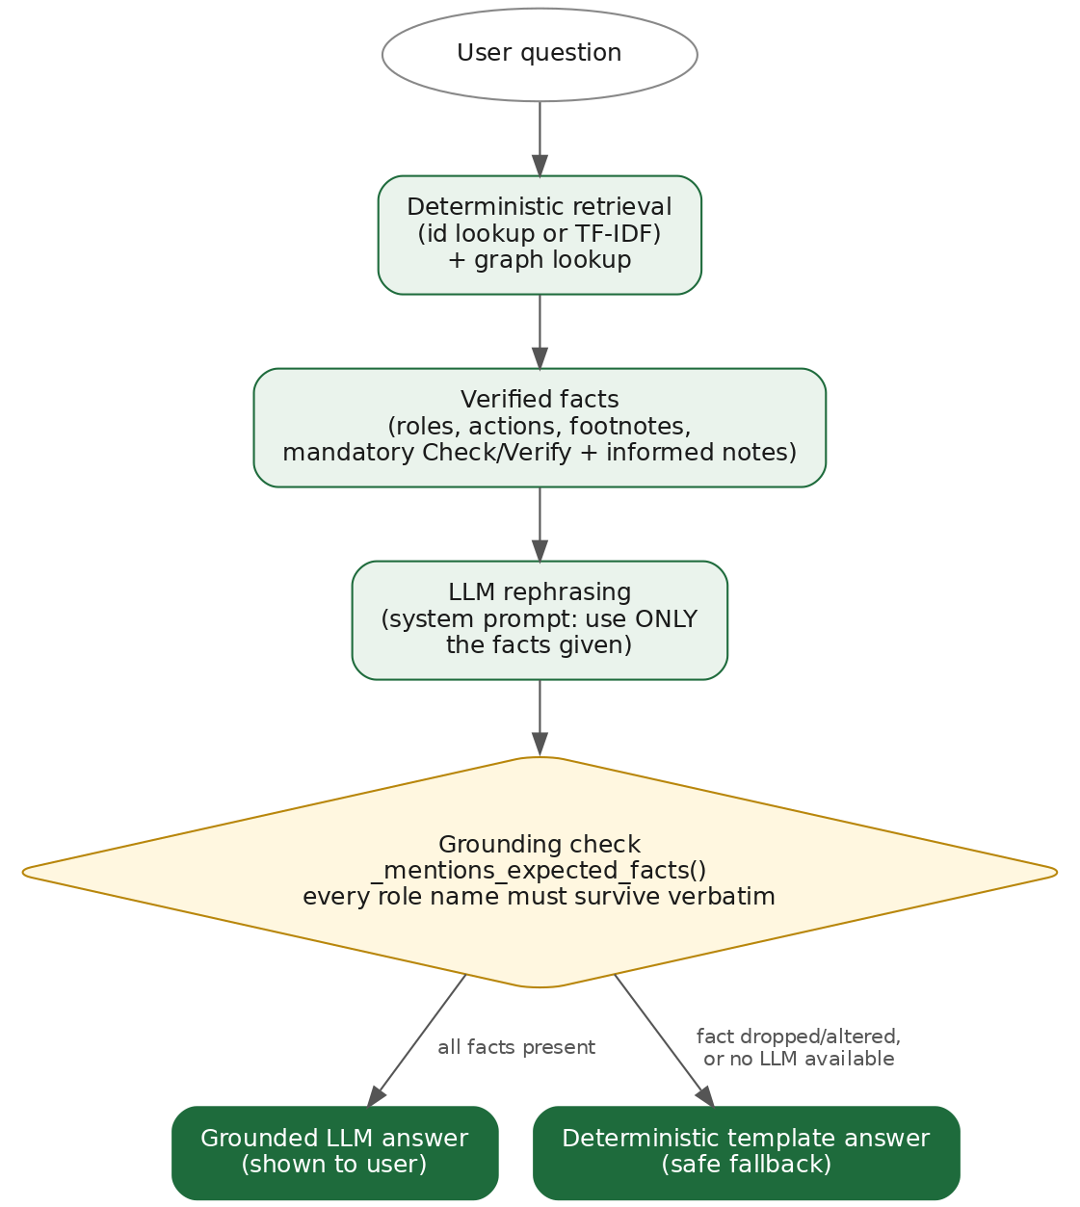
The AI talks. The matrix decides.
1
Facts come from the graph
The LLM never sees the whole document, only the retrieved node.
2
Strict prompt, low temperature
It may rephrase. It may not add a role.
3
Grounding check
If an expected role is missing from the answer, we discard it.
4
Deterministic fallback
Groq, Ollama or no LLM at all: the answer is always available.
Business
Data
Preparation
Modeling
Evaluation
Deployment
Notes:
SPEECH - Modeling, grounded AI (5:25 to 6:25)
This slide answers: why should we trust it?
The language model never reads the whole document. It receives only the facts of the retrieved task, with a strict prompt and a low temperature: it may rephrase, it may not add a role.
Then a grounding check compares the answer with the facts. If an expected role is missing, I discard the answer and return a deterministic template. So the user always gets a correct answer, even if the model is down.
One honest limit: the check verifies that required roles are present. It does not yet detect an added role. That is my first improvement.
The system is hybrid: Groq in the cloud by default, Ollama locally when data must not leave the machine.

Slide 8

See it work: one product, five minutes
In this clip
Landing page, protected login
Exact and natural-language questions
Typos, French, follow-ups, redirects
Honest refusal on a false id
QR sharing, voice, dashboard
LIVE DEMO
Insert screen recording here · 5:00
Business
Data
Preparation
Modeling
Evaluation
Deployment
Notes:
SPEECH - Live demo (6:25 to 11:25), one run, 5:00 maximum
## 0:00 to 0:35 Landing and login
[Landing page. Let the animation play two seconds.]
"This is the application. The landing page has two entry points: the Chat, where you ask questions, and the Dashboard, where you see the matrix at a glance."
[Click the Chat card. The login page appears.]
"Both are protected, because this tool is for Bank staff. I can sign in with email, or with Google, or Microsoft."
[Sign in. The chat opens.]
"I am in. Conversations are saved to my account, and the LLM mode is on Auto."
## 0:35 to 1:25 Exact question
[Type `who approves 2.126`, press Enter.]
"First question: who approves task 2.126?"
[Answer appears. Move the cursor over the approver, then over the Check/Verify and informed lines.]
"The agent names the approver. And look: it also tells me who must check and verify, and who must be informed. In the matrix, those steps are mandatory, so the agent shows them every time, even if I only asked about the approver. A new employee is never told half of the obligations."
## 1:25 to 2:00 Natural language
[Type `who needs to be informed for quarterly mission program`.]
"Now I do not give any id. I just describe the task."
[Answer appears.]
"Same task, found from its name. The agent understands what I describe, not only the codes I type."
## 2:00 to 2:30 Typos
[Type `who aproves the qaurterly mision program`.]
"Now with two typos."
[Answer appears.]
"Same correct answer. The correction is deterministic, based on the matrix's own vocabulary, so it works even offline."
## 2:30 to 3:05 French
[Type the French question. Show the language badge and the interface change.]
"And now in French. The answer comes in French, and the whole interface follows the language I write in. The role names are never translated, because they are official titles."
## 3:05 to 3:50 Follow-up and redirect
[Type `who approves of Communication with Co-Financiers of projects`. Then, without naming the subject: `and who are the informed parties?`]
"I ask about another task, and then I ask a follow-up without repeating the subject. The agent remembers what we were talking about, like a person would."
[Type `who initiates 1.117.2`.]
"This task contains only a pointer: 'see 2.120'. The agent follows the reference for me, like flipping to another page in the paper matrix."
## 3:50 to 4:10 Honest refusal
[Type `what happens with 9.999.999`. Pause two seconds on the refusal.]
"Last question: an id that does not exist. The agent refuses. It does not guess. This refusal is a feature, not a failure: every real answer must come from a real row of the matrix."
## 4:10 to 4:35 Sharing and voice
[Click Share, show the QR code. Close it. Click the mic, ask a short question, then click speak-aloud on the answer.]
"The platform is built for a team. I can share a conversation with a colleague through a QR code, and they are notified live. I can also ask by voice and hear the answer."
## 4:35 to 5:00 Dashboard
[Go back to the landing page, click the Dashboard card. If login appears again, sign in. Pick a chapter, then click an action bar.]
"Back to the landing page, now the Dashboard, with the same protection. I filter by chapter, and I click an action code to see which roles perform it most. That is the whole matrix at a glance."
Bridge: "So we have a working product. How do I know it is correct? Let's look at the evaluation."

Slide 9
Tested, broken, fixed, tested again
137
Bug found | Fix
Invalid code matched an unrelated task | Explicit invalid-id outcome
Note parser stripped digits before hyphens | Pattern corrected, references followed
Action questions swallowed by follow-up logic | Intent checked before context carry-over
LLM answers rejected too often | Grounding check tuned, fallback kept
Free hosting ran out of memory | Nodes cached at build time
automated tests, parser to API
Real bugs, found by testing real questions
Not hidden. Each one became a regression test.
Next: a benchmark of gold questions to put a precision figure on the agent.
Business
Data
Preparation
Modeling
Evaluation
Deployment
Notes:
SPEECH - Evaluation (11:25 to 12:55)
How do I know it works? I have 137 automated tests covering the parser, the graph, the agent, authentication and the API.
But I will be clear: 137 tests measure code quality, not answer accuracy.
What taught me the most were real bugs found by testing real questions. [Point to the table, pick two.] An invalid code was matching an unrelated task, and now it returns an explicit invalid-id result. Questions about action codes were swallowed by my follow-up logic, so I now check the intent first. Every bug became a regression test.
The next step is a benchmark: questions with expected roles, to give a precision figure.

Slide 10



Shipped: secure, containerised, live
Docker
Cloud hosted
One command runs app, frontend and local LLM.
FastAPI + React, Postgres on Neon, files on S3-compatible storage.
Secure by design
Multilingual UI
bcrypt, JWT, rate-limited login, admin-only routes, Google and Microsoft sign-in.
The interface switches to the language you type in.
Business
Data
Preparation
Modeling
Evaluation
Deployment
Notes:
SPEECH - Deployment (12:55 to 13:40)
Everything is containerized with Docker. In the cloud: FastAPI, React, Postgres on Neon, and S3-compatible file storage. Security: hashed passwords, tokens, rate-limited login, Google and Microsoft sign-in.
One honest remark: rate limiting and live notifications work per process today. For several servers, I would move them to Redis.

Slide 11
What the Bank gets
Seconds instead of minutes.
Sources instead of guesses.
Now
Next
Later
Live product, 137 tests, four languages
Gold-question benchmark, stronger grounding check
Other Bank matrices, Redis for scale
Thank you. Questions?
Notes:
SPEECH - Conclusion (13:40 to 14:25)
What did the Bank get? A live, tested product in four languages. What is missing? A precision benchmark and a stronger grounding check. What comes next? Other Bank matrices, and a scalable setup.
Seconds instead of minutes. Sources instead of guesses.
Thank you for your attention. I am happy to answer your questions.

