Slide 1
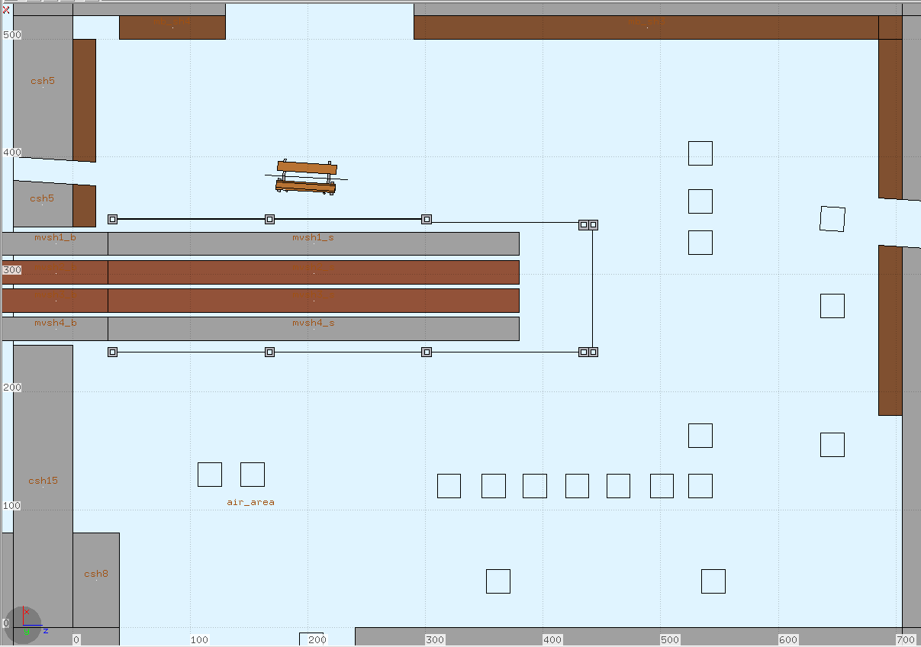
13
12
6
11
5
10
4
1
2
3
4
5
6
7
8
9
2
3

Slide 2
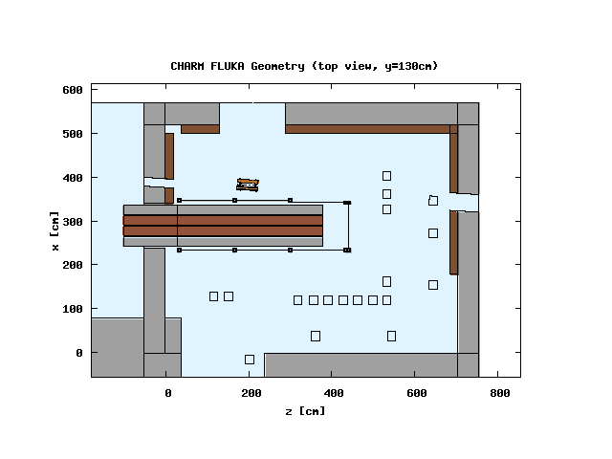
13
6
12
11
5
10
4
1
2
9
4
6
8
3
5
7
2
3
1

Slide 3
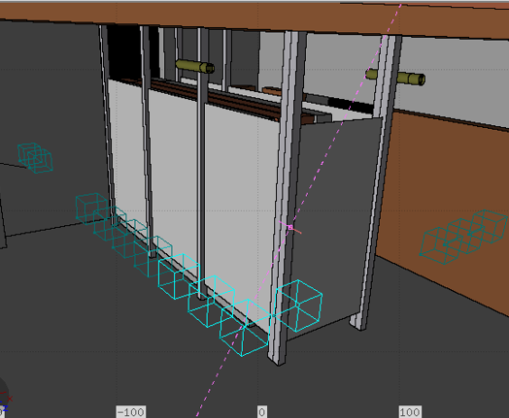
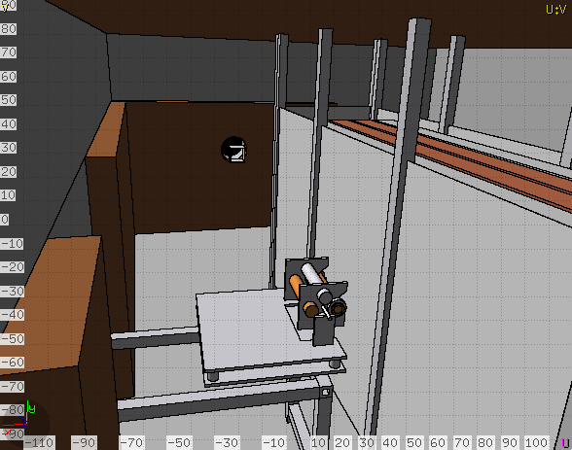
Test Positions
BLMs
24 GeV p+ Beam
Shielding
Target Table

Slide 4
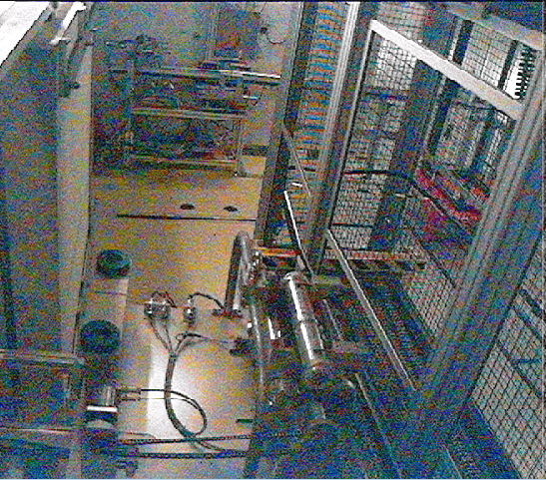

Slide 5
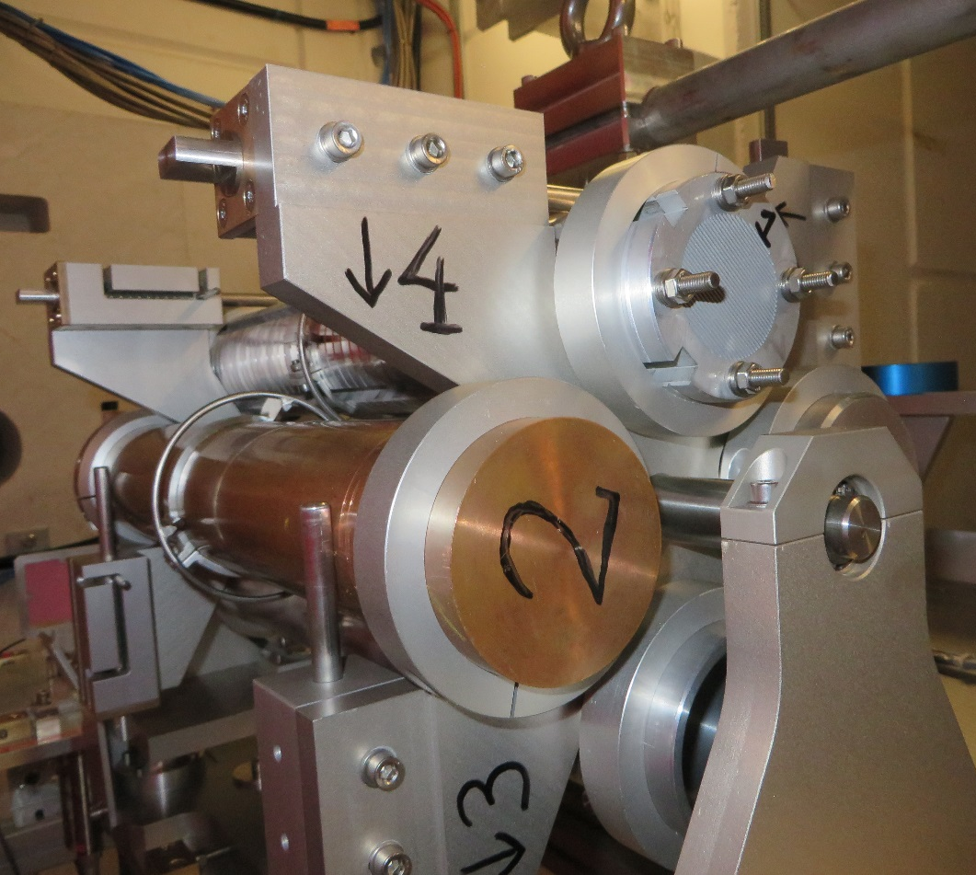
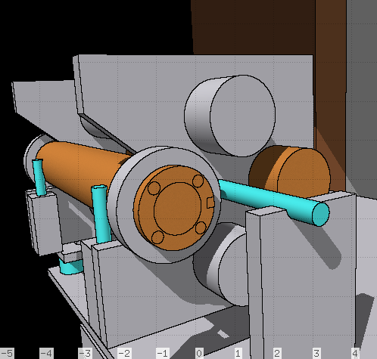

Slide 6
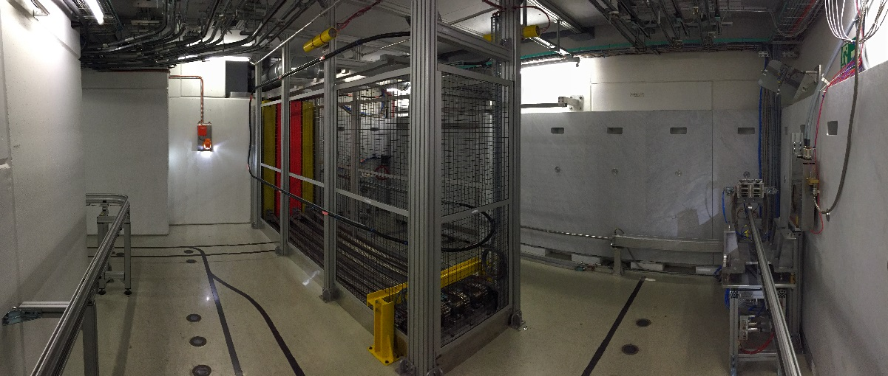
BLM
Montrac
AVT Path
Shielding

