Slide 1
Serverless Computing
Martin Boam
Solutions Architect @ West UC
@martinboam

Slide 2



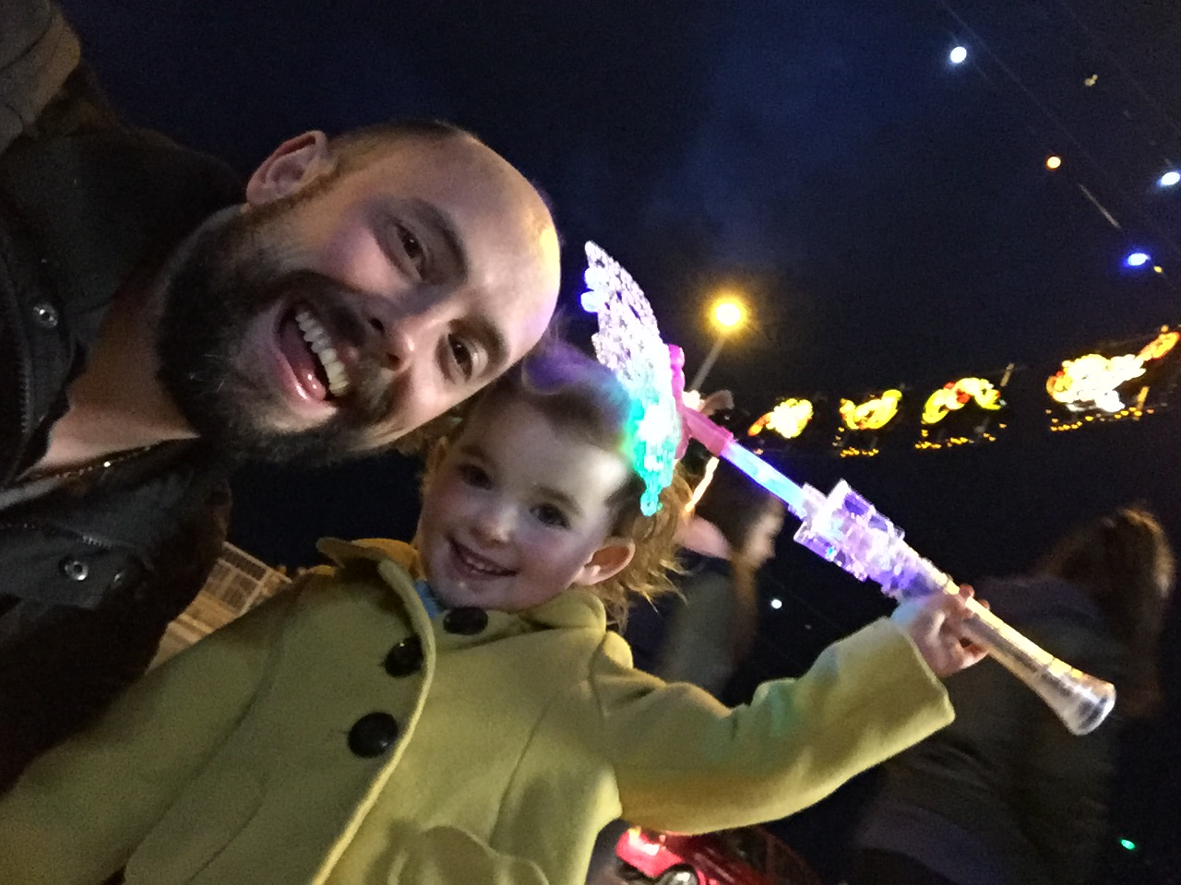
Who Am I?
Martin Boam
Microsoft Solutions Architect @ West Unified Communications
Husband, father of two and loves ripping out PBXs and desk phones to Skype for Business
I tweet from @martinboam
I blog at www.ucmart.uk
I run www.mshub.community
Email me martin.boam@ucmart.co.uk

Slide 3
Agenda
Evolution of Cloud and applications platforms
What is Serverless ?
Azure functions / Logic Apps / Event Grid
What can you do ?
Q&A – Ill try ☺

Slide 4
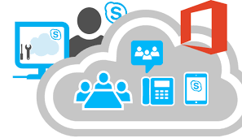
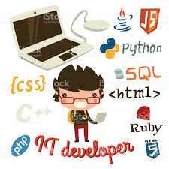
Warning
I do this
IT Dev – NooB!

Slide 5
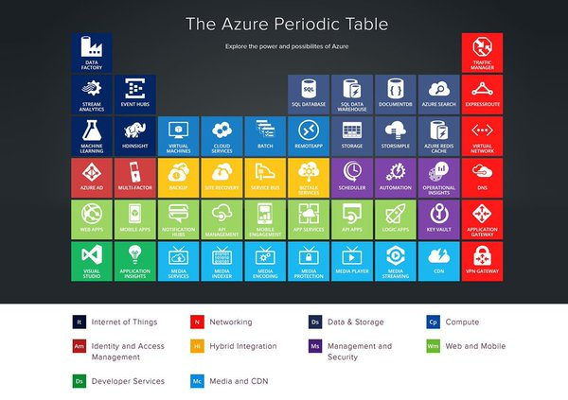
Azure !
There's quite
A bit in there!

Slide 6
Serverless ???
What does this mean ?
Any ideas ?

Slide 7

Serverless – Really ?
The term ‘Serverless’ is confusing as serverless applications there have both server hardware and processes running somewhere!
The difference is that you are not looking after the hardware or the processes – Someone else does this!

Slide 8

Evolution of Cloud and applications platforms
There is
On-premises – Traditional IT
IaaS – Infrastructure as a service
PaaS – Platform as a service / Containers
Serverless
Notes:
Understand the applications
Serverless may not be everyone

Slide 9
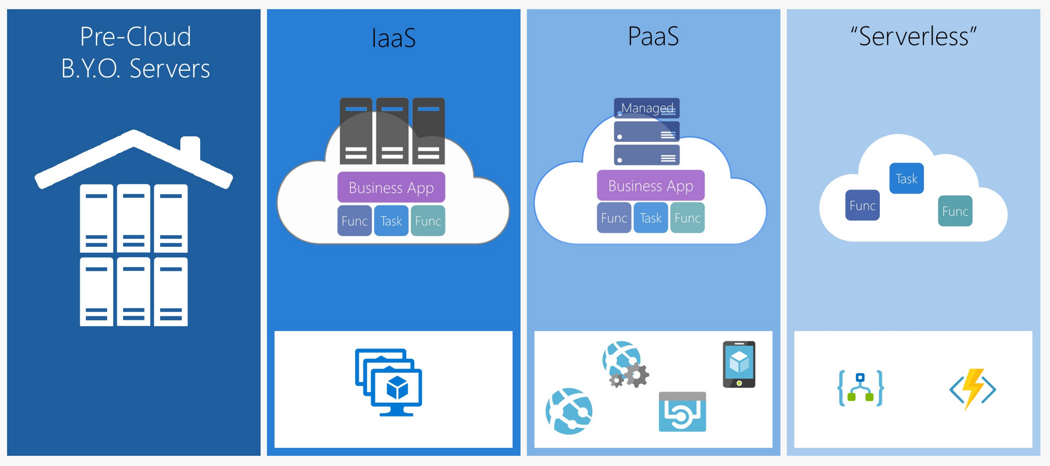
https://dzone.com/articles/what-is-function-as-a-service-serverless-architect

Slide 10
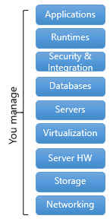
On-premises – Manage your own infrastructure
We need to think about a lot of things!
Physical datacentres
Hardware – How many servers ?
Physical / Virtual servers
Storage
Network
Monitoring
Backups
Scaling
Availability
Security
Power
Cooling
Deployment of Applications and code
Operating Systems
Updates

Slide 11
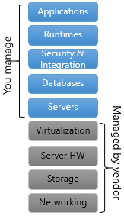
IaaS – Infrastructure as a service – Azure VM
Instead of managing hardware yourself let Cloud providers do this for you.
IaaS gives you a server in the cloud (virtual machine) that you have complete control over.
But with IaaS your still responsible for some stuff!
Deploying virtual servers
Operating System Updates and patching
Software & applications
Security
But don’t worry about these bits!
Virtualization platform
Serer Hardware
Storage Disks and Backups
Networking & Power

Slide 12
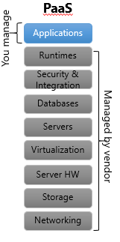
PaaS –Platform as a service – Azure Cloud Services/Websites/DB
PaaS is a complete development and deployment environment in the cloud
No management of servers or hardware required but there's still servers required and always there
Scale apps by thresholds on metrics like http transactions on a website
Ability Scale up and down on metrics
Even with PaaS you still need to think about
Metrics / Plans P1 P2
Scale
Run times
Notes:
Databases – DTU – database transactions units
Compute power,
When deployed as PaaS, an application is typically running on at least one server at all times. With FaaS, it may not be running at all until the function needs to be executed. It starts the function within a few milliseconds and then shuts it down.

Slide 13
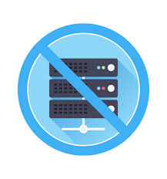
Serverless – Azure Functions / Logic Apps
Serverless computing is the abstraction of servers, infrastructure and operating systems.
Driven by the reaction to events and triggers!
As a fully managed service, server management and capacity planning are invisible to the developer !!! The Devs don’t care about the tin! ☺
Billing based just on resources consumed or the actual time your code is running.
Manage and focus on your apps instead of infrastructure !

Slide 14
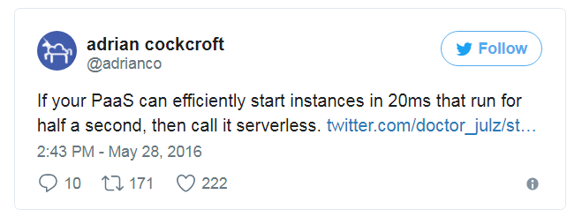
How is Serverless different to PaaS ?
I hope this helps in a tweet
Most PaaS applications are not geared towards bringing entire applications up and down for every request BUT serverless can
Also serverless if referenced (Function as a service (FaaS)
Backend as a server (BaaS)

Slide 15

The Next step in the evolution of building applications in the cloud
IaaS - pay for all the machine whilst its running
PaaS – Planning required for scale and pay for scalability and servers required to be available
Serverless does this for you !
Code/App dormant until triggered

Slide 16
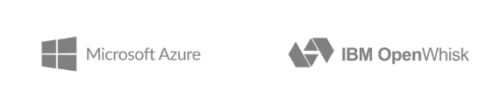
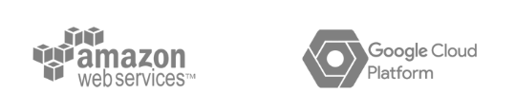
Providers
AWS Lambda
Azure Functions
Google Cloud Functions
Iron.io
Webtask.io

Slide 17
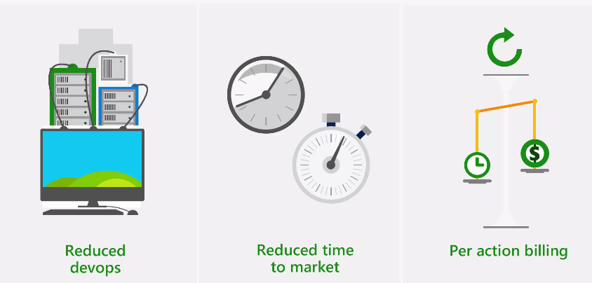
Benefits of Serverless

Slide 18
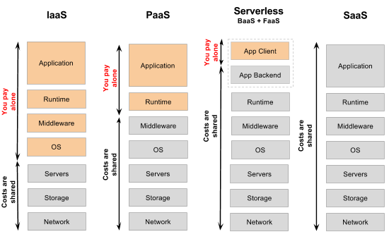
Billing Differences
https://specify.io/concepts/serverless-baas-faas

Slide 19
More Benefits of Serverless
Automatically Scales – based on load and requests
Focus on business logic – Not focus on hardware and software requirements
Faster time to market – running focused code faster

Slide 20
Serverless Components in Azure
Three core components
Functions – Serverless Compute
Logic Apps – Serverless Workflow
Event Grid – Serverless Events
Notes:
Logic apps – visually design a workflow (Microsoft Flow)
Event Grid – message routing service, publish events to parts of Azure
Built into the DNS of Azure, let me when new web service added, new record in DB, custom events

Slide 21
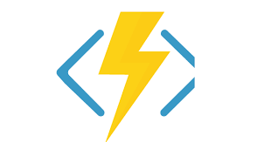
Azure Functions
Azure Functions lets you execute your code in a serverless environment without having to first create a VM or publish a web application.
Merger of Code + Events + Data
Triggers and Bindings – define how a function is invoked and what data it works with
Triggers - way to trigger code to run
Input and Output Bindings - provide a declarative way to connect to data from within your code

Slide 22
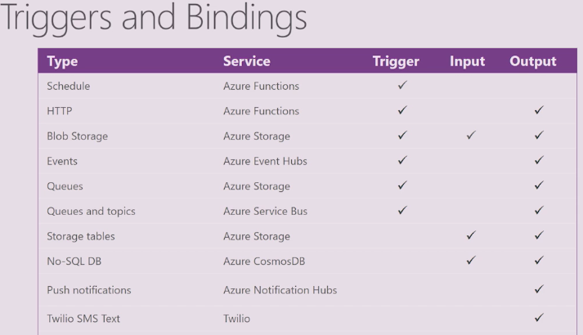
Trigger Examples

Slide 23
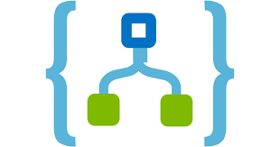
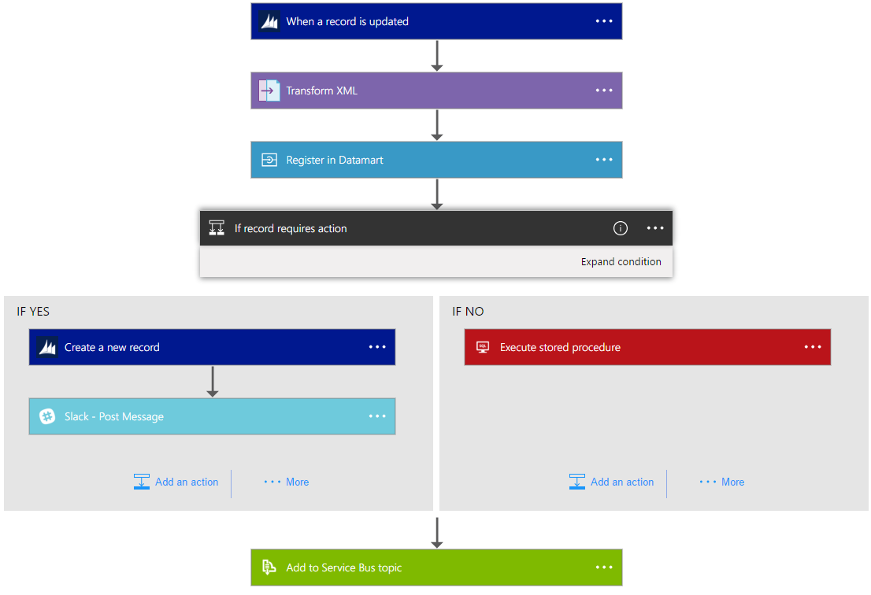
Azure Logic Apps
Logic Apps provide a way to simplify and implement scalable integrations and workflows in the cloud.
It provides a visual designer to model and automate your process as a series of steps known as a workflow.
Notes:
The advantages of using Logic Apps include the following:
Saving time by designing complex processes using easy to understand design tools
Implementing patterns and workflows seamlessly, that would otherwise be difficult to implement in code
Getting started quickly from templates
Customizing your logic app with your own custom APIs, code, and actions
Connect and synchronise disparate systems across on-premises and the cloud
Build off of BizTalk server, API Management, Azure Functions, and Azure Service Bus with first-class integration support

Slide 24

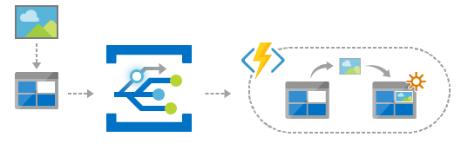
Event Grid
Azure Event Grid allows you to easily build applications with event-based architectures
Event Grid connects data sources and event handlers.
For example, use Event Grid to instantly trigger a serverless function to run image analysis each time a new photo is added to a blob storage container.

Slide 25
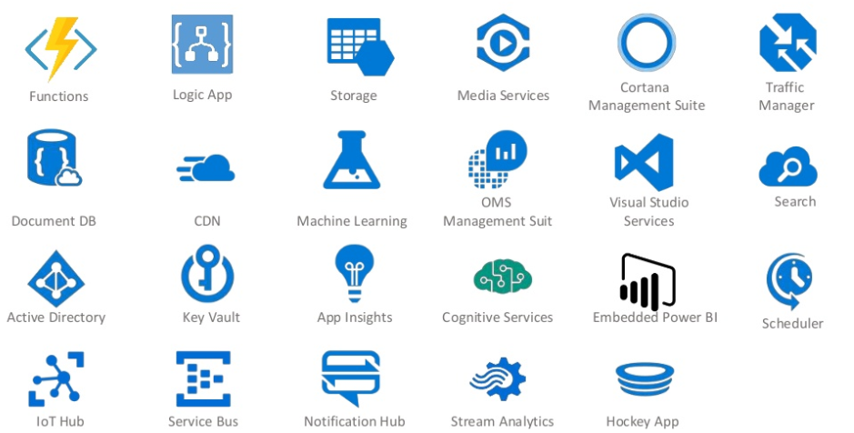
Microsoft Serverless Services – Theres A LOT!

Slide 26
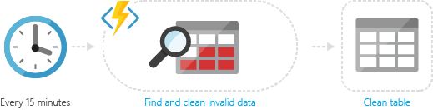
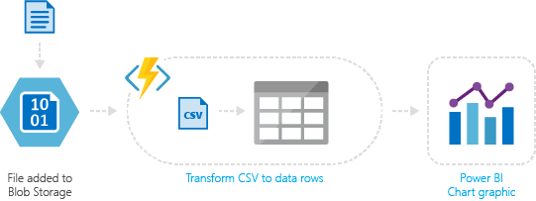
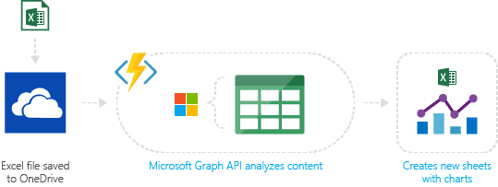
What can you do ? – A LOT!
Timer-based processing
Azure service event processing
SaaS event processing
Notes:
Timer-based processing
Azure Functions supports an event based on a timer using Cron job syntax. For example, execute code that runs every 15 minutes and clean up a database table based on customised business logic.
Azure service event processing
Azure Functions supports triggering an event based on an activity in an Azure service. For example, execute serverless code that reads newly discovered test log files in an Azure Blob storage container, and transform this into a row in an Azure SQL Database table.
SaaS event processing
Azure Functions supports triggers based on activity in a SaaS service. For example, save a file in OneDrive, which triggers a function that uses the Microsoft Graph API to modify the spreadsheet, and creates additional charts and calculated data.

Slide 27
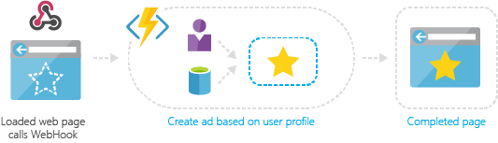
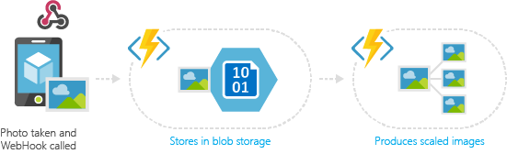
What can you do ?
Serverless web application architectures
Serverless mobile back-ends
Notes:
Serverless web application architectures
Azure Functions can power a single-page app. The app calls functions using the WebHook URL, saves user data and decides what data to display. Or, do simple customisations, such as changing advert targeting by calling a function and passing it user profile information.
Serverless mobile back-ends
A mobile back-end can be a set of HTTP APIs that are called from a mobile client using the WebHook URL. For example, a mobile application can capture an image, and then call an Azure Function to get an access token for uploading to blob storage. A second Azure Function is triggered by the blob upload and resizes the image to be mobile friendly.

Slide 28
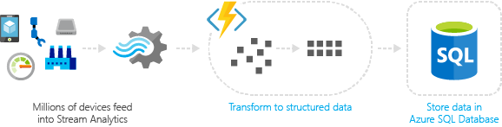
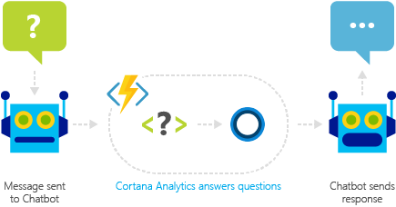
What can you do ?
Real-time stream processing
Real-time bot messaging
Notes:
Real-time stream processing
For example, Internet of Things (IoT) devices send messages to Azure Stream Analytics, which then calls an Azure Function to transform the message. This function processes the data and creates a new record in an Azure SQL database.
Real-time bot messaging
Use Azure Functions to customise the behaviour of a bot using a WebHook. For example, create an Azure Function that processes a message using Cortana Analytics, and call this function using Microsoft Bot Framework.

Slide 29
Supported Languages and Tools
Create Functions in the language you choose, such as
JavaScript, C# and F#,
scripting options such as
Python, PHP, Bash, Batch and PowerShell

Slide 30
Developing Code
Write code in an easy-to-use web-based interface, or upload pre-compiled code built with your favourite development tool.
In Azure portal
Visual Studio 2017

Slide 31
Application Insights
Integrated Monitoring and custom metrics with Application insights
Custom queries with analytics portal
Pin graphs

Slide 32
Is Serverless for everyone ?
Existing applications may not work as well with serverless
How much time would it take to rework it for serverless ? Costs?
Make sure your application works best in Serverless and think about how it will work
FaaS functions are stateless.
FaaS functions are typically limited in how long each invocation is allowed to run

Slide 33
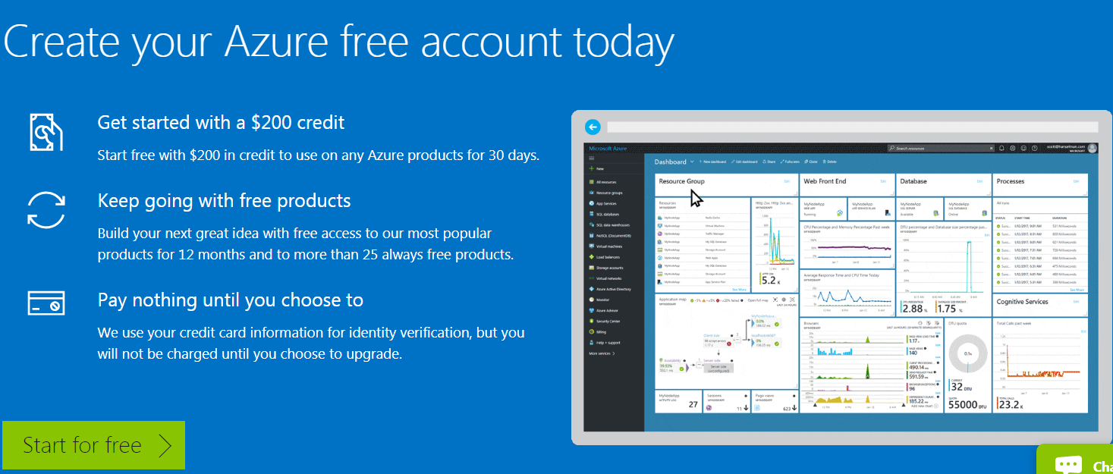
Try for FREE !

Slide 34
Resources
https://functions.azure.com
https://fuctions.azure.com/try - free trial
https://aka.msc/func-github
http://azure.com/serverless
Twitter @azurefunctions

Slide 35

Q&A
Notes:
First Slide

Slide 36
Thank you for attending

